Slide 1
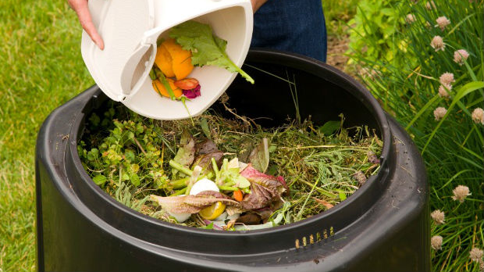
Compost

Slide 2
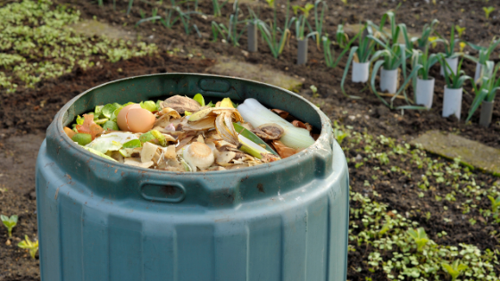
What is compost?
Composting is a biological process of decomposing and recycling organic matter, such as fruit peels, vegetables and feces from herbivorous animals. The process takes place in the presence of oxygen.

Slide 3
How to make?

Slide 4
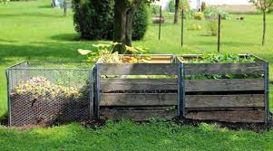
Step 1: Choosing the right location
The composter must be kept in a well-ventilated area. Care must be taken so that it is not exposed to the sun, rain and wind.

Slide 5
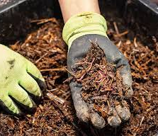
Step 2: Assemble the worm bed
Line the bottom of the two digester boxes with earthworm humus

Slide 6
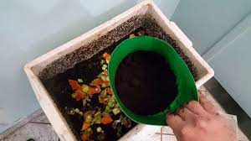
Step 3: Feed the worms
To feed the worms it is not necessary to give them fresh food. You can give them dried leaves, coffee grounds, banana peel and other foods like potatoes, cassava, apples and other non-citrus and spicy vegetables – all in small pieces.

Slide 7
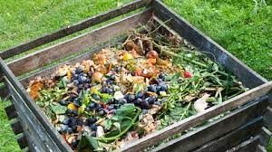
Step 4: Introduction of waste
Organic organic waste is covered in a corner of the compost bin (I don't really love the compost box) and really cover the ingredients by sawdust in addition to sawdust, in addition to sawdust, which also provide balance in the relationship in home composting. But do not place very thick leaves that make it impossible for air to pass through, as this will prevent oxygenation of the environment and the worms will eventually die.

Slide 8
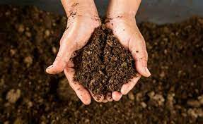
Step 5: Final product
To put the box full, from daylight, so that my children can hide. As earthworms are photosensitive, this technique facilitates the removal of humus. Remove until you leave two or three fingers of soil to serve as a “bed” again for the worms. This compost is used as organic fertilizer, since it is a great source of nutrients and fixed organics, being able to recover degraded soils.

Slide 9
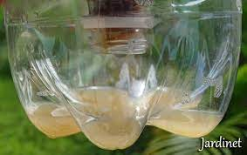
To remove the liquid slurry that is in the box below, just open the last one so that it falls into the container you will use to store it. If you think that a part of water can smear on the leaves of plants to keep the bee away, they are important. You should use this method at night or when you are down, as in contact with the slurry, sunlight can burn like leaves.
If naturalizing in ten parts of water, weeping can be used as a fertilizer

Slide 10
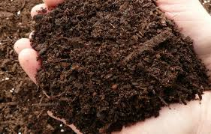
For the fertilizer to be ready, a work of 4 months is necessary, if made with microorganisms. If composting is carried out with worms, a time of 3 months is required for the final product.

