Slide 1
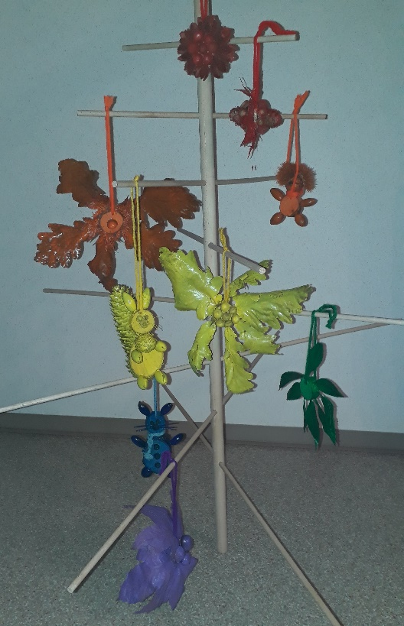
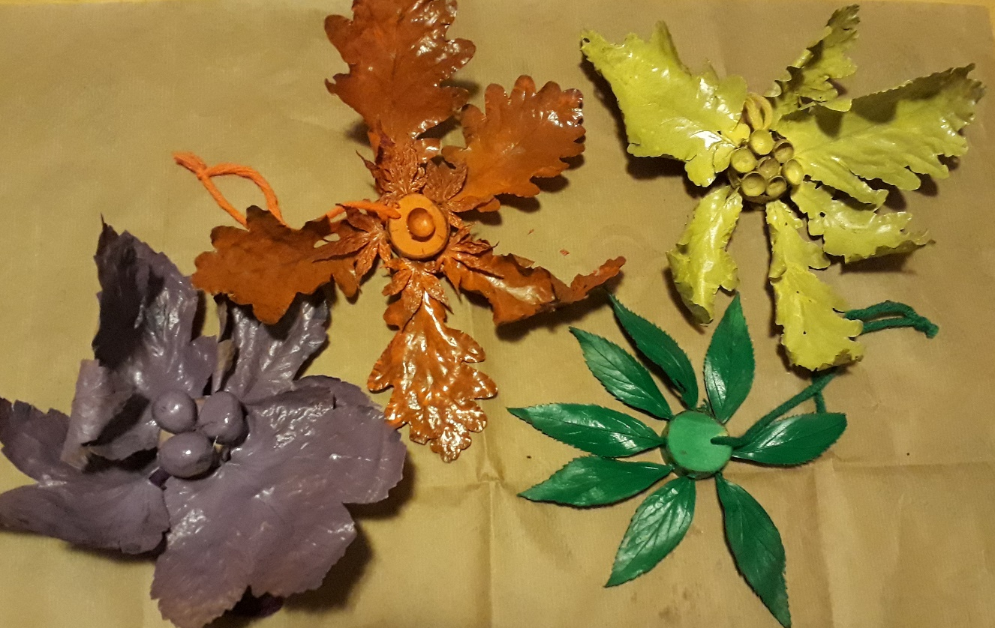
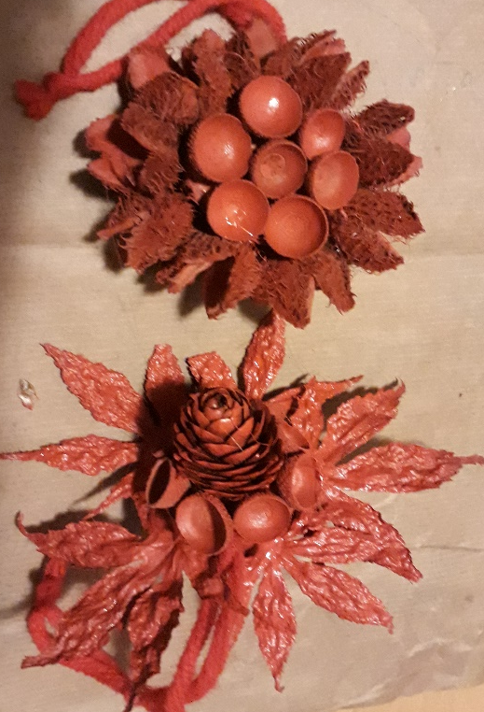
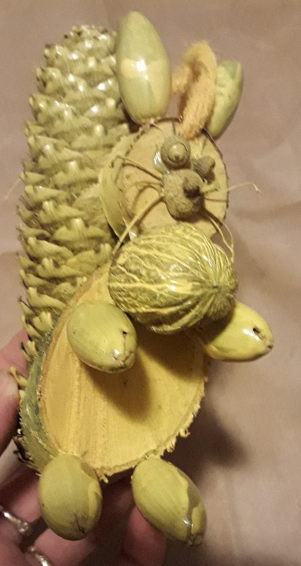
CHRISTMAS TREE DECORATIONS FROM FOREST FRUIT Topic: health and light
A CRAFT DAY

Slide 2
TOPIC: Health and light
CLASS (AGE): 7 (12 – 13 yrs)
LOCATION: a classroom and a craft room or a workshop
TIME: od 9.00 do 12.50
The topic of the craft day is health and light.
When collecting forest fruit, students are physically active outdoors breathing fresh air which is good for their health.
Christmas tree decorations are made from forest fruits and painted in rainbow colours. At science lessons, students are taught that a rainbow is a meteorological phenomenon that is caused by reflection, refraction and dispersion of light in water droplets resulting in a spectrum of light appearing in the sky. It takes the form of a multi-coloured circular arc.
The painted decorations are put onto the tree in the same order as there are colours of a rainbow.
The goal is encouraging students‘ creativity, connecting the school environment with the local one, cross curricular learning experience, broadening relationships, developing manual and language skills.

Slide 3
THE EXHIBITION OF CHRISTMAS TREES
COLLECTING FOREST FRUITS
THE PLAN
PREPARING THE CRAFT DAY
MAKING THE DECORATIONS AND TREES

Slide 4
Collecting forest fruits
Students collect forest fruits on their walks with families or friends, for example cones, walnuts, chestnuts, twigs, leaves
While collecting fruits, they plan the decorations so they store collected fruits accordingly, for example they dry them, smooth leaves …)
This way they revise their knowledge of the kinds of trees growing in our valley, their fruits, the shapes of leaves, what goes on in autumn. Besides, they are physically active outdoors, in fresh air having a good time with friends and family.
When the fruits are brought to school they are sorted out into different boxes, so that they are ready to be turned into decorations.

Slide 5
Organizing work
Students plan the stages of making their decorations carefully.
Tools, glue and paints are prepared. Desks are protected with old newspaper.
Students work in groups / teams to encourage team work and team spirit.

Slide 6
The number of decorations of each colour
RED | ORANGE | YELLOW | GREEN | BLUE | PURPLE

Slide 7
How to make a Christmas tree?
MATERIAL:
1 x stick Ø20
6 x sticks Ø8
wood 90 x 30 x 50 (2 pieces)
band saw
drilling machine
sandpaper

Slide 8
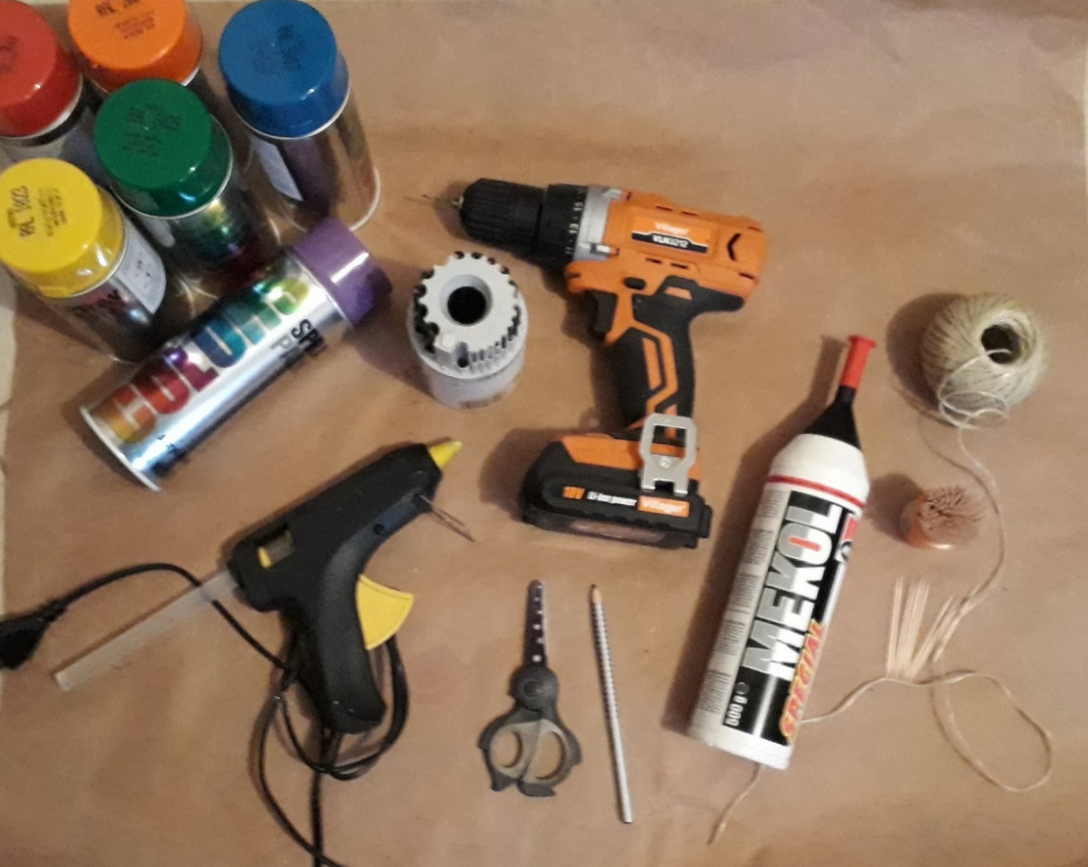
Making decorations
TOOLS, MACHINES AND ACCESSORIES:
drilling machine + drills Ø2,5 – Ø10
band saw
glue gun/pistolet
wood glue
rope
colour sprays (red, orange, yellow,
green, blue, purple)
tooth sticks
pencil + scissors
wool (in the same colour as sprays)
screwdriver
sticky tape

Slide 9
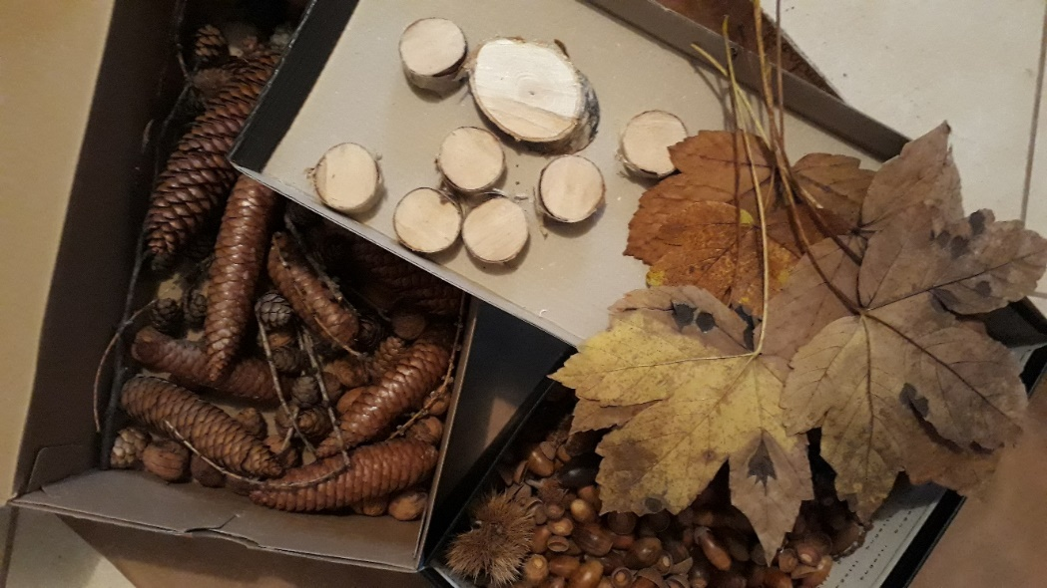
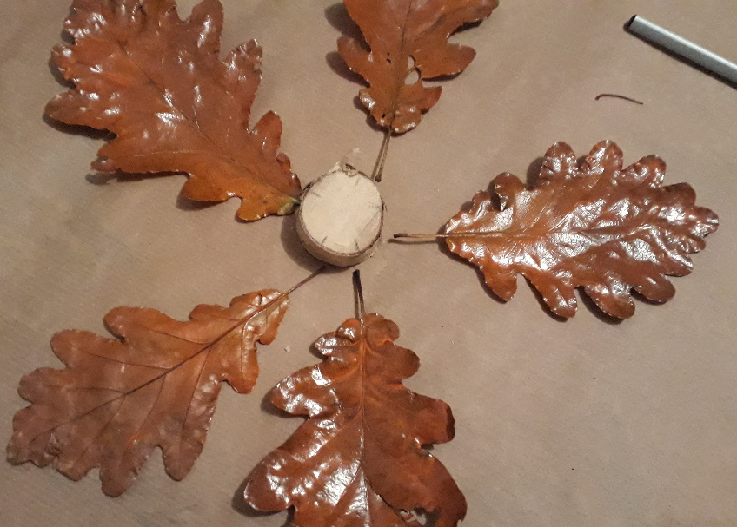
IDEA
The plan is drawn or written on a piece of paper.
Choose the fruits or material needed.
Arrange elements of your decoration before gluing.

Slide 10
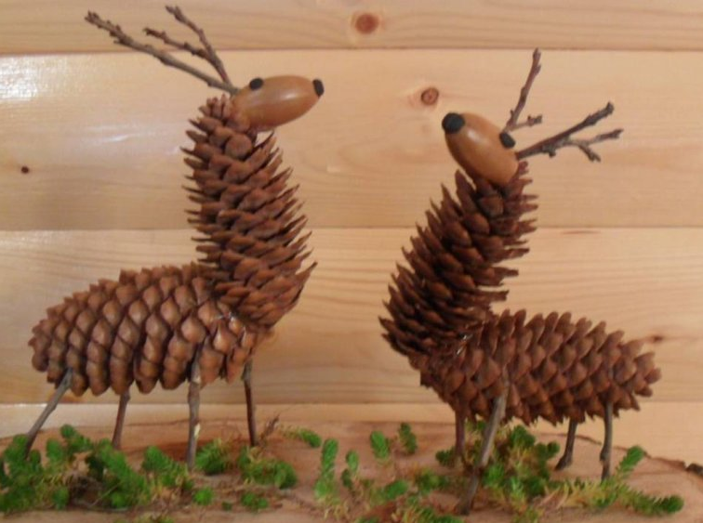
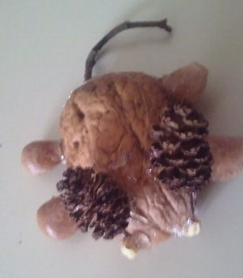
IDEA

Slide 11
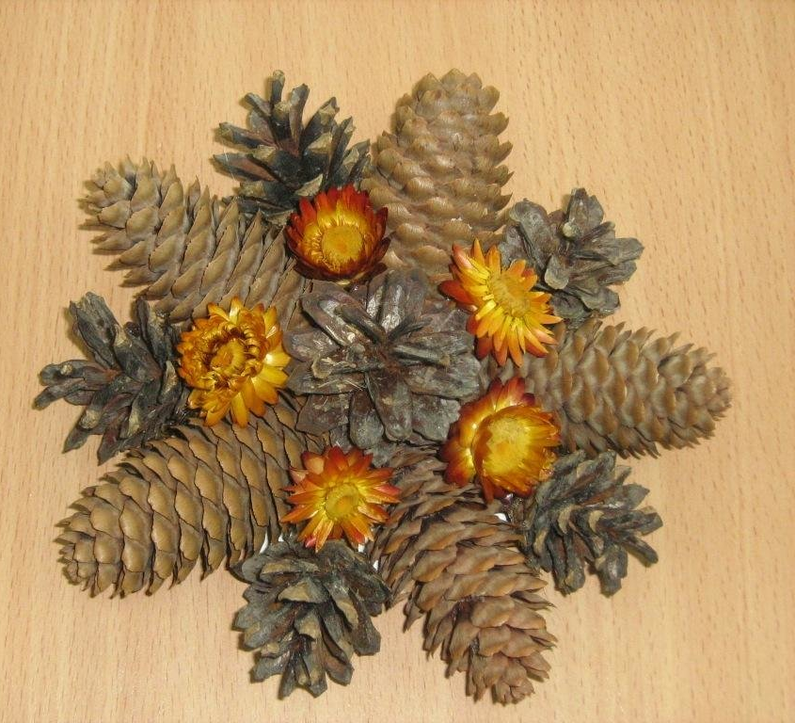
IDEA

Slide 12
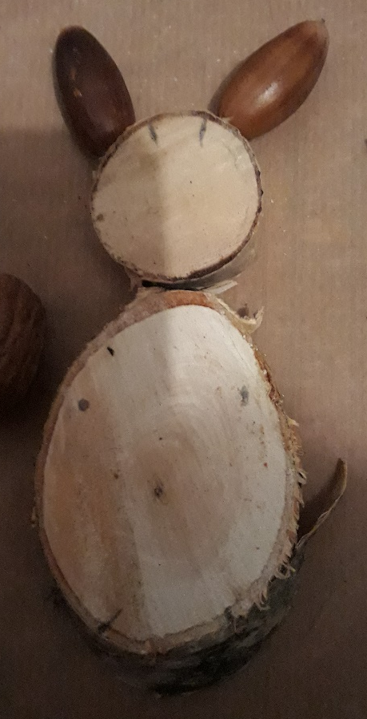
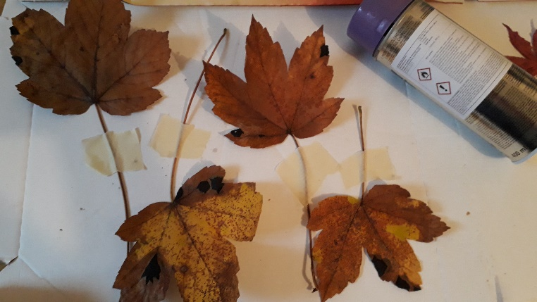
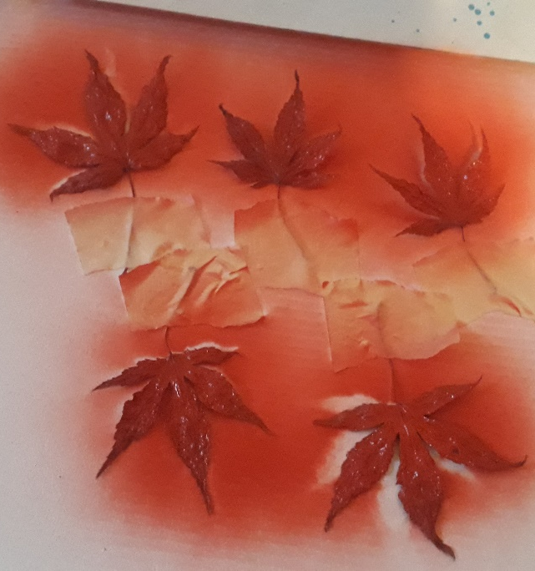
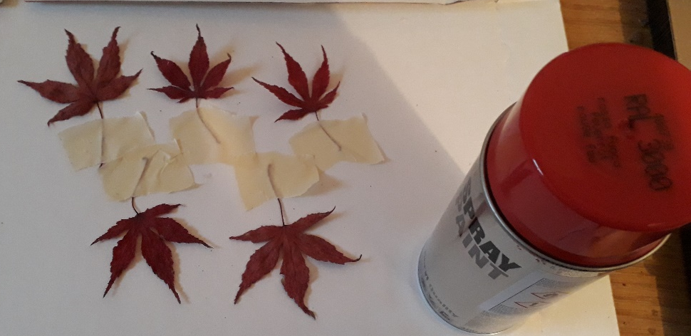
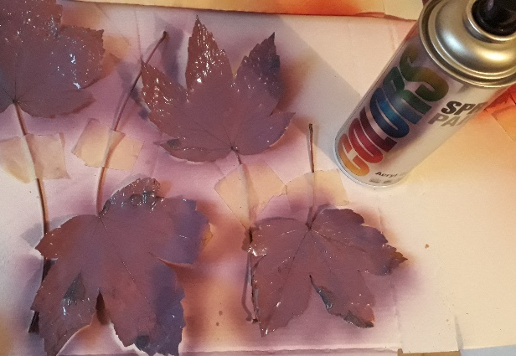
MARKING
Mark the location of drilling or gluing.
COLOURING
Leaves are coloured before gluing.
Leaves are glued with sticky tape.

Slide 13
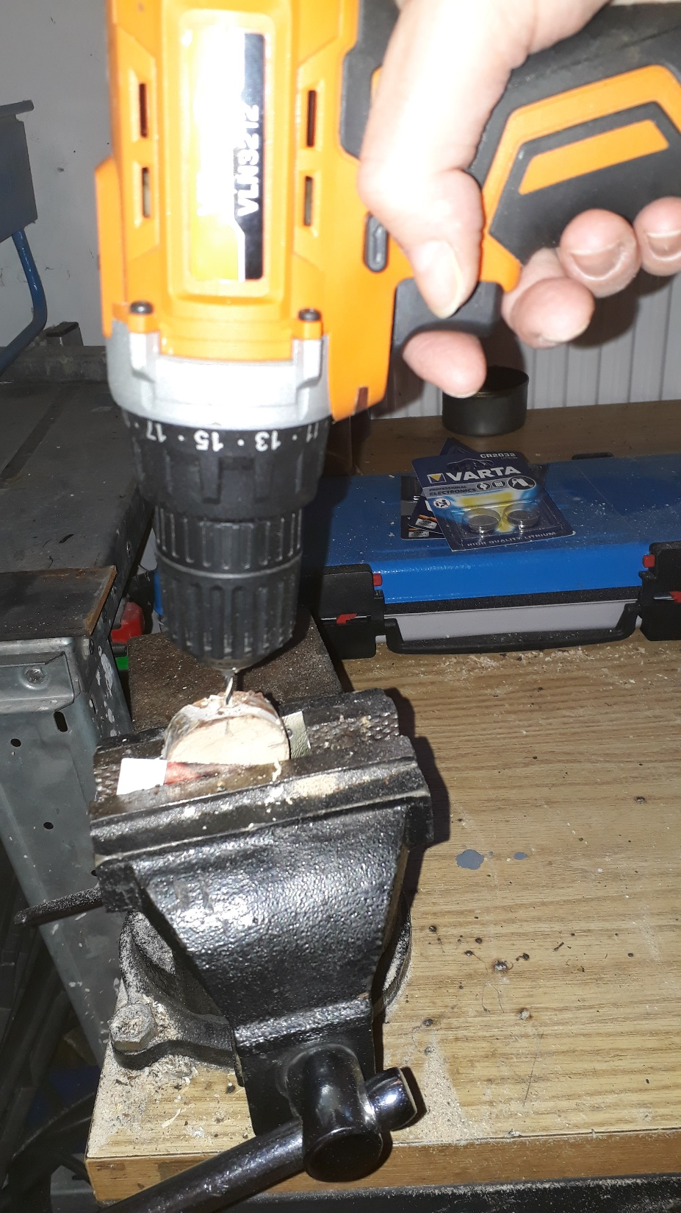
DRILLING
Choose the right size of a drill.
A hole for a ribbon must be drilled before putting the decoration together – Ø3,5.

Slide 14
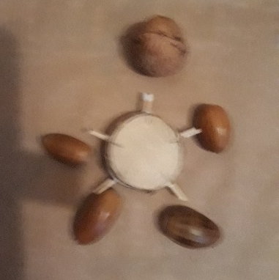
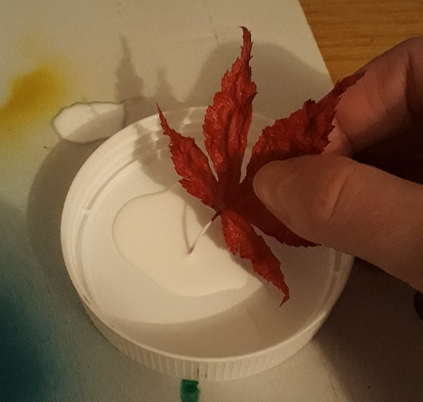
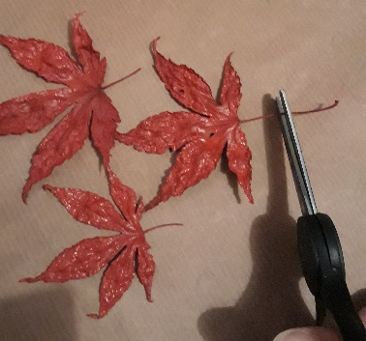
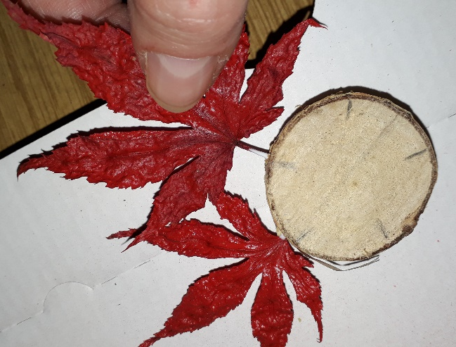
PUTTING DECORATIONS TOGETHER: gluing with wood glue
Drilled holes are deepened with a tooth stick. The depth and size of a hole is checked with a tooth stick, too.
Too long stems are cut.

Slide 15
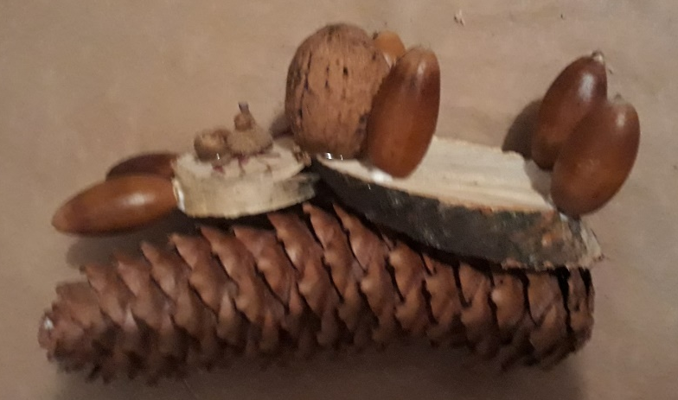
PUTTING TOGETHER: gluing with glue gun/pistolet
cones
chestnuts
acorns for eyes, buttons,…
twigs, stems for whiskers

Slide 16
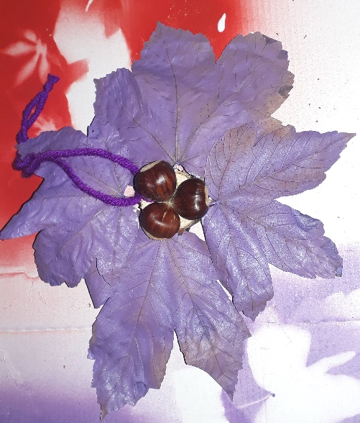
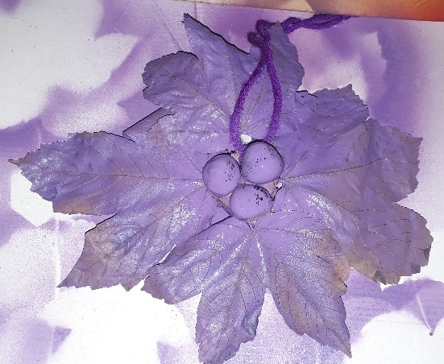
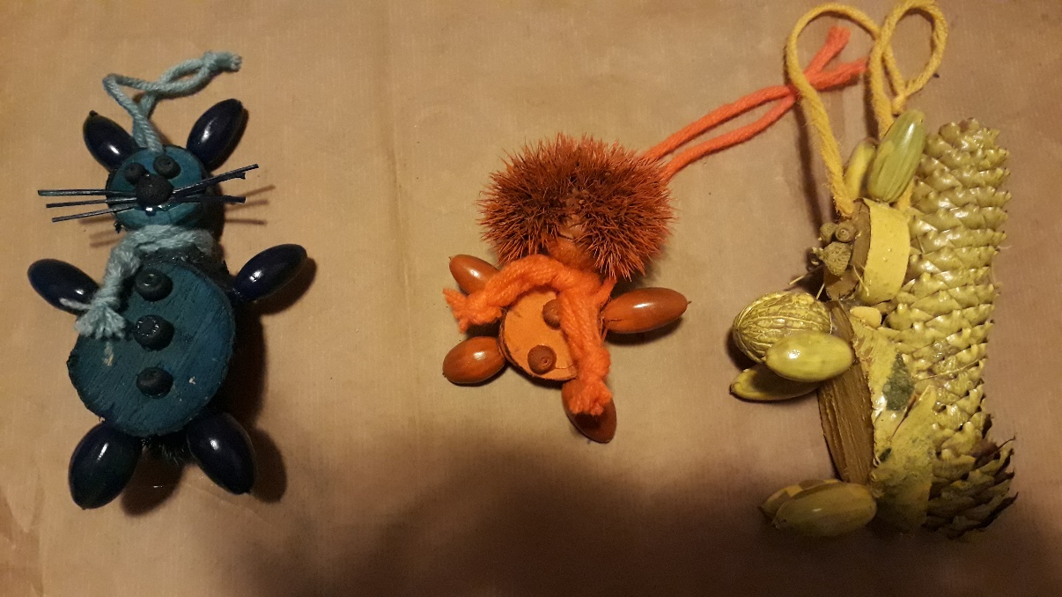
decorations
Wool is used as a ribbon or a scarf.
COLOURING
Final colouring.

Slide 17
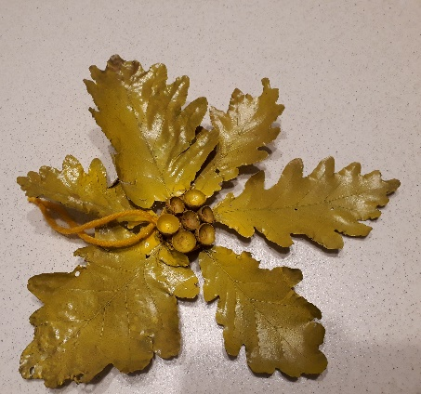
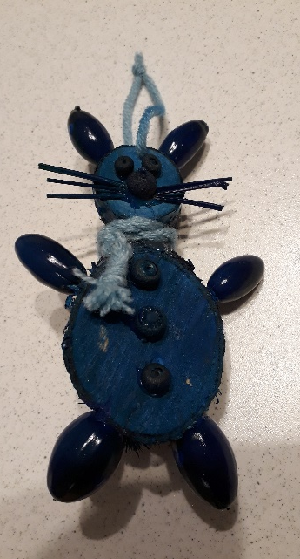
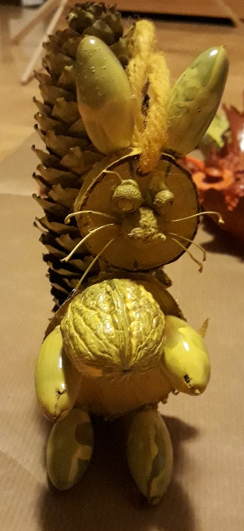
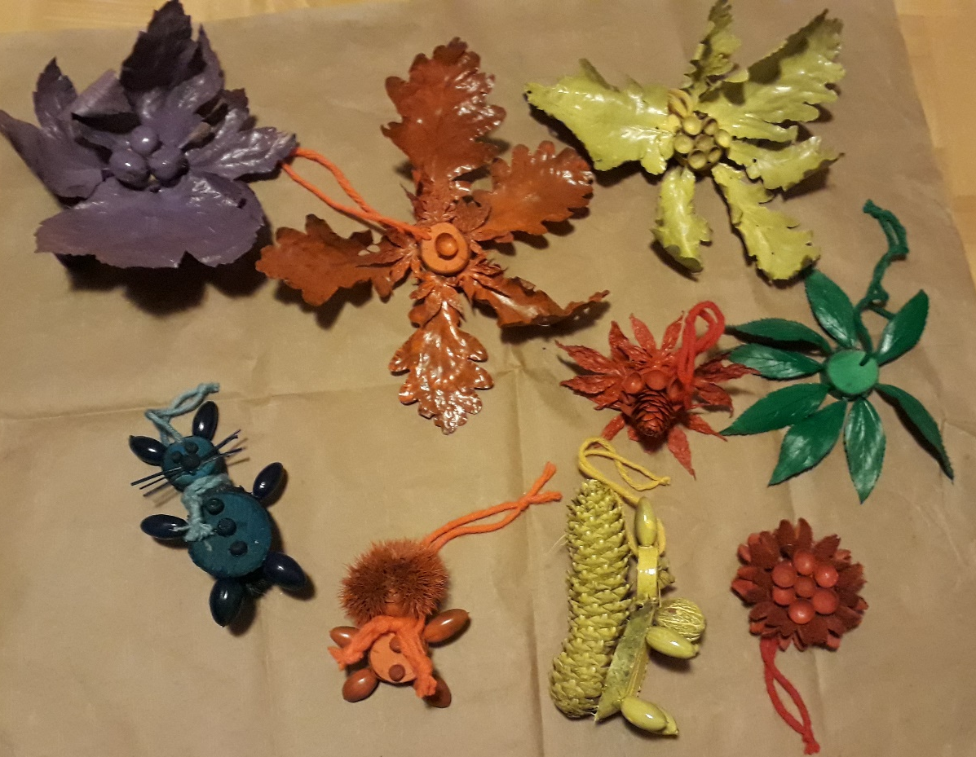
Decorations done

Slide 18
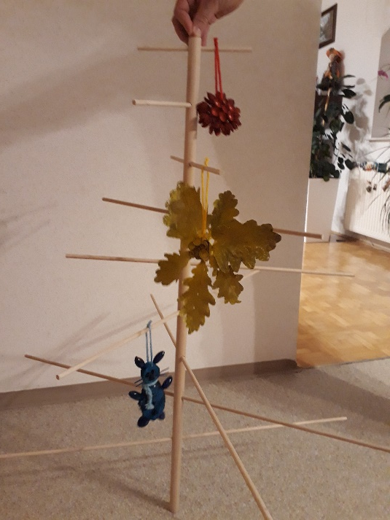
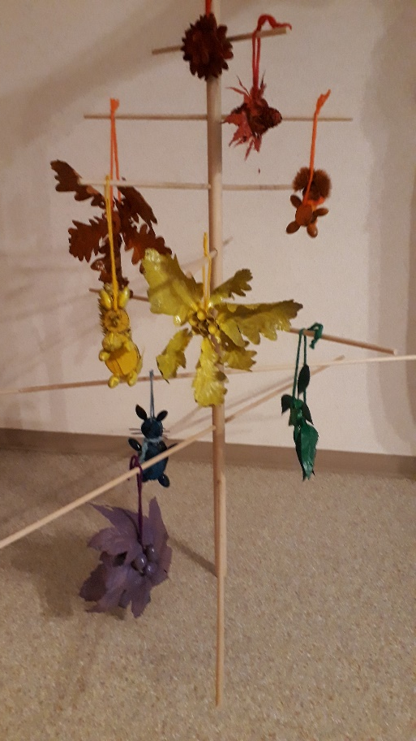
The exhibition
Decorations are put onto the trees in the same order as the colours of a rainbow.

Slide 19
GOALS
Students
walks in a forest are good for their health
having cross curricular learning experience
discovering and developing their abilities
developing creativity, manual skills, accuracy and work habits
developing senses for aesthetics, responsibility and respect
gaining confidence
developing their own ideas
linking theory and practice
developing cooperation

Slide 20
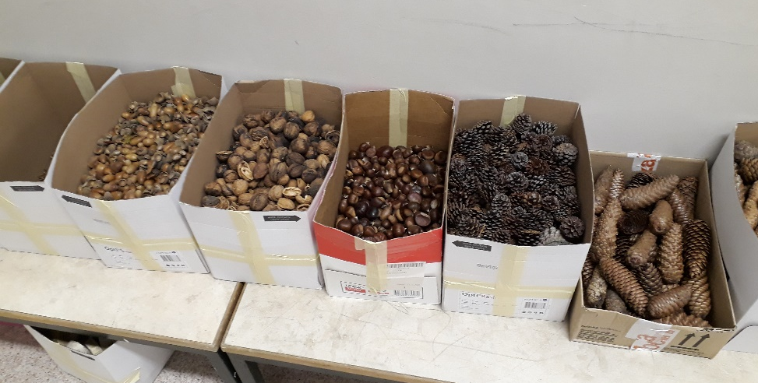
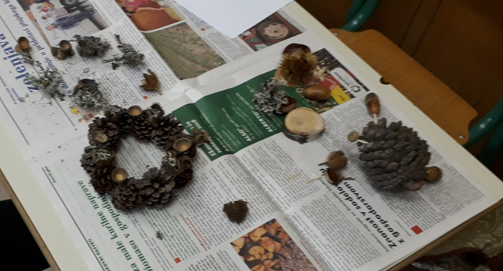
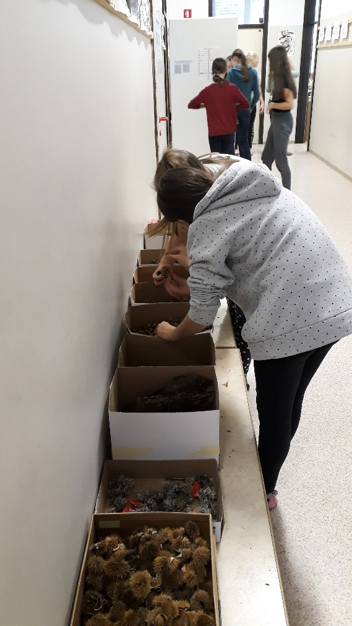
Some highlights of the project day

Slide 21
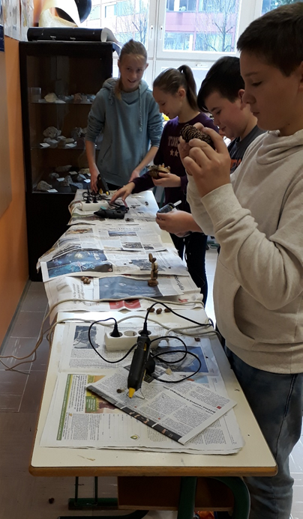
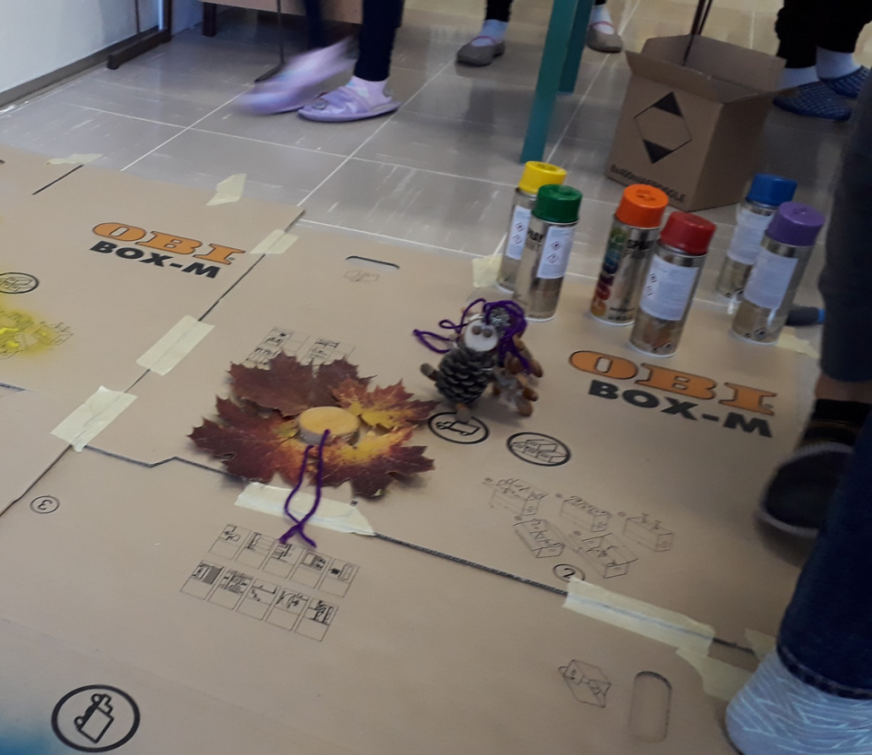
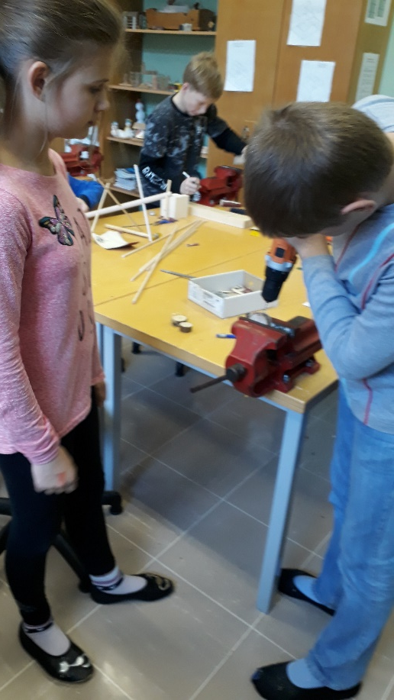

Slide 22
