Slide 1
Matematyka od kuchni
Erasmus+

Slide 2
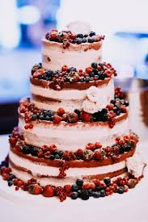
Task 1.
How many eggs, how many glasses of wheat flour and how many glasses of sugar do you need to use to bake 18 sponge cakes? …………….
…………….
…………….
…………….
…………….
Ingredients for cake sponge cake
6 eggs
¾ cup of wheat flour
¾ cup of potato flour
1 cup of sugar
2 tablespoons of water
1 teaspoon of baking powder

Slide 3
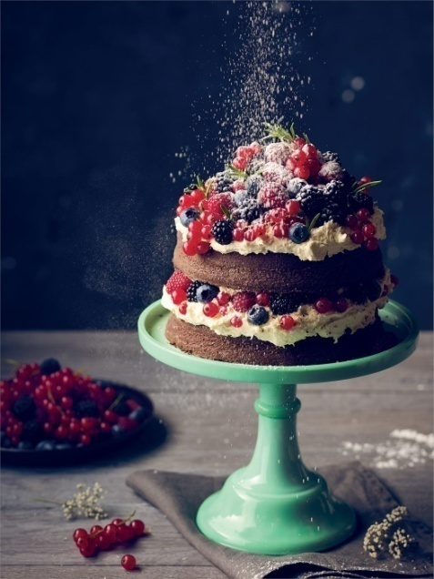
18 SPONGE CAKES
Eggs: 18 x 6 = 108
Flour: 18 x ¾ = 13 ½
Sugar: 18 x 1 = 18
To bake 18 cake biscuits,
you need to use 108 eggs, 13½ glasses of flour and 18 glasses of sugar.

Slide 4
Task 2.
My mother baked a cuboid-shaped cake for Grzes. Looking down at this cake, we see a square measuring 20 cm x 20 cm.
Grzes's mother decided to arrange the cherries on the cake so that they were 1 cm away from the shore and 2 cm apart. How many cherries will be on the cake?

Slide 5
Cherries
1cm | 3 cm | 5 cm | 7 cm | 9 cm | 11 cm | 13 cm | 15 cm | 17 cm | 19 cm
w | w | w | w | w | w | w | w | w | w
3cm
w
…
Alltogether: 10 (top) + 10 (down) + 8 + 8 (sides) = 36
There are 36 cherries on the cake.

Slide 6
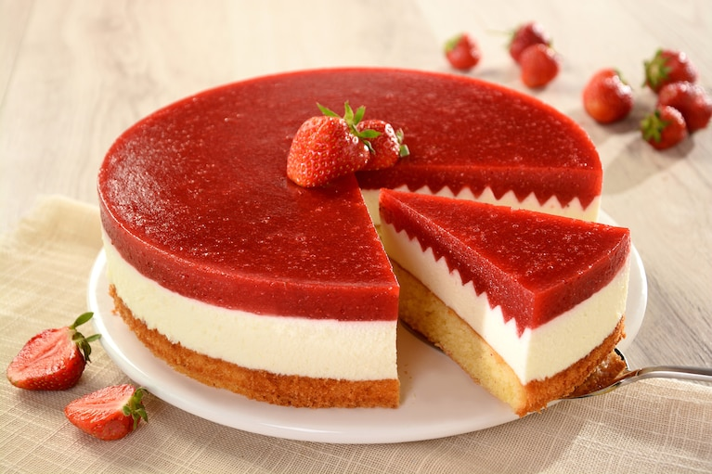
Task 3
14 guests came to Filip's birthday. The boy's parents prepared two identical cakes for this celebration, each weighing 2.4 kg. Filip would like to fairly divide the cakes between the guests, parents, grandma, whom he will visit tomorrow, and himself.
A) How much (fraction) of the cake will be allocated to each of the invited guests?
B) How much does one slice
of cake weigh?

Slide 7
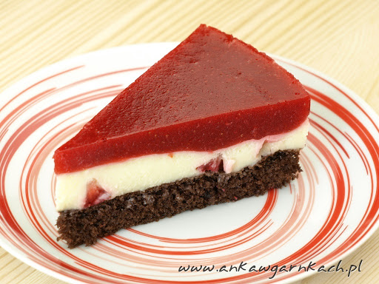
answers
A) Number of all persons to be divided:
14 + 2 + 1 + 1 = 18
So we divide each cake into 9 pieces.
Each guest will get 1/9 of the cake.
B) 1/9 x 2.4 kg ≈ 267 g
One piece of birthday cake weighs approximately 267 g.

Slide 8
Task 4.
Read as many names as possible from the table and write them down. Squares with successive letters of the word must touch their sides.
(given words are in Polish)
Ż | Y | T | E | S | Z | A
P | O | N | I | M | Y | N
S | R | I | Z | O | W | Y
Z | K | I | S | G | Y | R
E | N | N | Y | R | W | A
A | M | A | H | A | O | Z

Slide 9
Task 4.
A slice of wholemeal bread weighs approx 35 g.
A) Every day Stefan gets a sandwich of two such slices to school and "forgets" to eat it. On the way home, he throws the sandwich in the garbage can. How many slices of bread did Stefan throw away in the school year in which he attended school for 180 days?
B) How many kilograms does the bread he throws out during the school year weigh?
C) Estimate how much money Stefan's parents will cost for his son's unwise behavior in the next three school years, if the price of a half-kilogram loaf is PLN 4.

Slide 10
Don’t waste food…
A) Stefan threw away 360 slices of bread!
180 x 2 = 360
B) The bread he throws weighs 12.6 kg!
360 x 35 g = 12,600 g = 12.6 kg
C) Stefan's proceedings will cost his parents over PLN 300!
3 x 12.6 kg = 37.8 kg (almost 76 loaves)
76 x 4 zł = 304 zł

Slide 11
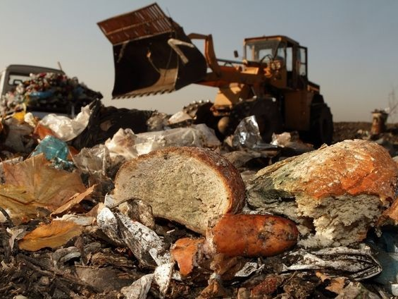
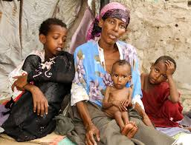
Do you know…
Polish people throw away 9 tonnes of food every year!
Nearly 800 million people go hungry in the world.
1/3 of the food produced in the world is wasted!

