Slide 1
Escape room
2.10.2020
Katarzyna Szczypka
Dominika Sojka

Slide 2
Janek and Jacek decided to help their grandparents do spring cleaning.
They started cleaning the attic.
There were many dusty cardboard boxes full of old, useless items.
When Janek was taking out one of those boxes, he tripped over something that was lying on the floor and it was covered with a blanket.

Slide 3
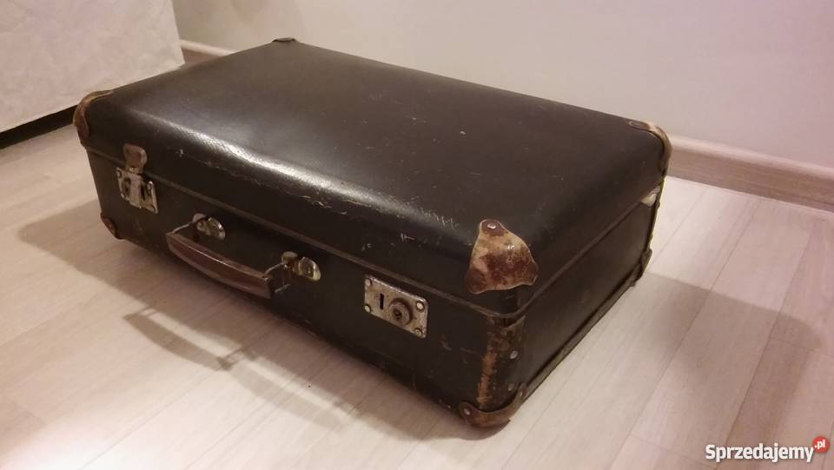

Slide 4
It turned out to be a closed suitcase.
When Janek picked up the suitcase, Jacek noticed that there was a worn piece of paper underneath it.
It was a secret letter ...

Slide 5
Task 1
Master of counting
https://learningapps.org/6810915

Slide 6
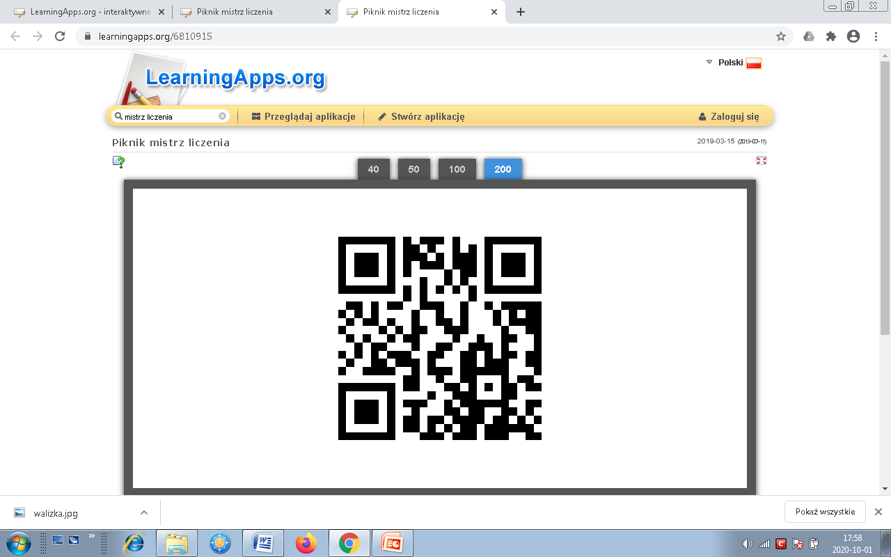
Bravo! Now solve the task in the yellow envelope…

