Slide 1
Youth and Unemployment in Spain.
By: Peace Leigh & Zainab Mohammed

Slide 2
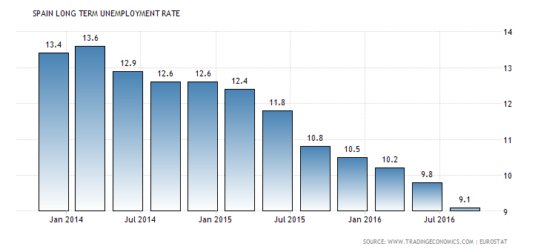
Percentage of unemployment in Spain.
Long Term Unemployment Rate in Spain decreased to 9.10 percent in the third quarter of 2016 from 9.80 percent in the second quarter of 2016. Long Term Unemployment Rate in Spain averaged 7.29 percent from 1992 until 2016.

Slide 3
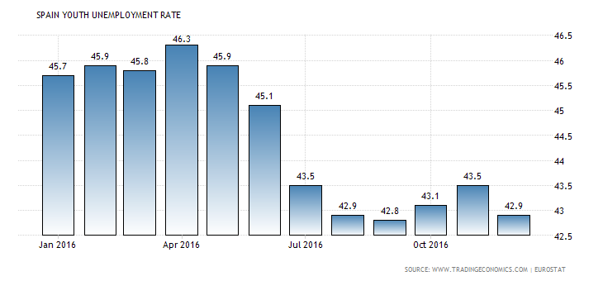
Comparison with Youth people unemployment.
Youth Unemployment Rate in Spain decreased to 42.90 percent in December from 43.50 percent in November of 2016. Youth Unemployment Rate in Spain averaged 34.58 percent from 1986 until 2016. In comparison, this means that less people can have jobs in Spain. Especially the young poeple.

Slide 4
Why are Young people unemployed?
Spain's economy took a down-turn after its property crash left millions of low-skilled workers without a job, and general economic decline eroded business and consumer confidence. Official data showed that the jobless rate in the last three months of 2012 rose 1% to 26%, or 5.97 million people. The Youth unemployment continues to be a cause for concern across the European Union, not just Spain. It has also become harder to tackle the Youth Unemployment program across all the 27-nation bloc which is a serious issue for governments and policy makers.

Slide 5
What do they do with their free time?
Siesta and Fiesta! (sleep and party) especially true in summer The people of Spain use their free time in the same way as most developed countries. They do devote more time to family visiting other family members on a daily basis. They like to have gatherings with neighbors and everyone rather than getting drunk and all that.

Slide 6
What has led to this situation?

Slide 7
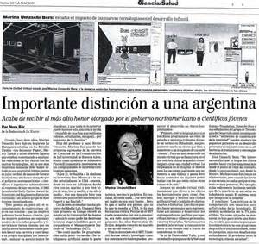
NEWSPAPERS IN SPAIN!

