Slide 1
santa amalia extremadura
The town was named after the wife of Fernando VII who died in 1819.
Santa Amalia extremadura is located in western midlands ,it is 47 km² with a population of 4,196 (2014).
The young people in the village has little to do however they have for this year SEMANA SANTA ,SAN ISIDRO (15 de mayo),SANTA AMALIA. Fiestas Patronales (10 de julio).

Slide 2
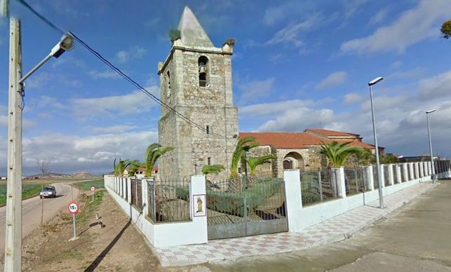
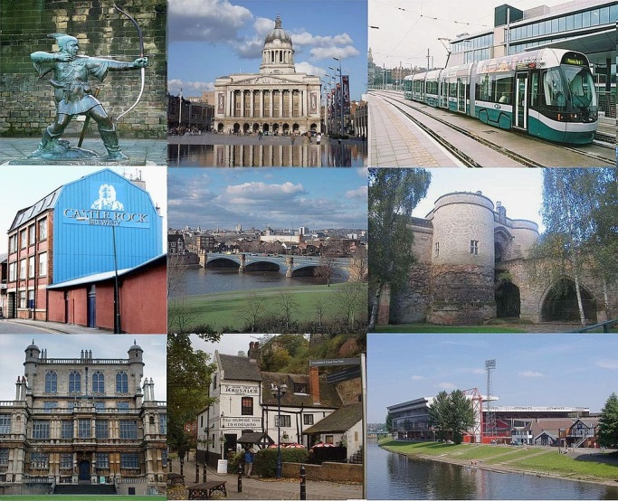
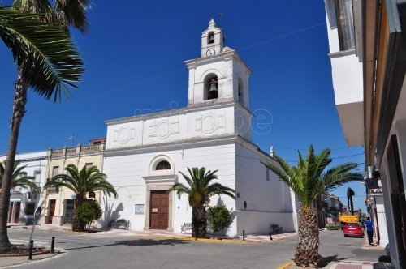
The village is different to Nottingham by the area 74.61 km² and young people has more to do .Nottingham has cinemas ,a train , and other stuff

Slide 3
What subjects do they study?
Spanish language
Maths
Geography
History
Biology
English
Technology
Physical education
Sociology
economy

Slide 4
Projects in the country
Project with other countries
Poetry
Music
Vegetables project
Global smiles

