Slide 1
Extremadura and its culture
By Duaa and Dalia

Slide 2
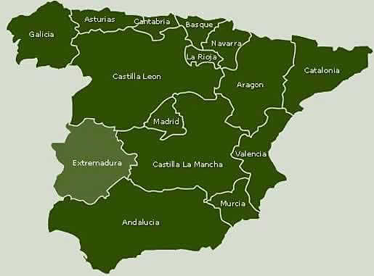
Location
Extremadura is right here!
Extremadura is located in Spain, to the southeast of the capital Madrid. It is bordered by Portugal in the west.

Slide 3
Origin of Extremadura
Extremadura was one of the poorest parts of Spain in the Middle Eastern times, the Extremeños used to continuously look for ways to make a livelihood.
Merida was founded in 25 B.C by the Romans and quickly became renounced as the most important main city of the Roman Empire.
Trujillo is known as the town of the conquistadores(conquerors), because it was conquered by many different tribes such as the Inca realm, dominates lead by Francisco Pizarro between 1532-72

Slide 4
Origin of Extremadura II
From a Spanish title of the Virgin Mary, Nuestra Señora de Guadalupe, meaning "Our Lady of Guadalupe". Guadalupe is a Spanish place name, the site of a famous convent, which means "river of the wolf" in Arabic. In the 16th century Our Lady of Guadalupe supposedly appeared in a vision to a native Mexican man, and she is now regarded as a patron saint of the Americas.( you can cut this out if u wanna I just thought it was a cool story to add)
Caceres was originally conquered by the Romans in the 9th Century and was named the Roman City of Norba Caesarina/Alkazares. However, it was then reconqured by the christians in 13th Century

Slide 5
Civilizations which conquered Extremadura throughout the ages
Extremadura has been conquered by a variety of different civilizations thus meaning that it has a rich heritage and a wide range of cultural monuments. Extremadura is home to many breath taking landmarks such as perfectly preserved churches, Roman bridges, temples, arches, and plazas.

