Slide 1
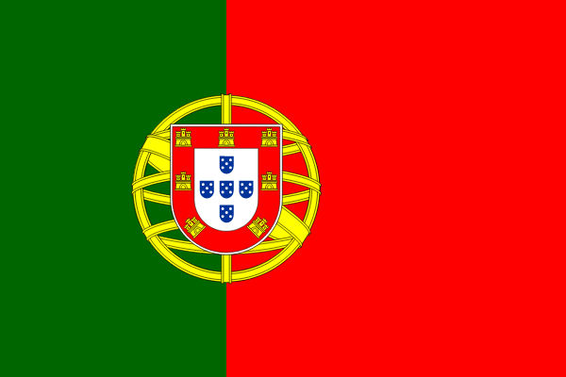
https://www.youtube.com/watch?v=KzY_pPN3k-M

Slide 2
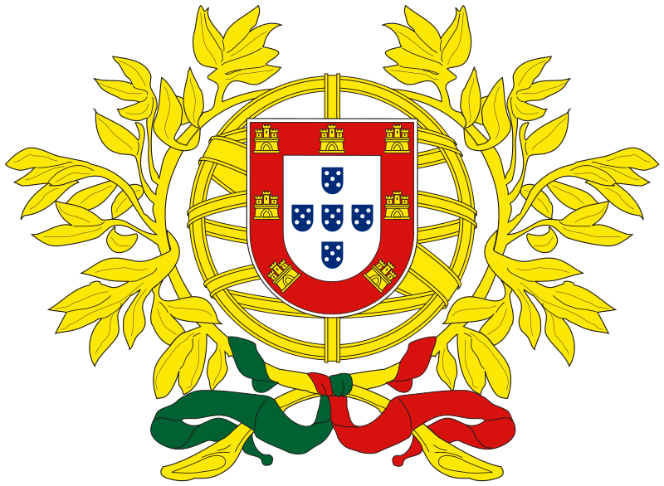

Slide 3
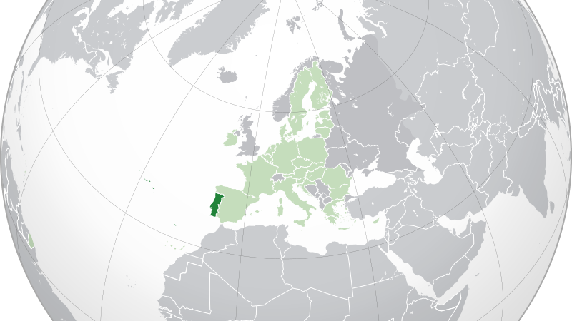
Localização de Portugal

Slide 4
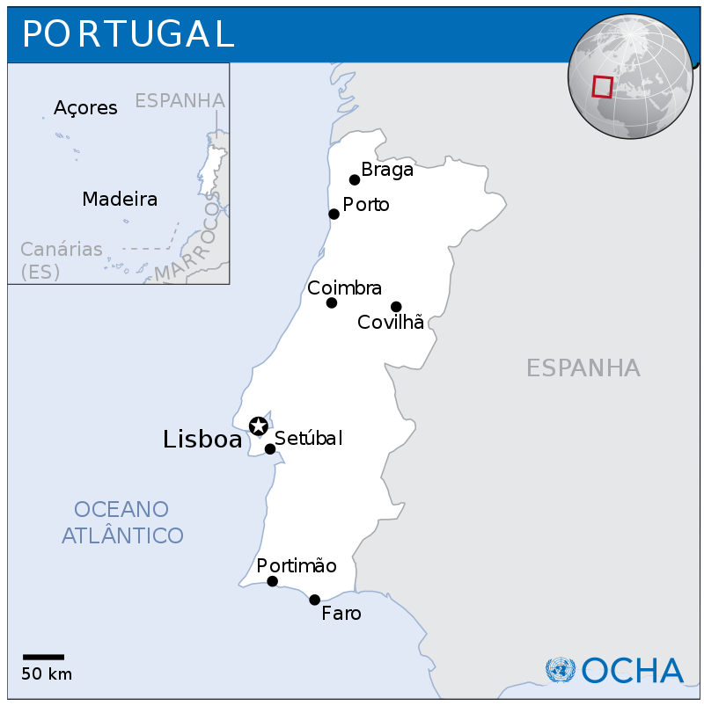
Mapa de Portugal

Slide 5
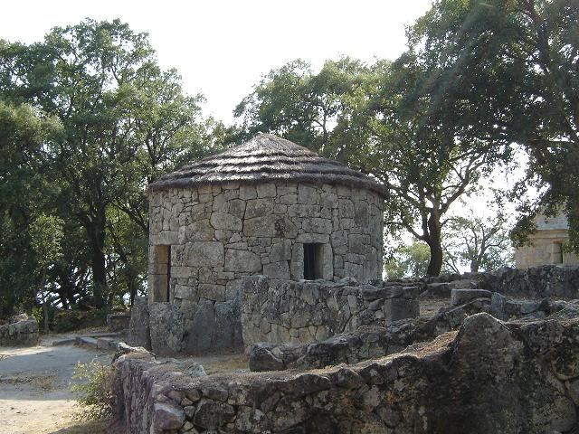
Citânia de Briteiros, Portugal.

Slide 6
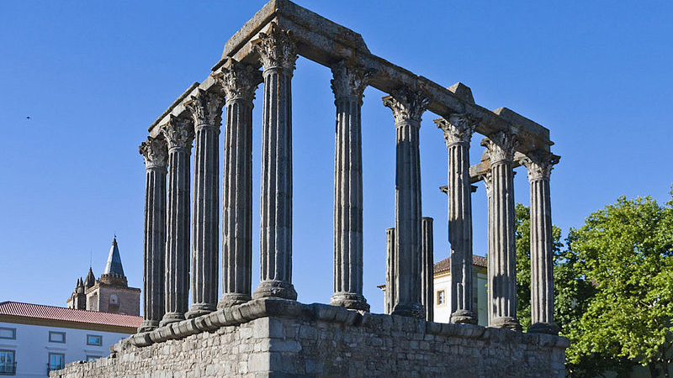
Frontal view of Evora roman temple

Slide 7
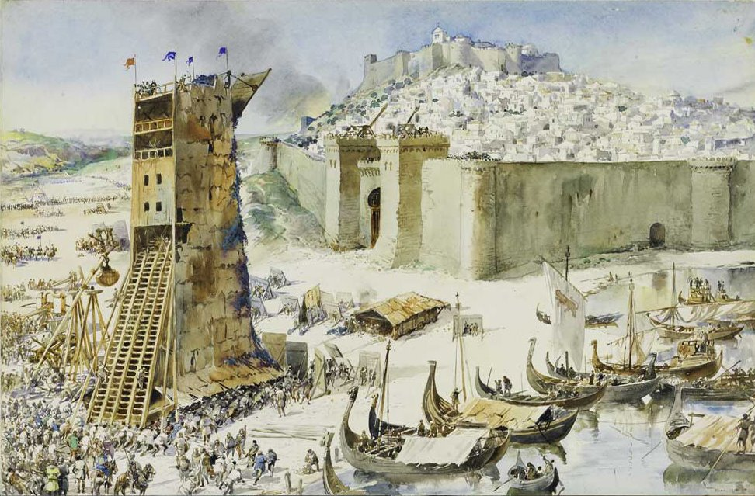
Cerco de Lisboa, em 1147.

Slide 8
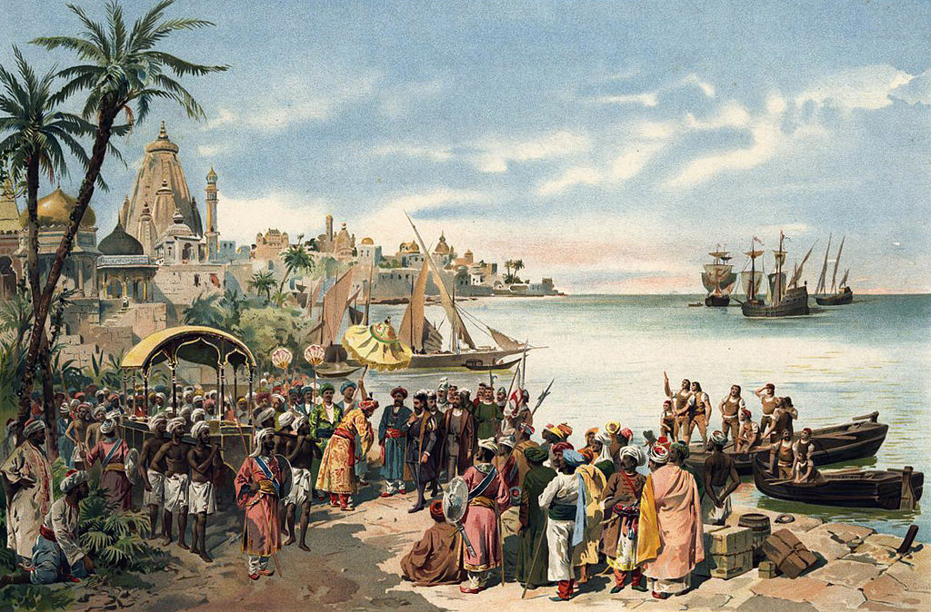
Vasco da Gama chega a Calecute, Índia, a 20 de maio de 1498.

Slide 9
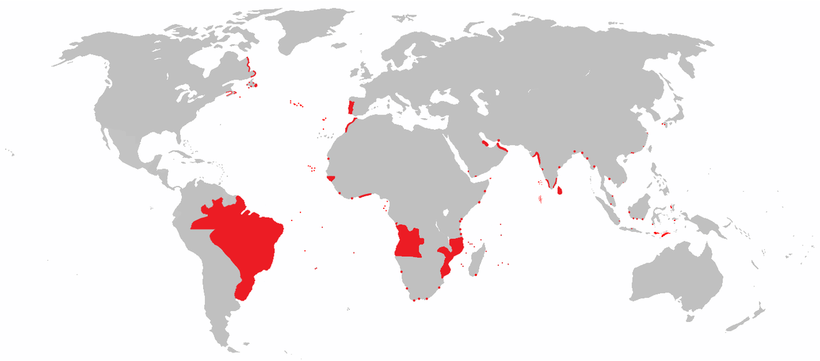
Mapa anacrónico dos territórios que já fizeram parte do Império Português.

Slide 10
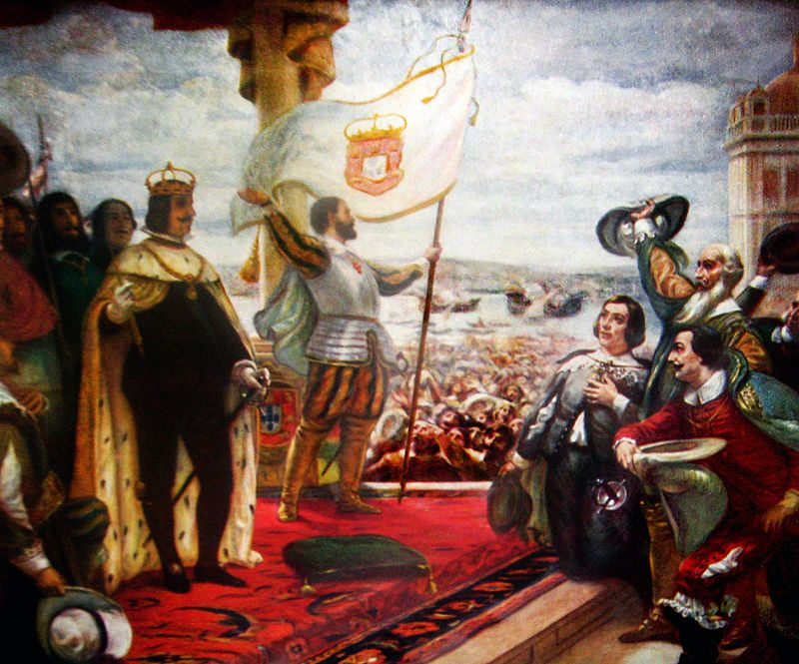
COROAÇÃO DE D. JOÃO IV (1908). Quadro de Veloso Salgado (1864-1945). Óleo sobre tela (325 x 285 cm). Museu Militar (Sala Restauração), Lisboa

Slide 11
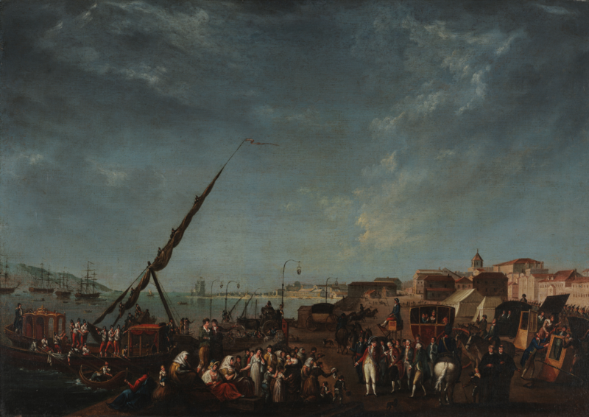
Embarque da família real portuguesa para o Brasil no cais de Belém, a 29 de novembro de 1807.

Slide 12
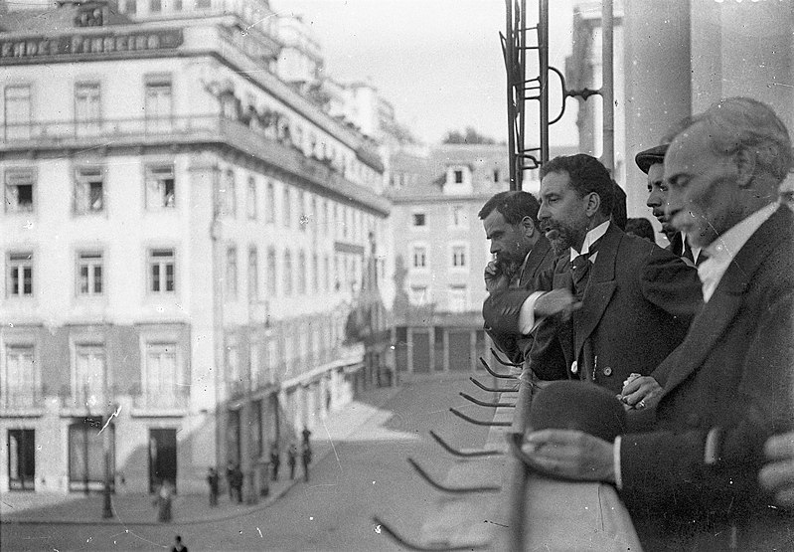
Proclamação da república por José Relvas em Lisboa, 1910.

Slide 13
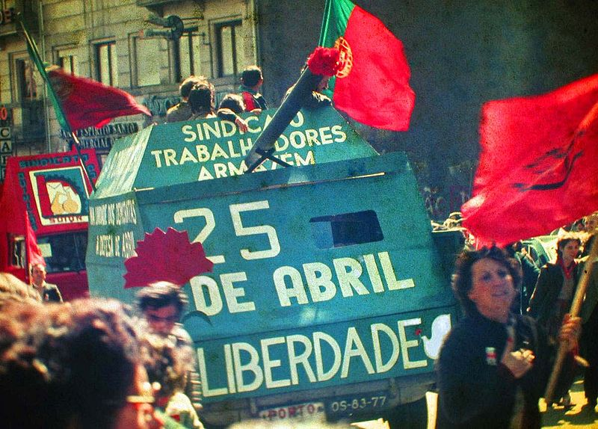
Manifestação pela Revolução dos Cravos na cidade do Porto em 25 de Abril de 1983.

Slide 14
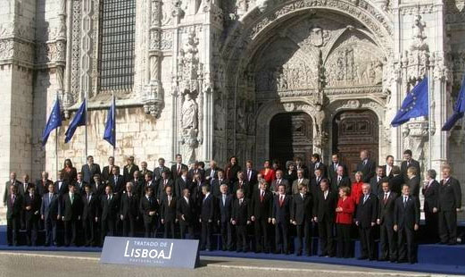
Foto de Família na cerimónia de assinatura do Tratado de Lisboa. Portugal é membro da União Europeia desde 1986.

Slide 15
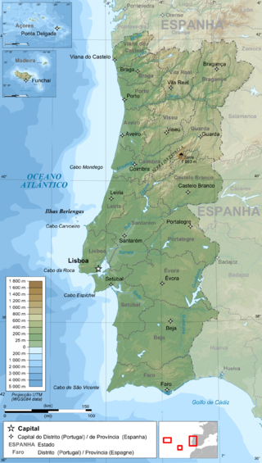
Carta topográfica e da administração de Portugal

Slide 16
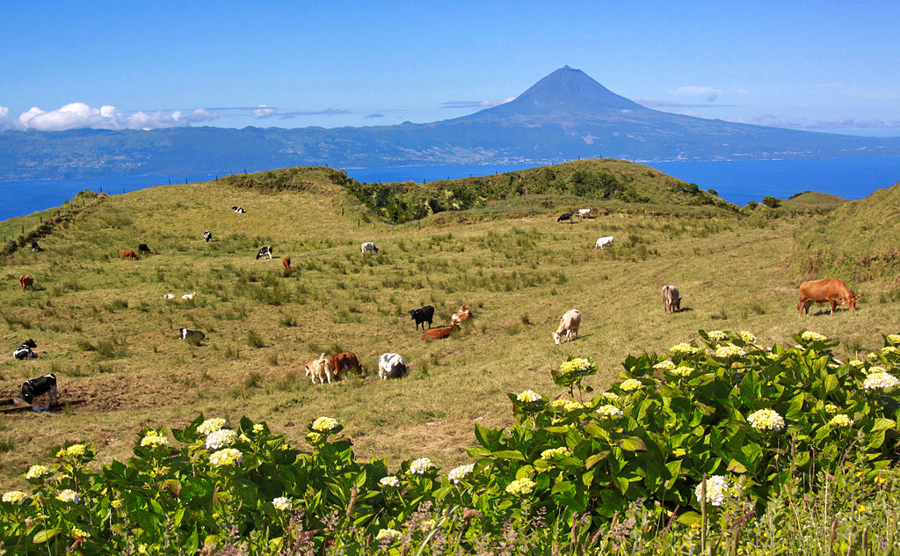
Ilha de São Jorge, Açores.

Slide 17
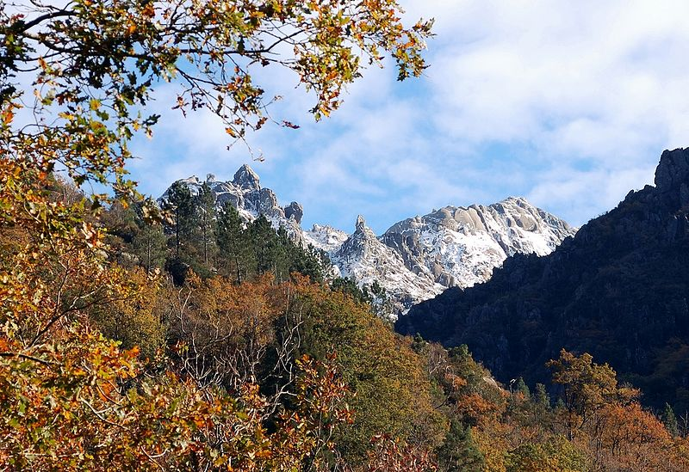
Mata da Albergaria, no Parque Nacional da Peneda-Gerês.

Slide 18
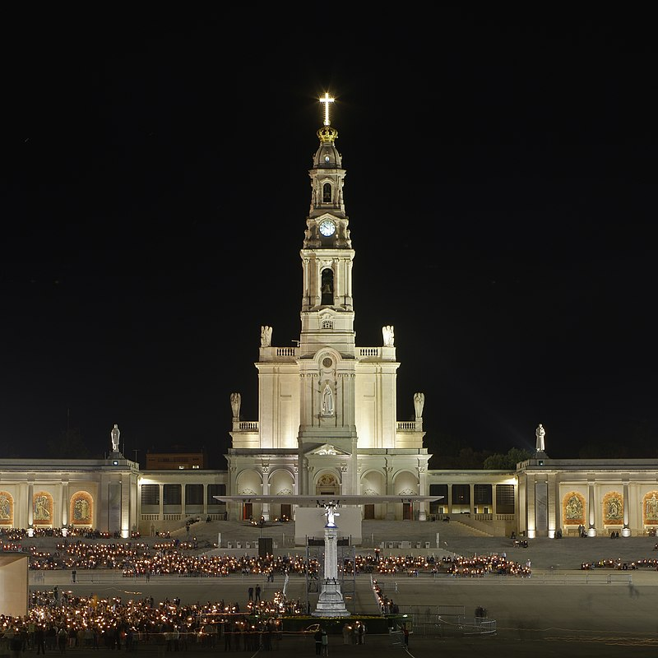
O Santuário de Fátima, também chamado "O altar do Mundo" pela sua projecção mundial entre os crentes católicos.

Slide 19
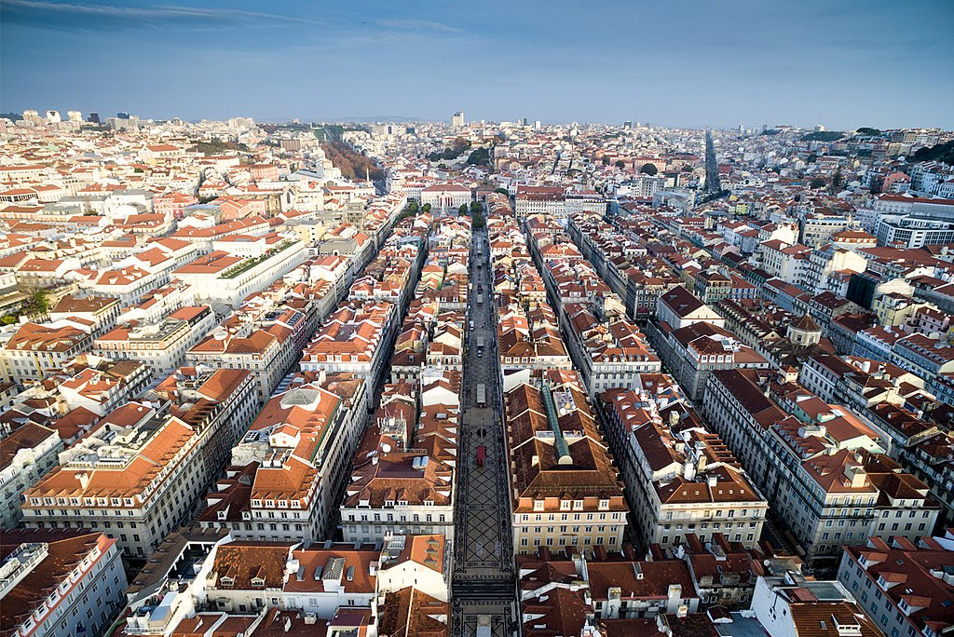
Aerial view of Augusta Street, Lisbon

Slide 20
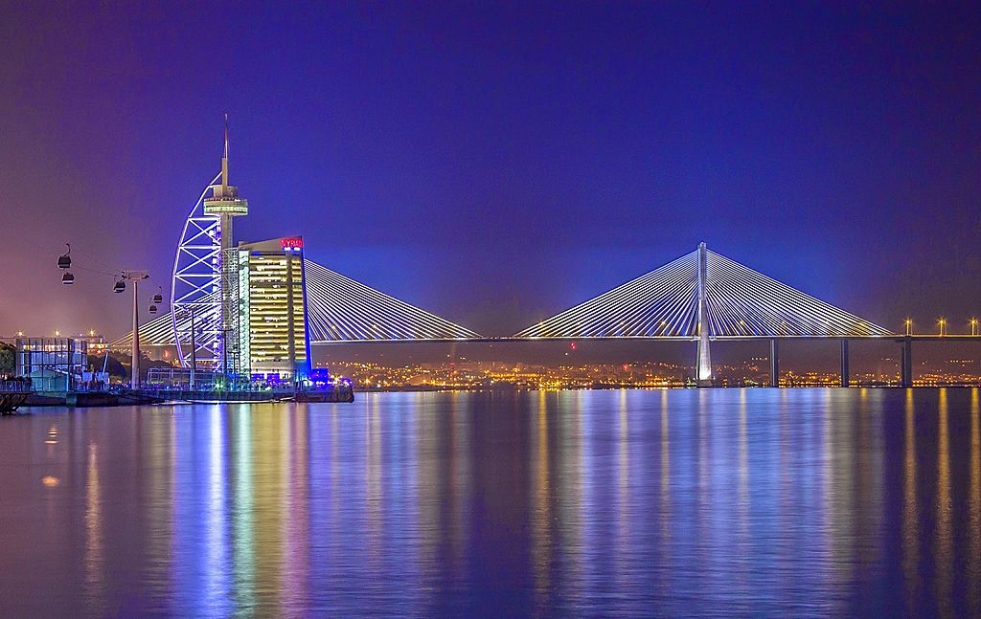
Torre Vasco da Gama no Parque das Nações, um dos centros financeiros de Lisboa e local onde foi realizada a Exposição Mundial de 1998.

Slide 21
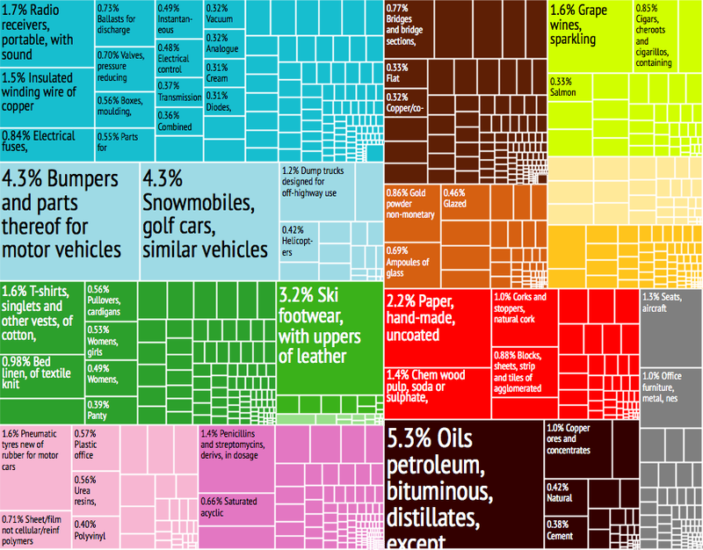
Principais produtos de exportação de Portugal

Slide 22
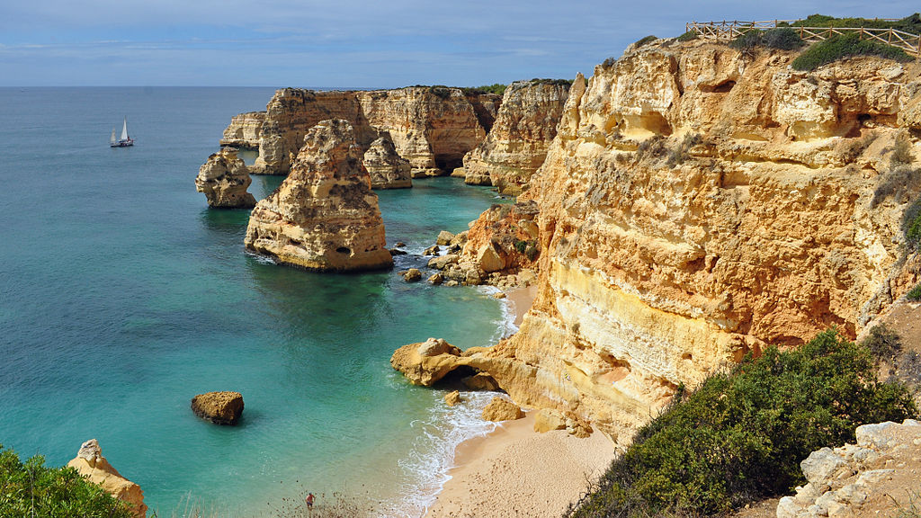
Praia da Marinha, em Lagoa, considerada uma das dez mais belas praias da Europa pelo Guia Michelin.

Slide 23
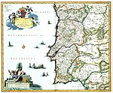
The history of Portugal can be traced from circa 400,000 years ago, when the region of present-day Portugal was inhabited by Homo heidelbergensis. The oldest human fossil is the skull discovered in the Cave of Aroeira in Almonda. Later Neanderthals roamed the northern Iberian Peninsula. Homo sapiens arrived in Portugal around 35,000 years ago.

Slide 24
Pre-Celtic tribes such as Lusitanians, Turduli and Oestriminis lived in the centre and north. The Cynetes, which lived in the south before the 6th century BC, developed the city of Tartessos and the written Tartessian language, and left many stelae throughout their territory. Early in the first millennium BC, waves of Celts from Central Europe invaded and intermarried with the local populations to form several ethnic groups and many tribes. Their presence is traceable, in broad outline, through archaeological and linguistic evidence. They dominated the northern and central area, while the south retained much of its Tartessian character, combined with the Celtici until the Roman conquest. Some small, semi-permanent trading settlements were founded by Phoenician-Carthaginians on the southern coast of the Algarve.

Slide 25
The Roman invasion in the 3rd century BC lasted several centuries, and developed the Roman provinces of Lusitania in the south and Gallaecia in the north. As elsewhere in Western Europe, there was a sharp decline in urban life during the Dark Ages following the fall of Rome. Germanic tribes (that the Romans referred to as Barbarians) controlled the territory between the 5th and 8th centuries. These included the Kingdom of the Suebi centred in Braga and the Visigothic Kingdom in the south. Eventually the Visigoths seized power in the whole of Iberia. Under the Visigoths a new class emerged, a nobility, which played a tremendous social and political role during the Middle Ages, and also began to play a very important part within the state, but since the Visigoths did not know Latin, the Catholic bishops continued the Roman system of governance. The clergy started to emerge as a high-ranking class.
In 711–716 an invasion by the Islamic Umayyad Caliphate conquered the Visigoth Kingdom and founded the Islamic State of Al-Andalus. The Umayyads advanced through Iberia and France. At the end of the 9th century, a county based in the area of Portus Cale was established under King Alfonso III of Asturias, and by the 10th century, the counts were known as the Magnus Dux Portucalensium (Grand Duke of the Portuguese). The Kingdom of Asturias was later divided so that northern "Portugal" became part of the Kingdom of León.

Slide 26
Initially a vassal of the Kingdom of León, Portugal grew in power and territory and gained de facto independence during weak Leonese reigns. In 1095, Portugal broke away from the Kingdom of Galicia. At the end of the 11th century, the Burgundian knight Henry became count of Portugal and defended its independence by merging the County of Portugal and the County of Coimbra. Henry's son Afonso Henriques proclaimed himself king of Portugal in 1139 with Guimarães (Vimarens) as capital. In 1179 a papal bull officially recognised Afonso I as king. The Algarve was conquered from the Moors in 1249, and in 1255 Lisbon became the capital. Portugal's land boundaries have remained almost unchanged since then.
During the reign of King John I, the Portuguese defeated the Castilians in a war over the throne (1385) and established a political alliance with England (by the Treaty of Windsor in 1386).

Slide 27
From the late Middle Ages, in the 15th and 16th centuries, Portugal ascended to the status of a world power during Europe's "Age of Discovery" as it built up a vast empire, including possessions in South America, Africa, Asia, and Oceania. Over the following two centuries, Portugal kept most of its colonies, but gradually lost much of its wealth and status as the Dutch, English, and French took an increasing share of the spice and slave trades by surrounding or conquering the widely scattered Portuguese trading posts and territories. Signs of military decline began with two disastrous battles: the Battle of Alcácer Quibir in Morocco in 1578 and Spain's abortive attempt to conquer England in 1588 by means of the Spanish Armada – Portugal was then in an uncomfortable dynastic union with Spain and contributed ships to the Spanish invasion fleet. The country was further weakened by the destruction of much of its capital city in an earthquake in 1755, occupation during the Napoleonic Wars and the loss of its largest colony, Brazil, in 1822. From the middle of the 19th century to the late 1950s, nearly two million Portuguese left Portugal to live in Brazil and the United States.

Slide 28
In 1910, there was a revolution that deposed the monarchy. Amid corruption, repression of the church, and the near-bankruptcy of the state, a military coup in 1926 installed a dictatorship that remained until another coup in 1974. The new government instituted sweeping democratic reforms and granted independence to all of Portugal's African colonies in 1975. Portugal is a founding member of the North Atlantic Treaty Organization (NATO), the Organisation for Economic Co-operation and Development (OECD), and the European Free Trade Association (EFTA). It entered the European Economic Community (now the European Union) in 1986.

Slide 29
Etymology
The word Portugal derives from the Roman-Celtic place name Portus Cale. Cale or Cailleach was the name of a Celtic deity^{[2]} and the name of an early settlement located at the mouth of the Douro River (present-day Vila Nova de Gaia), which flows into the Atlantic Ocean in the north of what is now Portugal. Around 200 BC, the Romans took the Iberian Peninsula from the Carthaginians during the Second Punic War, and in the process conquered Cale and renamed it Portus Cale (Port of Cale). During the Middle Ages, the region around Portus Cale became known by the Suebi and Visigoths as Portucale.
The name Portucale evolved into Portugale during the 7th and 8th centuries, and by the 9th century, that term was used extensively to refer to the region between the rivers Douro and Minho, the Minho flowing along what would become the northern Portugal–Spain border. By the 11th and 12th centuries, Portugale was already referred to as Portugal.
The etymology of Cale points to Cale^{[3]} being a Celtic name, like many others found in the region. The word cale or cala meant "port", an "inlet" or "harbour", referring to an older Celtic harbour.^{[4]} Today's Gaelic word for harbour is still cala.^{[5]} Some argue it is the stem of Gallaecia, again of Celtic derivation. Another theory claims it derives from the word Caladunum.^{[6]}
In any case, the particle Portu in the word Portucale was used as the basis of Porto, the modern name for the city located on the site of the ancient city of Cale at the mouth of the Douro River. And port became the English name of the wine actually produced further inland, in the Upper Douro Valley region, but exported through Porto. The name Cale is today reflected in Gaia (Vila Nova de Gaia), a city on the south bank of the river.

Slide 30
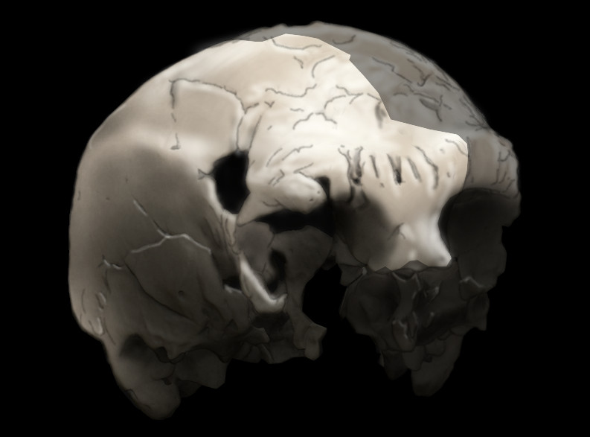
Aroeira 3 skull of 400,000 year old Homo heidelbergensis. The oldest trace of human history in Portugal.

Slide 31
The region of present-day Portugal has been inhabited by humans since circa 400,000 years ago, when Homo heidelbergensis entered the area. The oldest human fossil found in Portugal is the 400,000-year-old Aroeira 3 H. Heidelbergensis skull discovered in the Cave of Aroeira in 2014.^{[7]} Later Neanderthals roamed the northern Iberian peninsula and a tooth has been found at Nova da Columbeira cave in Estremadura.^{[8]} Homo sapiens sapiens arrived in Portugal around 35,000 years ago and spread rapidly throughout the country.^{[9]}
Pre-Celtic tribes inhabited Portugal leaving a remarkable cultural footprint. The Cynetes developed a written language, leaving many stelae, which are mainly found in the south of Portugal.
Early in the first millennium BC, several waves of Celts invaded Portugal from Central Europe and intermarried with the local populations to form several different ethnic groups, with many tribes. The Celtic presence in Portugal is traceable, in broad outline, through archaeological and linguistic evidence. They dominated much of northern and central Portugal; but in the south, they were unable to establish their stronghold, which retained its non-Indo-European character until the Roman conquest.^{[10]} In southern Portugal, some small, semi-permanent commercial coastal settlements were also founded by Phoenician-Carthaginians.

Slide 32
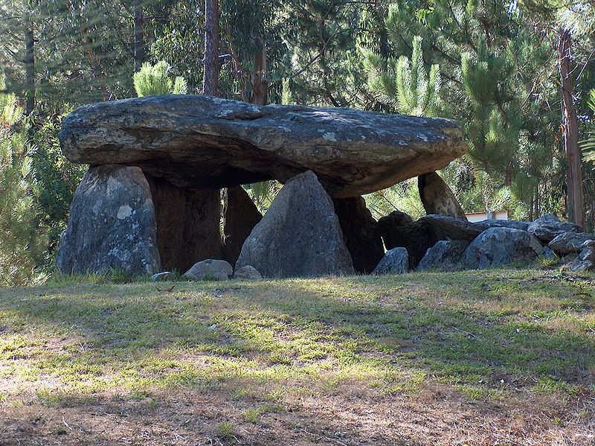
Dolmen of Cerqueira, Sever do Vouga

Slide 33
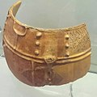
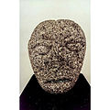
Archaeological artifact from the work developed in the area of Citânia de Briteiros
Cross or cruzado in Citânia de Briteiros
Megalithic spirals, cromlech near Évora
Another artifact from Citânia de Briteiros

