Slide 1
The Internet Security

Slide 2
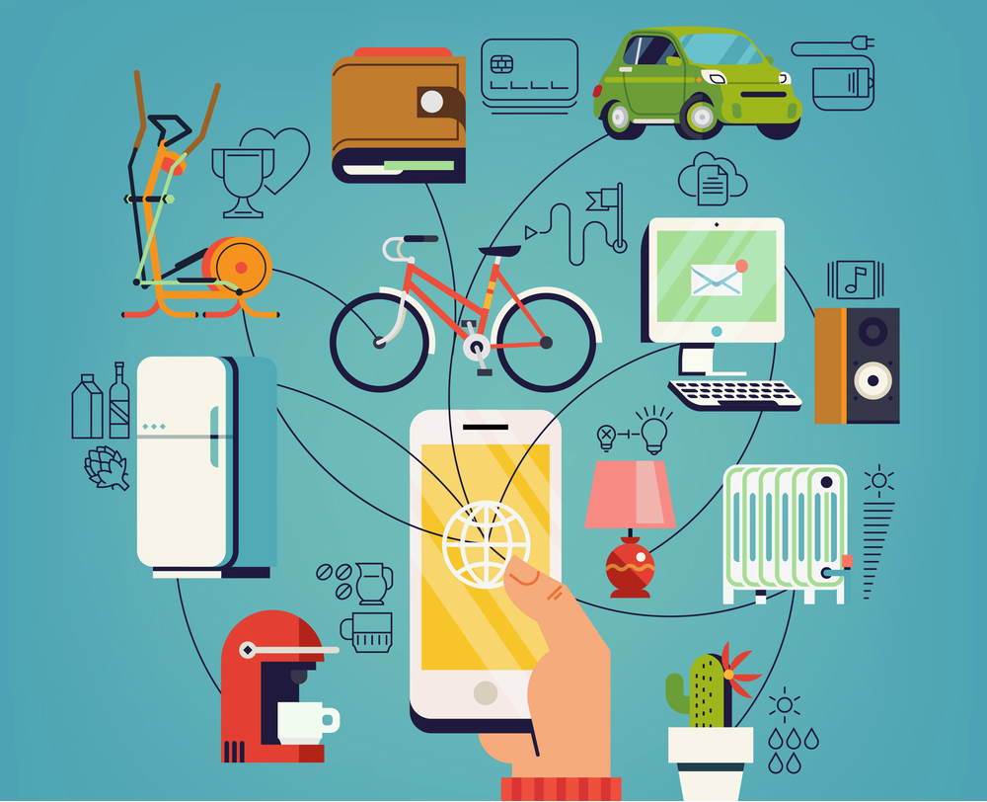
The Internet
With the implementation of the internet and its use on a global scale, our world has become increasingly connected. The internet can be considered as one of the most important inventions in the history of mankind since it provides endless opportunities to companies as well as to everyone of us in our daily life. However, there are also some issues related to the use of the internet.

Slide 3
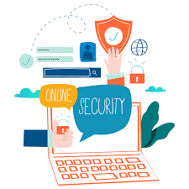
What Is Internet Security
Internet security can be characterized as the precautions that we must take as users to protect ourselves from the potential risks that the digital space implies.

Slide 4
The Advantages of Internet
Information, knowledge, and learning
Connectivity, communication, and sharing
Entertainment
Work from home, collaboration, and access to a global workforce
Selling and making Money
Address, mapping, and contact information

Slide 5
Information, knowledge, and learning
Connectivity, communication, and sharing
The Internet allows people to learn information about any topic and offers an answer to any type of question, as it contains endless knowledge and information.
In the past days, if you sent a letter or someone sent you, it could take days and sometimes even months to a reach letter at the destination. In modern times, you can send a letter or important information to anyone in the e-mail all over the world through the Internet. And, it often will be delivered to the destination in less than a minute.
Entertainment
The Internet provides people to access endless entertainment. With the Internet, you can watch movies, videos, play games online, listen to music, etc. There are many sites available on the Internet, which contain different entertainment material like music, videos, and more. Also, you can watch online videos on a platform like YouTube.

Slide 6
Work from home, collaboration, and access to a global workforce
Selling and making money
The Internet connection offers many people an option to create a virtual office by allowing them to work from home, which is very usefull due to the pandemic .
If you want to sell products and services or run a business, the Internet is the best place to sell goods. Because anyone can find and access your website all over the world with the help of the Internet. With online business, you are able to sell goods every day at all times as the Internet is always on and always available.
Address, mapping, and contact information
The Internet can help users to provide information almost every place in the world on the map with the help of GPStechnology. You can find businesses in your area or the quickest route to your location. Although, today's search engines are most powerful to know the user's location and help offer the relevant searches for your area.

Slide 7
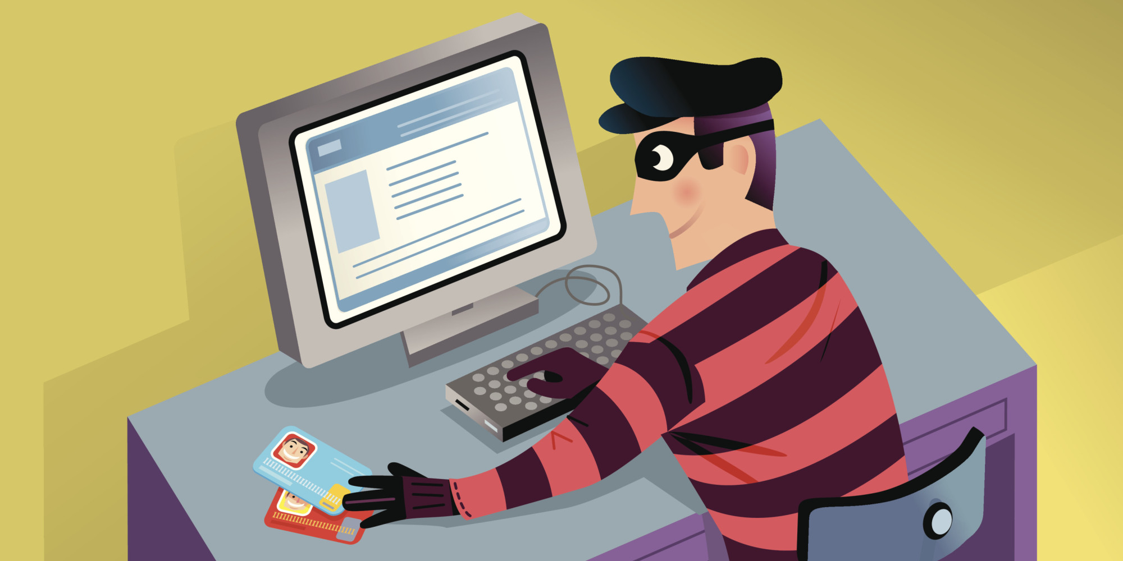
The Risks of the Internet
Depression, loneliness, and social isolation
Viruses/Malwares
Addiction, time-waster, and causes distractions
Bullying, trolls, stalkers, and crime
Getting scamed

Slide 8
Depression, loneliness, and social isolation
Viruses/Malwares
The Internet also becomes a reason lead to depression as many people tend to compare their lives with others on social networking sites. Social networking sites provide users the option to make thousands of friends and communicate with each other. There are also available online games that allow players to communicate with others. Although social networking sites can give you benefits to find new connections all over the world, you may find yourself disconnected from your real-life friends.
The frequently use of the Internet may infect your system from viruses that can damage your valuable data, which is difficult to recover. These viruses enter into the system through USBs, CIDs, and the Internet. Also, because of viruses, your system can become totally worthless..

Slide 9
Addiction, time-waster, and causes distractions
Bullying, trolls, stalkers, and crime
If any person is spending much time on the Internet connected devices, he can be addicted to the Internet. An Internet addictive person can lead to spending his precious time on the Internet, rather than doing something productive.
A person who uses the Internet very frequently can face abusive or trolls' people. Another issue cyberbullying is also increasing rapidly over the years. Sometimes, you can be tracked on the Internet by hackers or unauthorize persons; they can be harmful to you by stealing your personal information.
Getting scamed
If you buy things for a non verificated/trustfull website theres a high chance to get robbed

Slide 10
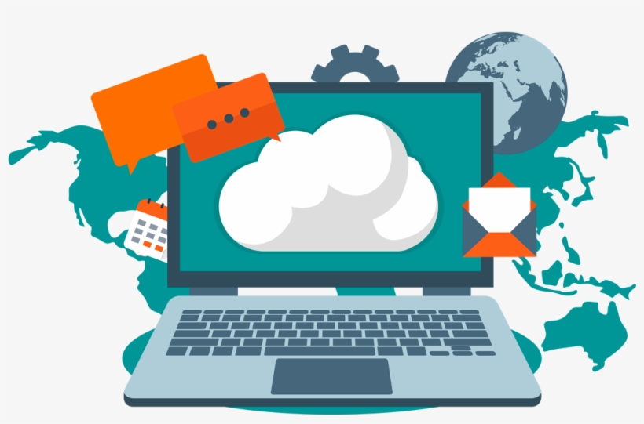
conclusion
The Internet can be an amazing place to improve your knowlodge but it has a lot risks. When we use the Internet, or post something on it, we should be more careful because everything that enters on the virtual world, it does not get off

Slide 11
Thank you for the attention

