Slide 1
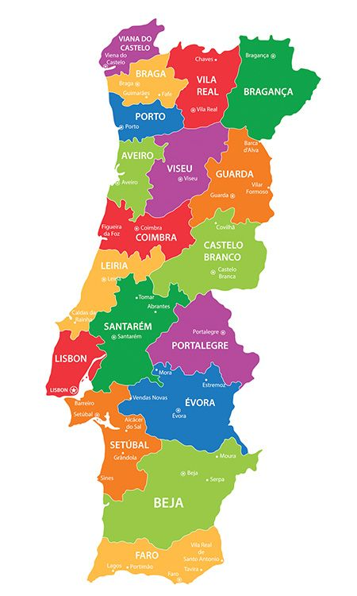
History and geografy of Portugal
Work done by:Leonor Grilo nº13 9ºD

Slide 2
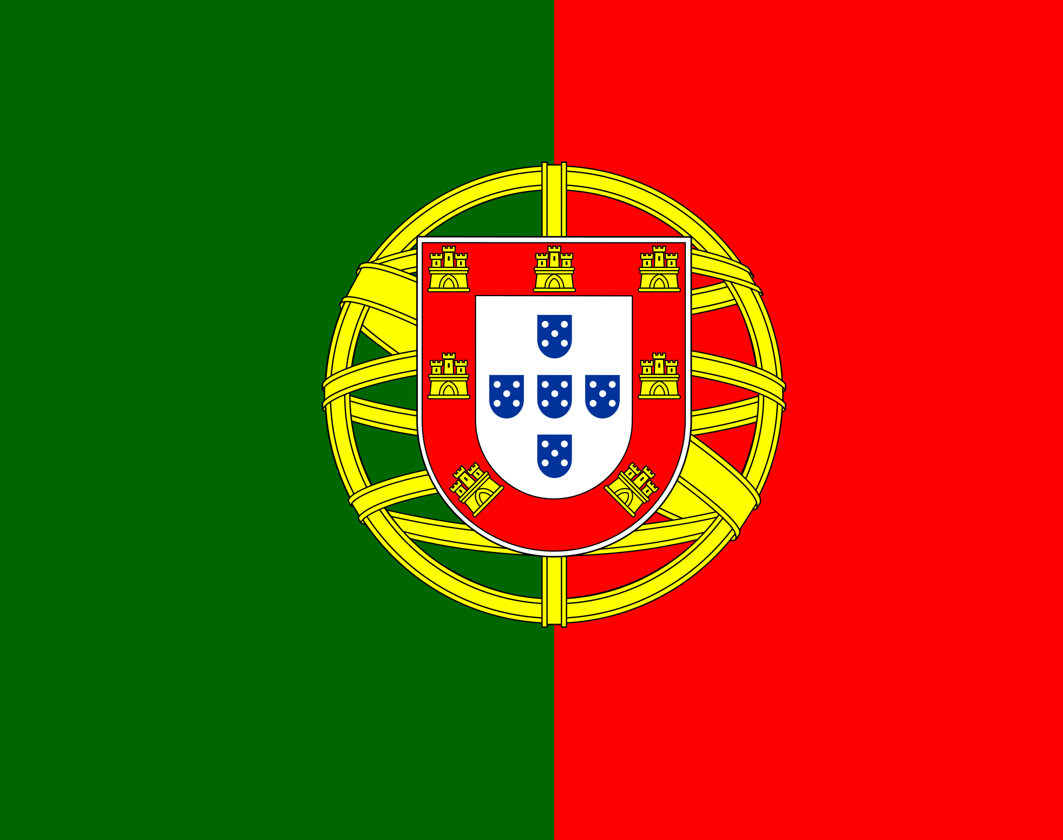
The history of Portugal as a European nation dates back to the Low Middle Ages, when the Portucalense county became autonomous from the kingdom of León.
In 1139, during the Christian Reconquest, the Kingdom of Portugal was founded from the Portucalense county, born between the Minho and Douro rivers. The stabilization of its borders in 1297 made Portugal the European country with the oldest borders.
In 1580 a succession crisis resulted in the Iberian Union with Spain. With no autonomy to defend its overseas possessions in the face of the Dutch offensive, the kingdom lost much of its wealth and status. In 1640 independence was restored under the new dynasty of Bragança.

Slide 3
A revolution in 1910 deposed the monarchy, but the first Portuguese republic failed to resolve the problems of a country immersed in social conflict, corruption and clashes with the Church. A coup d'état in 1926 gave way to a dictatorship. From 1961 onwards, it fought a colonial war that lasted until 1974, when a military revolt overthrew the government.
Since 718, taking refuge from the sudden Muslim invasion of the Iberian Peninsula, a group of Visigothic Christians resisted in the north, in the mountainous region of Asturias. There, led by Pelagius, they founded the Kingdom of Asturias and began the reconquest of territories. This gradual process gave rise to the birth of small kingdoms, which were enlarged as the conquests were successful. Thus was born the Kingdom of Leon, Navarre, Aragon, Castile and Galicia.

Slide 4
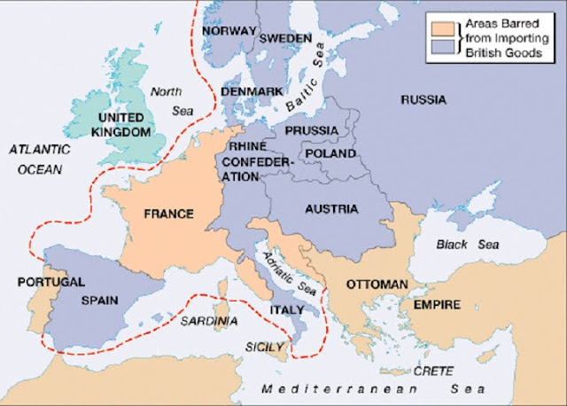
In 1500, on his second voyage to India, Pedro Álvares Cabral departed the African coast and landed in Brazil.In Lisbon, the Casa da India was established to administer all aspects of overseas trade and navigation, and the first viceroy of India based in Cochin was appointed.
In 1807 Portugal refused to participate in the Continental Blockade decreed by Napoleon Bonaparte, respecting the traditional Luso-British Alliance. Imperial France required all European states to join, as part of the strategy to eliminate Great Britain as the leading power at the time and ensure hegemony in Europe. Those who refused would be invaded.

Slide 5
The regicide of 1 February 1908, which took place at Terreiro do Paço, in Lisbon, profoundly marked the history of Portugal, as it resulted in thand main heir.
After the death of the king and the Prince Real, the surviving male son, D. Manuel de Bragança, ascended from the rank of infante to that of king, taking the name of D. Manuel II. However, due to the establishment of the Republic on October 5, 1910, the time of his effective reign was short and the new monarch was forced to go into exile, as well as all the other members of the Portuguese royal family of the Bragança dynasty. . To this end, the Portuguese Republic enacted the Proscription Law.
In October 1910, a revolt broke out. The army's reluctance to fight the approximately two thousand revolting soldiers and sailors would provoke the deposition of D. Manuel II and the proclamation of the Portuguese Republic, leaving the king for exile in Great Britain. The Republic was proclaimed on October 5, 1910, from the balcony of the City Hall in Lisbon. A provisional government headed by Teófilo Braga directed the country's destiny until the approval of the 1911 Constitution that gave rise to the First Republic.Among other changes, with the establishment of the republic, the national symbols were replaced: the national anthem and the flag as well as the currency, with the shield replacing the real.

Slide 6
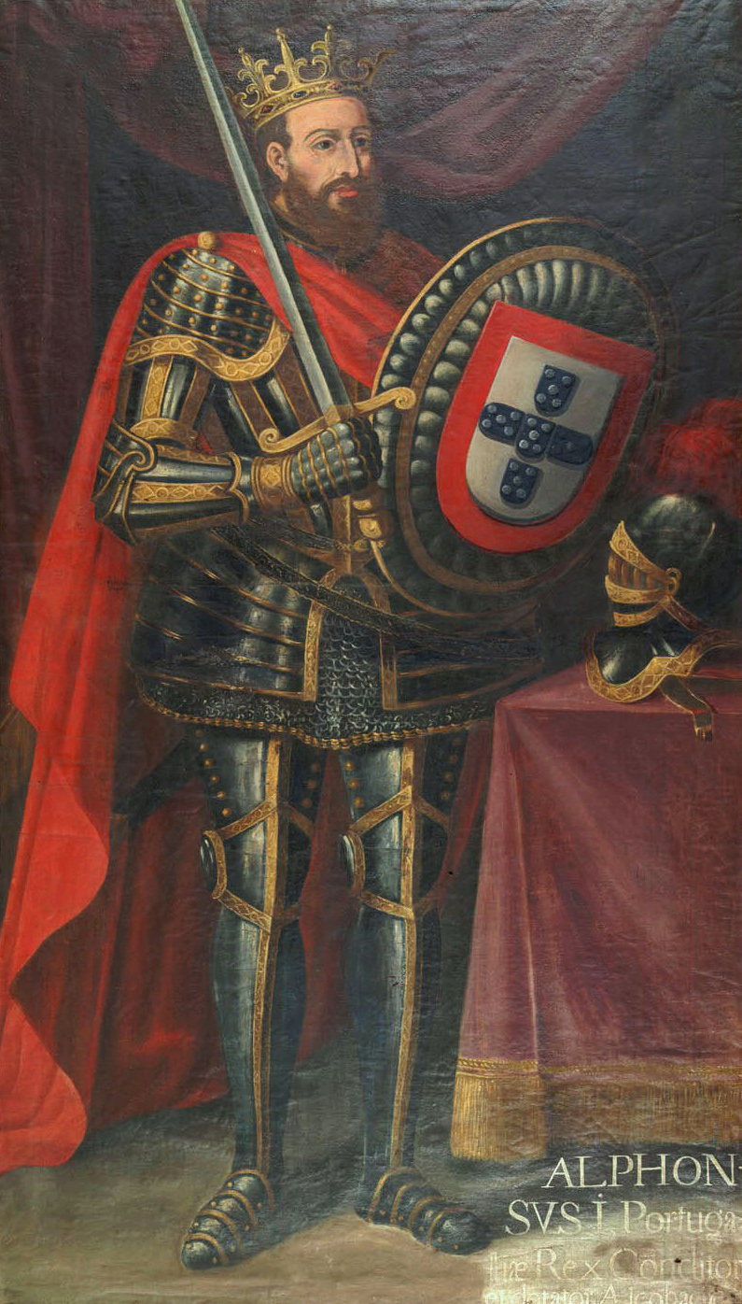
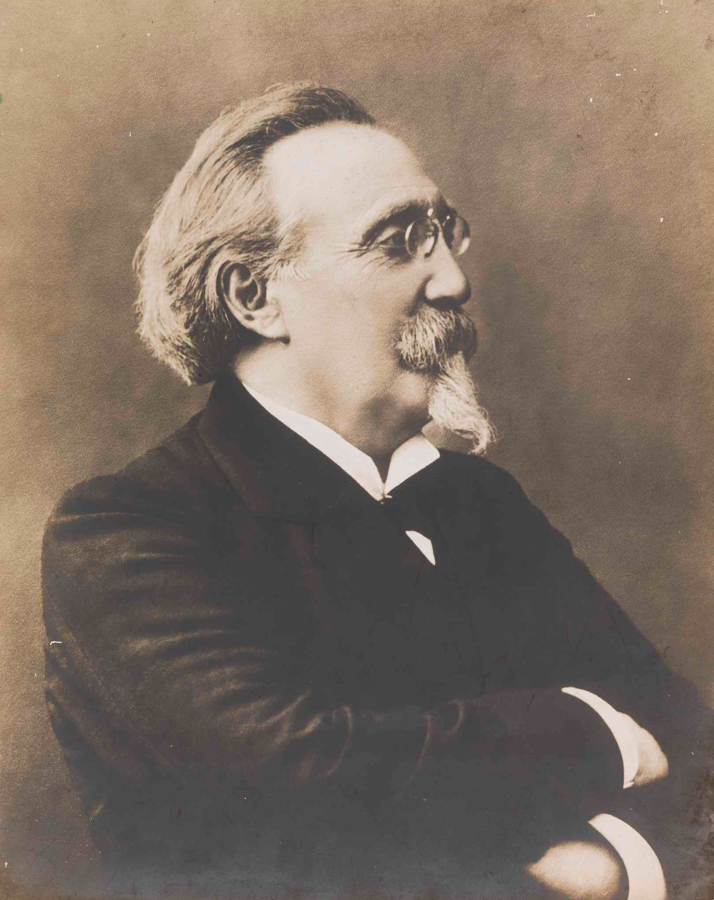
In the 1970s, Portuguese society's discontent with the regime grew, driven by economic difficulties resulting from 13 years of overseas war and the 1973 oil crisis. Marcelo Caetano's refusal to accept a political solution to the war revolted the forces armed forces, who concluded that the end of the conflict passed through the overthrow of the dictatorship.
The first king of portugal was dom afonso henriques, and the first president of the portuguese republic was manuel de arriaga

