Slide 1
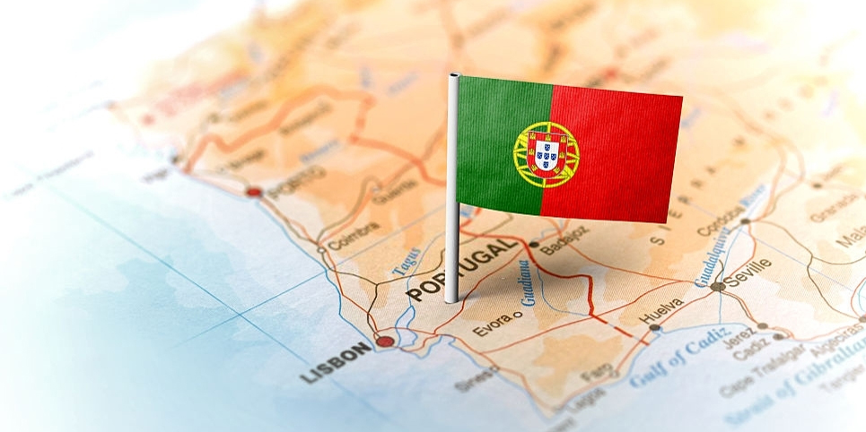
History and Geography of Portugal

Slide 2
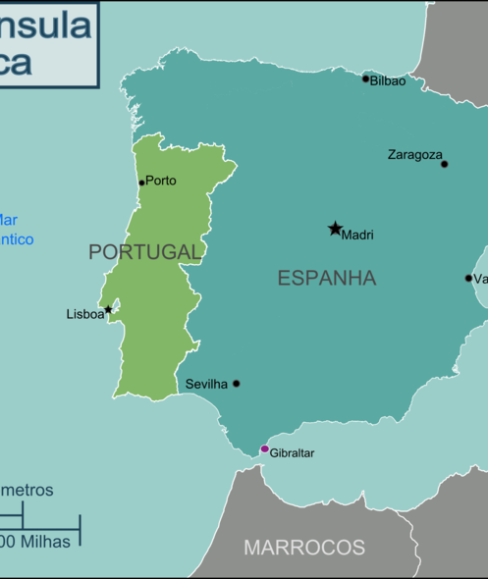
Geography of Portugal
Portugal is located in Europe on the Iberian Peninsula
Portugal has about 10 million people and it is the 79th most populous country on earth
Its capital is Lisbon and the currency is the Euro

Slide 3
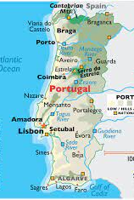
Portugal is divided by the Tagus river, which separates the rugged north from the rolling plains in the south. In the north, the landscape is an extension of the mountains of the Iberian Peninsula – forested and intersected by deep valleys.
In the Southern part of the Tagus river, the landscape is characterised by wide plains, planted with mostly Mediterranean species including cork oaks, figs, olive trees and vineyards.
Many of Portugal’s rivers originate in Spain and flow into the Atlantic Ocean, including the Minho, Douro, Tagus and Guadiana rivers, creating a rich hydrographic network.

Slide 4
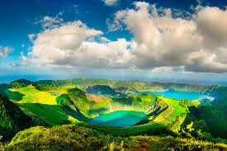
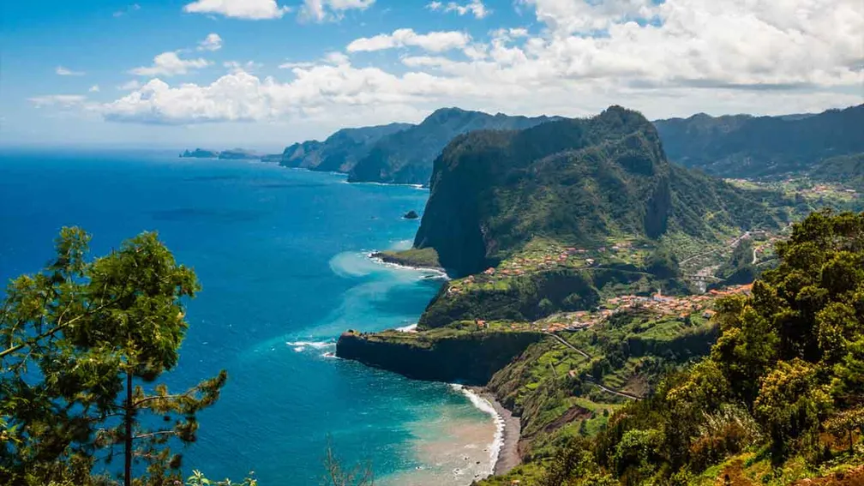
Azores
Madeira
The islands of Madeira and Azores are also part of the Portuguese territory. Located in the Atlantic Ocean, both archipelagos have volcanic origins and are abundant with natural beauty and indigenous species.

Slide 5
Portugal is one of the oldest countries in Europe.
The first people in Portugal were from the stone ages and arrived in Portugal from Southern France before 10.000 BC. They settled in the north.

Slide 6
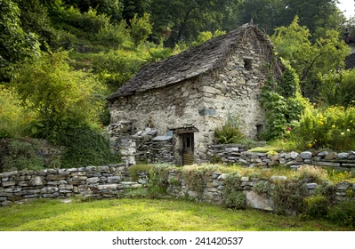
Portugal at the time of Celtic People
They settled in the north and their language start to spread.
They lived in villages in small stone houses as the picture shows.

Slide 7
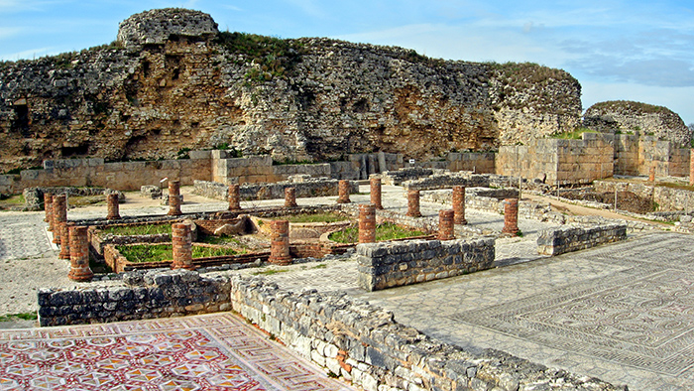
Roman Portugal
They settled mostly in the south because it was better for agriculture and livestock farming.
Their language spread and they layed down their code of law which became the basic of the Portuguese legal code,
Around 25 BC, Julius Ceaser and Junius Brutus established Lisbon as the capital.
They also divided Portugal into many provinces.

Slide 8
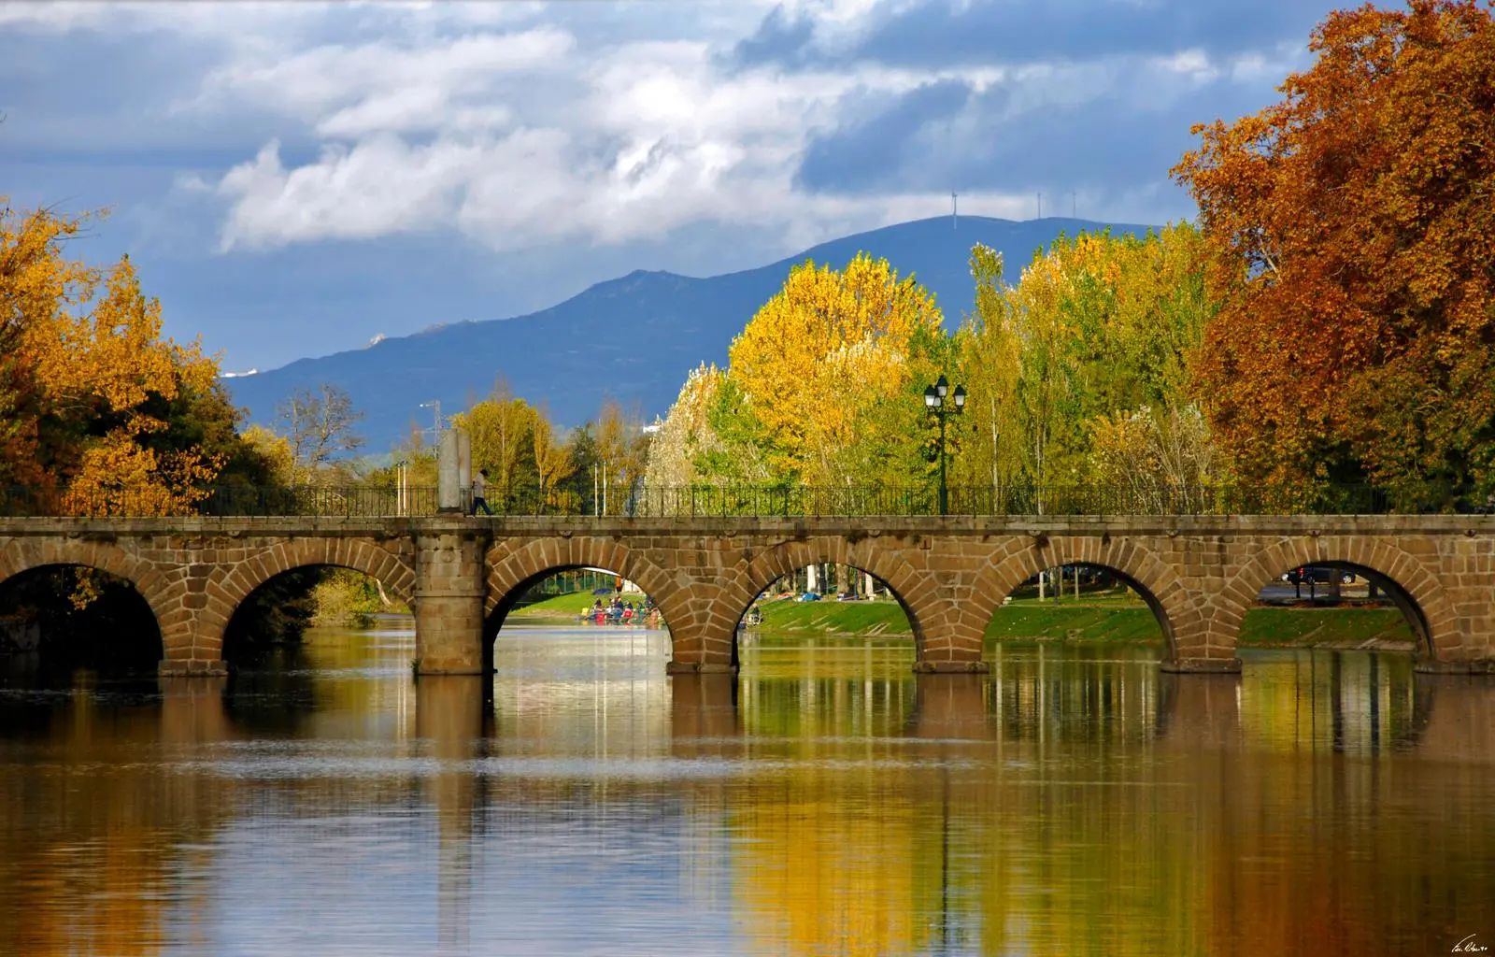
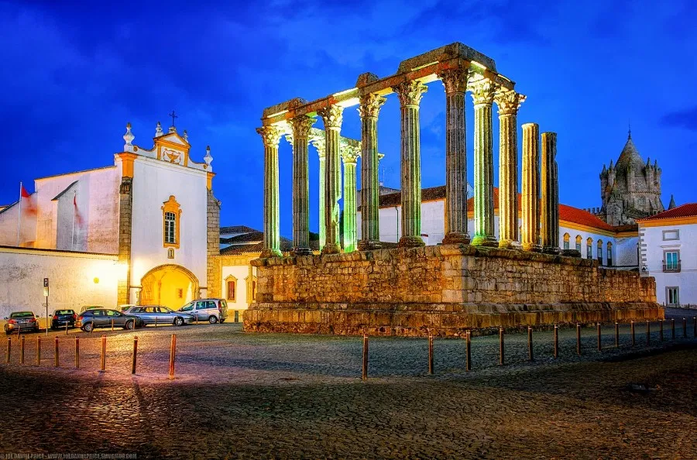
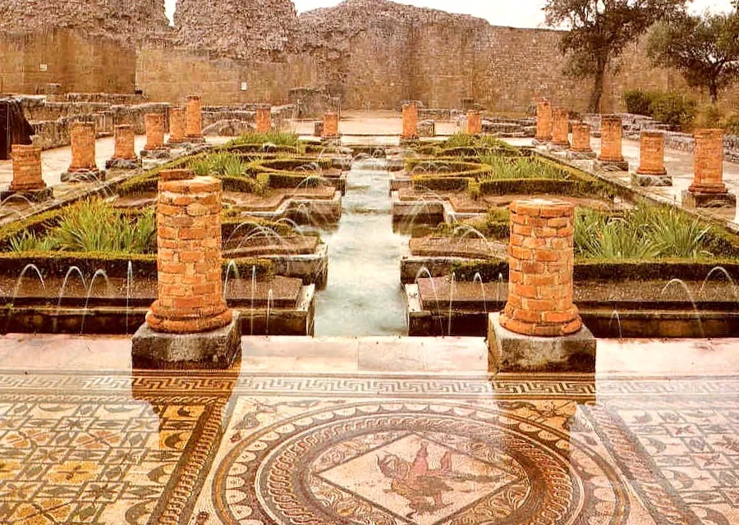
Contributors of the Romans
Trajano Bridge
Roman Temple in Évora
Ruins in Conímbriga
In addition to language and laws, the Romans also contributed to art and architecture of our country

Slide 9
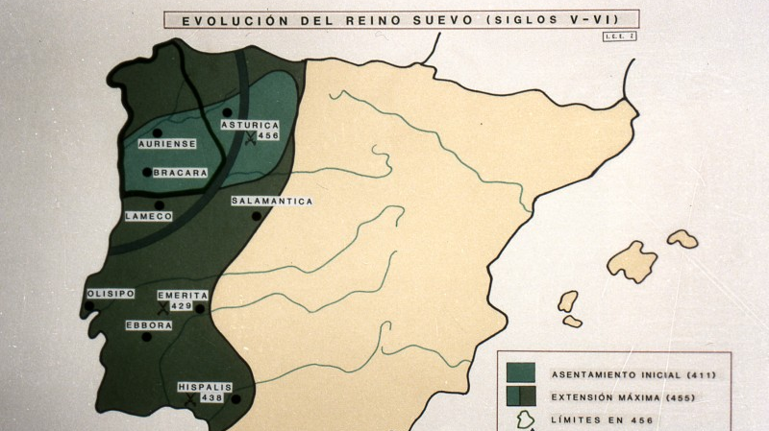
Germanic Portugal
They did not completely get rid of the Romans. They blended with both the Romans and the Celts since their cultures were mostly the same.
They settled in the north and northwest which was better for their crops

Slide 10
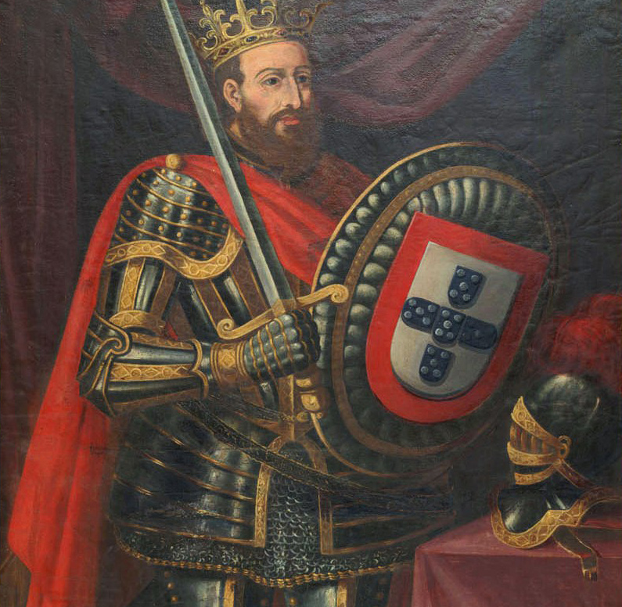
Portugal gained independence in 1143 and became a Monarchy.
Afonso Henriques was the first King of Portugal in the 12th century.

Slide 11
Discoveries
The Portuguese people were the first Europeans to:
Discover the islands Madeira, Azores, and Cape Verde
Sail throug western Africa
Cross the equator

Slide 12
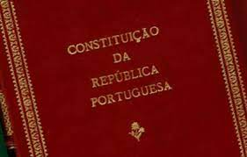
1910
In 1910 Portugal became a Republic.
1976
The Constitution of the Portuguese Republic was written in 1976 and is the current Portuguese constitution.

Slide 13
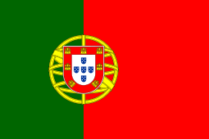
Potugal Flag Symbology
The green colour represents the hope of the Portuguese people.
The red colour represents the courage and the blood of the Portuguese people killed in combat.
The armillary sphere symbolizes the world that the Portuguese navigators discovered in the 15th and 16th centuries and the peoples with whom they exchanged ideas and trade.
The 5 blue shields represent the victories of King Afonso I and the 5 white dots are meant to represent the five wounds of Christ.
The 7 golden castels represent the moor cities conquered by Afonso Henriques.

Slide 14
Portuguese Anthem
The Portuguese Anthem is called
" A Portuguesa" and was composed by Henrique Lopes de Mendonça and Alfredo Keil.

Slide 15
Curiosity
On 10th of June Portugal commemorates the death of Luís de Camões and celebrate the National Day of Portugal.

Slide 16
"Portugal, a country of history"

