Slide 1
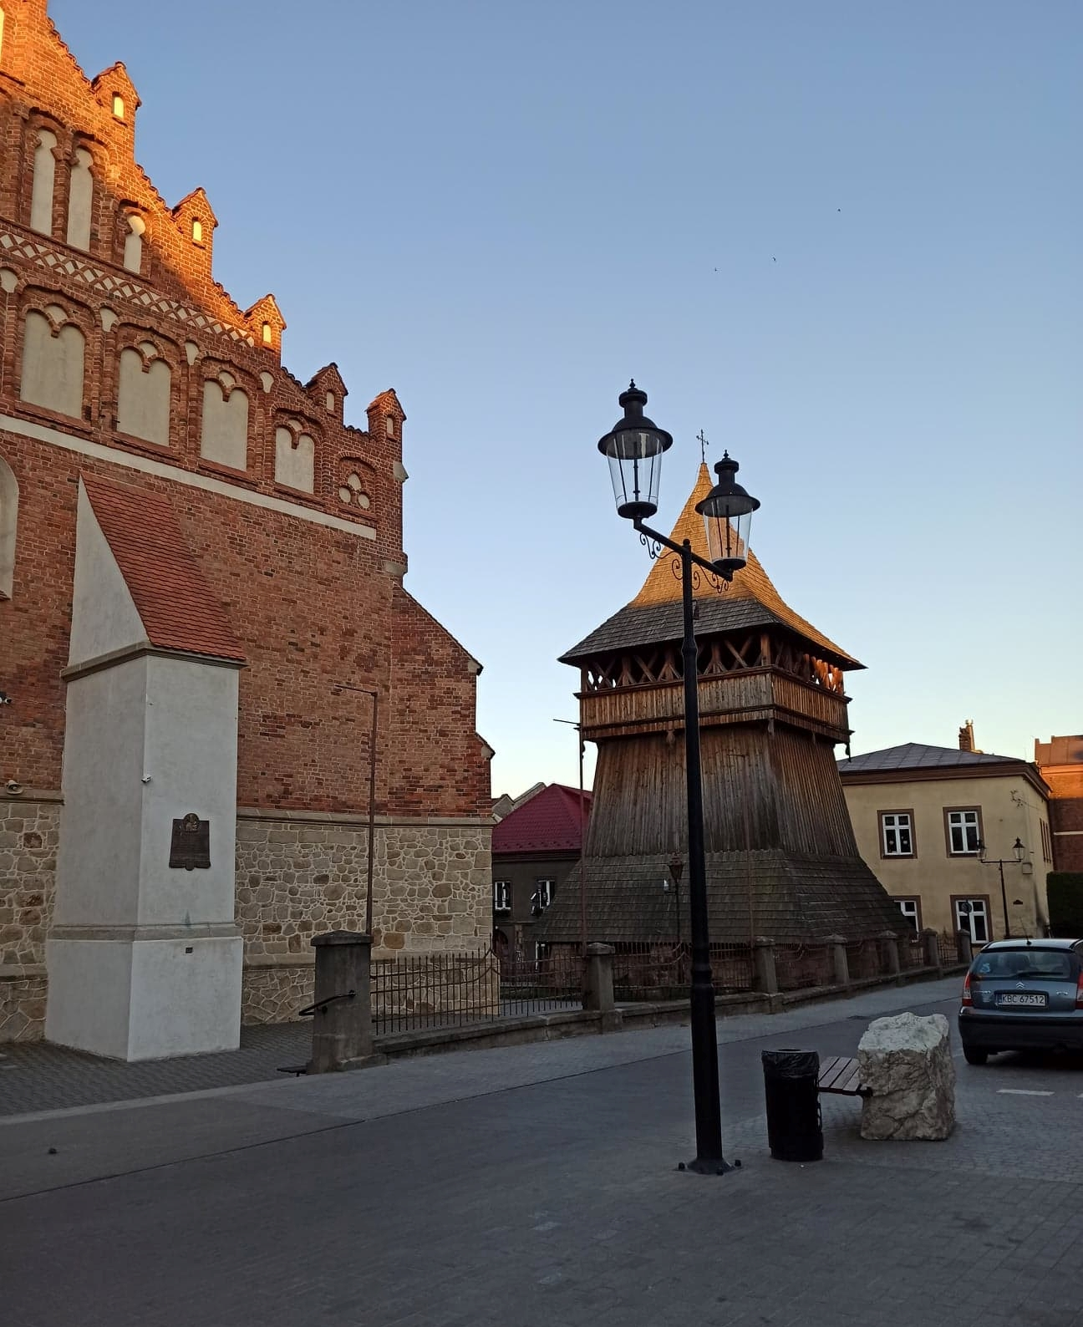
The wooden belfry of Bochnia
There is a wooden belfry next to the Basilica in Bochnia. It was one of the most valuable monuments of wooden religious architecture in Poland. It was built in the 16th century. Unfortunately, it burnt down in unexplained circumstances on the night of 7/8 October 1987. If in a given city there was a fire or raid in the belfry, there were big bells that were rung to warn the inhabitants

Slide 2
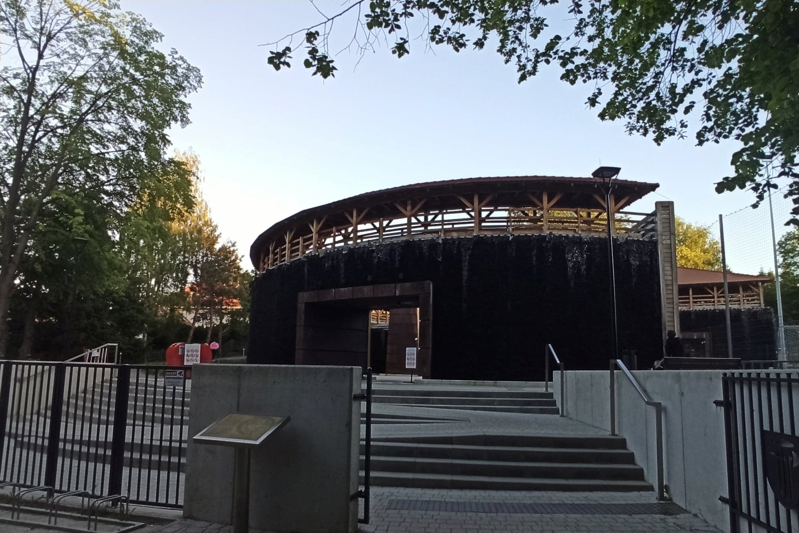
Brine graduation tower in Bochnia
Brine graduation tower in Bochnia. It was built in the 21st century. It is used for medicinal purposes.

Slide 3
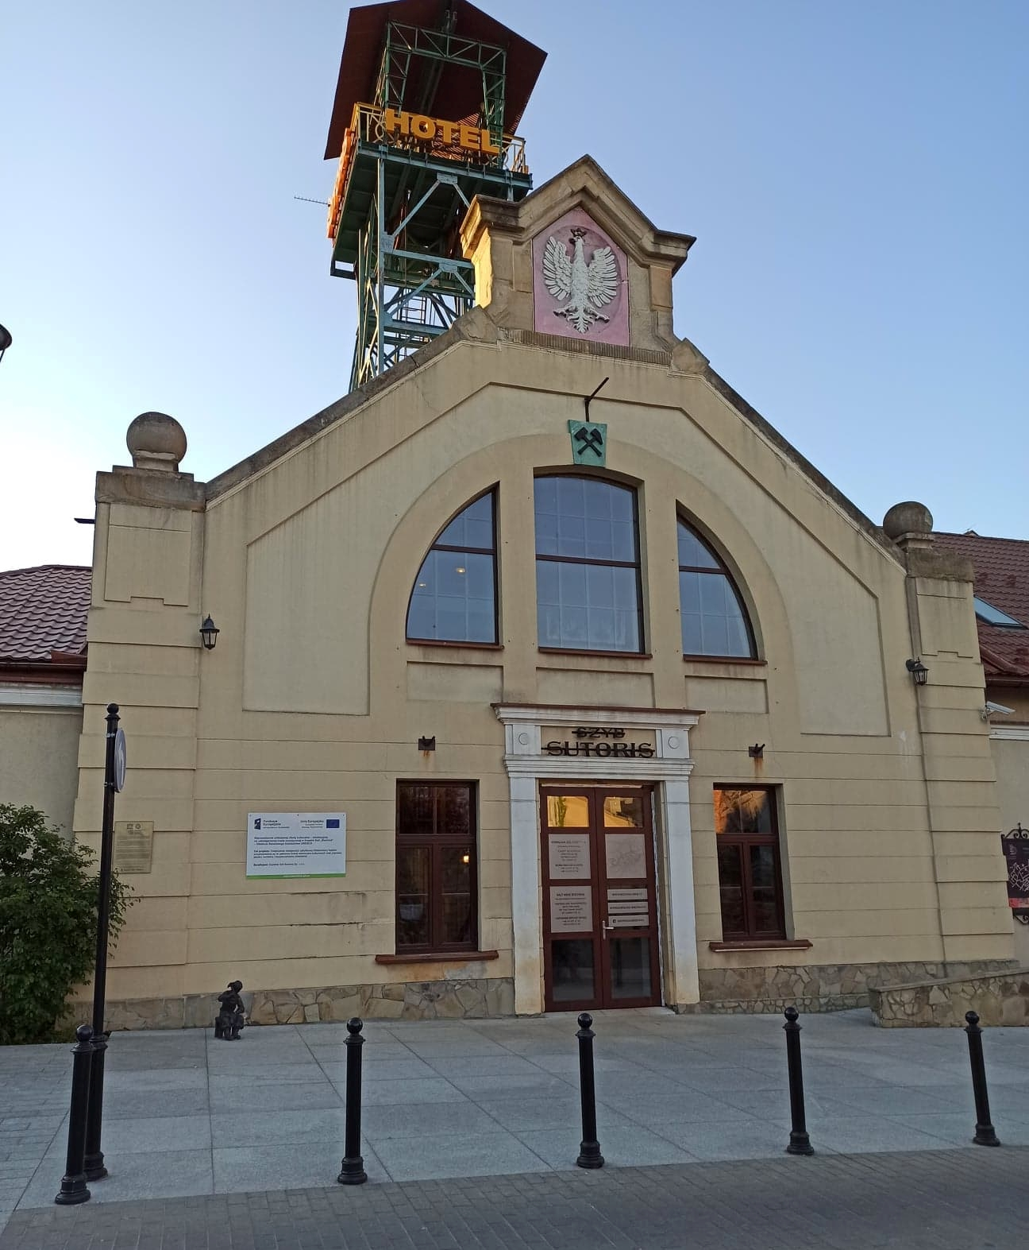
Salt Mine
The Sutoris sutoris shaft is otherwise known as Szewcom Góra. It was built in the 14th century. Legend has it that rock salt was found there. In the past, miners used this shaft to go down to the mine to extract rock salt, now the mine is open only to tourists and there is a sports facility in it.

Slide 4
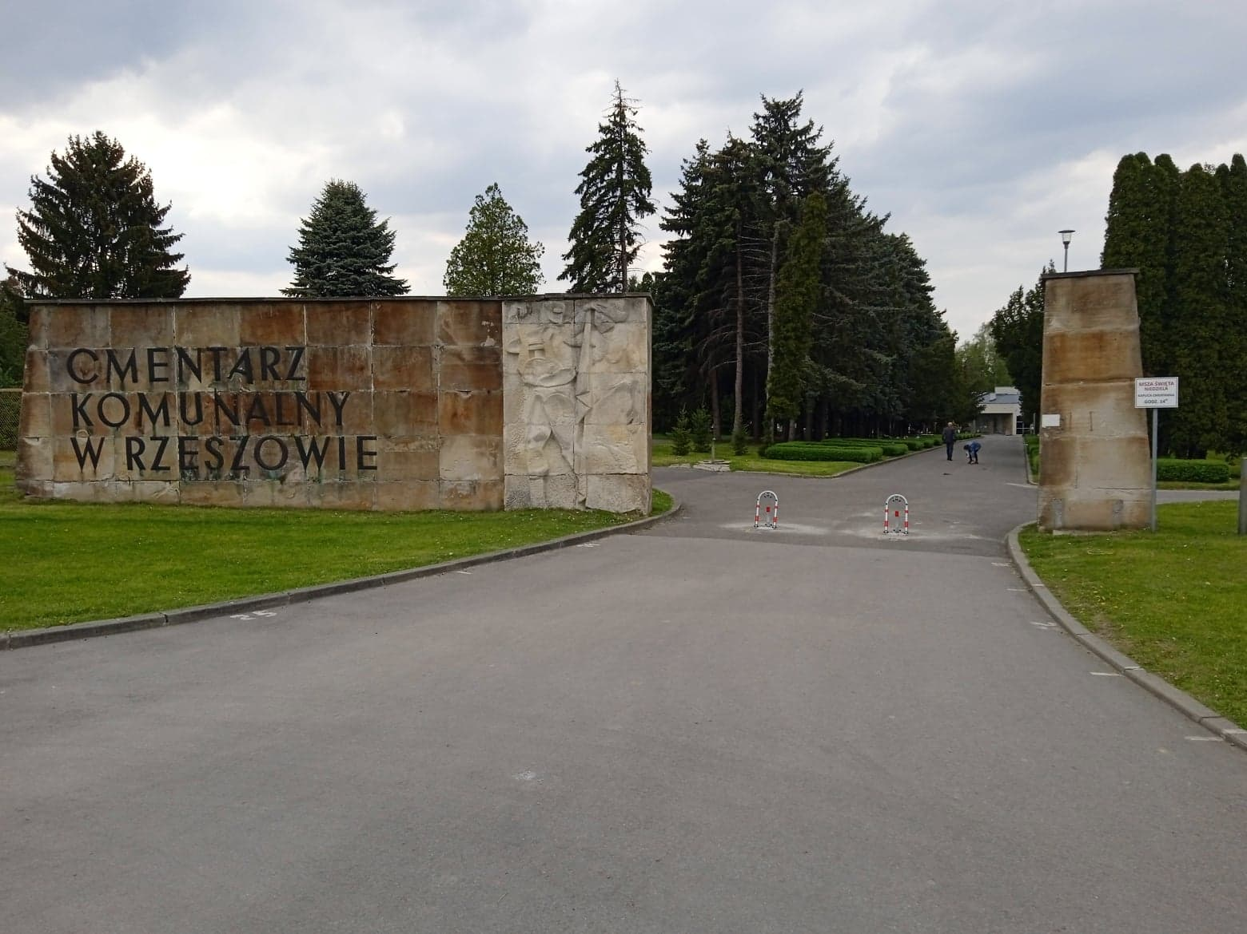
Cemetery in Rzeszów
The cemetery was established in the 20th century. It is the main cemetery in Rzeszów. The dead of the Catholic faith are buried here. About 23,000 people are buried there.

Slide 5
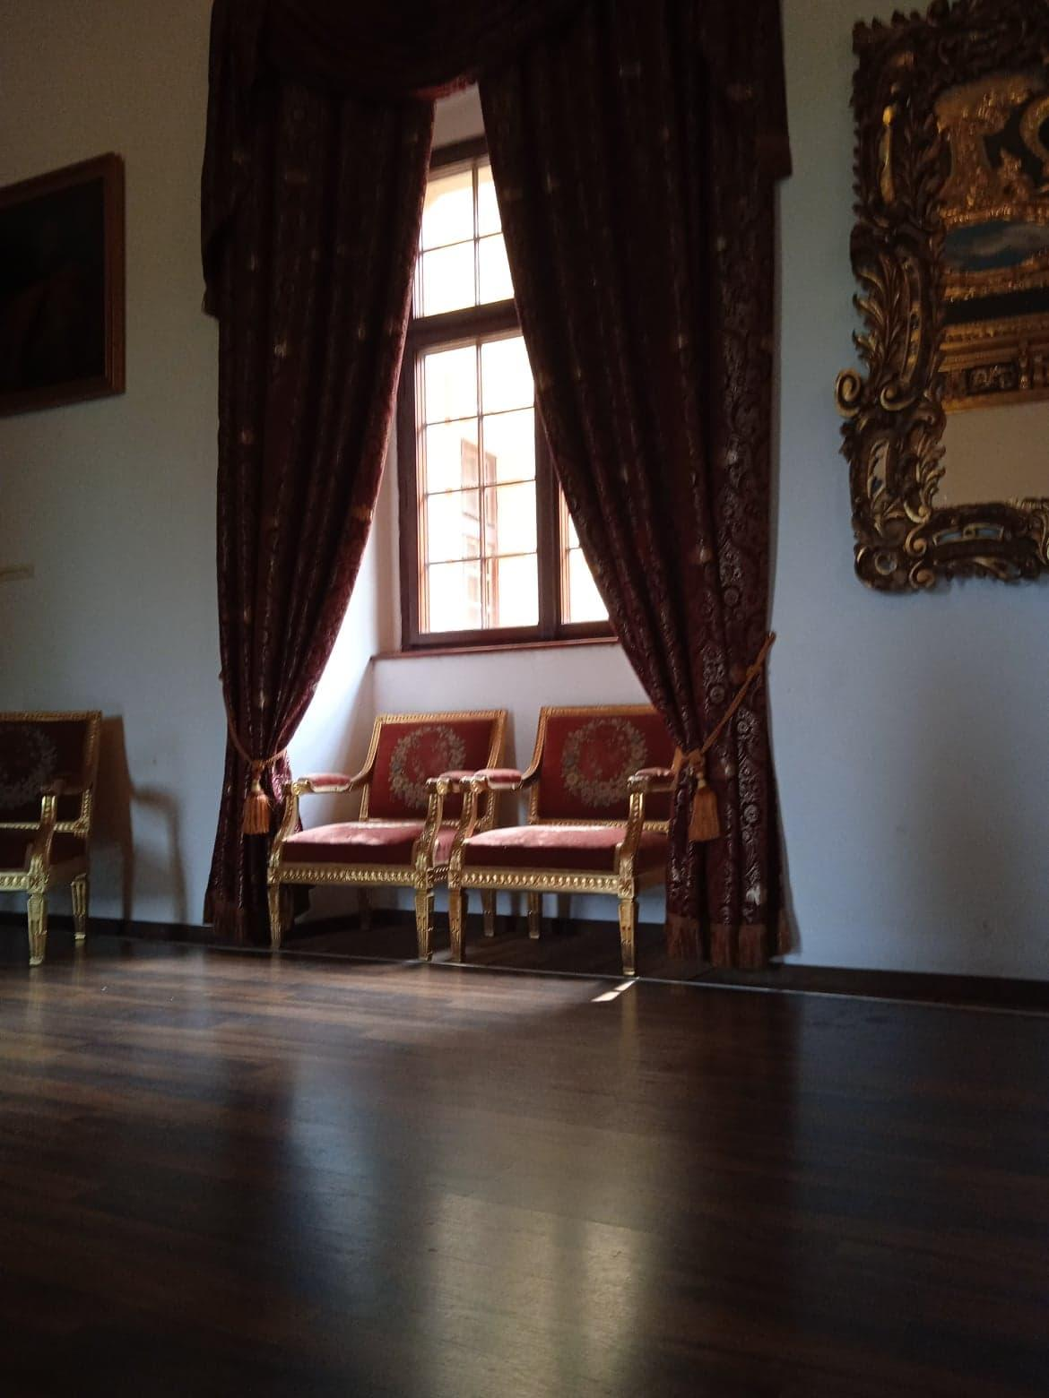
Castle in Wiśnicz
The castle in Wiśnicz was erected in the mid-fourteenth century. It belonged to Jan Kmita. Jan is a noble. At the turn of the 15th and 16th centuries, the castle already had four wings and three towers, it is a baroque castle.

Slide 6
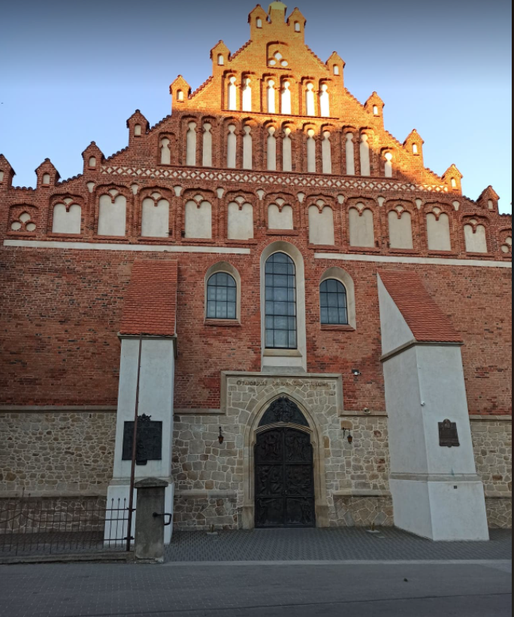
Basilica of St. Nicholas in Bochnia
St. Nicholas was built in the first half of the XV century
This Basilica is Catholic-Roman
since 755, services are held there.

Slide 7
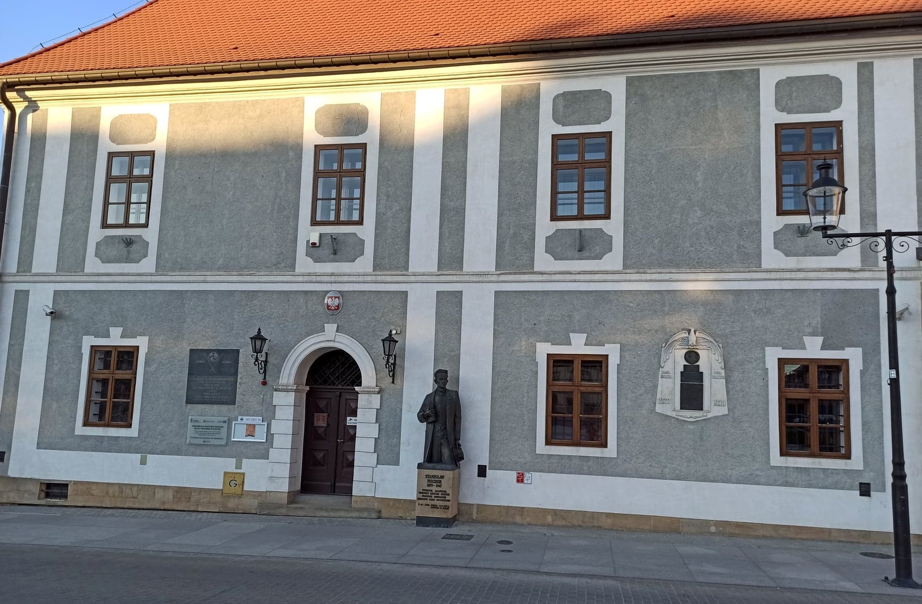
Museum in Bochnia
The museum was established in 1959
There are a collection of old folk sculptures and paintings, old prints and manuscripts, guild memorabilia, military and archaeological specimens.

Slide 8
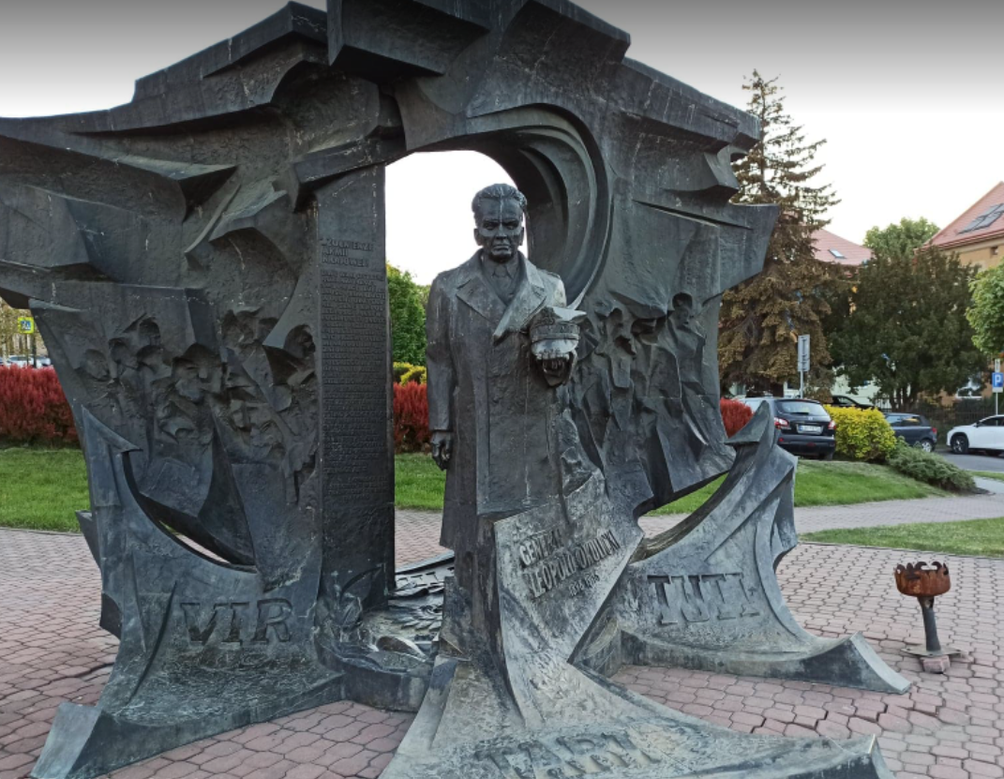
Monument to General Leopold Okulicki
Leopold Okulicki Monument It was erected in 1996
It is to remind about General Leopold Okulicki

Slide 9
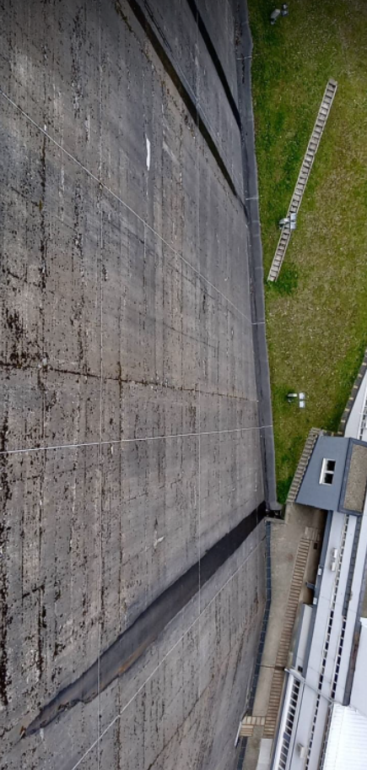
Dam over the soline
The main earthworks and foundation works were completed in 1964
The concrete dam in Solina is the largest pumped storage power plant in Poland. It consists of 4 hydro sets and the slope that can be used is as high as 60m.

Slide 10
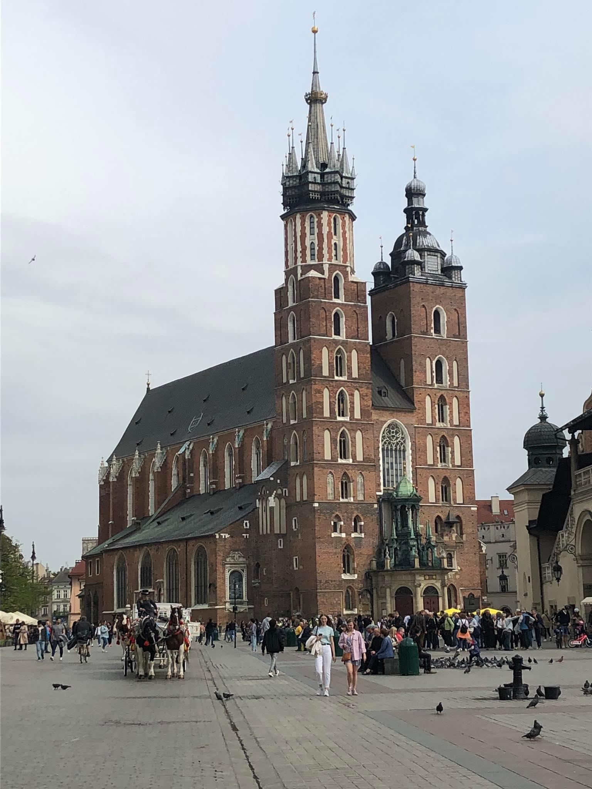
St. Mary's Church
The basilica was founded in 1347
This basilica is Catholic-Roman
they are held there every day for masses

