Slide 1
Portuguese traditional dishes

Slide 2
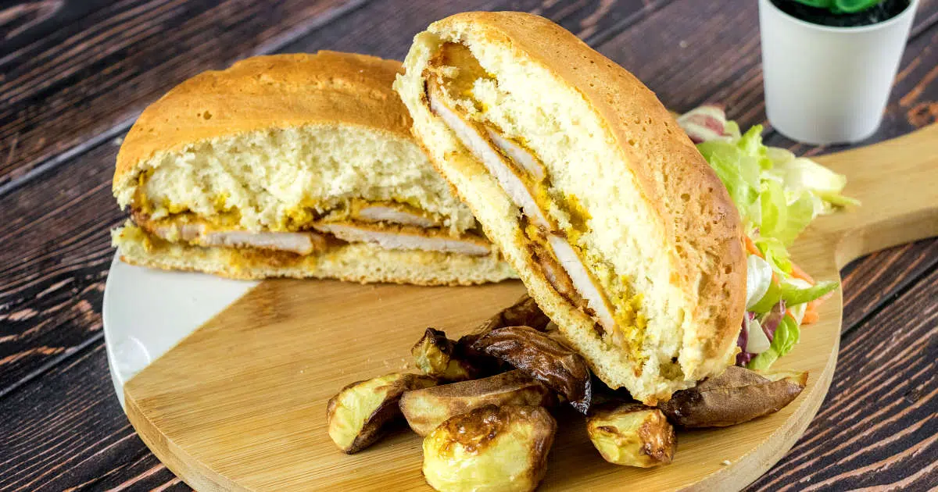

Slide 3
This bifana recipe is for a classic Portuguese sandwich that is universally loved. Thin slices of pork marinated in white wine, garlic, paprika and olive oil, just oozing in flavor. Served stuffed in toasted rolls with a smear of mustard and piri piri sauce, this delicious sandwich will have everyone begging for more.
Tempting bifanas sandwiches found across Portugal
Bifana is a traditional Portuguese sandwich consisting of Portuguese bread known as Papo Secos stuffed with marinated pork chops.
The secret of the bifana sandwich is the perfectly juicy pork in its signature marinade and the method of preparation.
Thinly sliced ​​pork chops, garlic, olive oil, white wine and a few spices are all you need for this Portuguese sandwich that will awaken all your senses.
The Bifana sandwich is popular across Portugal and available at almost all cafes, local bars and eateries and even as a street food.

Slide 4
There are regional differences when it comes to bifana Portugal and every cook prepares it a little differently.
How much the bread is soaked in the seasoning makes a difference. Whether the bifana sandwich is served with mustard or an olive oil and white wine also influence the taste.
The bifana sandwich is beloved in Portugal and a source of national pride.

