Slide 1
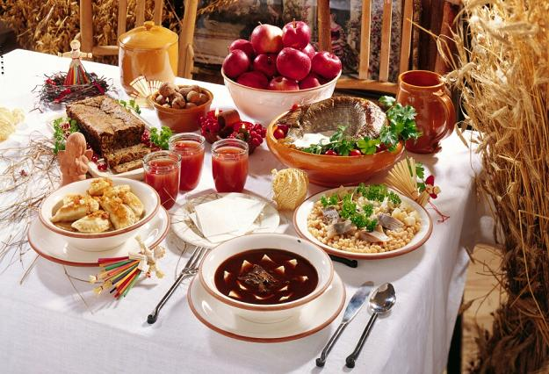
Polish Cuisine

Slide 2
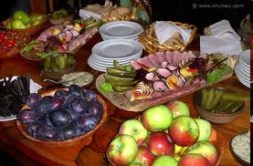
Polish national cuisine shares some similarities with other Central, Eastern European, French and Italian traditions. It is rich in meat, especially pork, chicken and beef (depending on the region) and winter vegetables (potatoes, cabbage, carrots, parsley roots, celeries and onions).

Slide 3
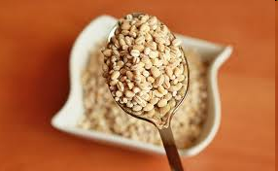
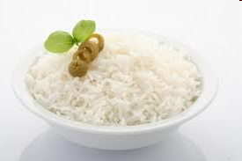
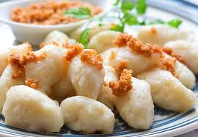
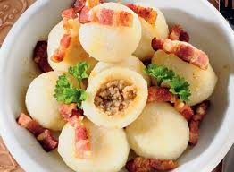
Polish cuisine is also characteristic in its use of various kinds of noodles called *pyzy, *kopytka as well as buckwheat and rice.

Slide 4
Generally speaking, Polish cuisine is hearty and uses a lot of cream and eggs. The traditional dishes are often demanding in preparation. Many Poles allow themselves a generous amount of time to serve and enjoy their festive meals, especially Christmas Eve dinner

Slide 5
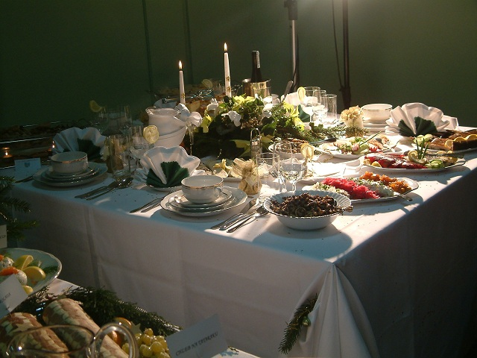

Slide 6
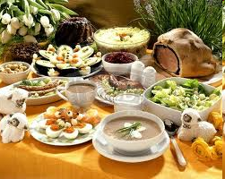
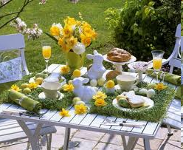
or Easter breakfast which could take a number of days to prepare in their entirety.

Slide 7
Traditionally, the main meal is eaten about 2 p.m. or later, and is usually composed of two courses, starting with a soup, such as popular chicken noodles and tomato soup or more festive beet borscht or sour rye soup. The main course is usually meaty including a roast beef or breaded pork cutlet. Vegetables, currently replaced by lettuce, are most commonly served as shredded root vegetables with lemon and sugar or sour cream (carrot, celery, beetroot) or sauerkraut.
The side dishes are usually boiled potatoes or more traditionally buckwheat or rice.
Meals often conclude a dessert such as a poppy seed pastry, or a type of yeast cake.

Slide 8
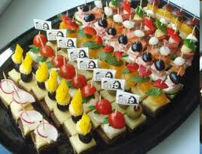
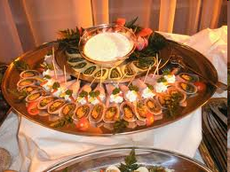
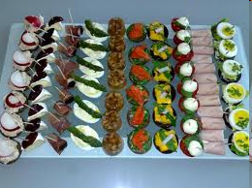
In a restaurant firstly you would be served an appetizer of herring (prepared in either cream, oil, or vinegar) or other popular appetizers such as a variety of cold meat, vegetables or fish in aspic.

Slide 9
The Polish national dishes could be considered to be

Slide 10
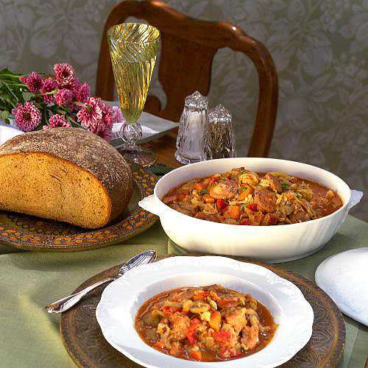
made of a variety of meat and shredded cabbage - hunter’s stew

Slide 11
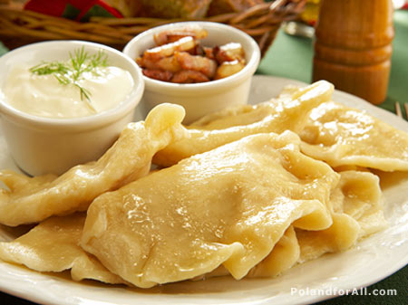
A variety of pierogies - with saurkraut and forest mushrooms

Slide 12
with potatoes and cheese – called Russian pierogies

Slide 13
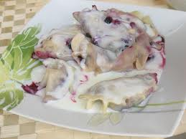
with blueberries and apples (or other fruits)

Slide 14
famous in the world sausages in Polish
*kielbasa

Slide 15
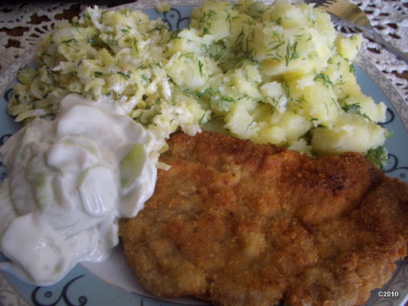
breaded pork cutlets

Slide 16
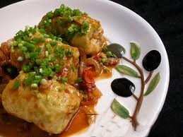
cabbage rolls

Slide 17
beef escallops

Slide 18
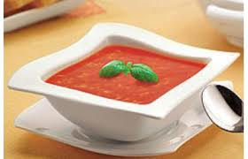
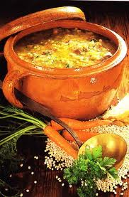
tomato soup
buckwheat soup

Slide 19
chicken soup

Slide 20
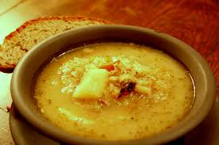
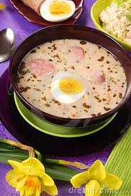
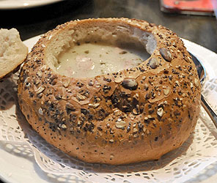
sauerkraut soup
sour rye soup

Slide 21
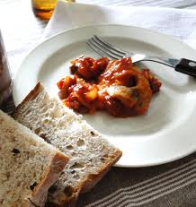
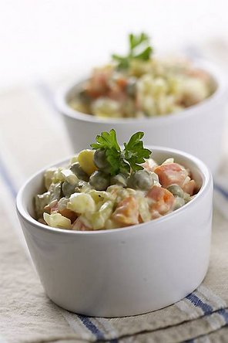
herring salad
vegetable salad

Slide 22
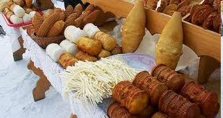
Oscypki – smoked cheese made of salted sheep's milk exclusively in the Tatra Mountains

Slide 23
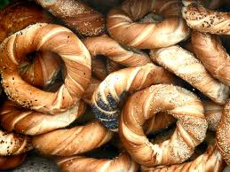
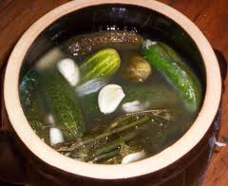
bagels from Krakow - *obwarzanki
pickled cucumbers

Slide 24
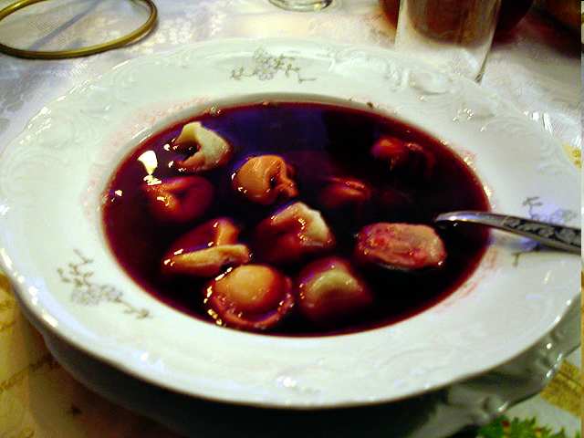
Traditional Christmas Eve supper usually consists of red borscht with small dumplings called uszka, which means “little ears” – a classic Polish Christmas Eve starter

Slide 25
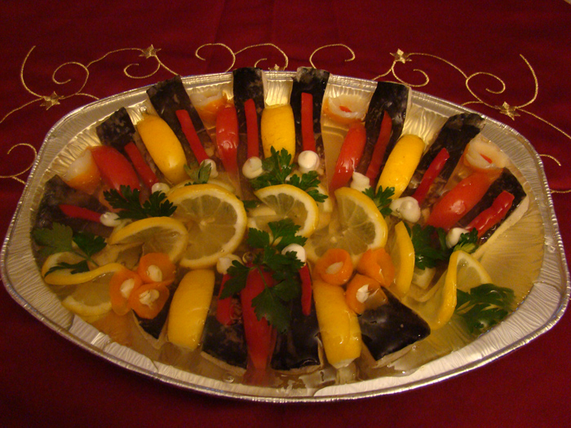
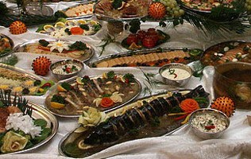
followed by fried carp, carp fillet with potato salad, carp in aspic etc. Carp provides a main component of the Christmas Eve meal across Poland.

Slide 26
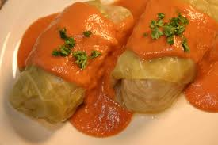
Other popular dishes include pickled herring, pierogies with sauerkraut and forest mushrooms, cabbage rolls with forest mushrooms, fish soup, and vegetable salads.

Slide 27
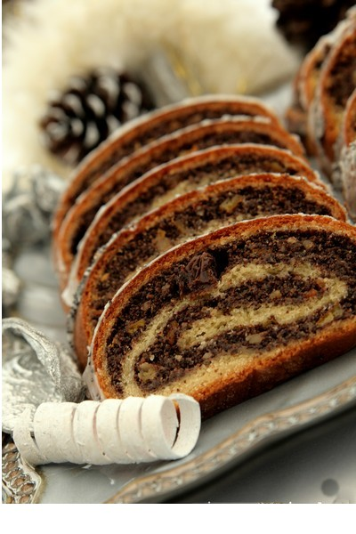
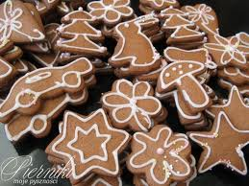
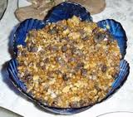
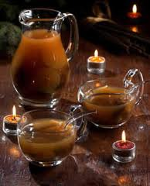
Among popular desserts are among others: poppy seed cake, fruit compote, pasta with poppy seeds, *kutia - sweet grain pudding in the eastern regions and ginger cakes.

Slide 28
Fat Thursday is a Catholic feast celebrated on the last Thursday before the Lent. Traditionally it is a day when people eat big amounts of sweets and cakes that are afterwards forbidden until Easter. The most popular sweets during Fat Thursday are donuts or faworki called also in some regions of Poland "chrust". The donuts one can fill with marmalade and cover with powdered sugar or sugar-icing.
One of the old superstitions says that the one who does not eat any donuts on Fat Thursday will not succeed afterwards. But the Poles do not feel endangered with this superstition an average Pole eats on Fat Thursday 2,5 of donuts while the whole country eats almost 100 million of them altogether.

Slide 29
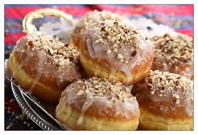

Slide 30
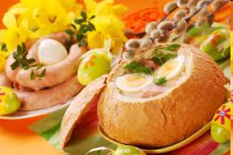
A typical Easter Breakfast often consists of sour rye soup, cold-cuts served with horseradish sauce and beet salads, breads, smoked or fried salmon or herring, marinated vegetable salads

Slide 31
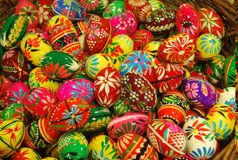
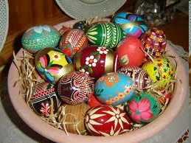
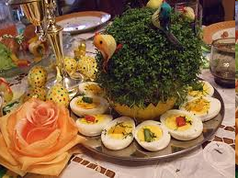
loooots of eggs (also these which were blessed in the Easter baskets)

Slide 32
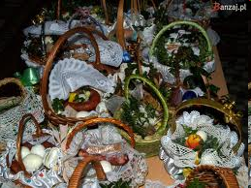
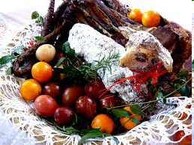
Baskets containing a sampling of Easter foods (eggs, bread, salt, sausage, horseradish) are brought to church to be blessed on Holy Saturday.

Slide 33
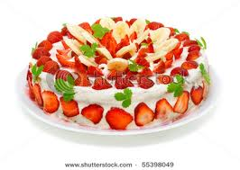
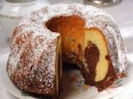
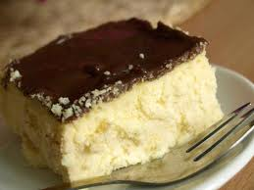
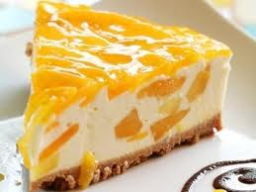
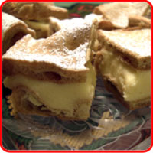
and cakes, i.e. chocolate cake, mazurek cake, cheese cake etc.

Slide 34
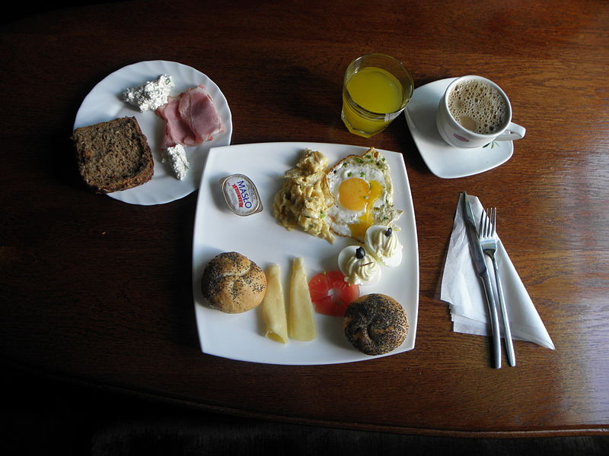
Everyday breakfasts, lunches and suppers are more modest, they usually consist of sandwiches ☺

Slide 35
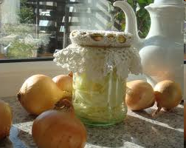
Syrop z Cebuli - A cough remedy made of chopped onion and sugar; although it is very tasty, it is still considered a medicine

Slide 36
The end
source: wikipedia.com

