Slide 1
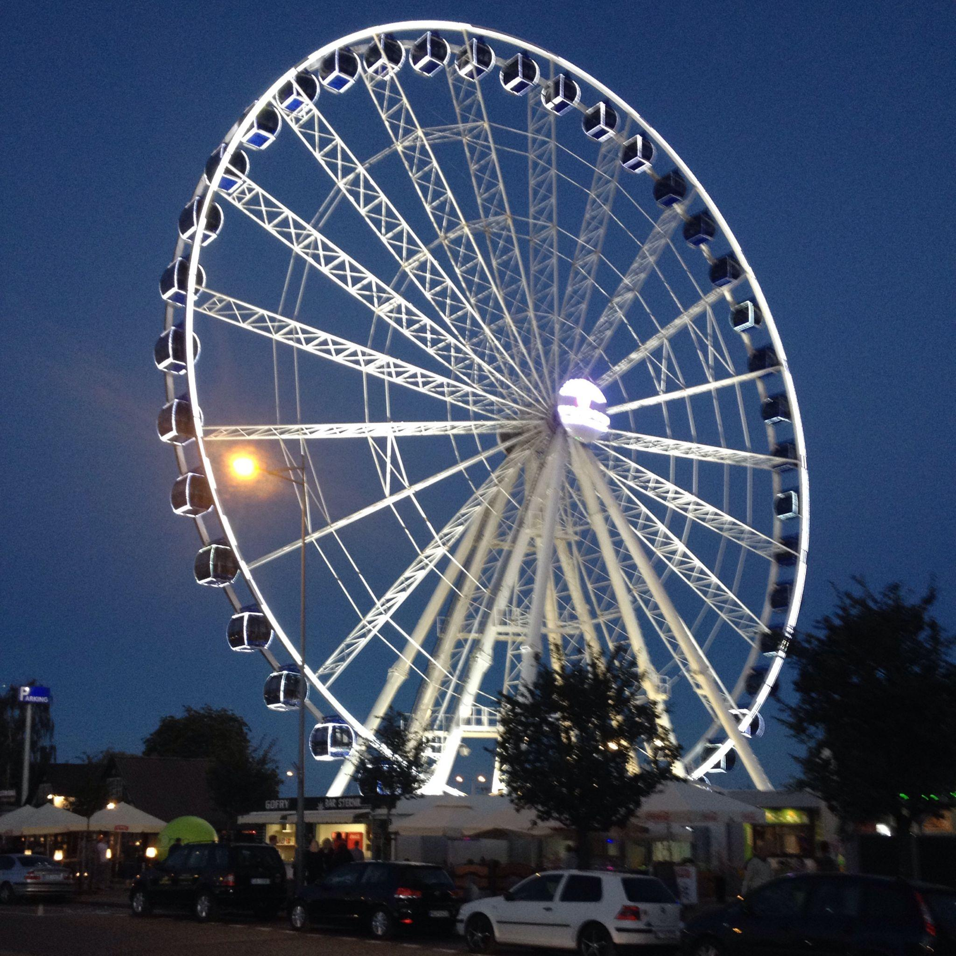
Buildings in Poland
by Zofia Wełna

Slide 2
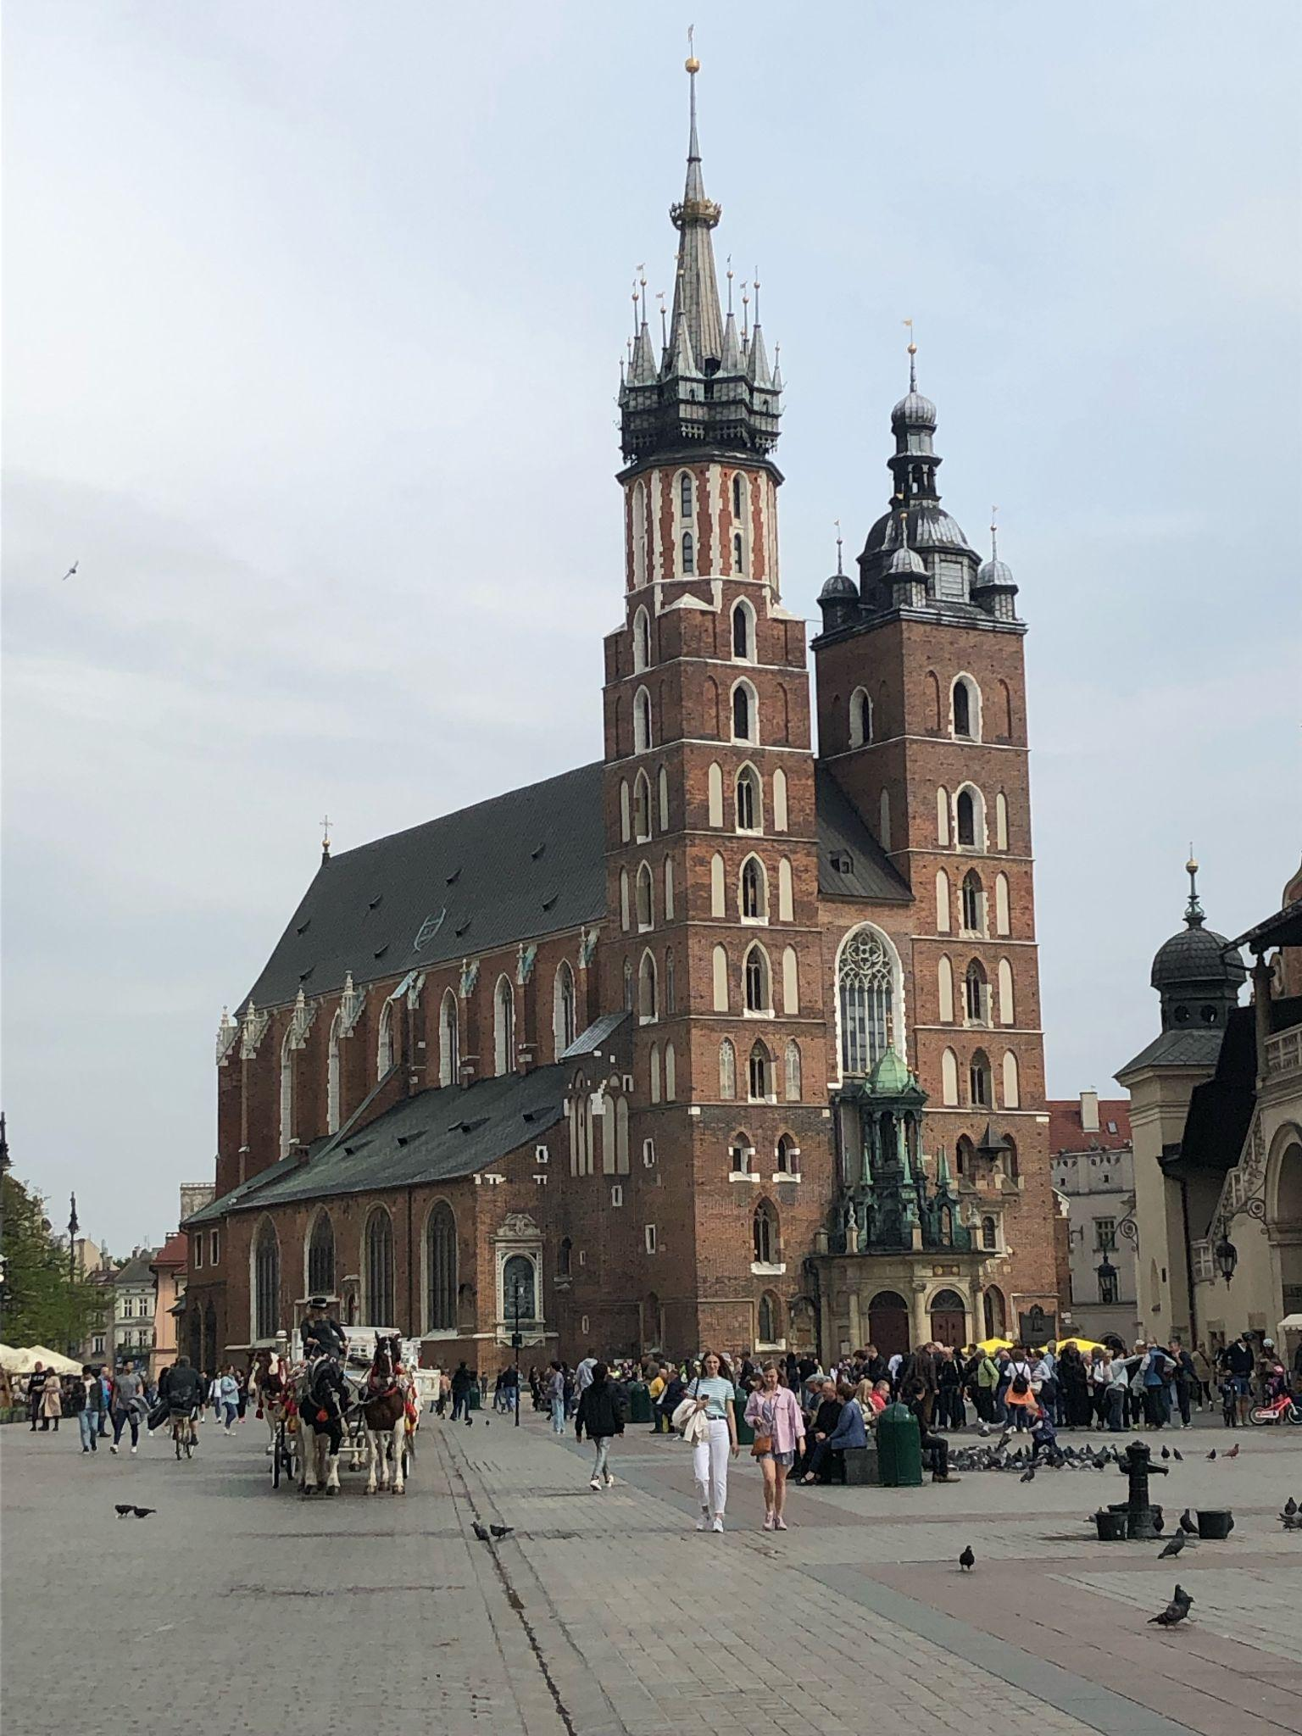
St. Mary's Church in Kraków
St. Mary’s Church in Kraków was built in 1222.
This church was renovated many times for various reasons.
It is commonly used as a monument where important church events are held.

Slide 3
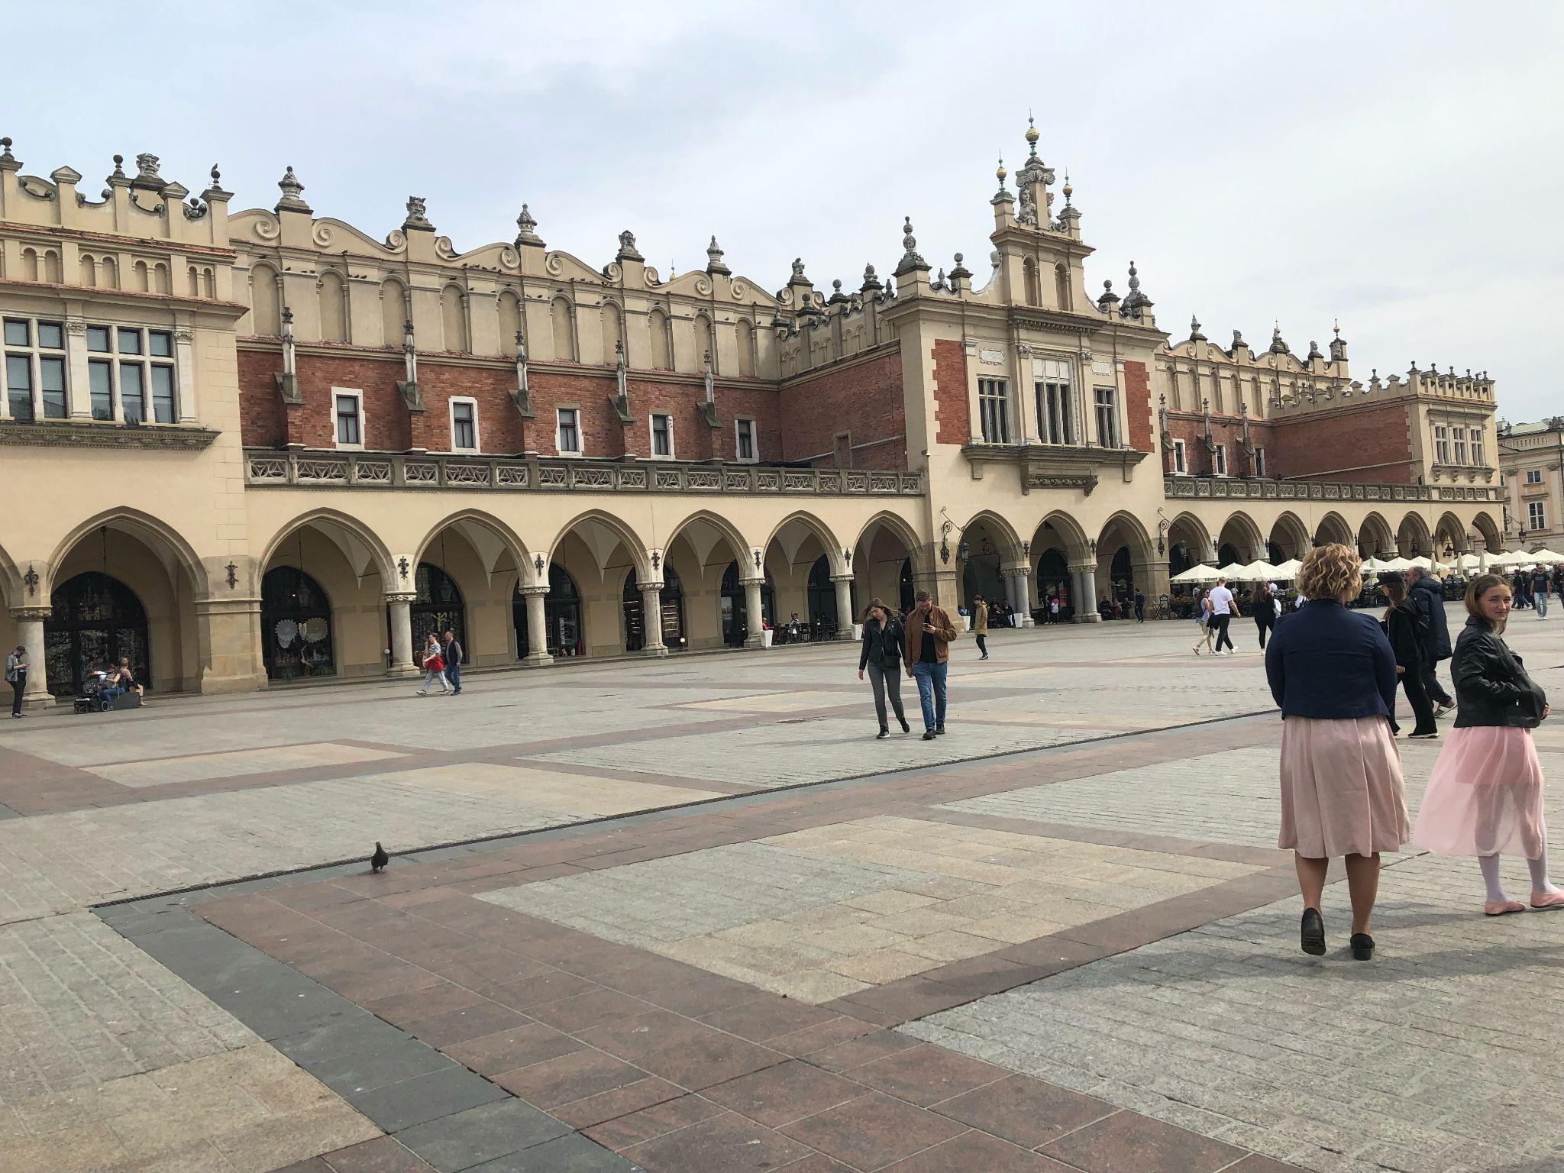
Cloth hall in Kraków
Cloth hall was built in 1358.
In the past, there were about 18 stalls in the cloth hall, where people traded goods.
Today, in the Cloth Hall, there are two rows of stalls, the main ones with jewelry, souvenirs and handicrafts.

Slide 4
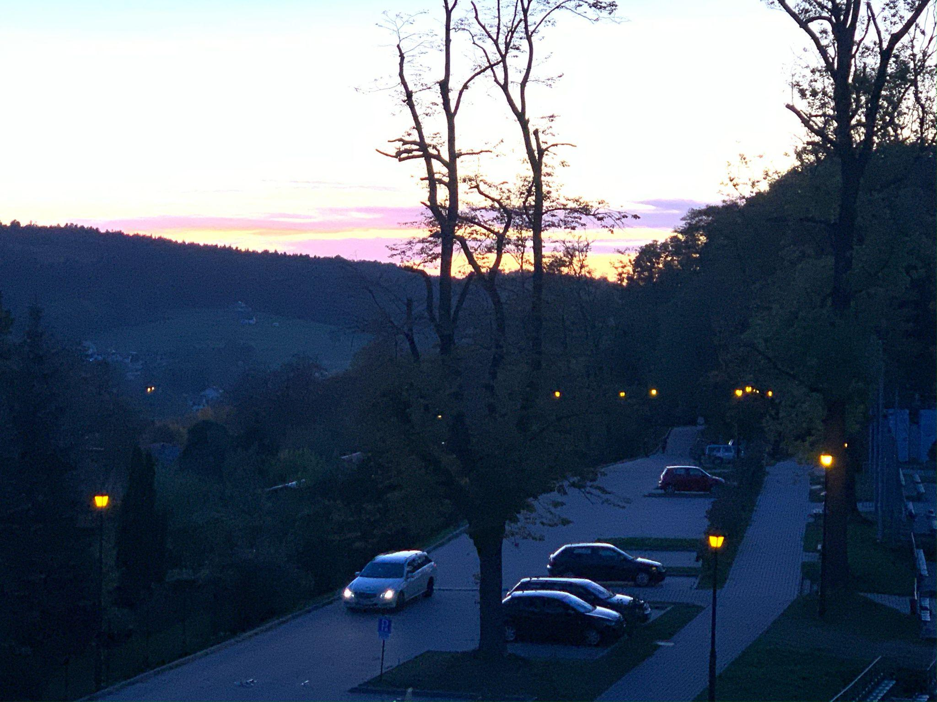
Uzbornia Family Park
Formerly, gypsum was mined on the Uzbornia. After almost a hundred years, gypsum mining was completed. Since then, there is a gypsum street at Uzbornia.
Now Uzbornia has become a family park.

Slide 5
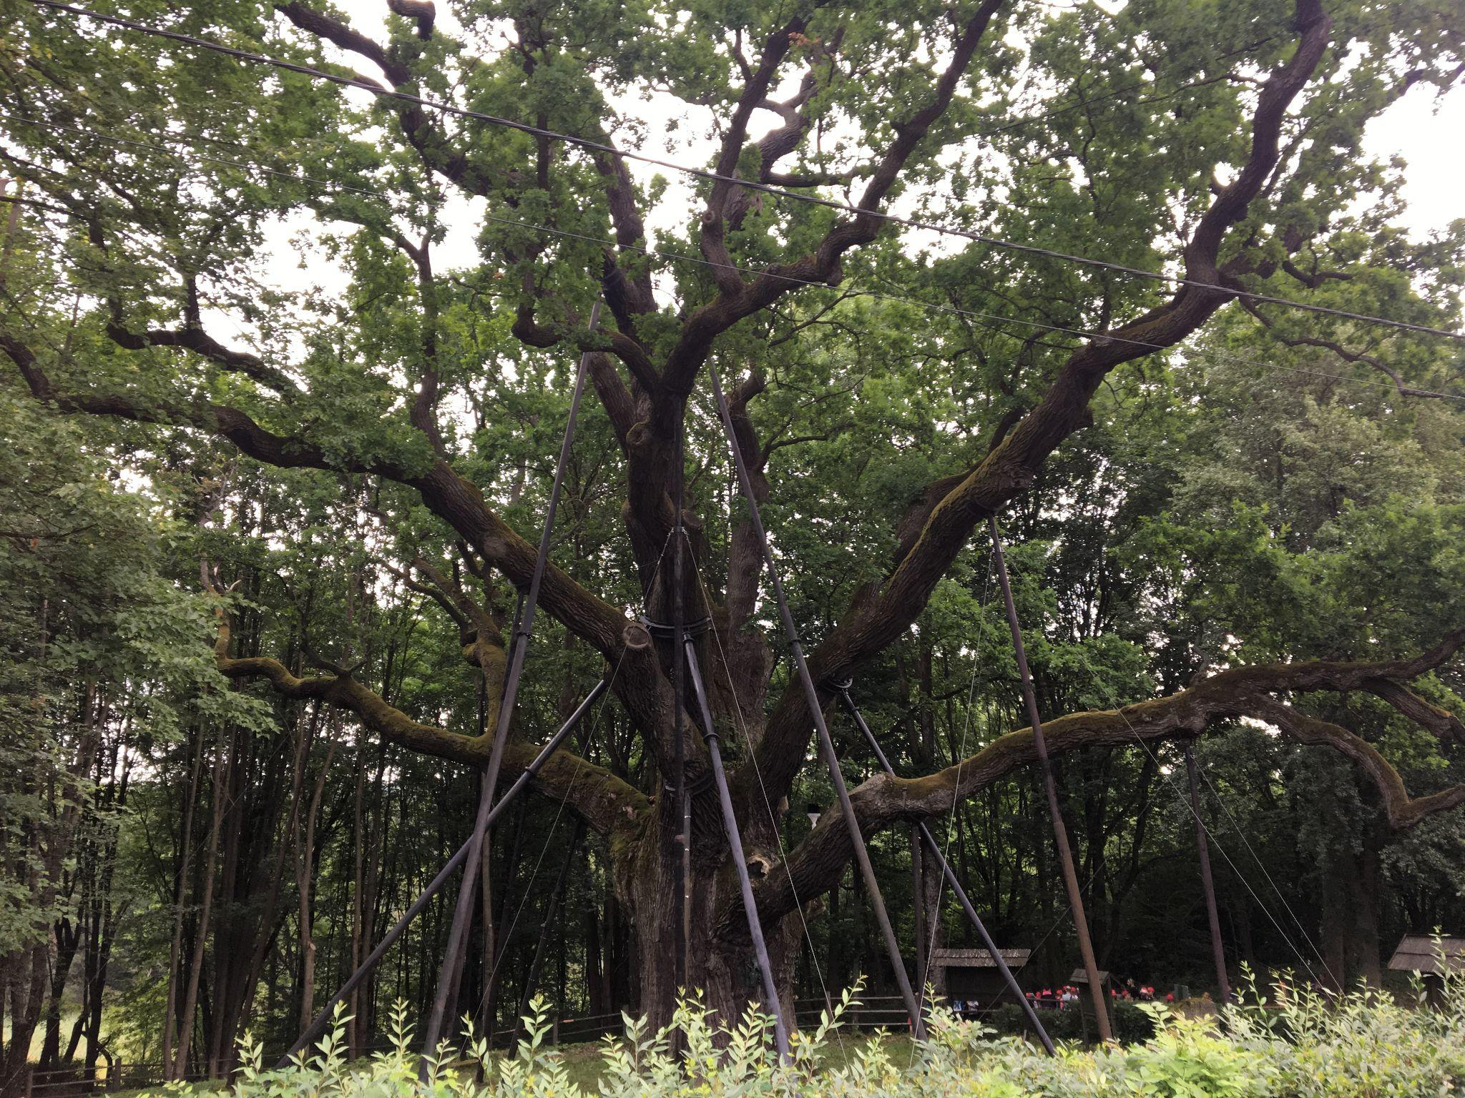
Bartek Oak
Bartek Oak is the oldest tree in Poland. Its age is estimated at 645-685 years. This tree is about 30 meters high. Lots of people want to see tree like this. Everyday school trips come to admire this tree.

Slide 6
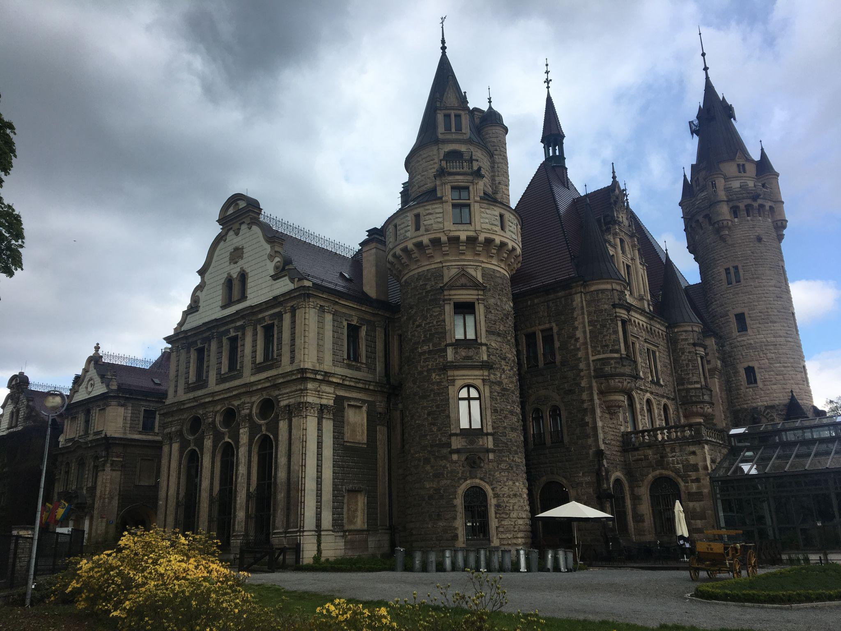
Castle in Moszna
Castle in Moszna was built in 1896. Formerly this building was a castle, but now it has become a 4-star hotel.

Slide 7
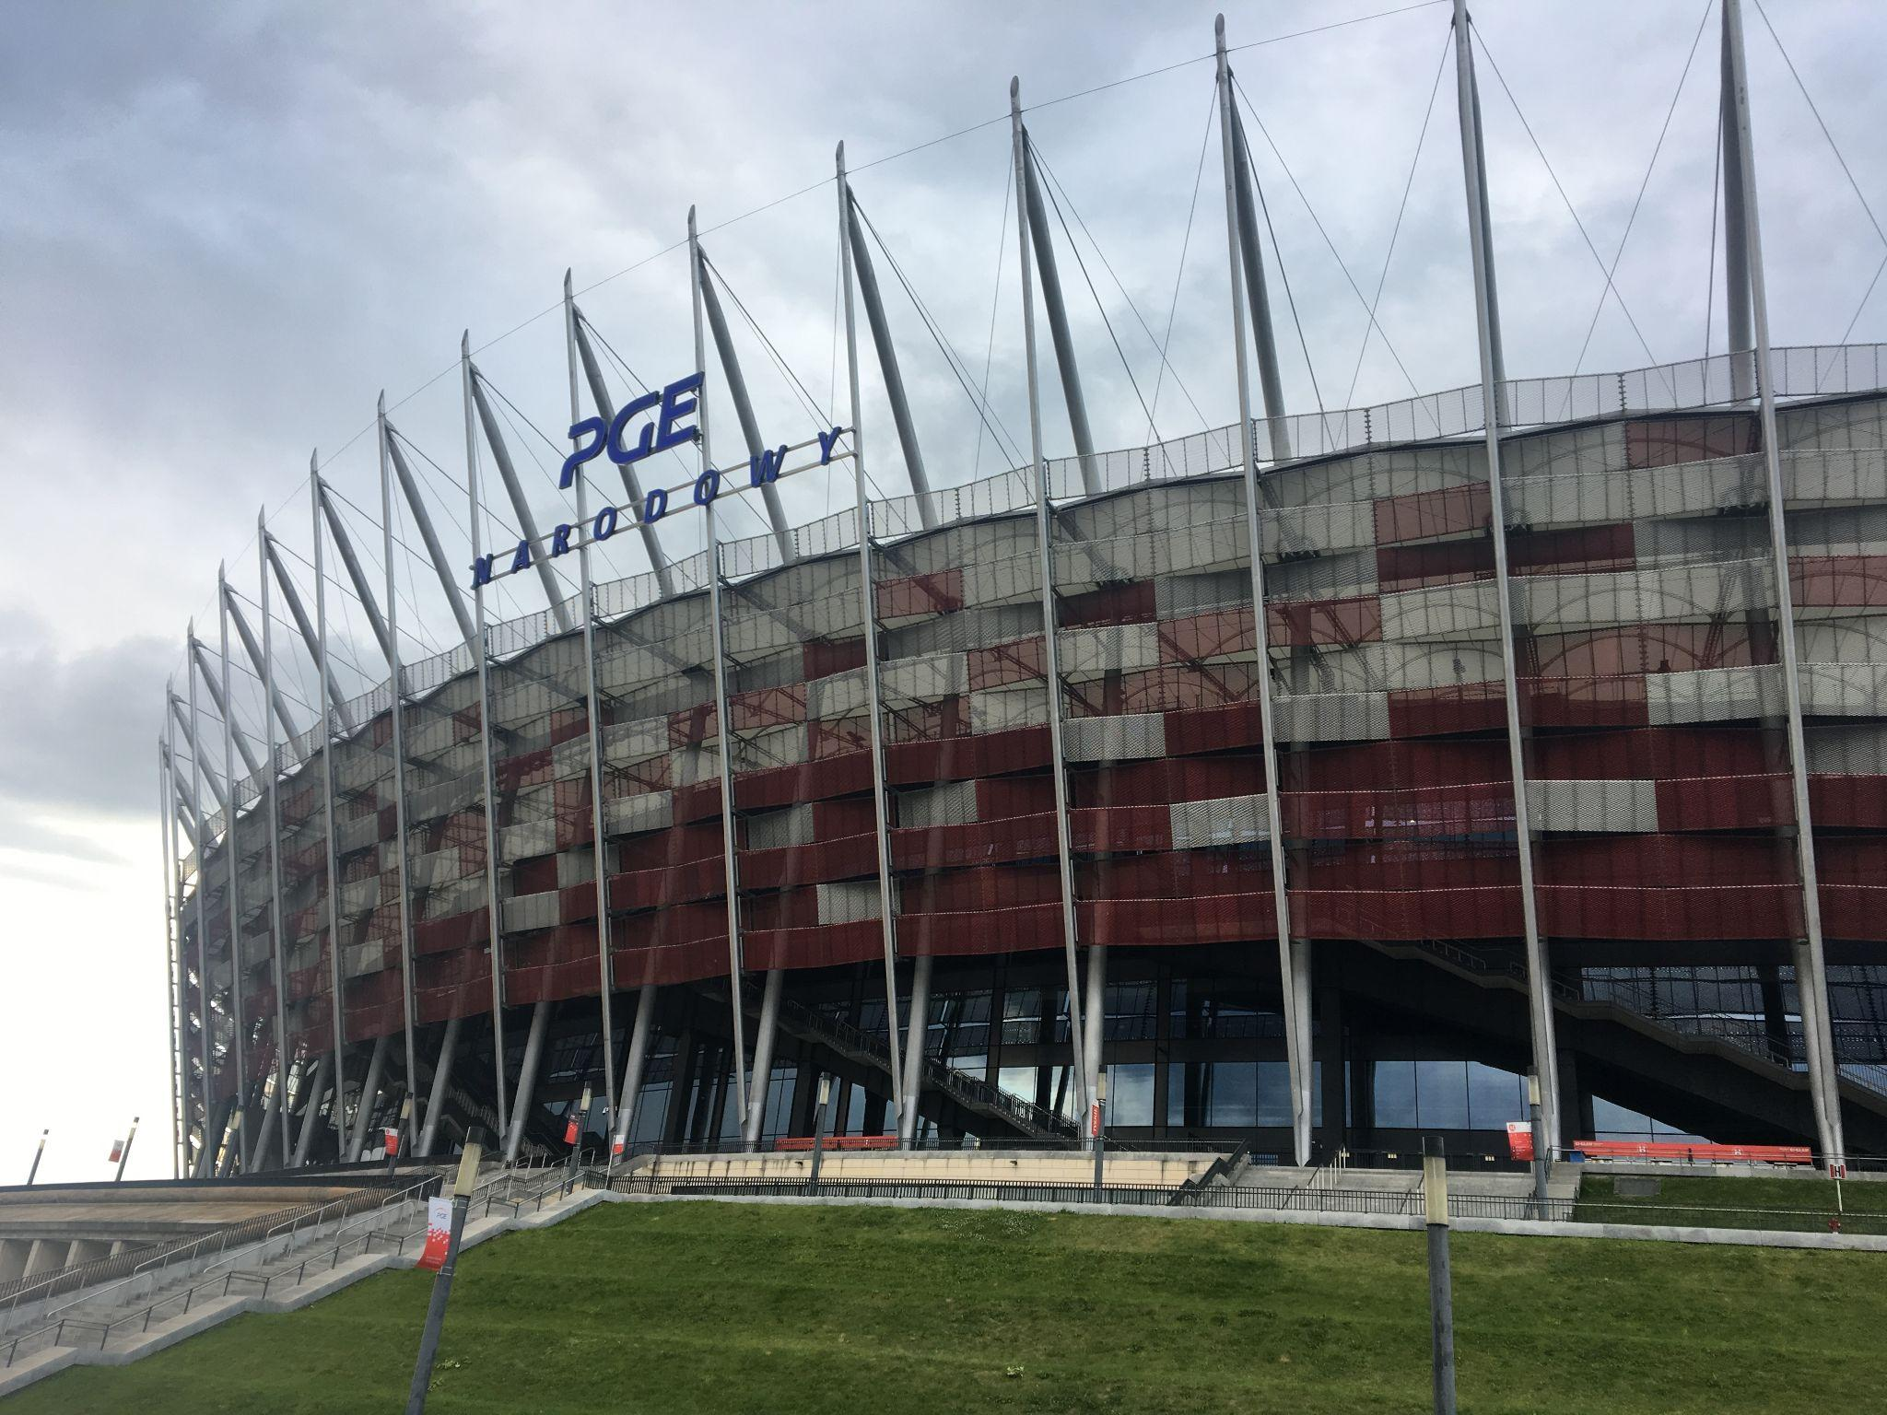
National stadium in Warsaw
National stadium in Warsaw was built in 2012.
It is a place where sports events are organized (for example - football matches).

Slide 8
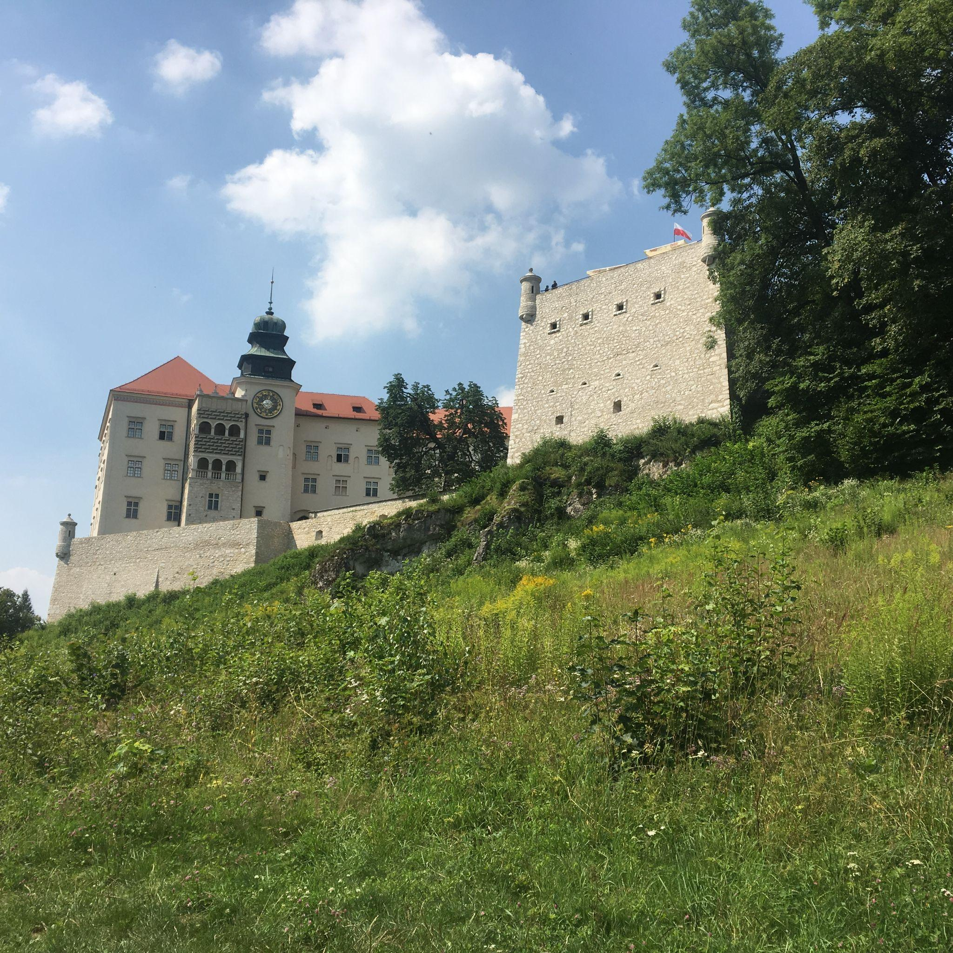
Castle on Pieskowa Rock
Castle on Pieskowa Rock was built in 1315.
After some years, this castle was expanded and became a magnate residence.
It has recently become a museum that is visited by a large number of tourists.

Slide 9
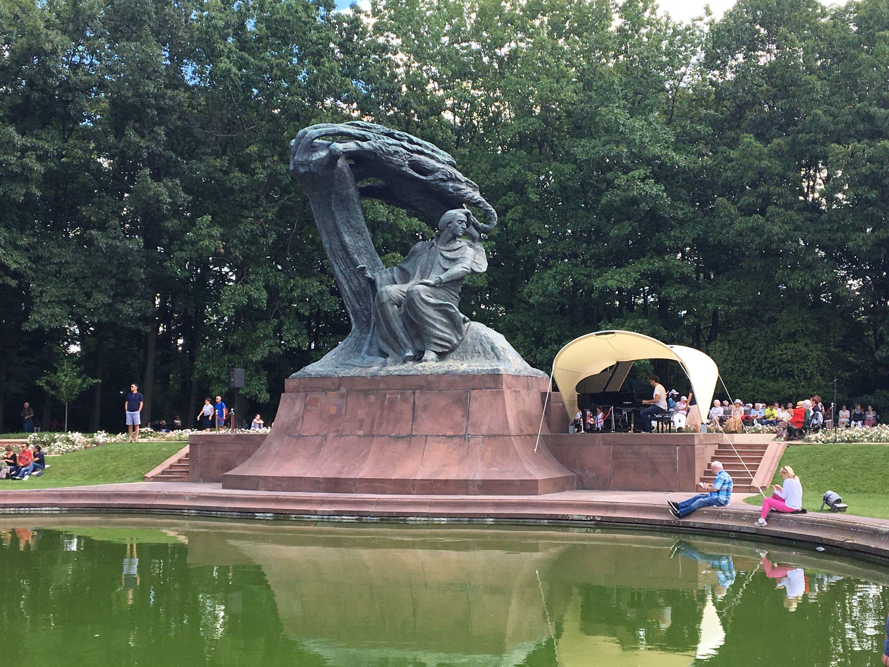
Frederic Chopin Monument in Warsaw
The Frederic Chopin Monument in Warsaw was established in 1926. A musical instrument competition is organized next to this monument.
While taking a picture, I came across a few shows playing the piano.

Slide 10
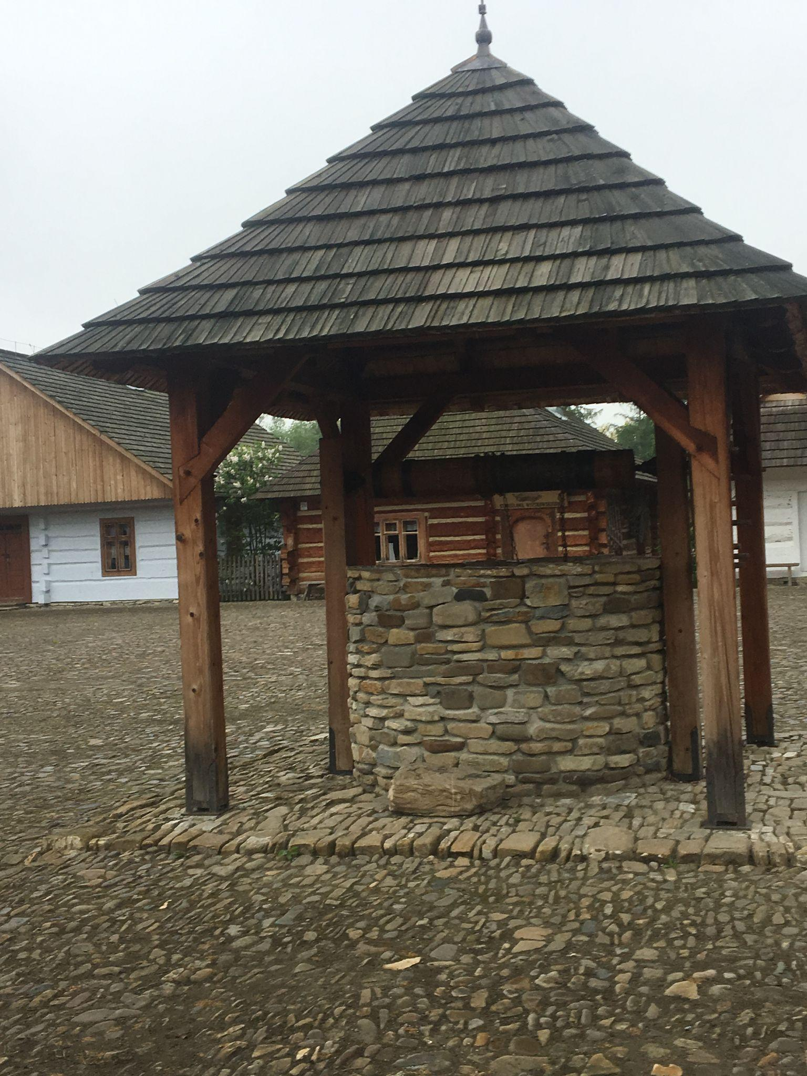
Open-air museum in Sanok
Open-air museum in Sanok was built in 1958. The first sightseeing objects were opened in 1966. The open-air museum in Sanok is full of tourists to this day.
You can see how the peasants used to live in Poland about 1600.

Slide 11
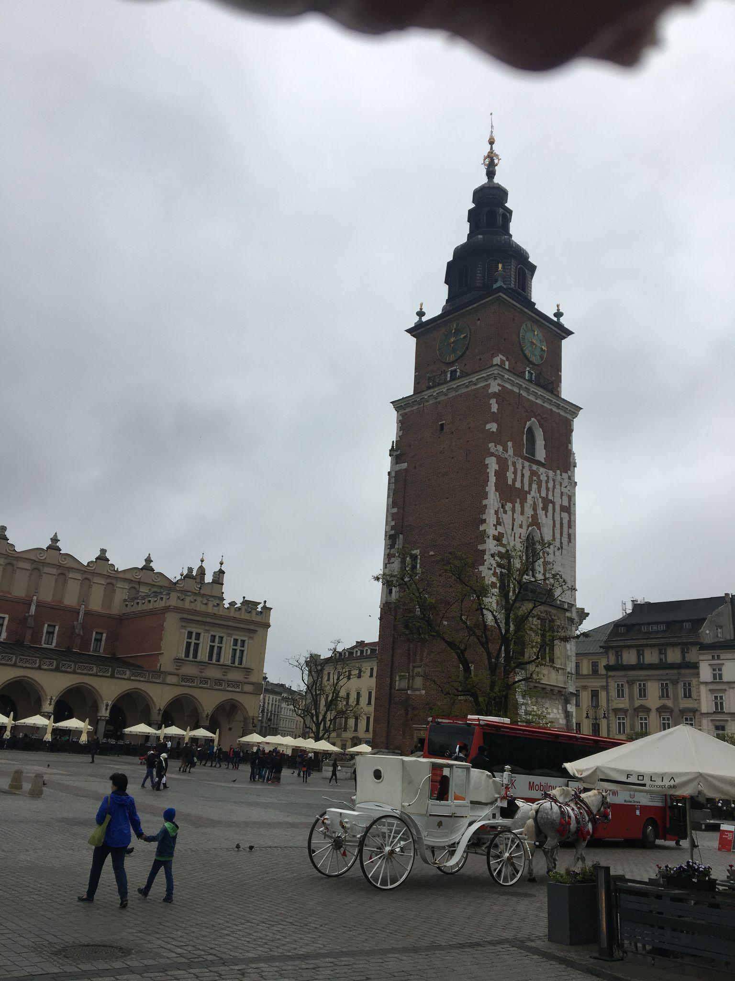
Town Hall Tower in Kraków
Town Hall Tower in Kraków was built in 1300. In front of the tower there was the town hall where the mayor used to work, there was a juror's court, a chancellery and an archive. There were dungeons and a torture chamber in the basement of the tower and the town hall. Unfortunately, in 1820 the town hall was destroyed and only the tower with the treasury remained. The Maszkaron theater was opened in the basement, providing a stage here. Currently, performances of the Folk Theater are on show.

Slide 12
Thank you for your attention
:)

