Slide 1
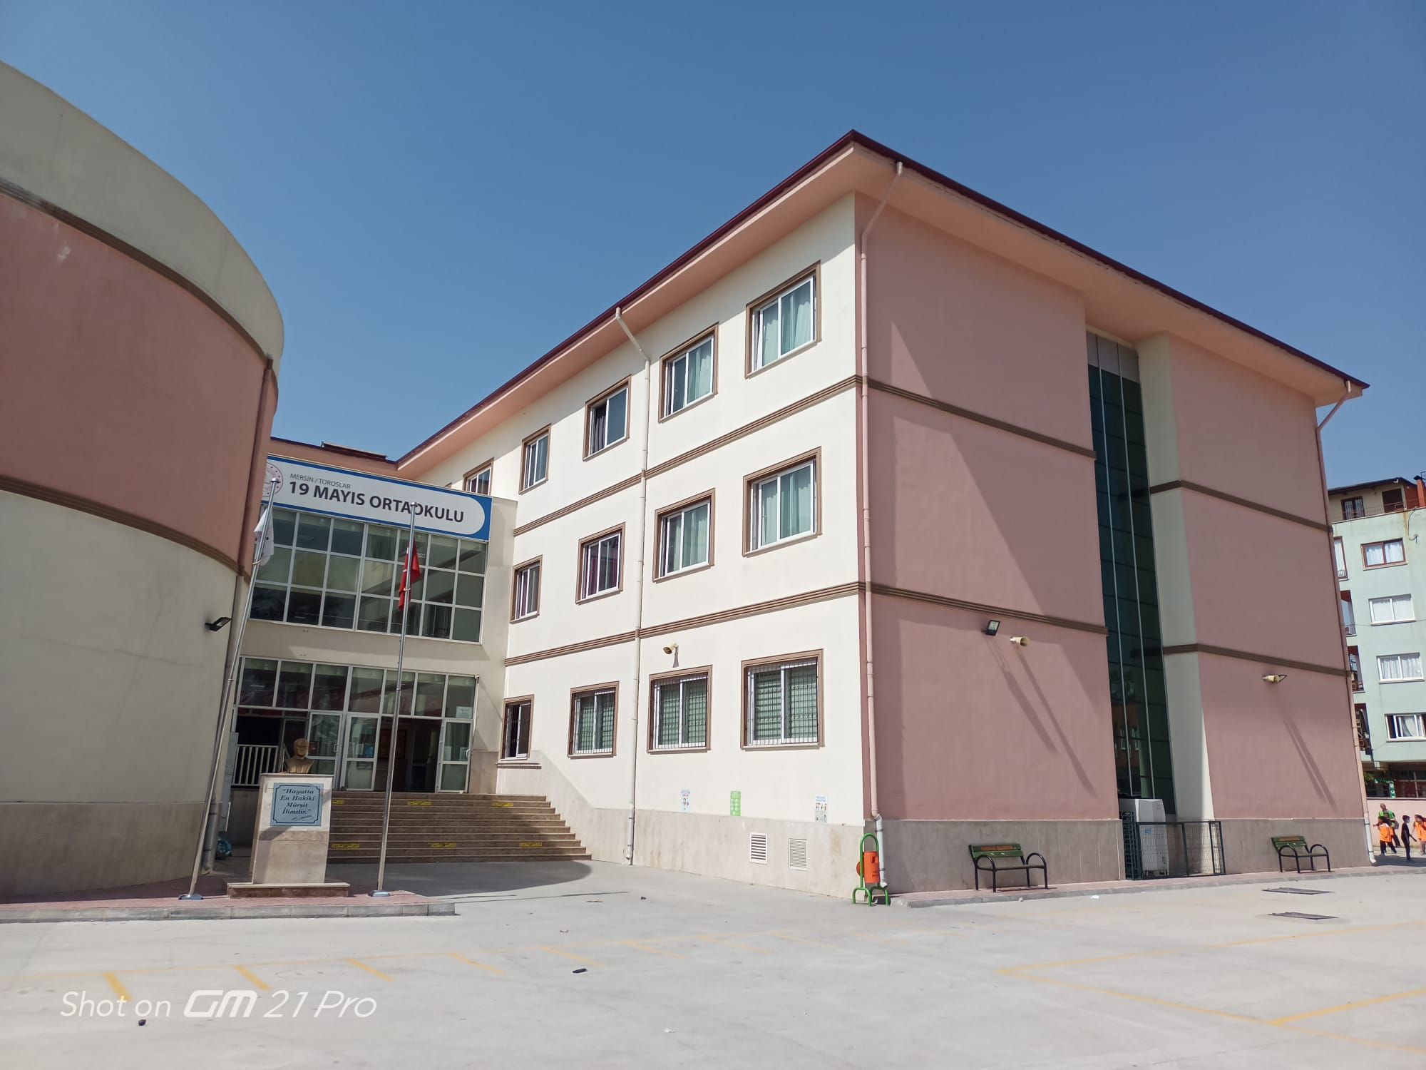
19 MAYIS MİDDLE SCHOOL

Slide 2
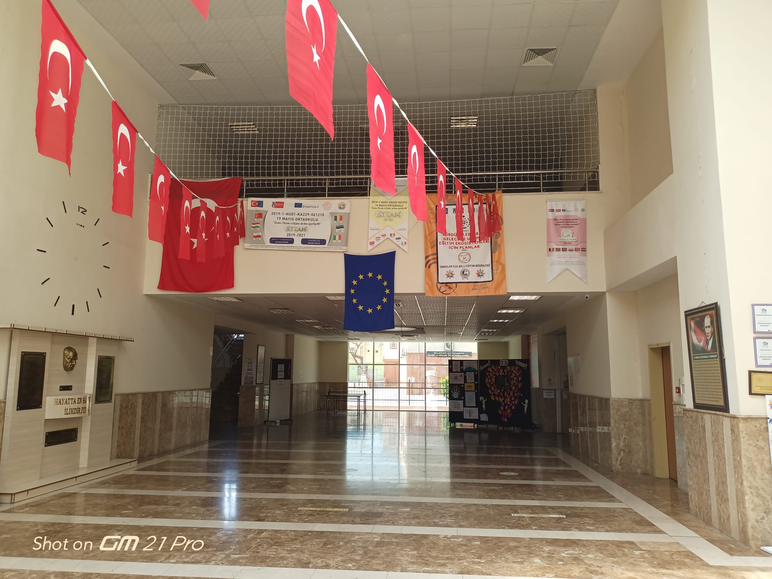
Entrace of our school

Slide 3
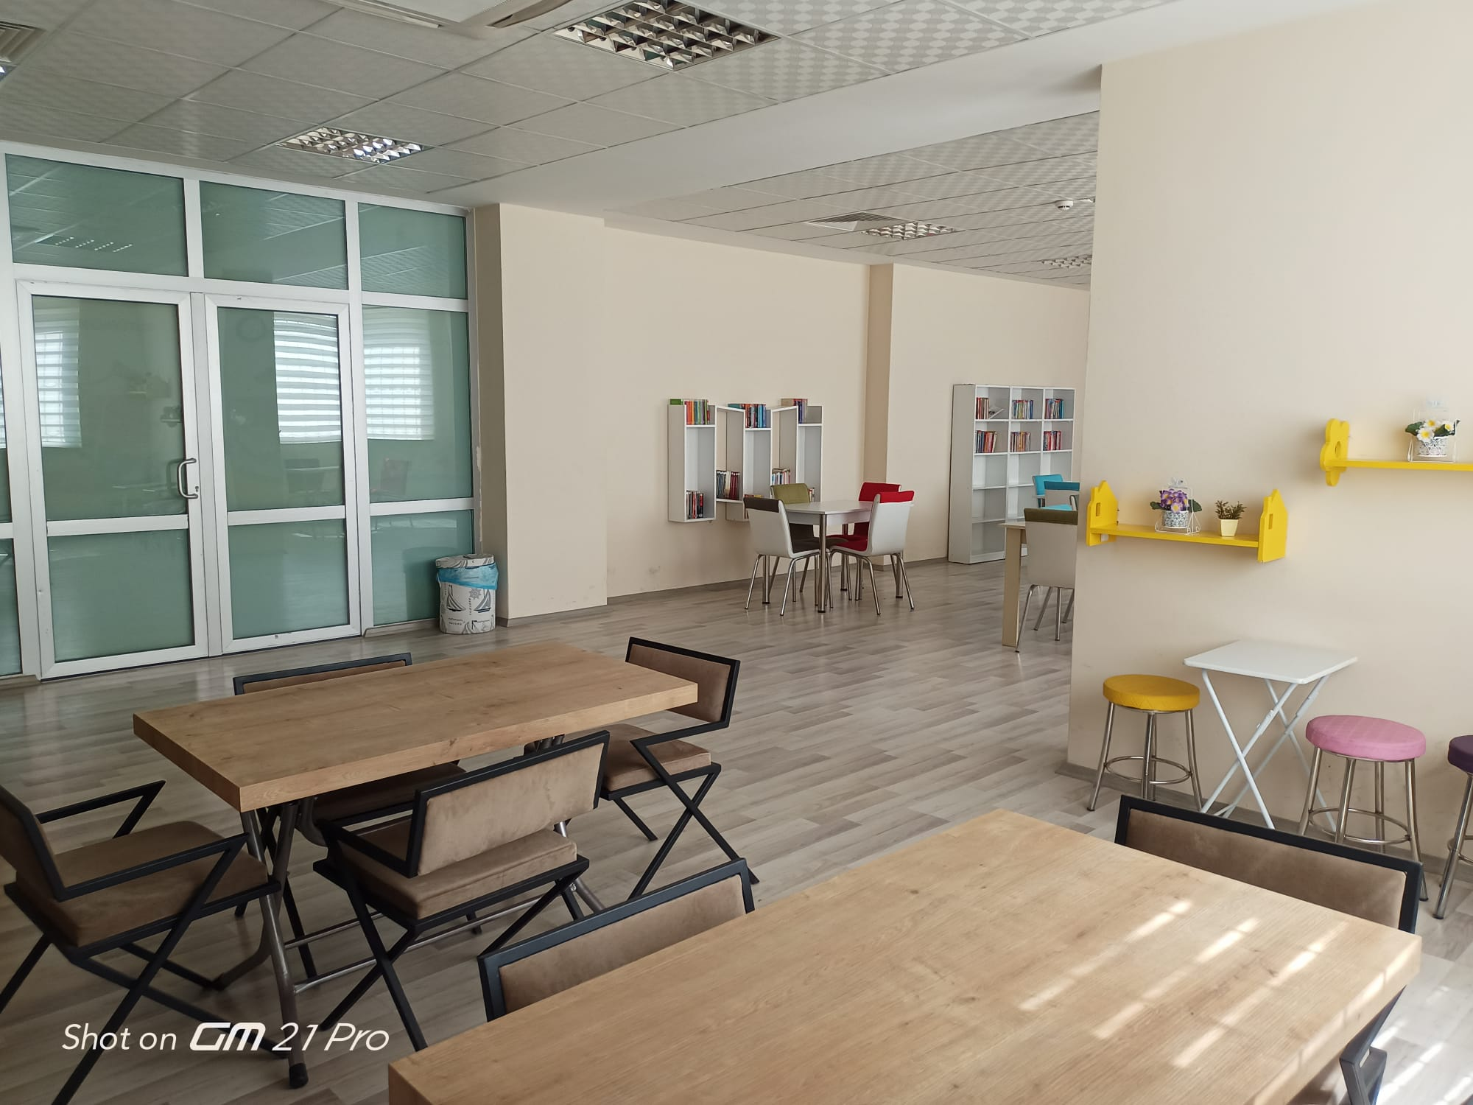
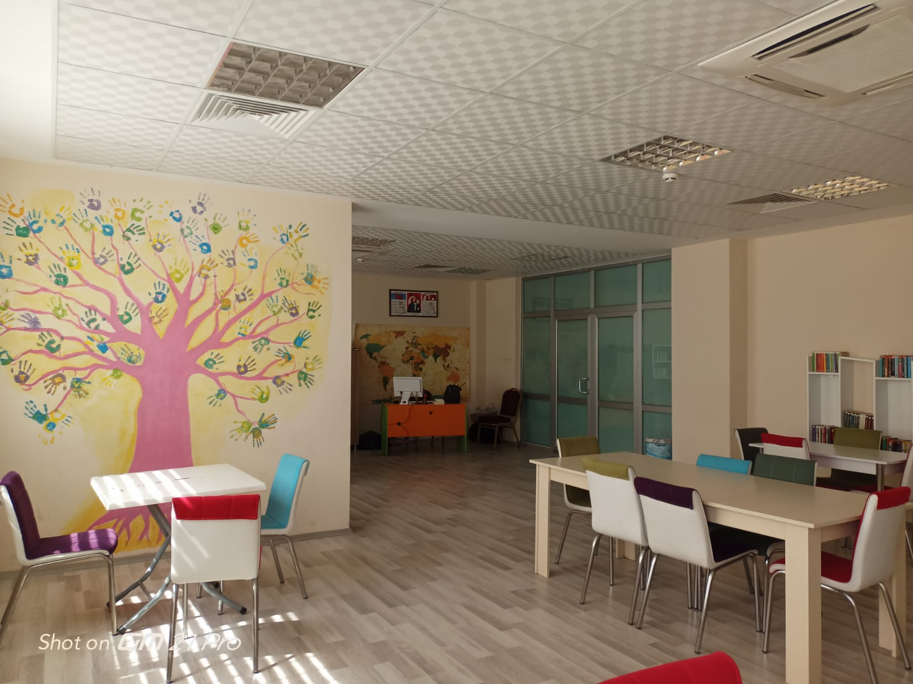
This is our school library. we usually use this place in Turkish lesson

Slide 4
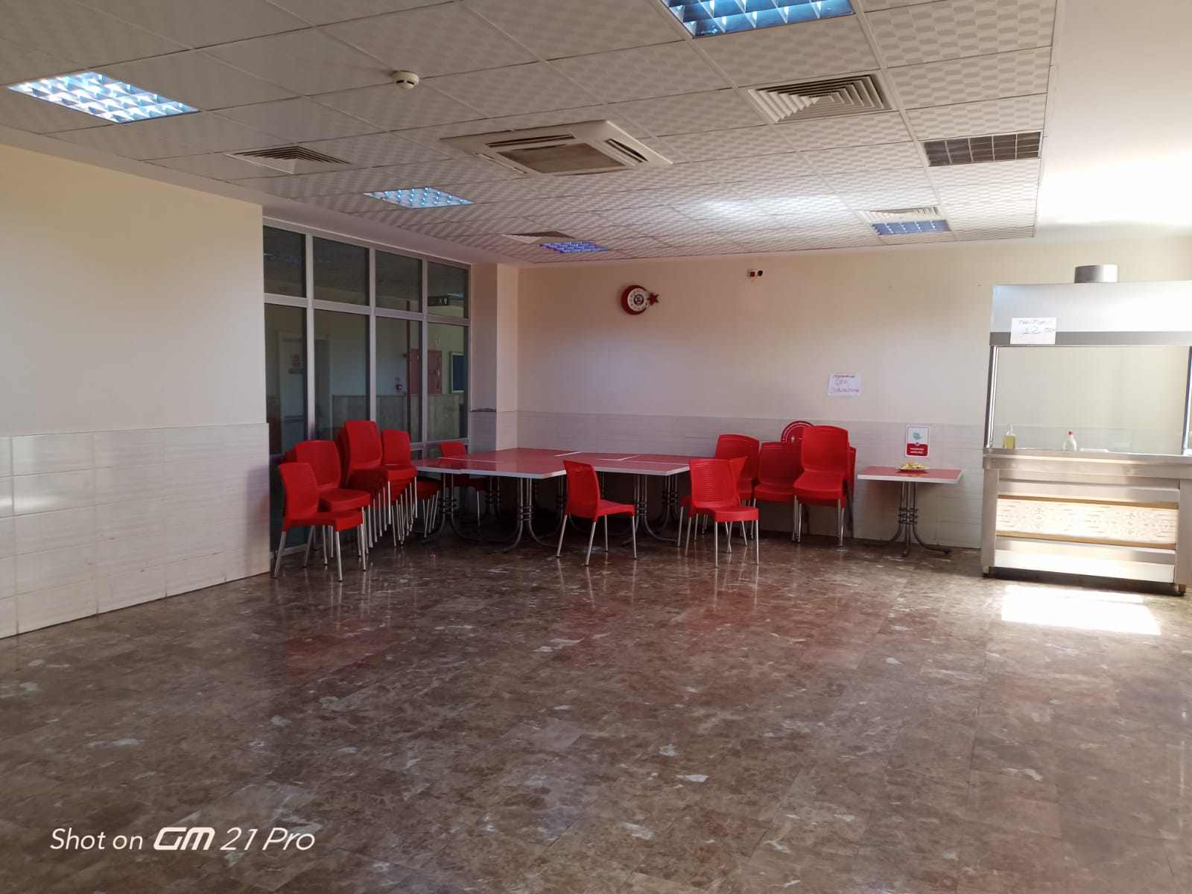
This is our school canteen

Slide 5
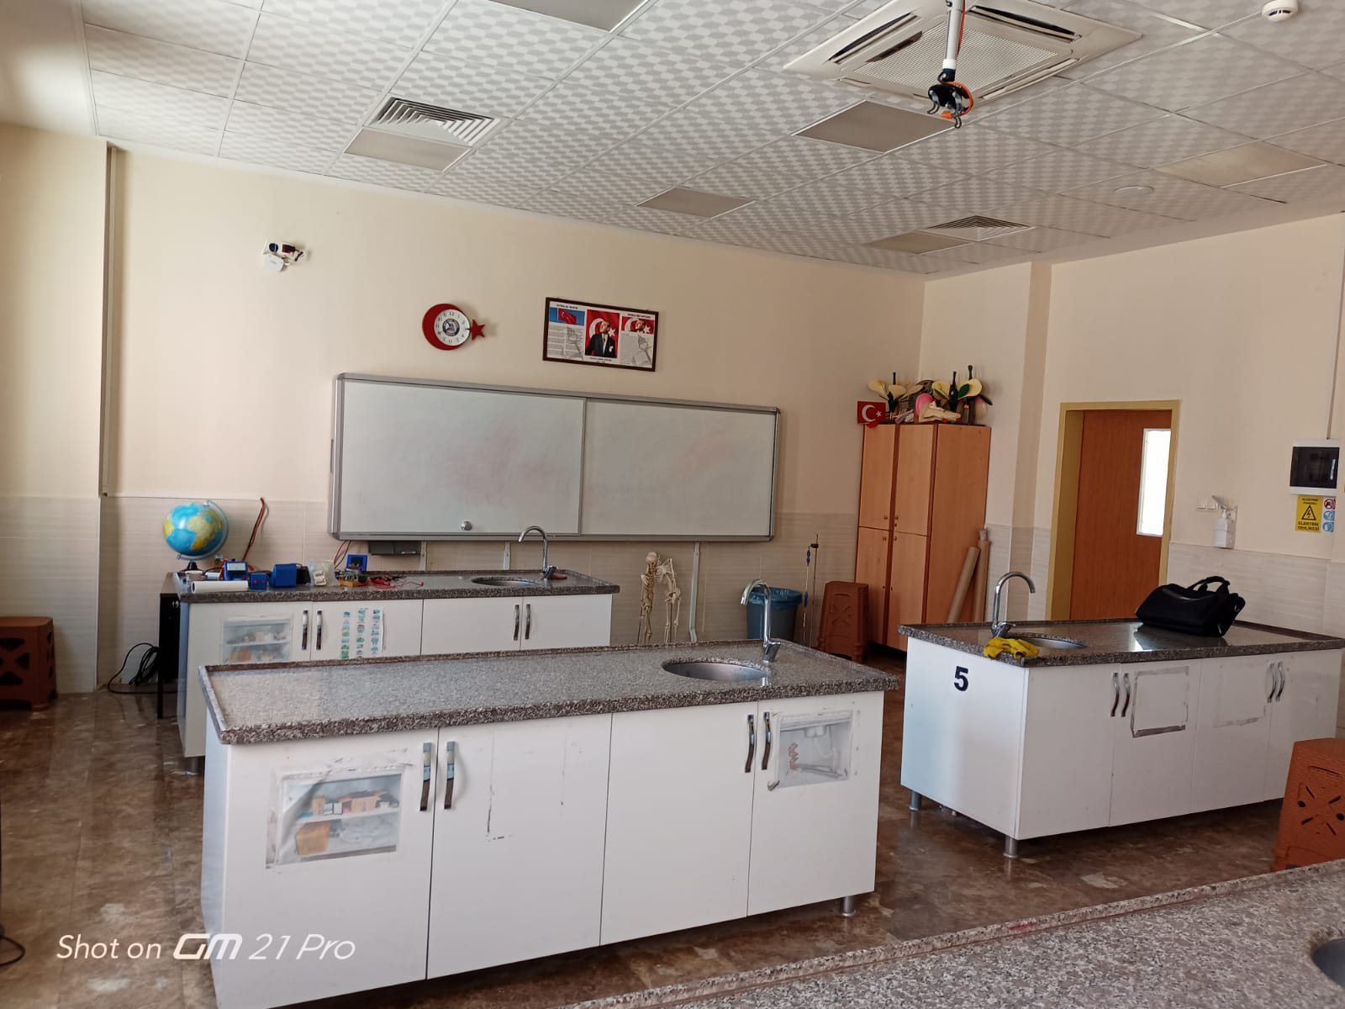
This is our science lab. we usually experiment here

Slide 6
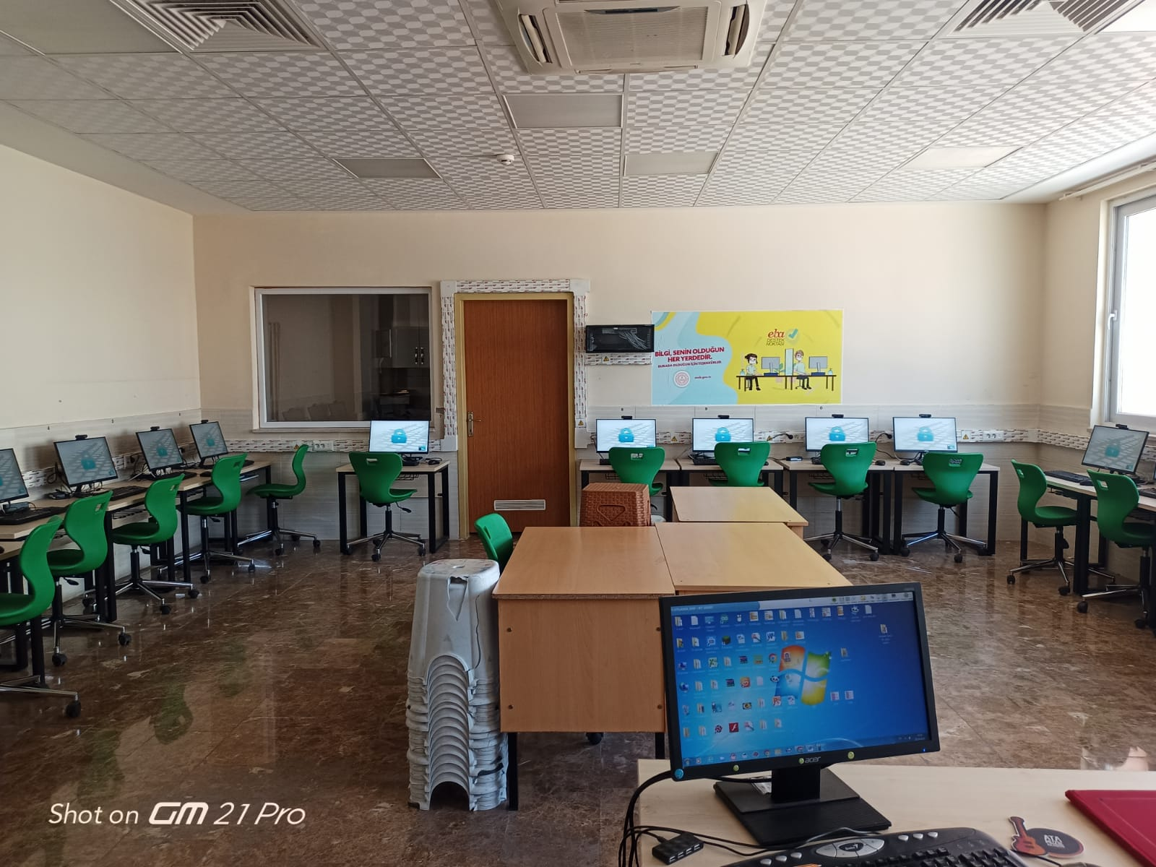
This is our IT classroom. only 5th and 6th graders use this place

Slide 7
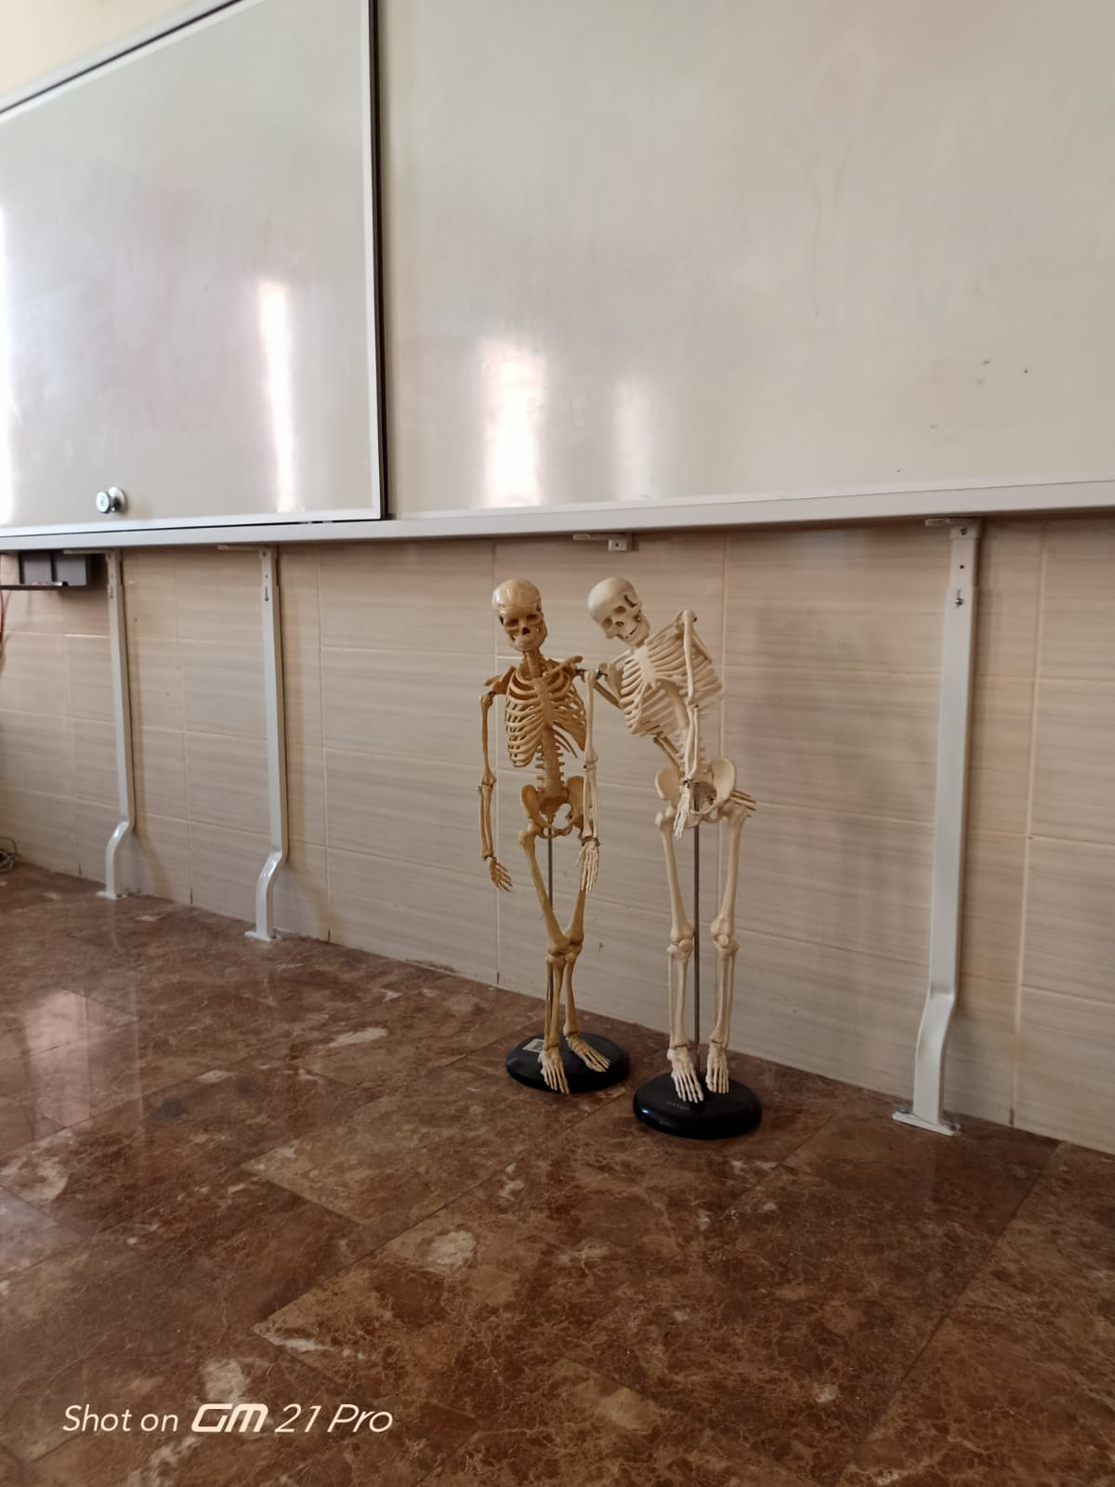
Thank you for watching us :)
Şeyda 7/C Bilge 7/E

