Slide 1
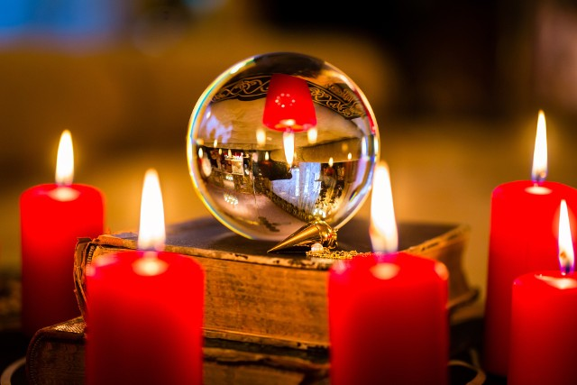
„Andrzejki (St. Andrew’s Day)” and „Katarzynki (St. Catherine’s Day)”

Slide 2
If you are a single, unmarried woman or a bachelor in Poland on the night of November 29, you have a unique opportunity to learn more about your future. St. Andrew's Day (Andrzejki) has been associated with fortune-telling in Poland for centuries. The first written record of the tradition dates back to 1557. Today, there are few people who believe in such signs, but St. Andrew's Day is still an opportunity for fun, dancing and social gatherings.

Slide 3
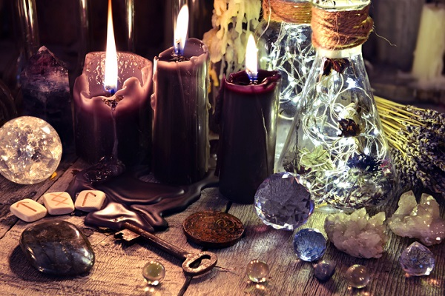
St. Andrew’s Day
It is a fortune-telling evening, which is usually organized on the night of November 29-30 - on the eve of St. Andrew’s day.

Slide 4
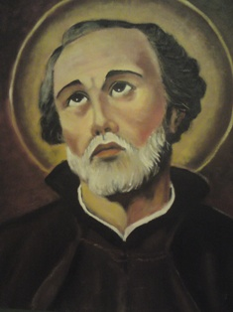
Who was St. Andrew?
St. Andrew was one of the 12 apostles.
He is the patron of:
Slavic nations, married couples, travelers, fishermen, knights and lovers. Helps with prayers for offspring and brings couples together.

Slide 5
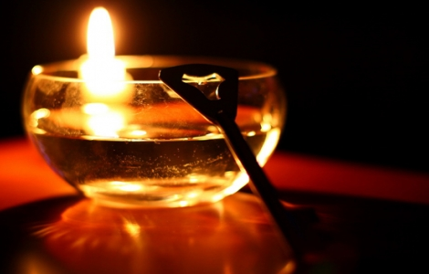
St. Andrew’s Day
St. Andrew's Day is the perfect occasion to organize the last big parties just before Advent (which lasts until Christmas and is a period of fasting). It is true that people no longer believe in the fortune telling, but it is the highlight of every party and people in Poland love to hang out on that day and have fun.

Slide 6
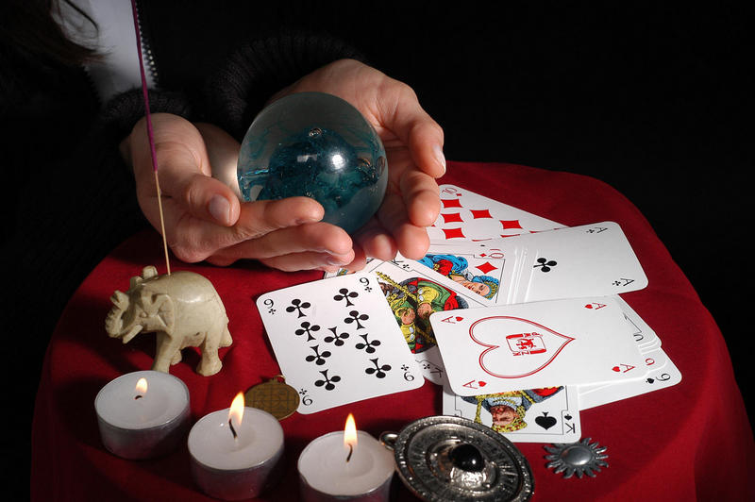
Examples of the most famous fortune-telling on St. Andrew’s Day

Slide 7
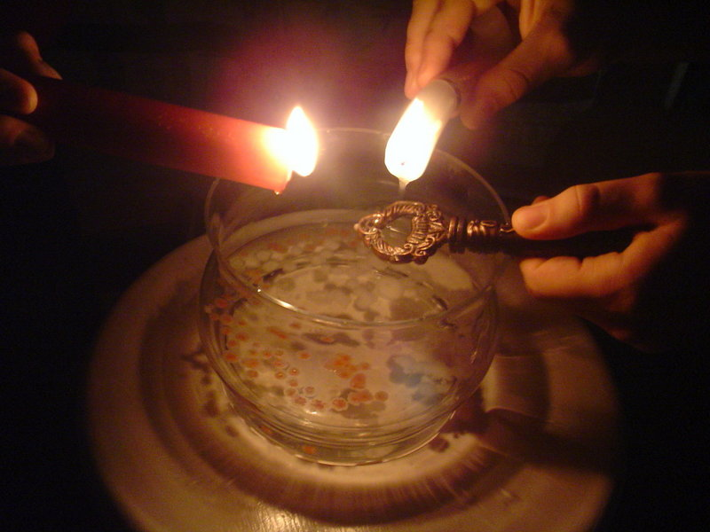
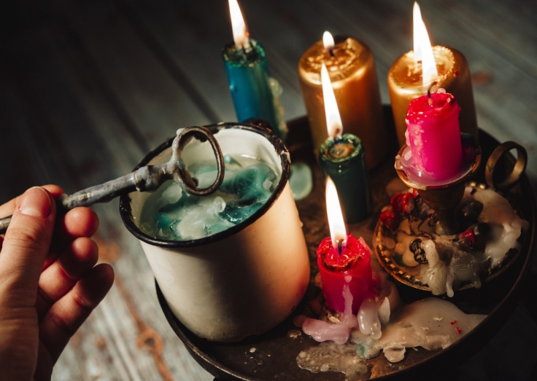
Wax melting.
In the most popular tradition of St. Andrew's Day we use hot wax as a glimpse into the world of ghosts. The wax must be melted and then poured through the eye of a skeleton key into a bowl of cool water. Then, it is held in front of a light and the shape reveals the future.

Slide 8
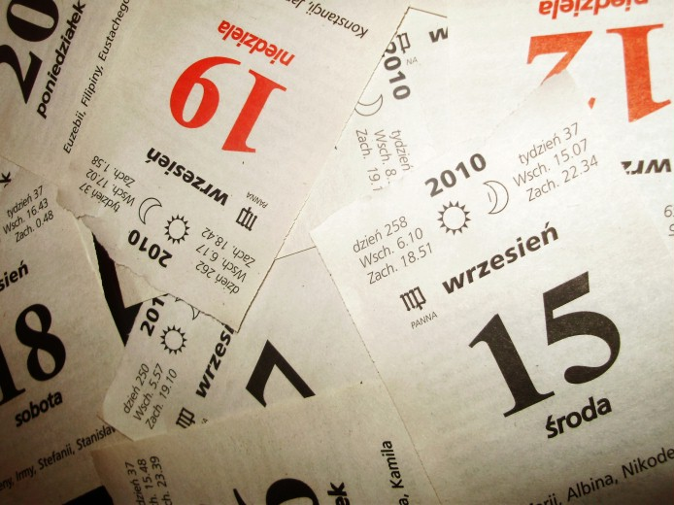
The name of the beloved – way number 1
The first way to get to know the name of your beloved is flipping the pages of a calendar with closed eyes. Stopping on a piece of paper with the name – reveals the name of your future husband.

Slide 9
The name of the beloved – way number 2
Cut out from paper a large heart. Overleaf, write the names of men. Close your eyes and puncture heart with a pin anywhere – then turn the heart upside down and check your future husband’s name.

Slide 10
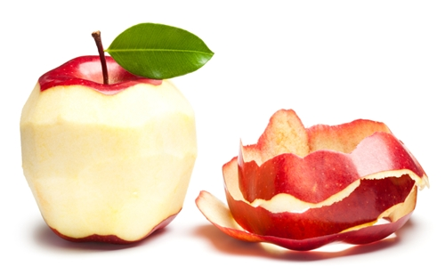
The name of the beloved – way number 3
Equally popular is the divination with the peel of an apple. Try to peel the apple to make the longest peel. Then each person throws the peel behind the back. In the shape of a peel girls look for the shape of the letter - this is the sign of the first letter of beloved’s name.

Slide 11
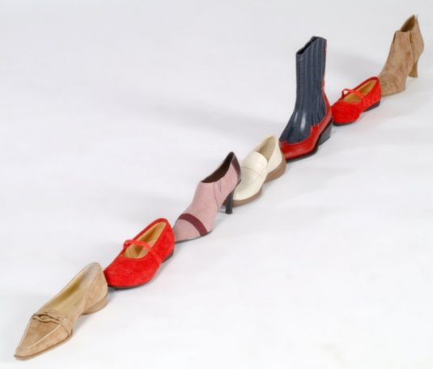
Shoes
It's probably one of the most famous divinations. Women take off one shoe and begin to set them up in one line. Then shoes are reordered - always in the same combination. The one whose shoe will pass the threshold first- will be married soon.

Slide 12
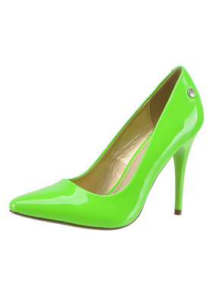
Shoes
There is one more prophecy related to shoes. The woman takes off her shoe and throws it over her left shoulder behind her. If it falls pointed towards the door, it means "leaving the house", that is, getting married, if the opposite - it is not time to think about getting married.

Slide 13
The spinning bottle
The girl who organizes the St. Andrew's party puts cards with divination around. Each meeting participant turns the bottle in the center of the circle, drawing a divination for oneself. People say they usually come true ... ;-)

Slide 14
Colours
In this fortune-telling you should close your eyes and draw one piece of paper with a color. Each color has a different meaning:
blue - crazy success in love and finances
white - joy and quiet days
green - fulfillment of the innermost dreams
red - nice meeting and fun
orange - reconciliation with the beloved
yellow - a rival in love, ready for anything
grey - you have to learn more.

Slide 15
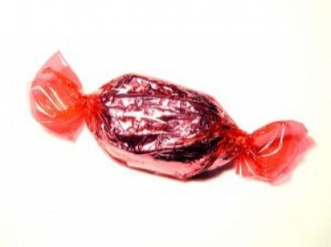
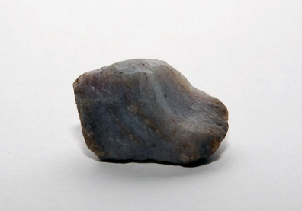
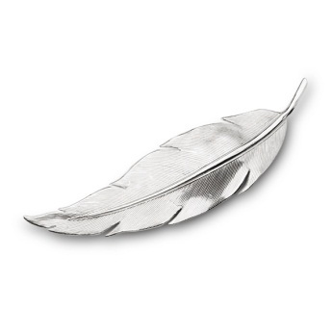
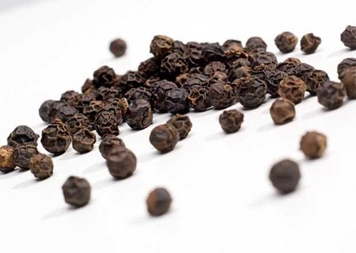
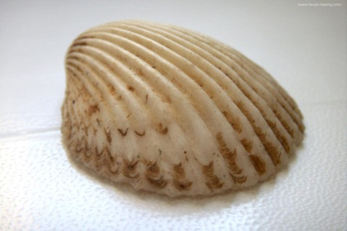
Divination with plates.
There are objects hidden under the plates:
a candy, feather, a grain of pepper, shell, pebble.
The girl chooses one plate not knowing what is under. Each item has a different meaning:
Candy - a sweet and happy life
Feather - life is light and pleasant
A grain of pepper - an adventurous life
Shell - life at sea or in a distant country
Pebble - a busy and useful life.

Slide 16
Blots
It is a fortune-telling similar to a wax one. But for this divination you will need a piece of paper and paint or ink. Fold it in half, then unfold it so that you can see the bend. In the center of the sheet, where the fold is, we make a stain. Fold the paper with the stain firmly and press it. Then, unfold the sheet of paper and observe the shape. It will show something linked to your future life.

Slide 17
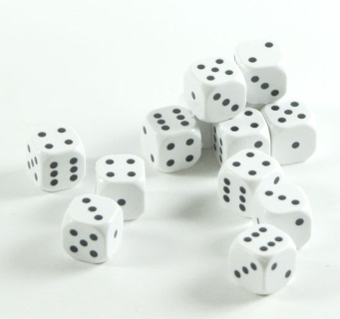
A magical dice.
For this divination you need 3 dice and a cup. Put the dice in the cup and shake it - each number of dots has its own meaning:
Three - happiness, a dream will come true
Four – a surprise
Five - you will soon meet the love of your life
Six - your friend will give you a gift soon
Seven – there is a party ahead of you
Eight - listen to the advice of friends
Nine - you will meet a new friend
Ten - you'll have siblings
Eleven – you will discover something nice
Twelve - good news
Thirteen - someone two-faced is close Fourteen – help from a person you do not expect
Fifteen - you can't do everything by yourself, you need allies
Sixteen – a friendship with someone from abroad
Seventeen - something is in the air Eighteen – there are rumors about you.

Slide 18
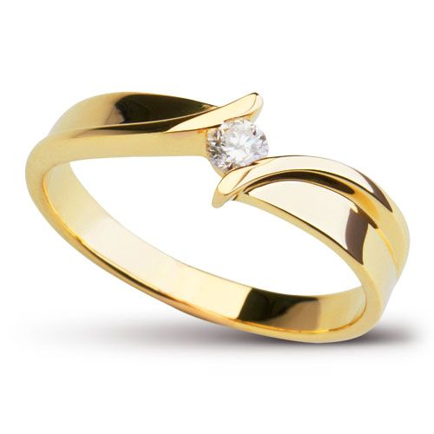
Pendulum
You should hang a ring or wedding ring on a red thread. Hold the ring on a red thread over a vessel of water. Place the pendulum above the center of the vessel. You have to keep your hand still and observe the ring. If the pendulum doesn’t move, you will meet your beloved after many years. If it starts moving it means you will meet the loved one this year.

Slide 19
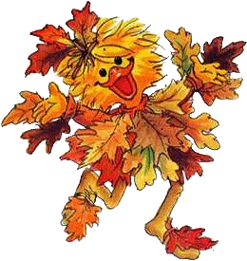
Thank you for your attention and we invite you to the workshops ☺

