Slide 1
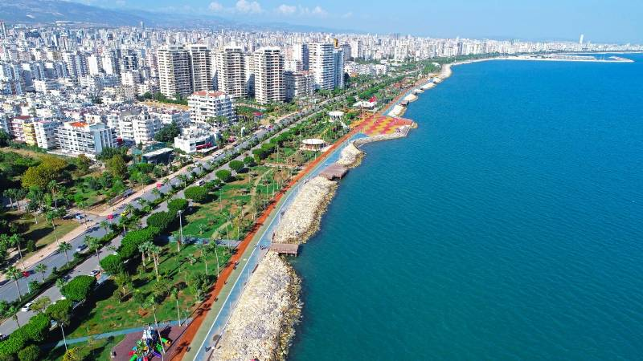
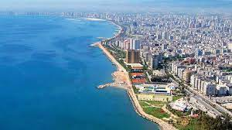
Mersin

Slide 2
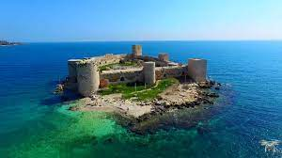
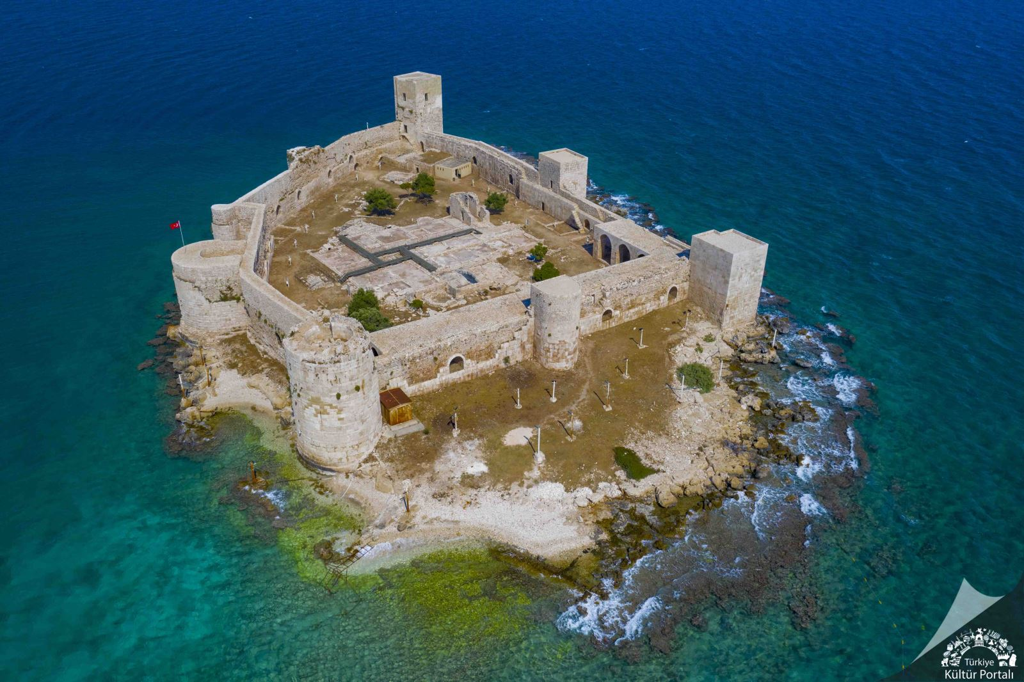
Kız Kalesi
There was a king . The king wanted her to be his daughter , finally one day. One day a fortune teller came to korykos told to king that a snake would bite his daughter and she would die. The king decided to snatch in a tower so she would not die. The girl started to live in a tower until one day when she wanted grapes. A snake came out of grape basket and bit the girl

Slide 3
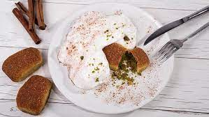
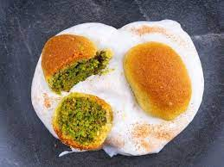
Kerebiç ( Dessert)
Kerebiç belonging to mersin. Kerebiç made with semolina is filled with pistachio and a special white sauce poured on it

Slide 4
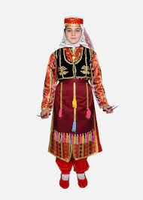
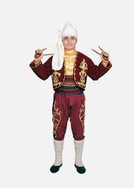
Traditional Clothes
The outfit of a game playing by slamming the spoons they hold in their hands

Slide 5
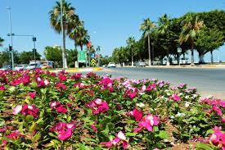
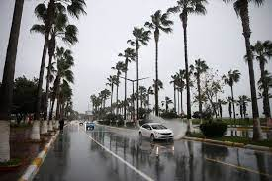
Climate of Mersin
Mersin and its surroundings have warm and temperate climate. Summer months are hot and extremely humid. winter months are quite warm and rainy
19 Mayıs Middle School Bilge Arslan 7/E

