Slide 1
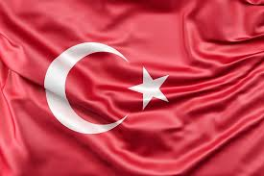
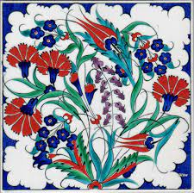
TURKEY
19 Mayıs Middle School Bilge Arslan 7/E

Slide 2
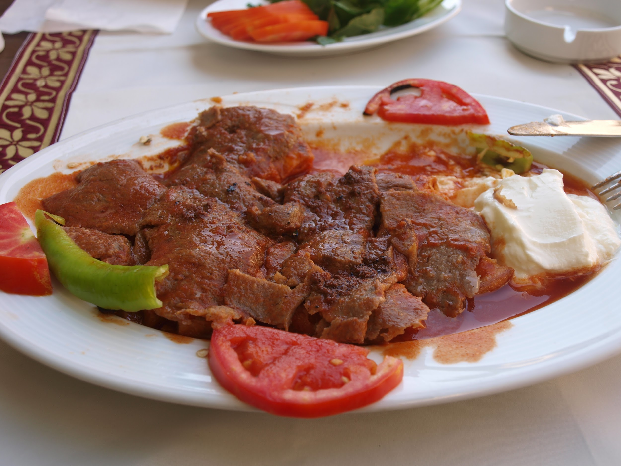
Iskender
This food made with thinly cut meat , pide and tomato sauce

Slide 3
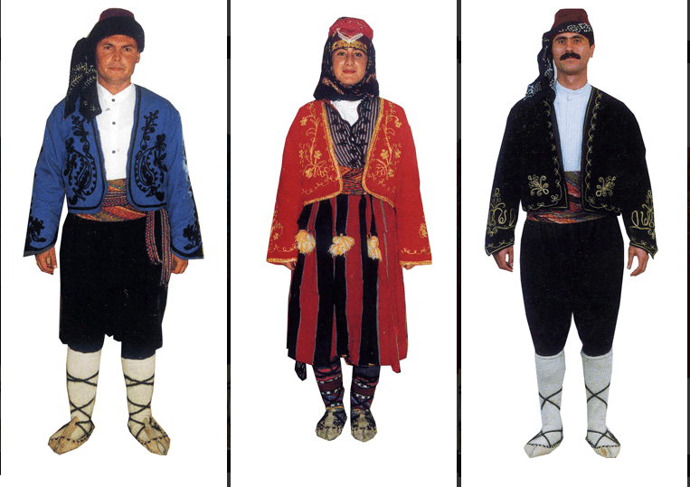
Tradıtıonal clothes
Clothes depends on
towns in Turkey

Slide 4
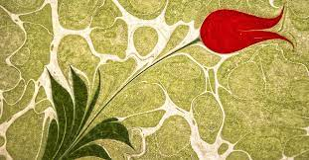
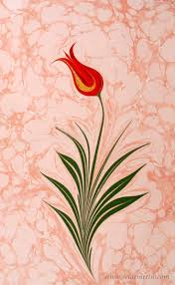
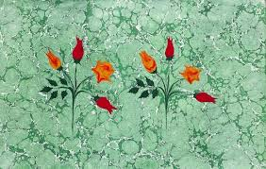
Marbling art
After the paint
dripped into
special water,
shapes are given
and transferred
to the paper.

Slide 5
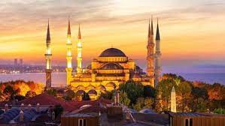
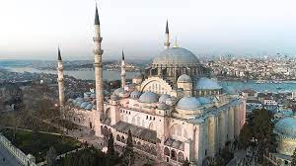
Mosques
The history of mosques
in Turkey dates back
to ancient times.
There are even
5000-year-old
mosques.
Notes:
19 Mayıs Middle School Bilge Arslan 7/E

