Slide 1
Weather in Picanya
From 23 to 29

Slide 2
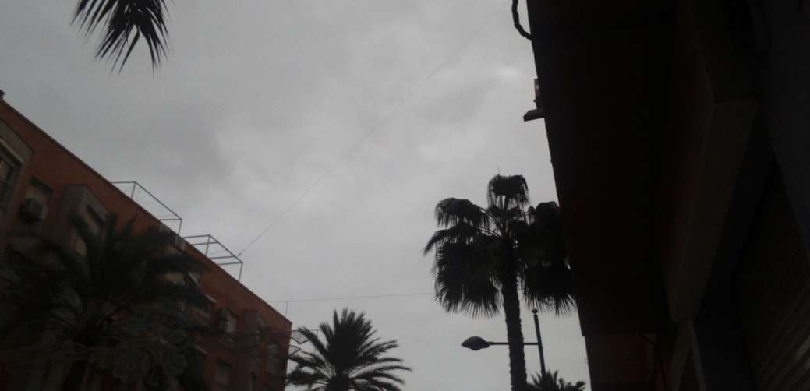
DAY 19 MONDAY

Slide 3
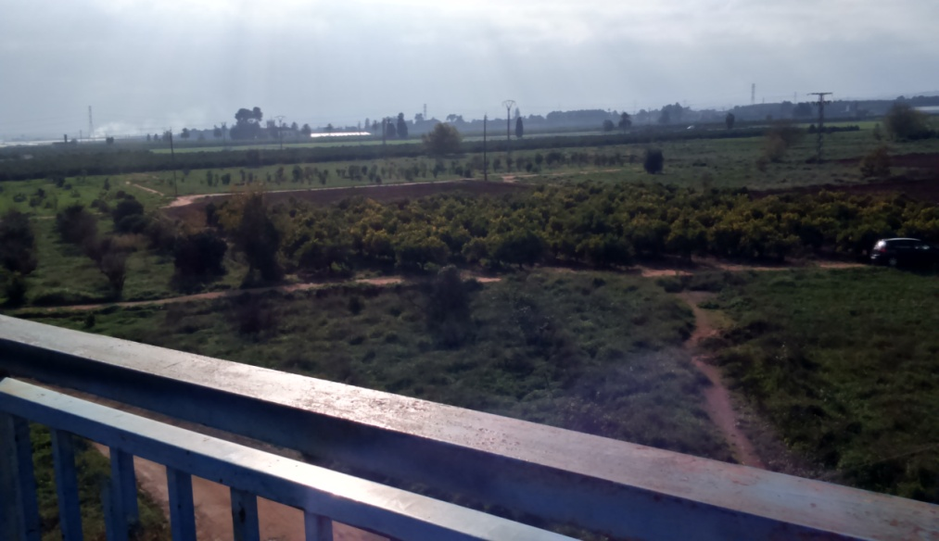
DAY 20 TUESDAY

Slide 4
DAY 21 WEDNESDAY

Slide 5
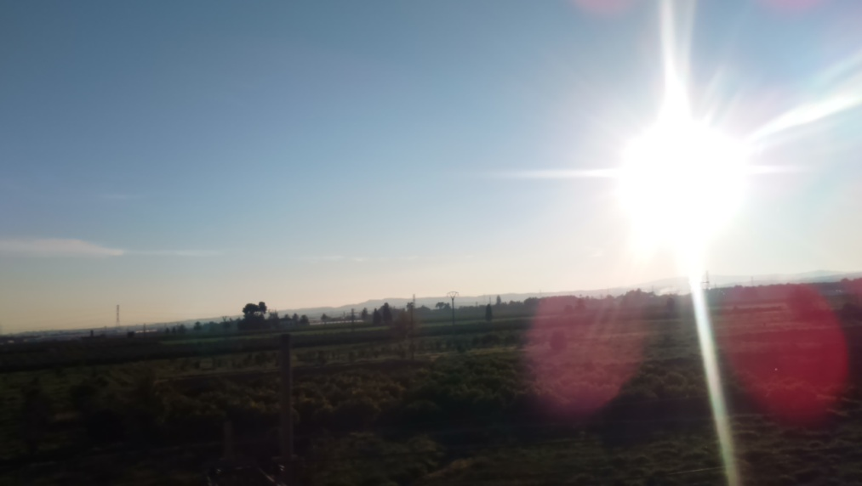
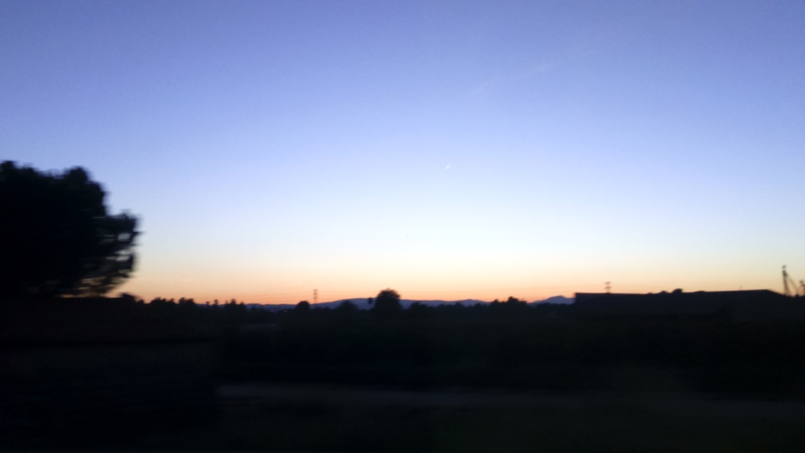
DAY 23 FRIDAY

Slide 6
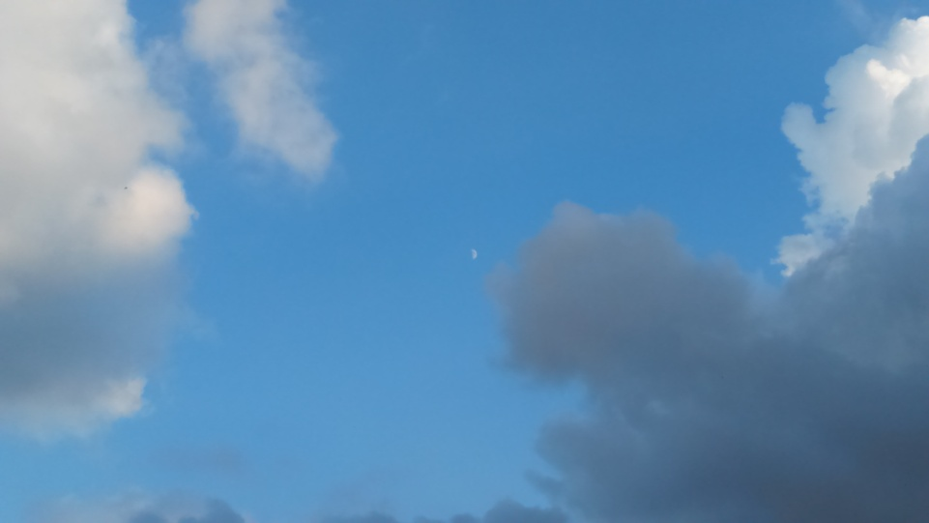
DAY 22 THURSDAY

Slide 7
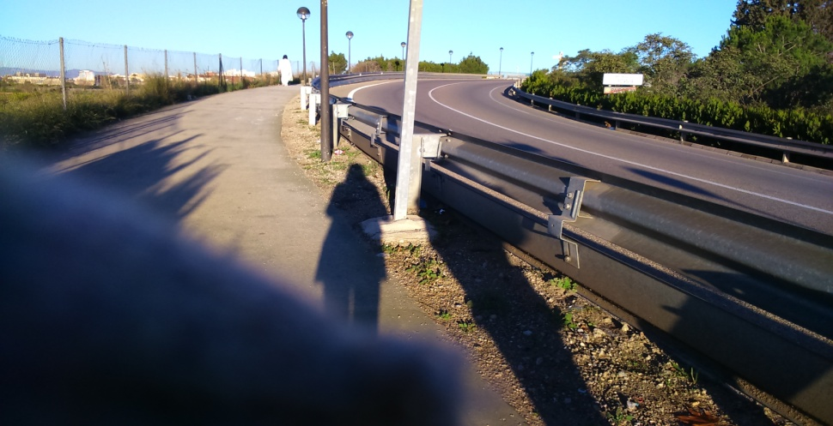
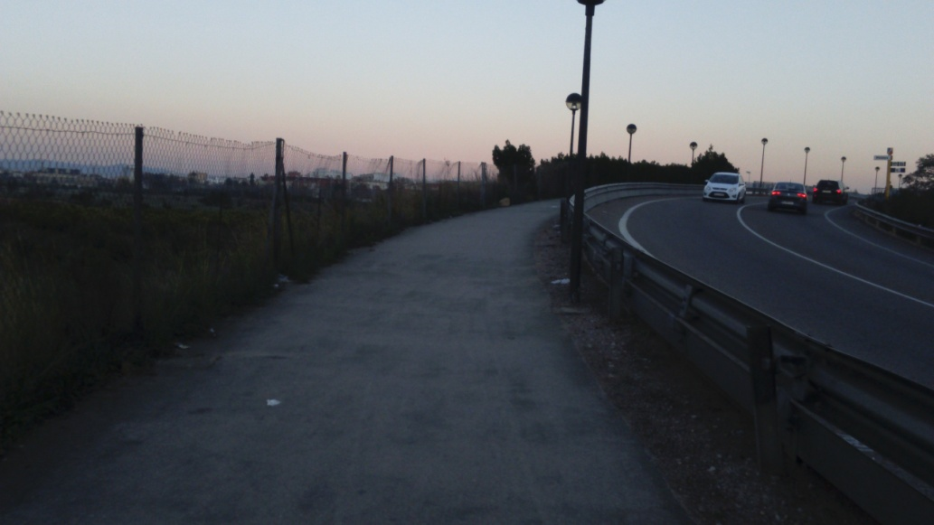
DIA 24 SATURDAY

Slide 8
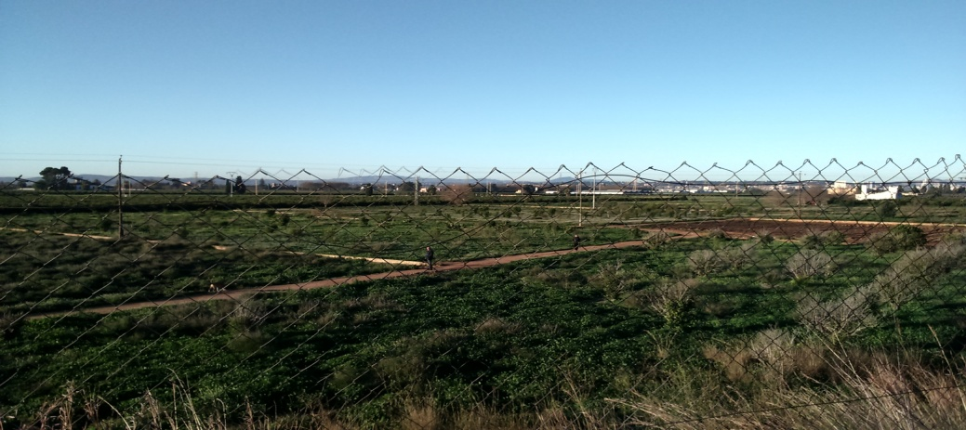
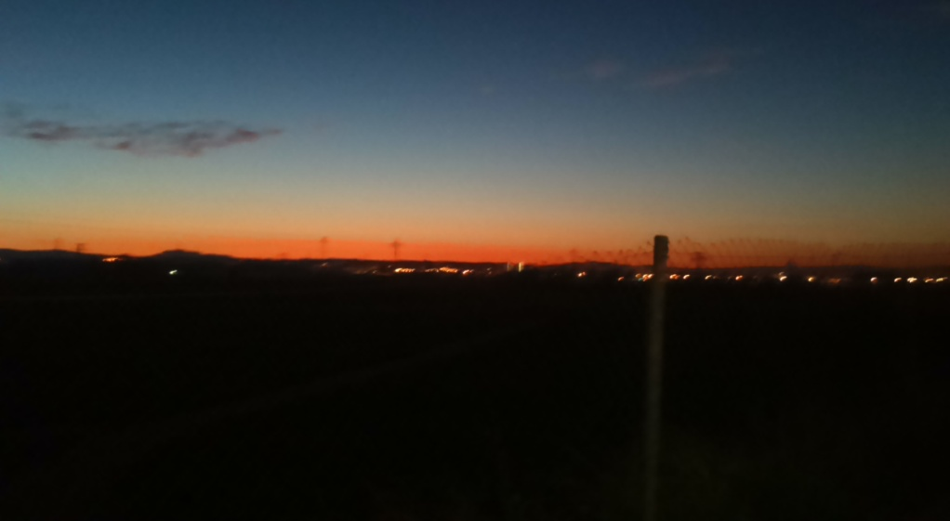
DAY 25 SUNDAY

