Slide 1
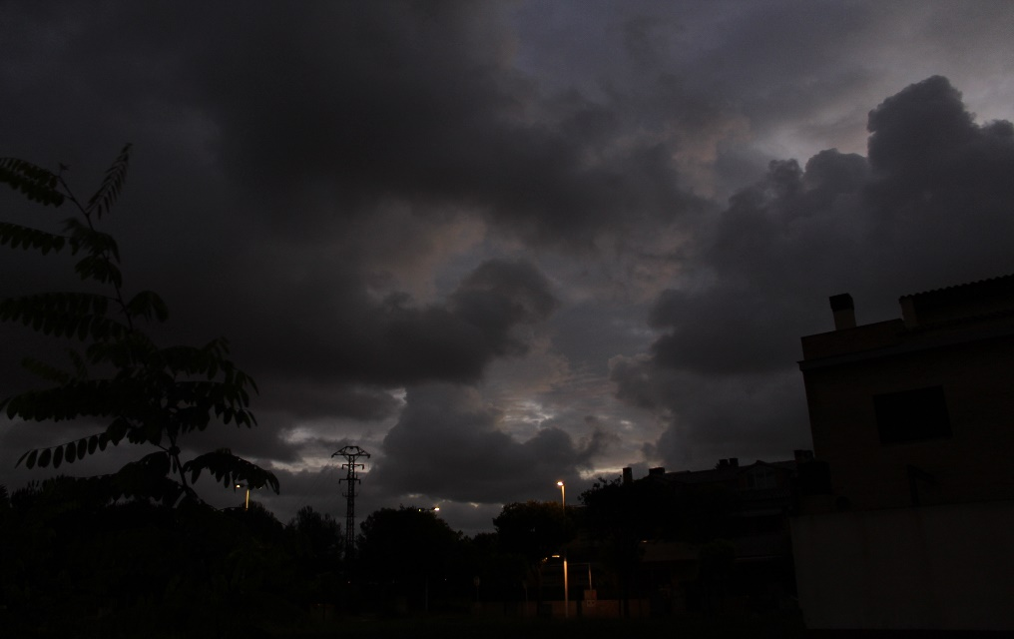
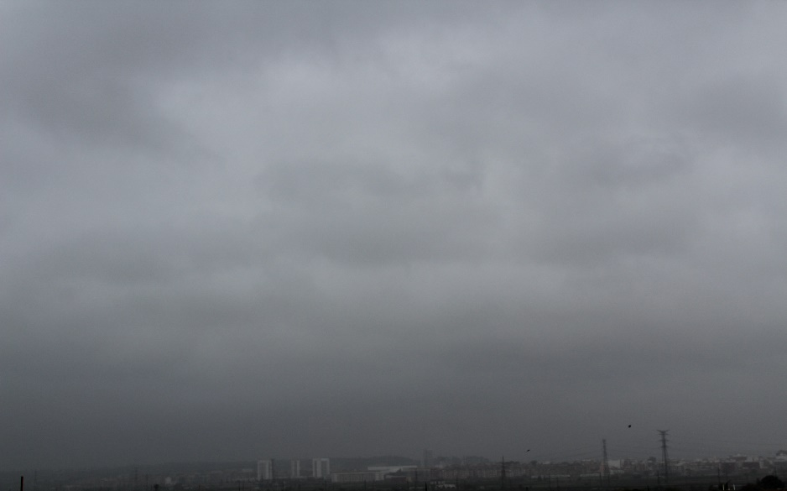
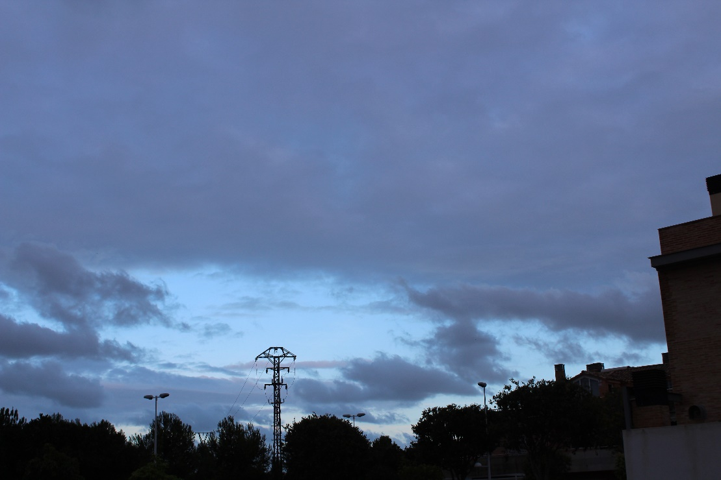
Wednesday 30
7:30 A.m
11ºC
Wind East-Northeast 5Km/h
Cloudy
5:00 P.m
15ºC
Wind East-Northeast 28Km/h
Clouds and clears
3:00 P.m
16ºC
Wind East-Northeast 19Km/h
Cloudy

Slide 2
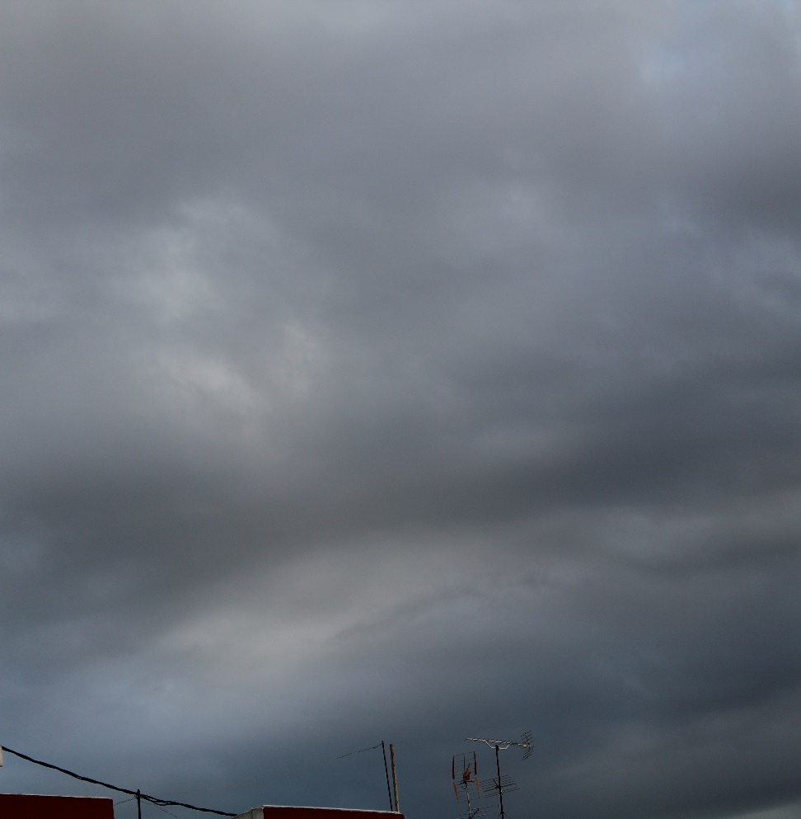
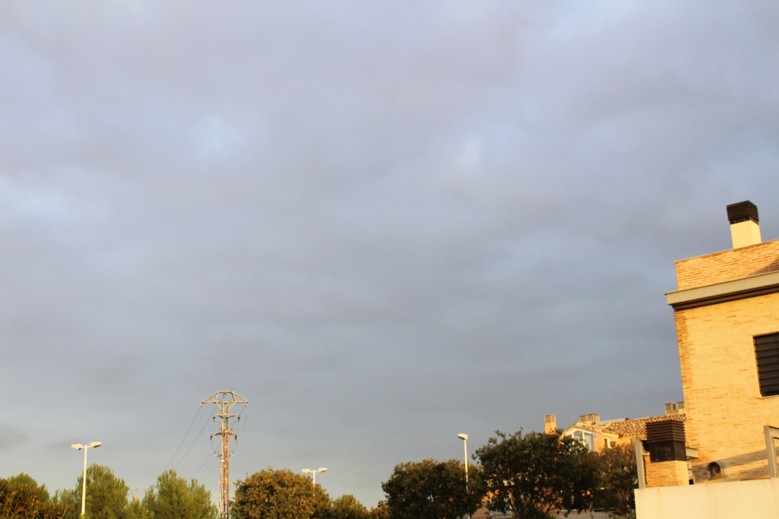
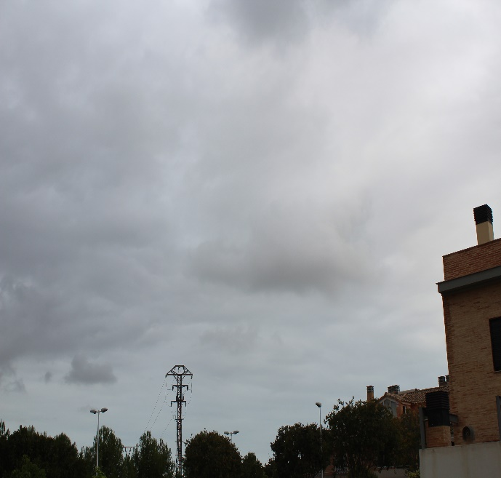
Thursday 1
7:30 A.m
11ºC
Wind North 13Km/h
Cloudy
3:00 P.m
15ºC
Wind East-Northeast 7Km/h
Cloudy
5.00 P.m
14ºC
Wind East-Northeast 15Km/h
Sunny and Cloudy

Slide 3
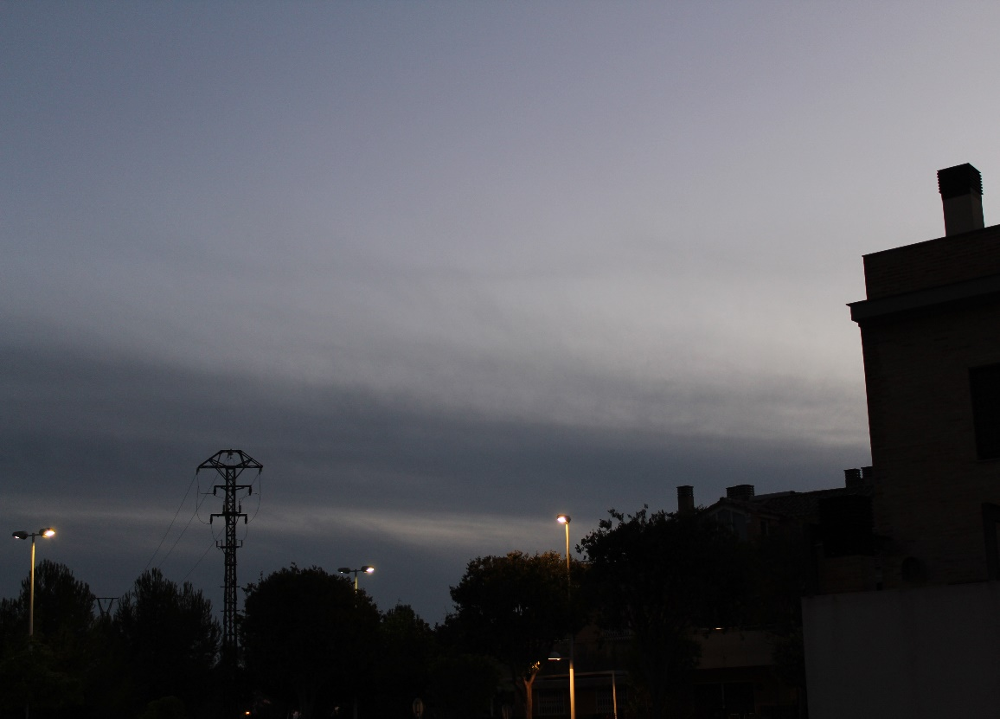
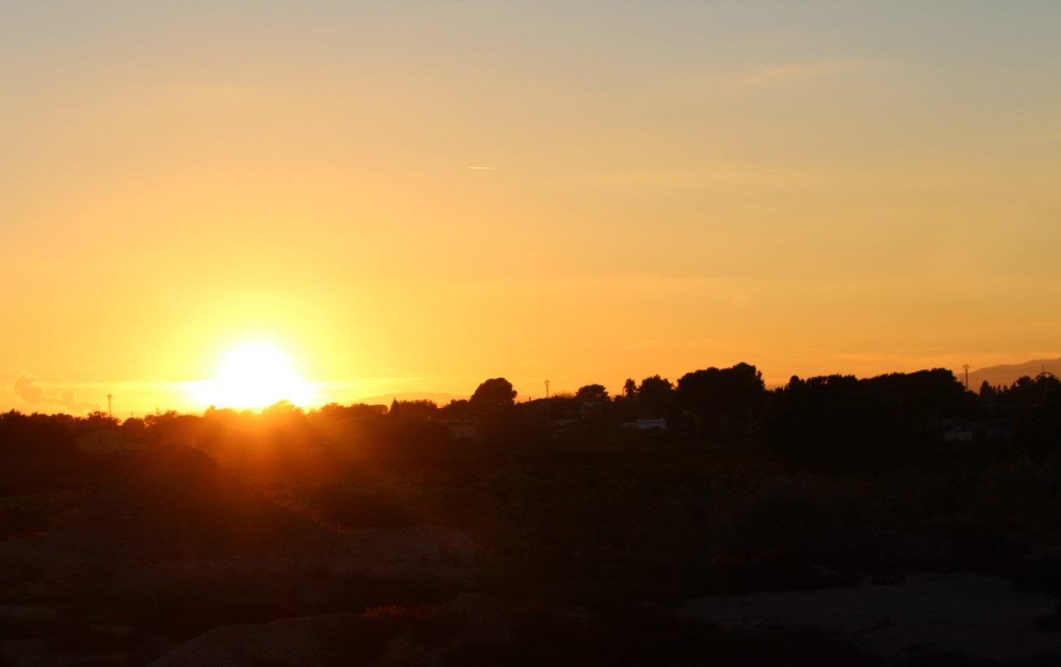
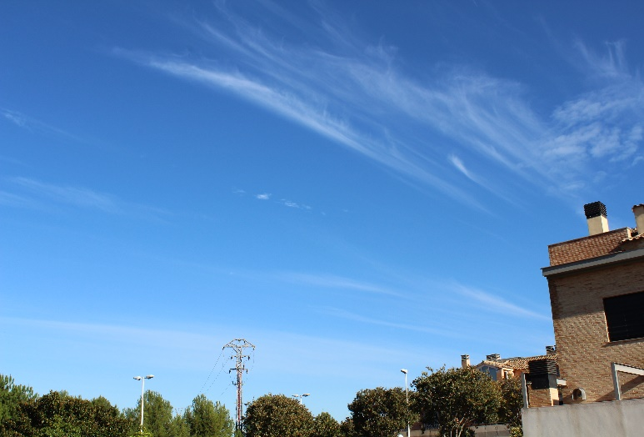
Friday 2
7:30 A.m
9ºC
Wind West 5Km/h
Clouds and Clears
5.30 P.m
20ºC
Wind Southwest 1Km/h
Sunny
3:00 P.m
17ºC
Wind West-Southwest 3Km/h
Sunny and High Clouds

Slide 4
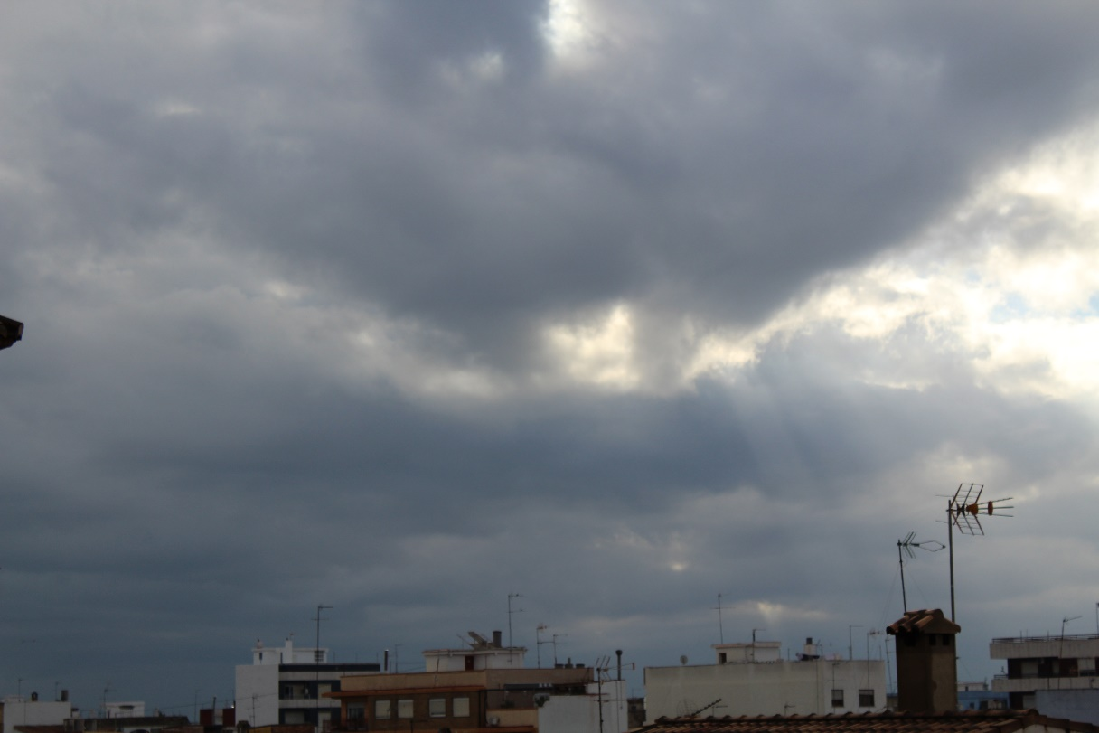
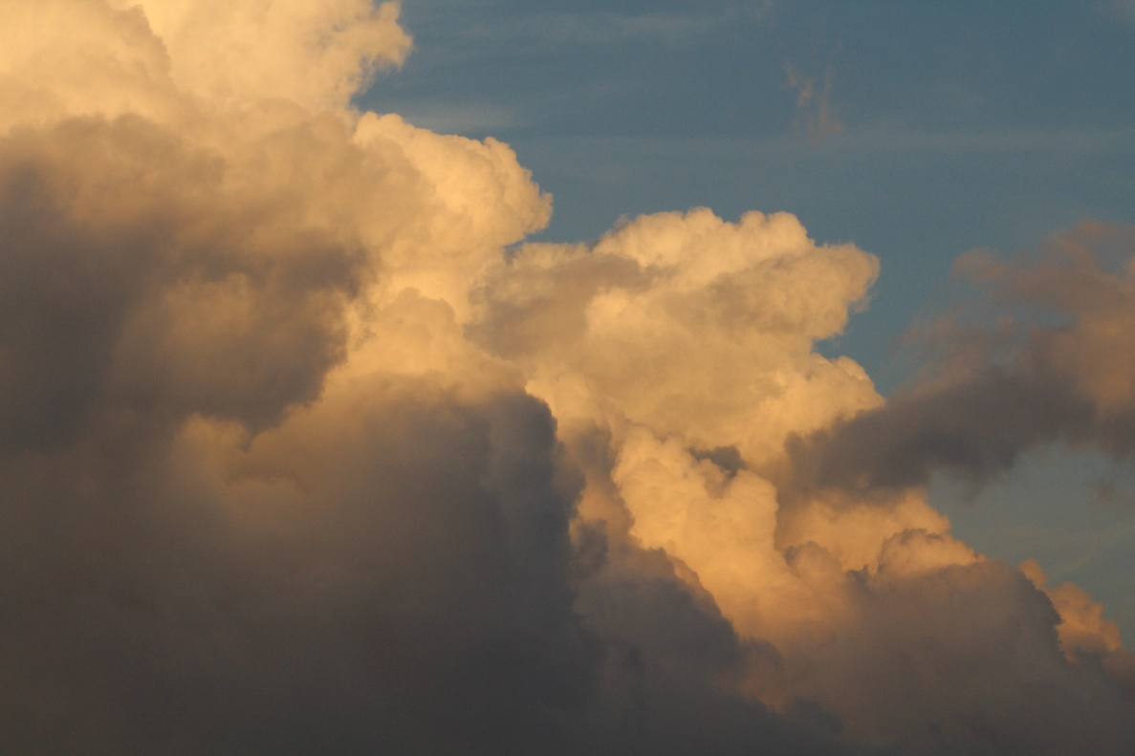
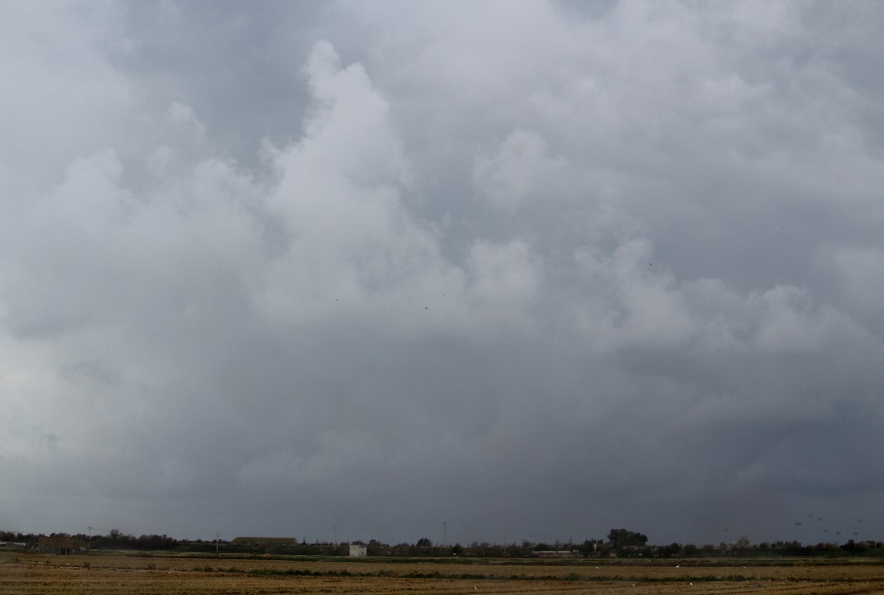
Saturday 10
7:30 P.m
9ºC
Wind West 8Km/h
Cloudy
5:30 P.m
16ºC
Wind East-Northeast 3Km/h
Sunny and Clouds
3:00 P.m
16ºC
Wind East-Northeast 3Km/h
Cloudy

Slide 5
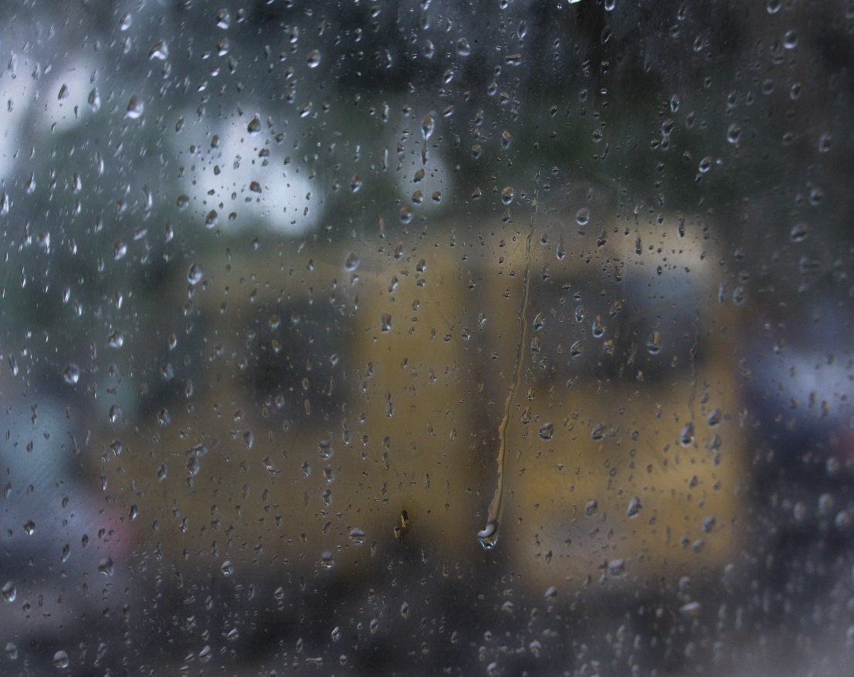
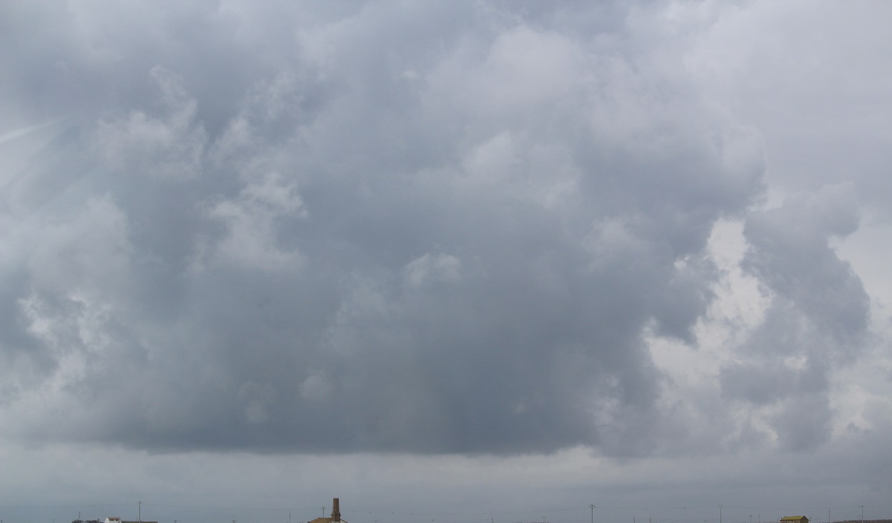
Sunday 4
7:30 A.m
12ºC
Wind North-Northeast 6Km/h
Rain -1 L/m2
5:30 P.m
16ºC
Wind East 14 Km/h
Rain 2 L/m2
3:00 P.m
14ºC
Wind East 12 Km/h
Soft Rain 2 L/m2

Slide 6
Monday 5
7:30 A.m
13ºC
Wind North 15 Km/h
Rainy 1L/m2
5:30 P.m
13ºC
Wind North-Northeast 12Km/h
Rain 2L/m2
3:00 P.m
10ºC
Wind North 11 Km/h
Torrential Rain 10L/m2

Slide 7
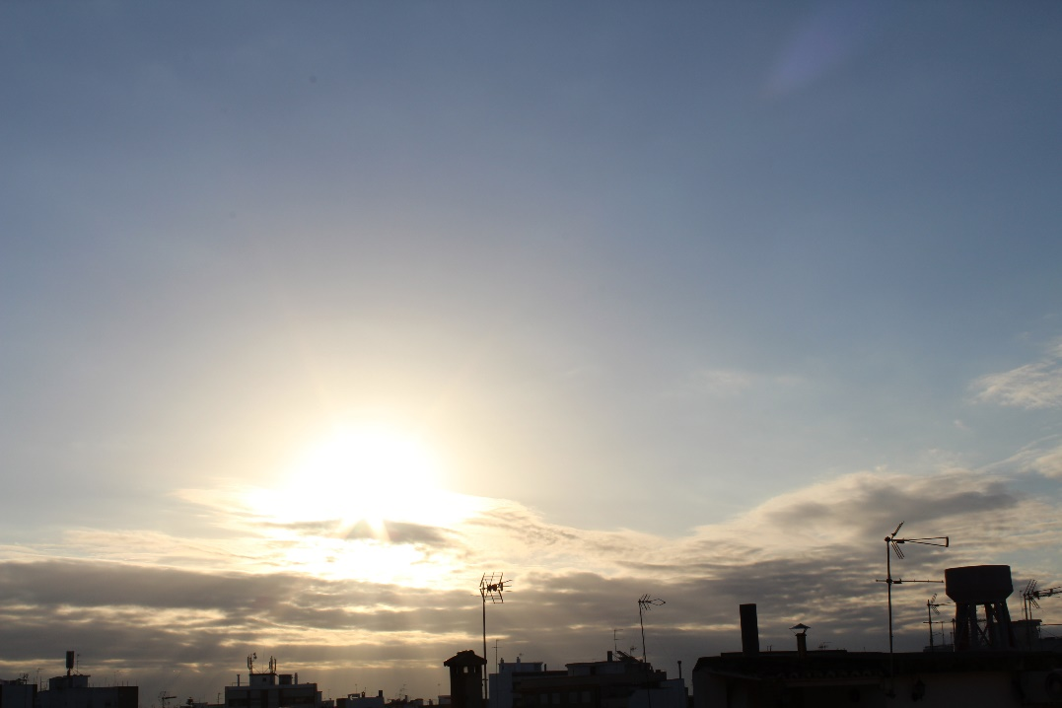
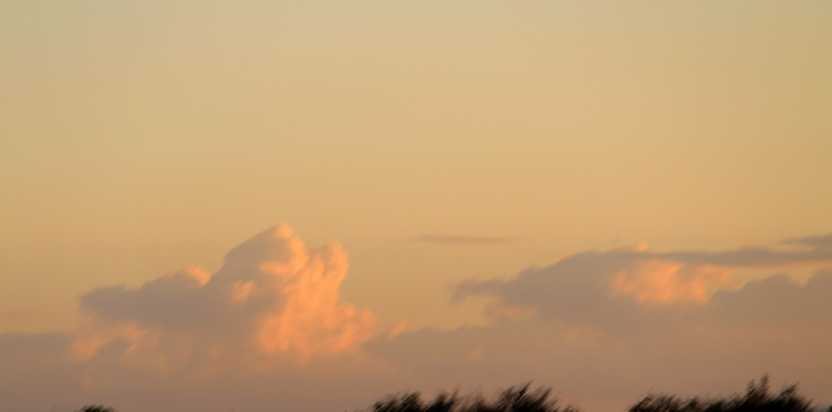
Tuesday 6
9:00 A.m
13ºC
Wind North-Northeast 8Km/h
Sunny and High Clouds
5:30 P.m
16ºC
Wind North 8Km/h
Sunny
3:00 P.m
13ºC
Wind North 8Km/h
Sunny and Clouds

Slide 8
All potos are mine(Copyright Manel Roman Sanchez).
If there are no photo is because that hour or that day I couldn`t do the photo
The End

