Slide 1
FLAMINGOS
ALBUFERA

Slide 2
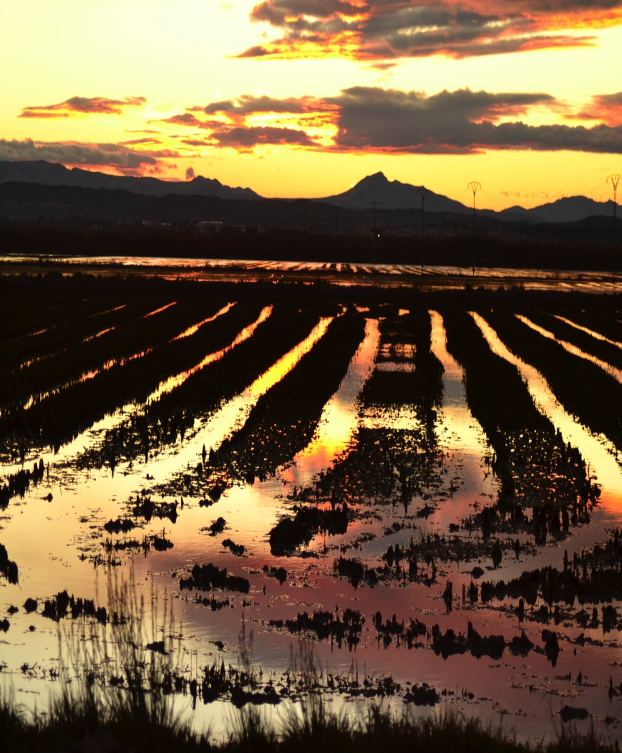
WHERE FLAMINGOS COME FROM
In rice fields of Albufera, there are a lot of flamingos.
Since 2008, they come from Africa, in winter time.
At first they were only a few, but last year 2500 flamingos came.

Slide 3
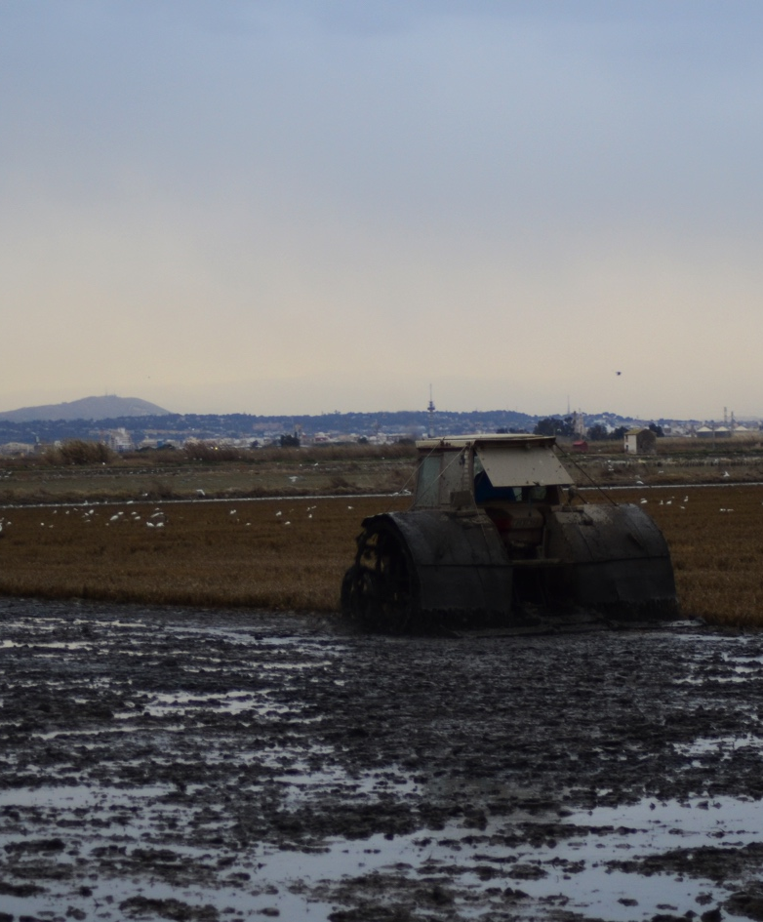
WHERE THEY FEED
When the farmers put water in the rice fields, the flamingos eat.

Slide 4
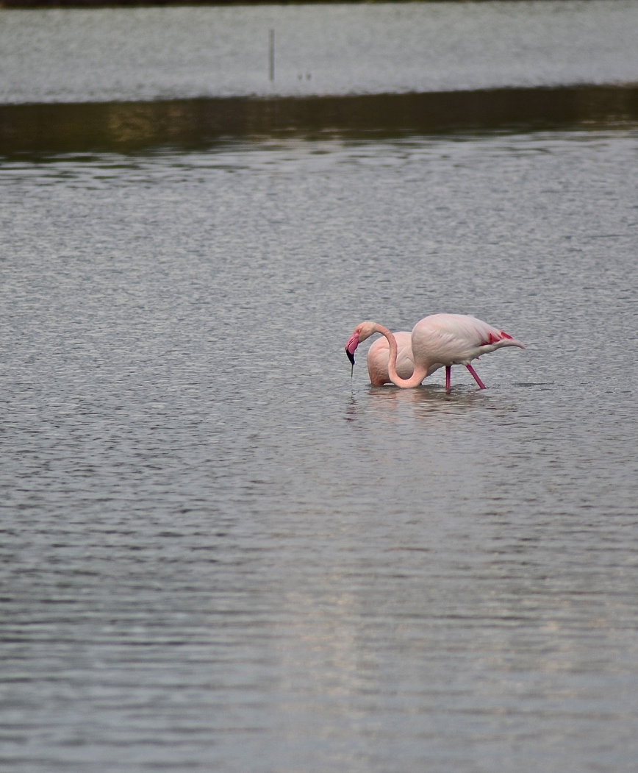
WHAT IS THEIR FOOD
They search water algae, small prawns, crustaceans, molluscs, small fish, and water insects, this is their food.
They need to drink fresh water.

Slide 5
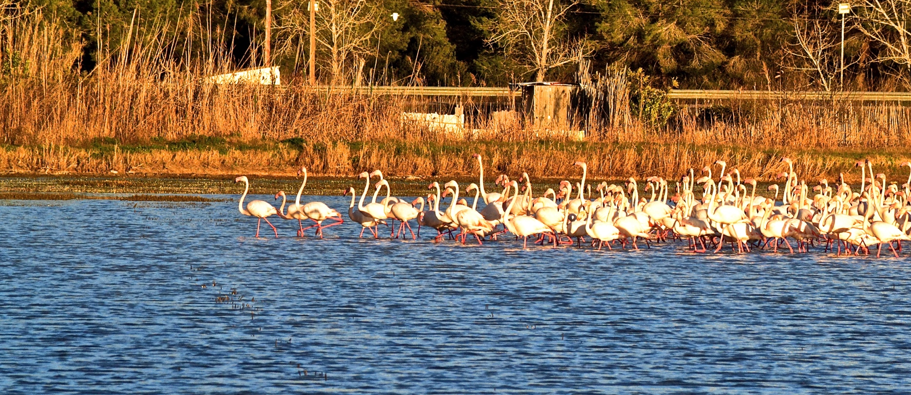
THEIR COLOUR
Flamingo’s colour is because of their food. If a flamingo isn’t pink, it is because it’s sick.
Only baby flamingos are gray, and they look all the same, but their parents know who their baby is.

Slide 6
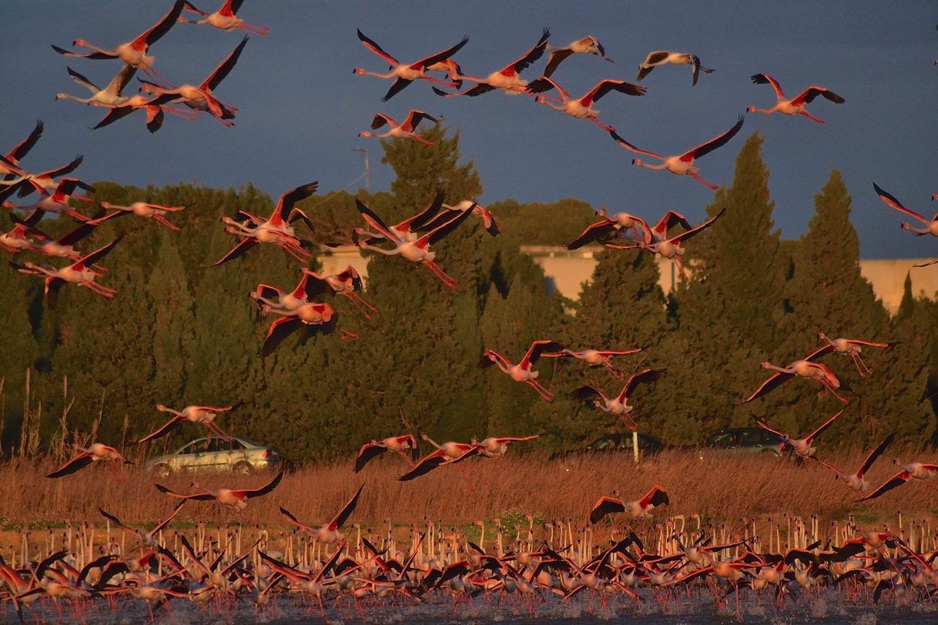
HOW LONG THEY LIVE
Flamingos have a long life, they can live until seventy
years old more or less, like humans.

Slide 7
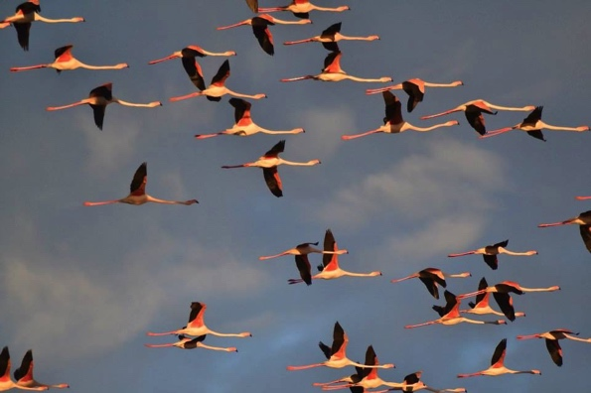
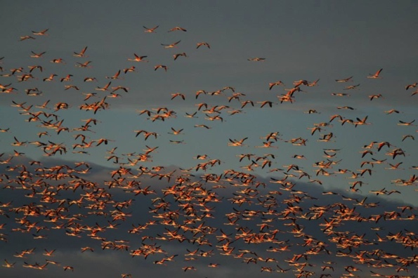
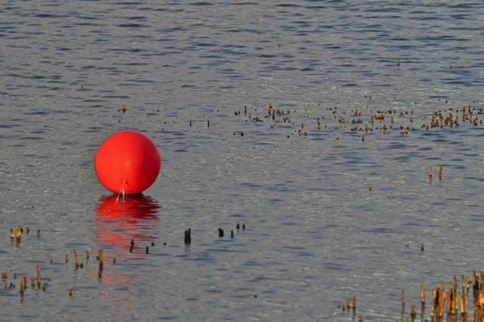
PHOTOS

