Slide 1
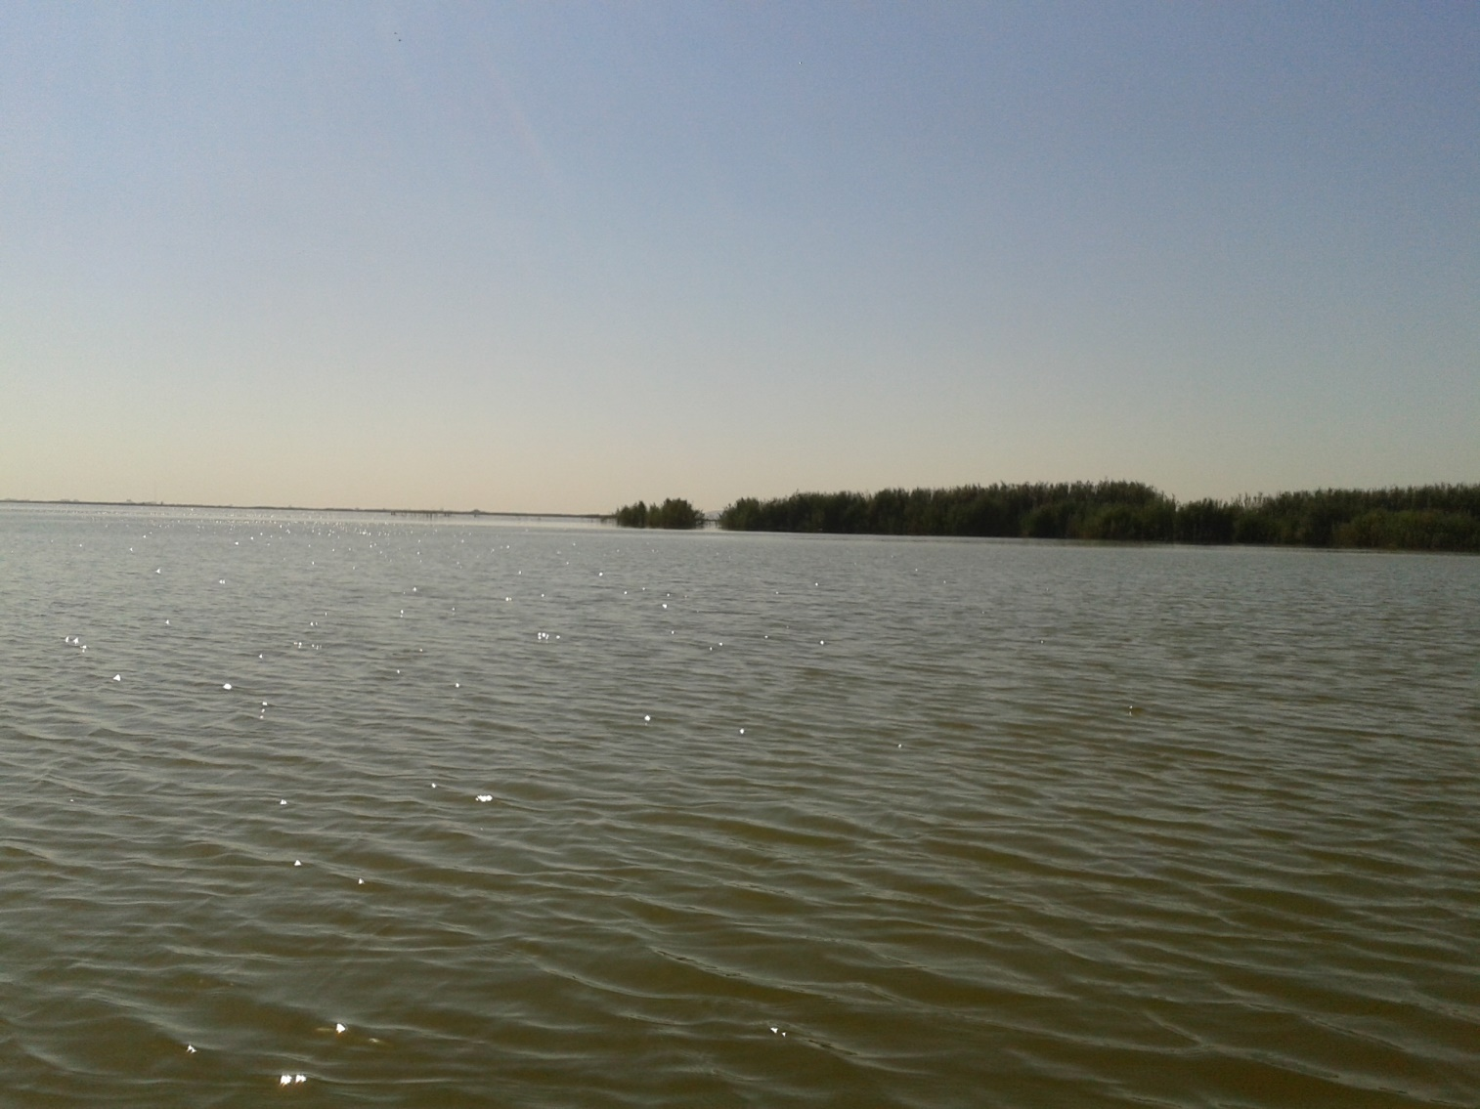
THE ALBUFERA

Slide 2
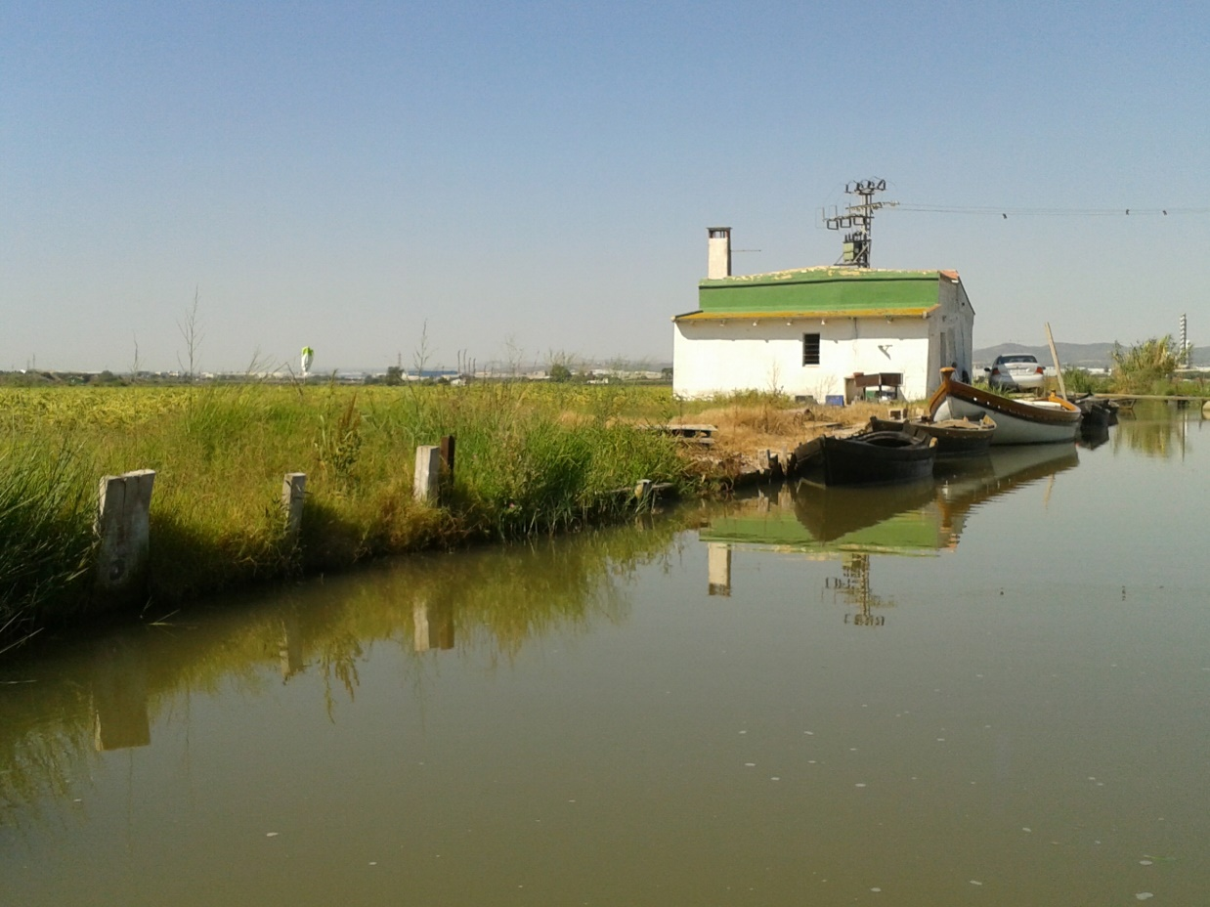
What’s that?
L’Albufera is a natural park in Valencia.
It has got many species, both wildlife and vegetation
The traditional activities performed in the Park are hunting, fishing and agriculture.

Slide 3
features
It is located about 10 km in the south of the city of Valencia, Spain.
It has got 21,120 hectares.
It has an average depth of 1 meter.
It has an extension of 23.94 km2.
It is surrounded by 223 km2 of rice fields.

Slide 4
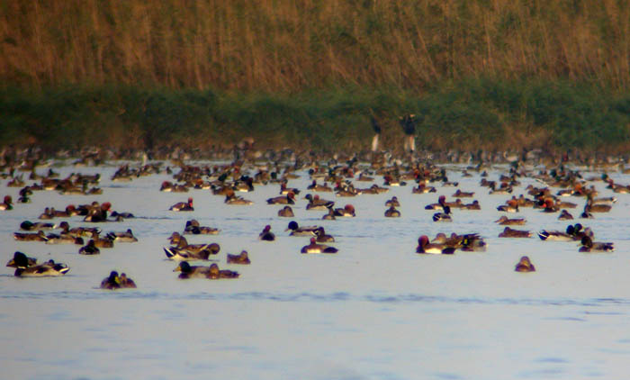
Wildlife
It has great diversity of animals in their environment like the samarugo, the Spanish toothcarp and the duck , and the most typical fish of the Park are the sea bass and eels, among others.

Slide 5
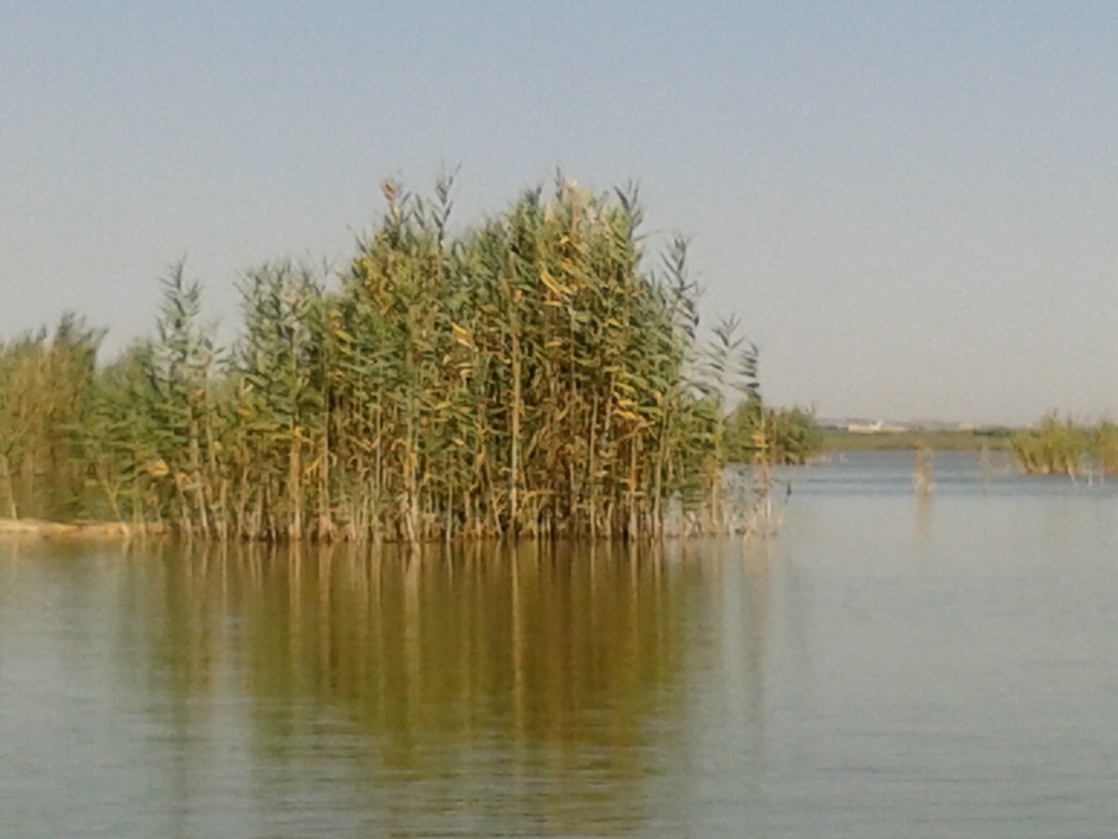
vegetation
The plants that live here are adapted to the high salt concentrations, for example, the salt grass and Barilla.
It has got many great fields of rice. You can also see cattails, reeds and mansiegas.

Slide 6
And that's all, I hope that you liked and enjoyed it. Thank you for everything.
Anna Cuadra, Spain.

