Slide 1
Climate in Picanya (Valencia)
Here is the climate in Picanya from the 30 of nov to the 6 of dec.

Slide 2
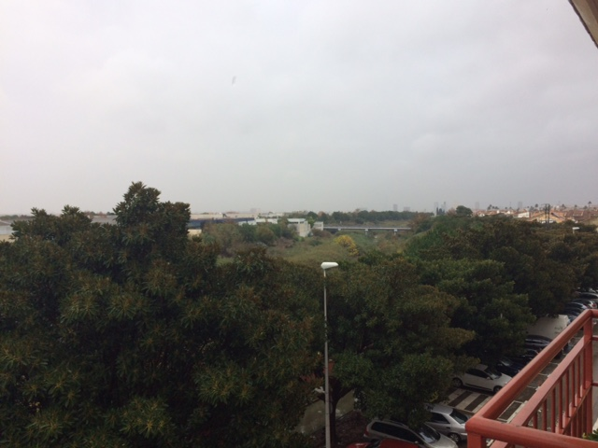
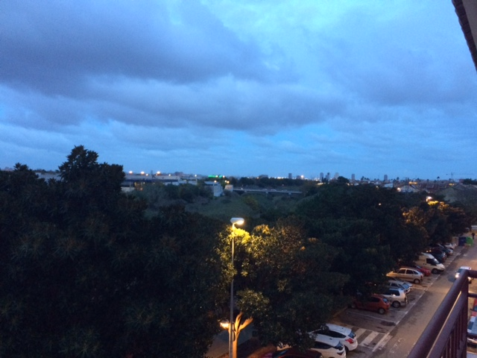
Temperature:
Max: 15ºC
Min: 9ºC
Wendsday 30

Slide 3
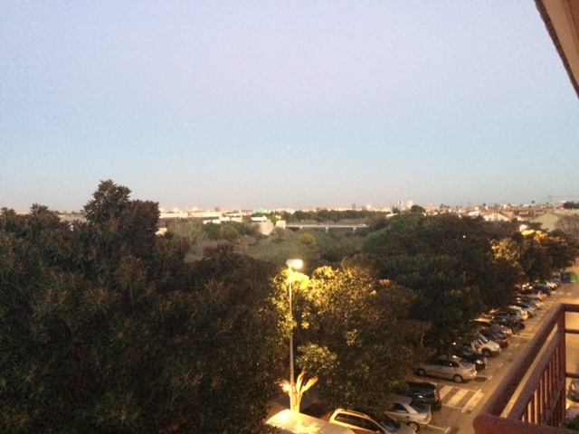
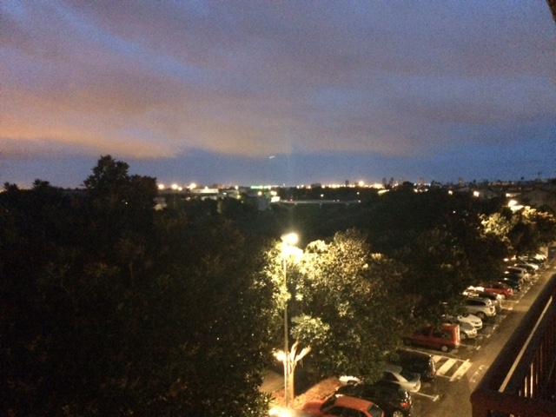
Temperature:
Max: 16ºC
Min: 9ºC
Thursday 1

Slide 4
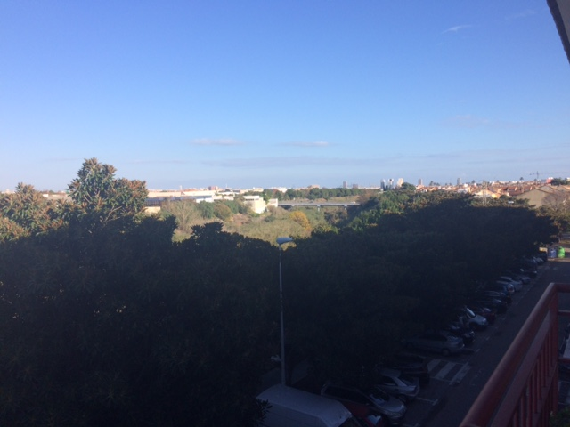
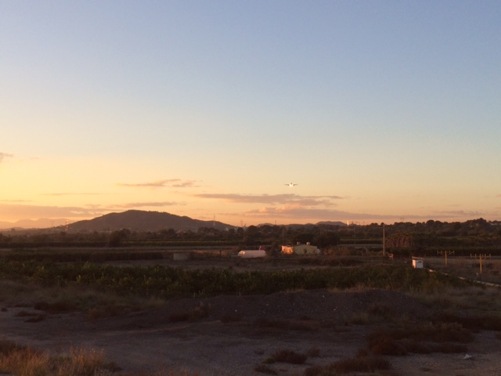
Temperatuure
Max: 17ºC
Min: 7ºC
Friday 2

Slide 5
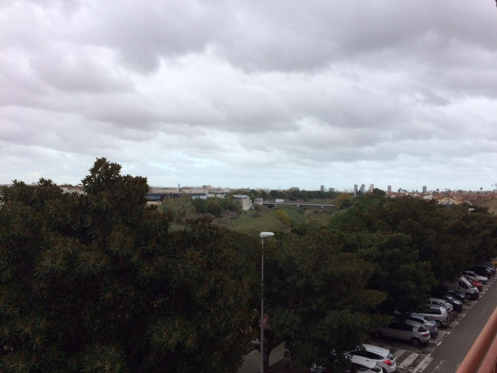
Temperature
Max: 16ºC
Min: 6ºC
Saturday 3

Slide 6
Temperature
Max: 16ºC
Min: 12ºC
Sunday 4

Slide 7
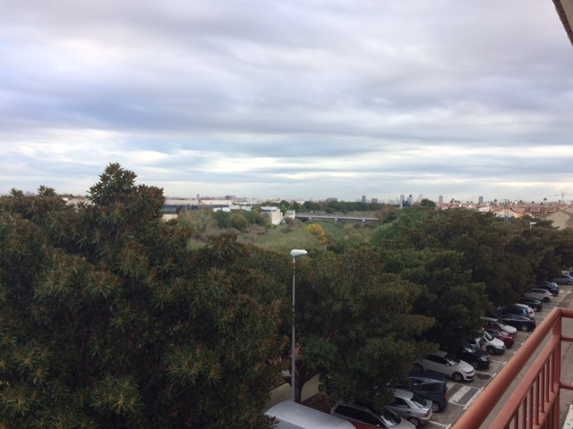
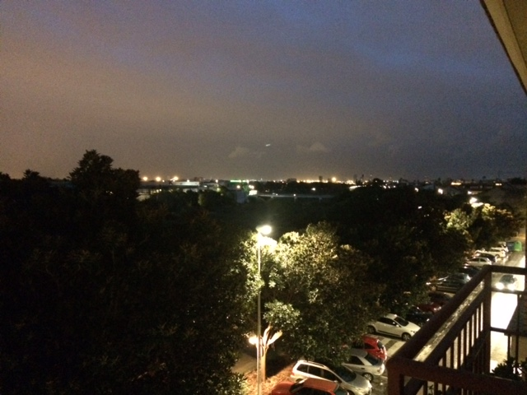
Temperature
Max : 16ºC
Min: 13ºC
Monday 5

Slide 8
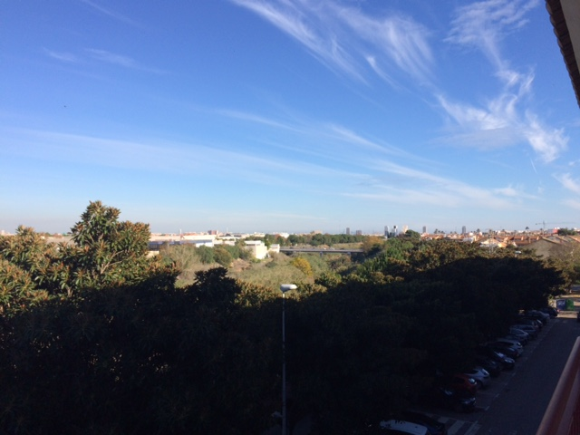
Temperature
Max: 18ºC
Min: 10ºC
Tuesday 6

