Slide 1
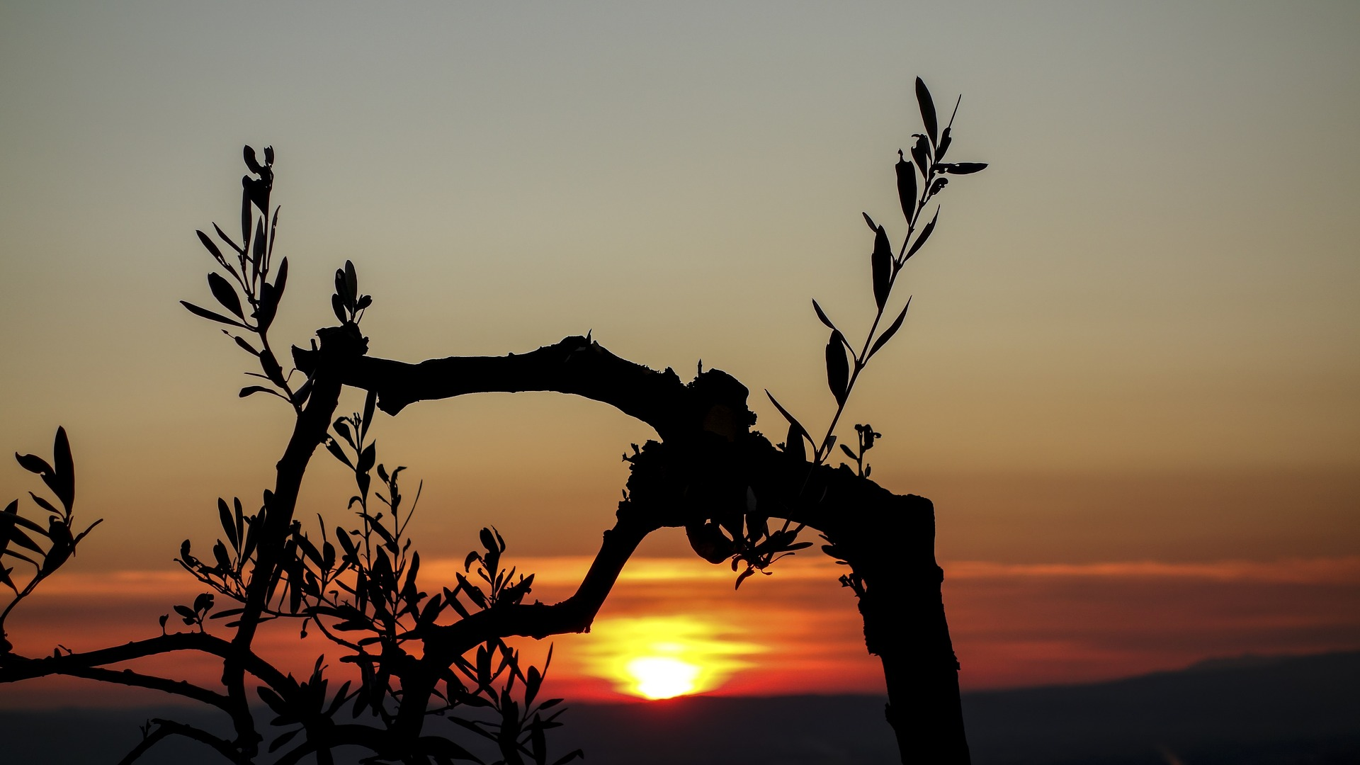
OLIVE TREE:
EVOLUTION OF THE OLIVE TREE.
Carmen Espartal 2ºD

Slide 2
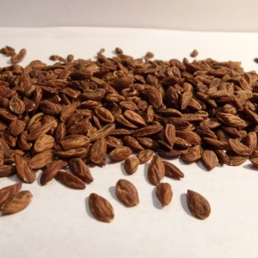
1.SOW THE SEED
.These seeds need a lot of water and sun light to grow.
.They need a month to grow and to turn into a plant.

Slide 3
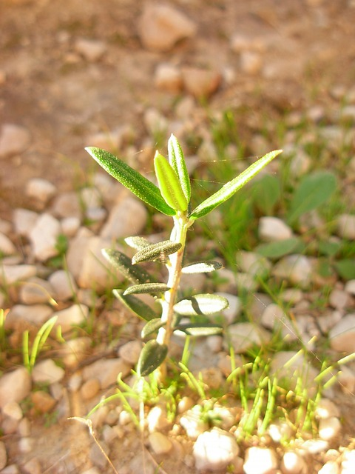
2.THE PLANT GROWS:
The olive trees grow very slowly.
They are very strong trees that resist low temperatures.
When they are big trees, they don’t need too much water, although they need sun light.

Slide 4
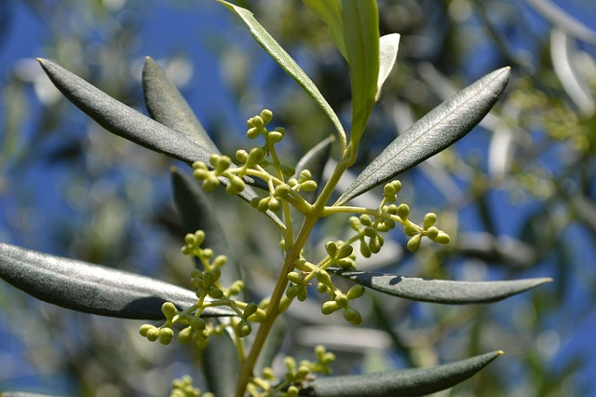
3.FLOWERS:
In Spring the olive flowers bloom.
They bloom when the tree is three or more years old.

Slide 5
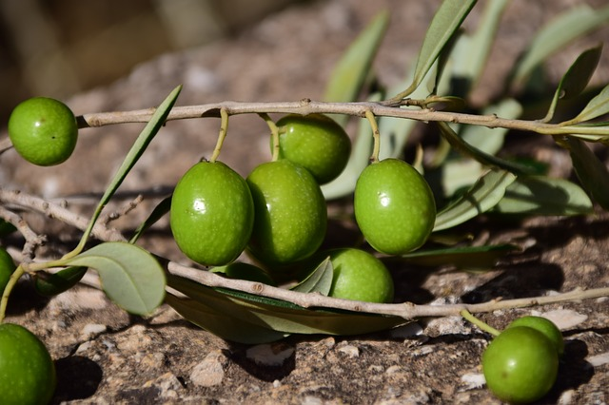
4. FRUITS:
The olive trees’ fruits are the olives.
On December the fruits are picked and you can make oil with them.

