Slide 1
The weather in Picanya

Slide 2
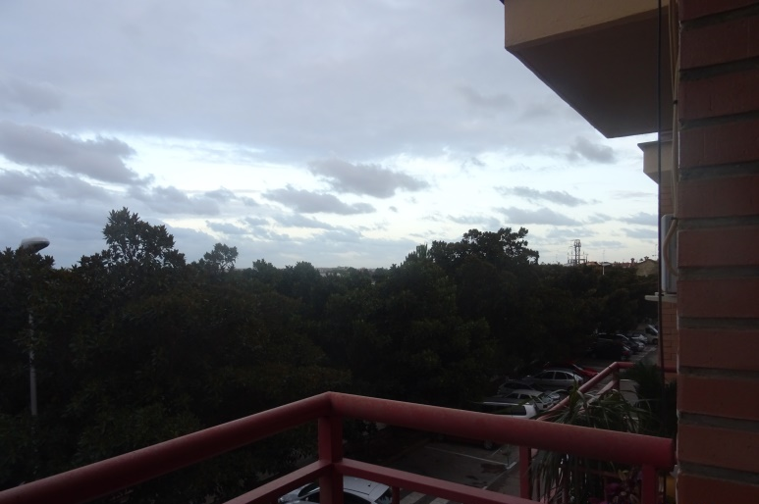
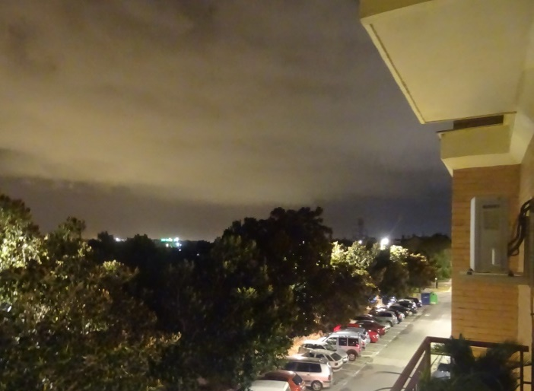
Day 30/11/2016
7:34
17:12
20:44
Temperature maximum: 16ºC
Temperature minimum: 12ºC
Speed and direction of the wind: 15km/h, Northwest
Chance of precipitation: 65%
Moisture maximum: 70%
Moisture minimum: 100%
Dawn: 8:03
Dusk: 17:39

Slide 3
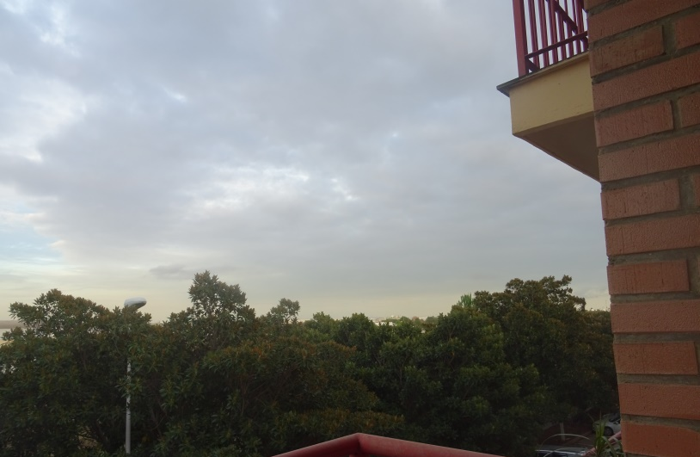
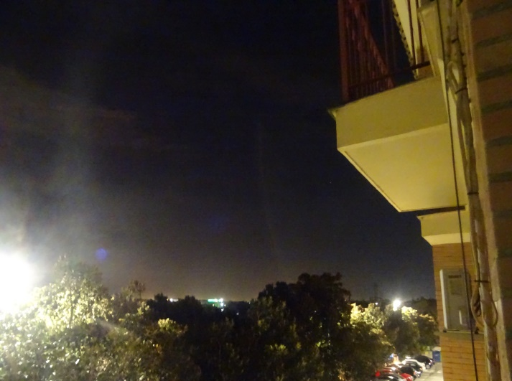
Day 1/12/2016
7:35
17:09
20:48
Temperature maximum: 15ºC
Temperature minimum: 11ºC
Speed and direction wind:
Chance of precipitation: 15%
Moisture maximum: 90%
Moisture minimum: 70%
Dawn: 8:04
Dusk: 17:38

Slide 4
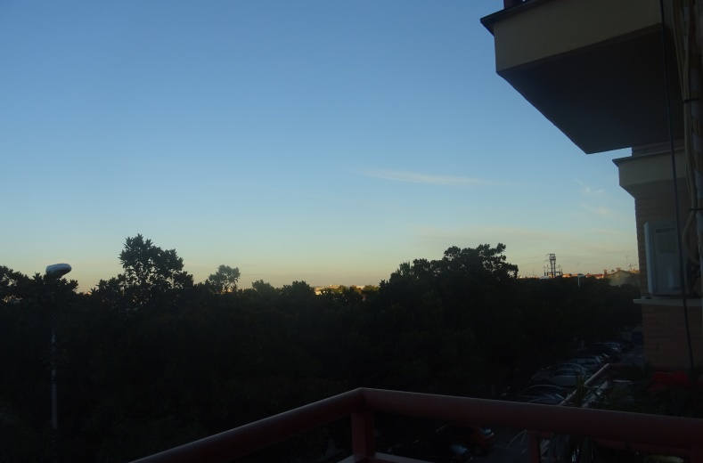
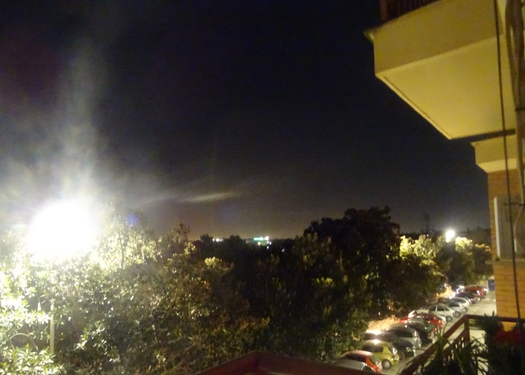
Day 2/12/2016
7:37
7:37
17:16
17:16
20:51
20:51
Temperature maximum: 17ºC
Temperature minimum: 7ºC
Speed and direction of the wind: 10km/h, Nordwest
Chance of precipitation:
Moisture maximum: 100%
Moisture minimum: 60%
Dawn: 8:05
Dusk: 17:38

Slide 5
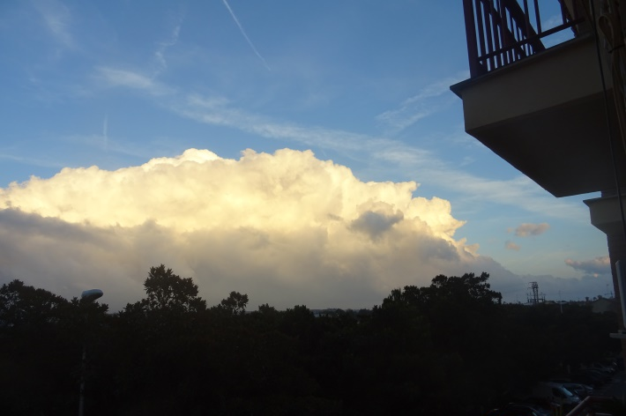
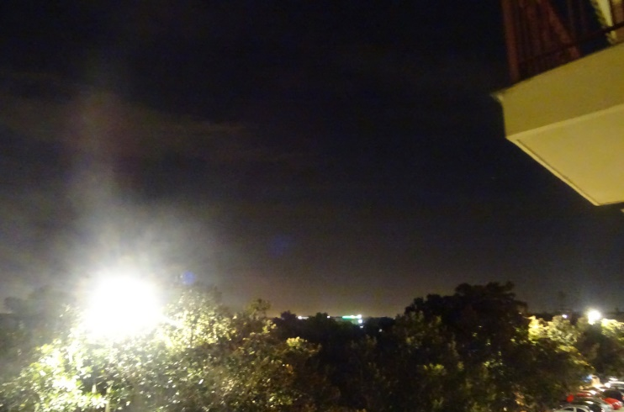
Day 3/12/2016
7:34
17:11
20:55
Temperature maximum: 16ºC
Temperature minimum: 7ºC
Speed and direction of the wind wind:
Chance of precipitation: 75%
Moisture maximum: 100%
Moisture minimum: 70%
Dawn: 8:06
Dusk: 17:38

Slide 6
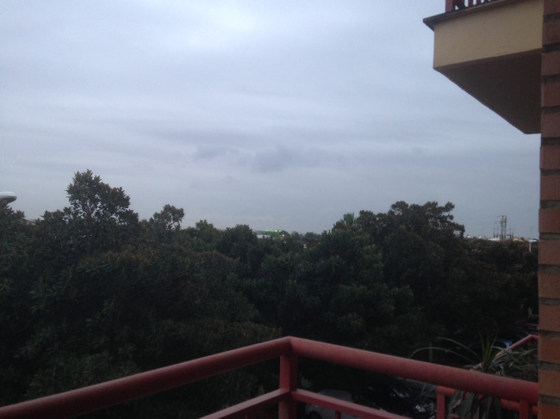
Day 5/12/2016
7:35
17:31
21:00
Temperature maximum: 15ºC
Temperature minimum: 13ºC
Speed and direction of the wind: 15km/h, Nord
Chance of precipitation: 95%
Moisture maximum: 100%
Moisture minimum: 80%
Dawn: 8:08
Dusk: 17:38

Slide 7
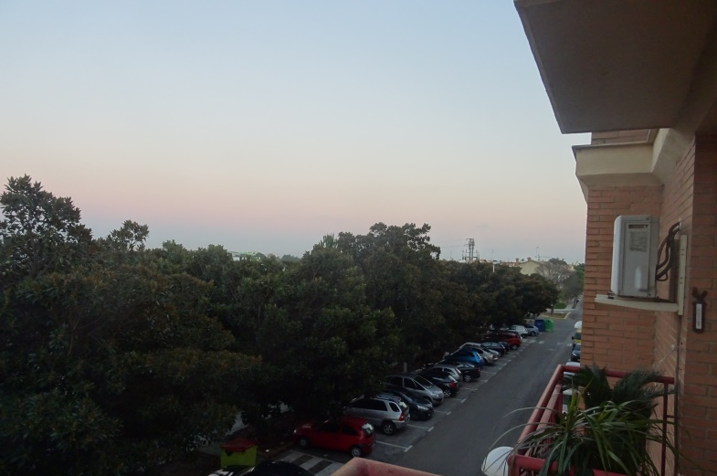
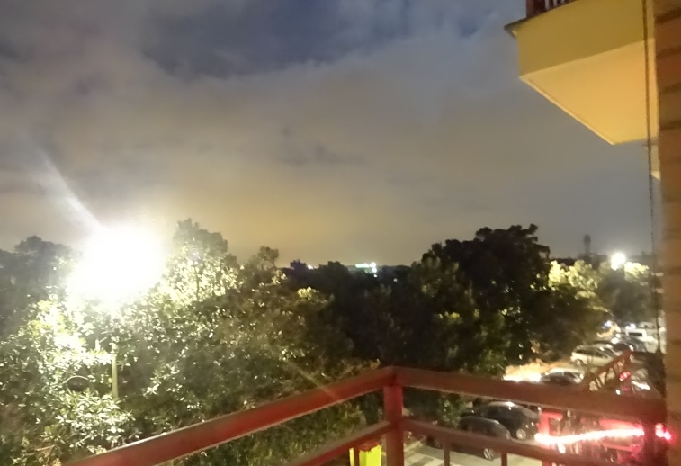
Day 7/12/2016
7:36
17:32
21:00
Temperature maximum: 16ºC
Temperature minimum: 8ºC
Speed and direction of the wind:
Chance of precipitation: 60%
Moisture maximum: 100%
Moisture minimum: 40%
Dawn: 8:06
Dusk: 17:35

Slide 8
And that's all, thank you.
Anna Cuadra, Spain.
Photos made by Anna Cuadra.

