Slide 1
ERASMUS WORK
My grandfather´s olive
CLARA SOLÁ 2º C

Slide 2
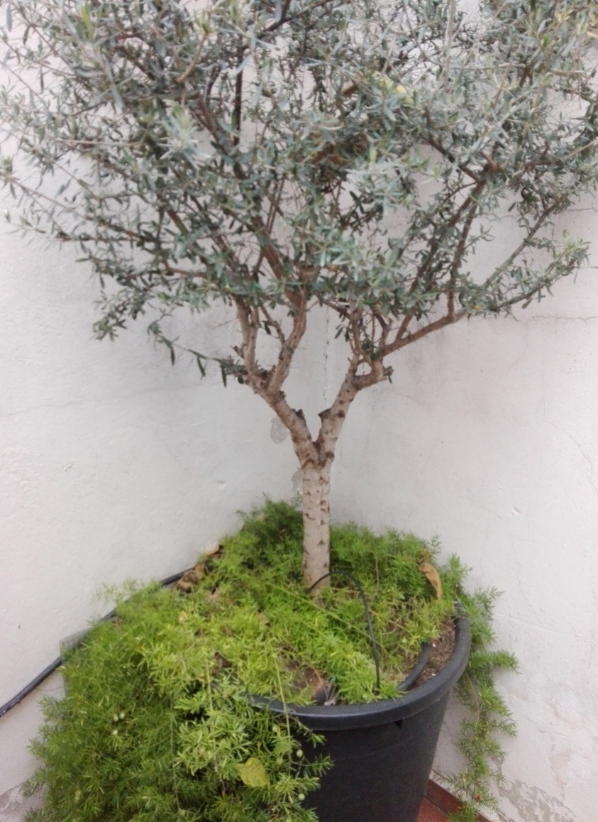
My grandfather Vicente was a farmer. When he lived, he cultivated trees and vegetables: oranges, peaches, olives, peppers, tomatoes and beans. But what he most liked was making tree seedlings of olive.
Notes:
<número>

Slide 3
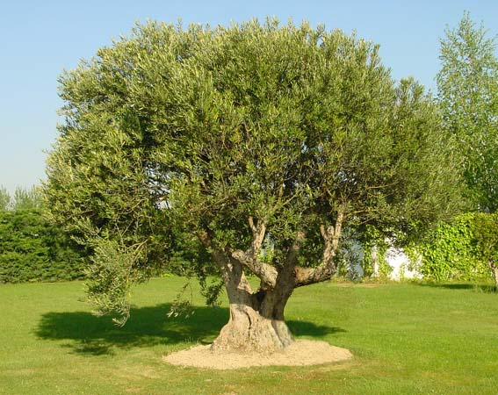
The olive is a long lived tree that has a wide cup, thick trunk and gray or silver bark. It lives in Mediterranean area. It´s rainfed agriculture.

Slide 4
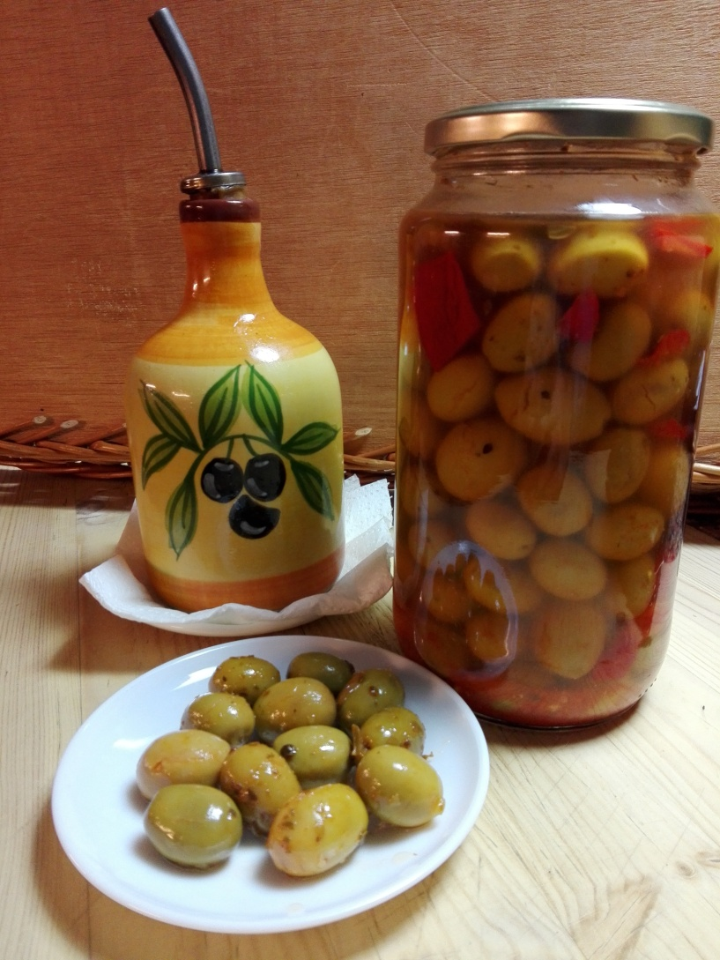
Olive is the fruit of the olive tree. It´s edible.

Slide 5
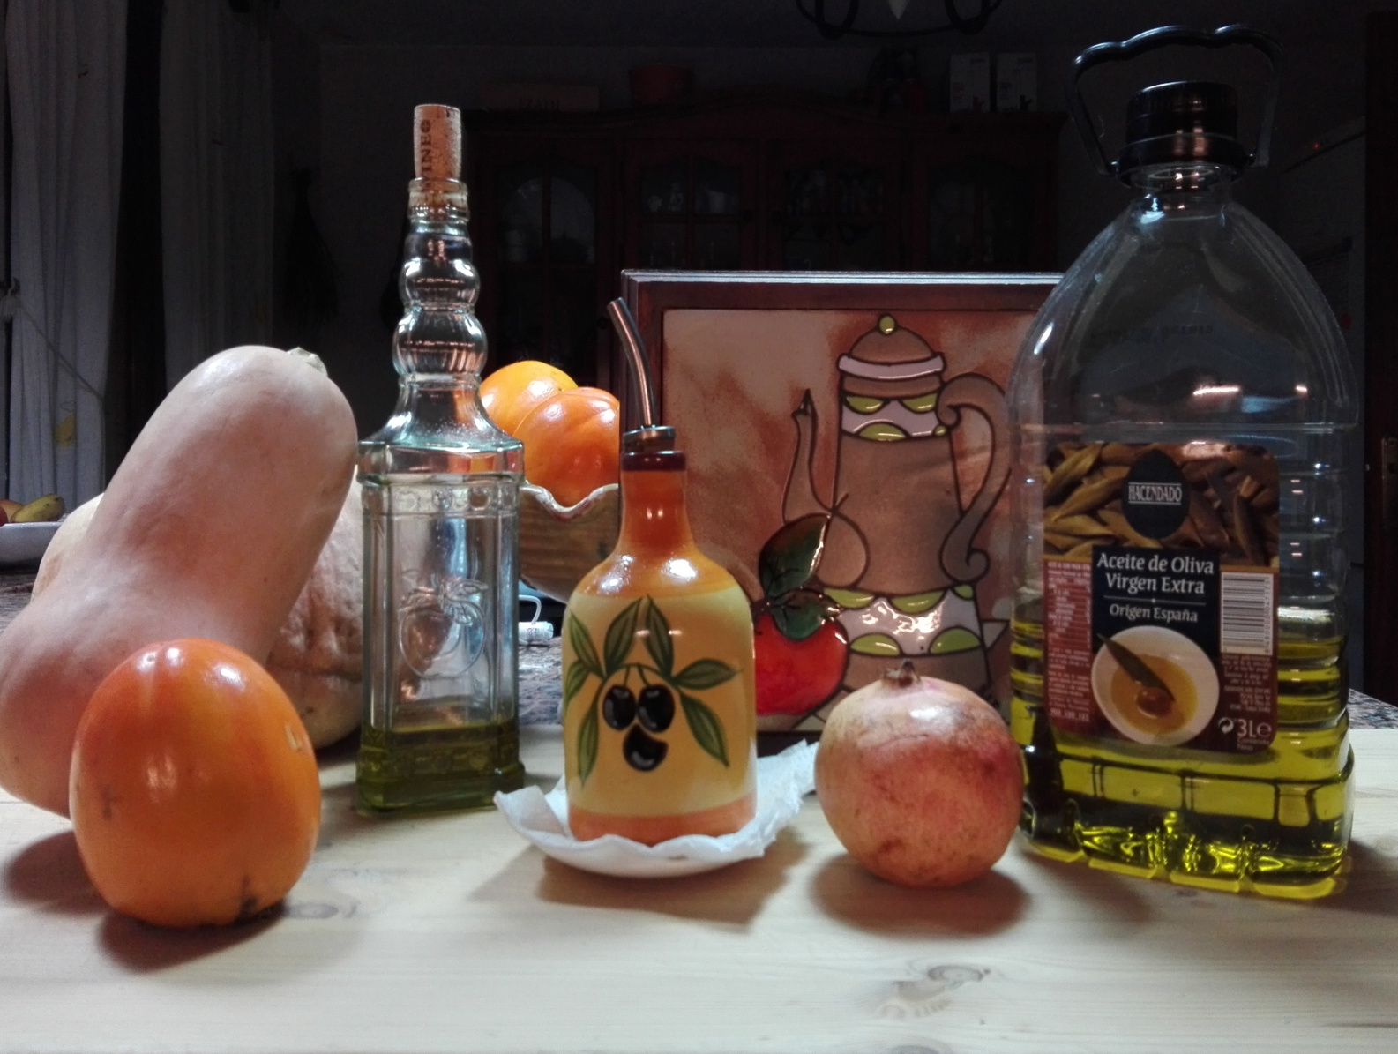
Oil is obtained by pressing olives.
Oil is used for cooking, and also for creams, soaps …

Slide 6
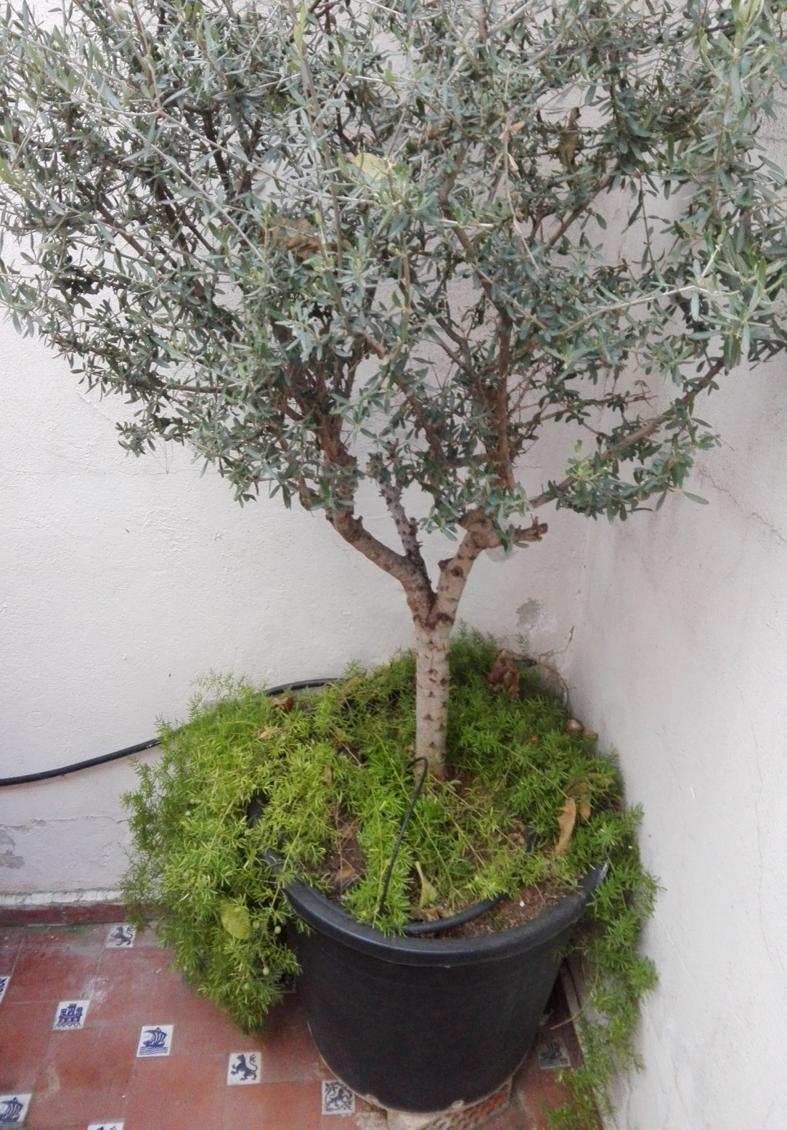
My grandfather Vicente planted this olive tree before he died.
The tree lives for the memory of my grandfather.

