Slide 1
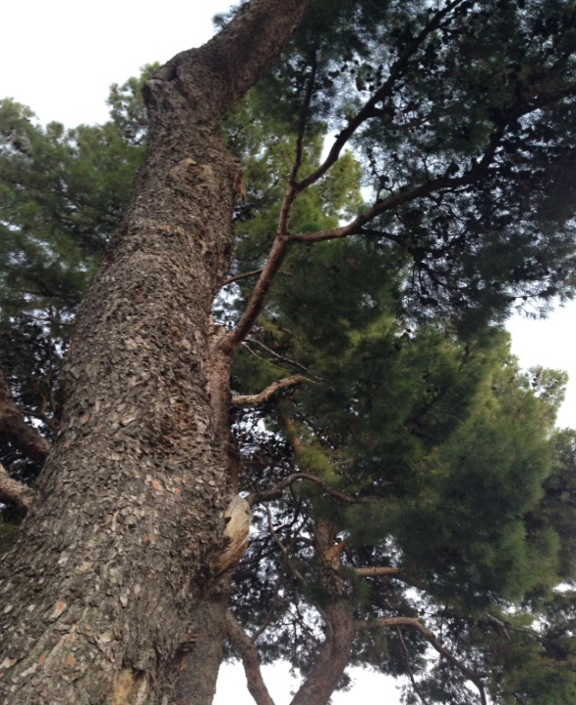
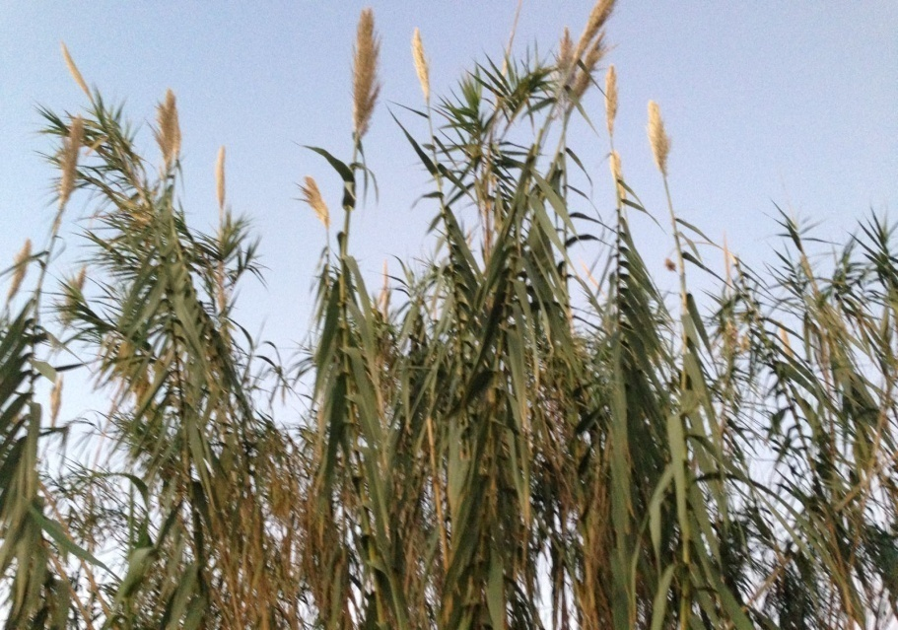
MY PROJECT ABOUT PICANYA´S VEGETATION
by Violeta Quesada
THE WHITE PINE AND THE REEDS

Slide 2
A LITTLE BIT OF HISTORY:
The name of our village, Picanya, is related to its vegetation .
PI (in valencian) = PINE
CANYA (in valencian) = REED
Picanya was called like this because the pines and reeds were one of the firsts species that there were here.

Slide 3
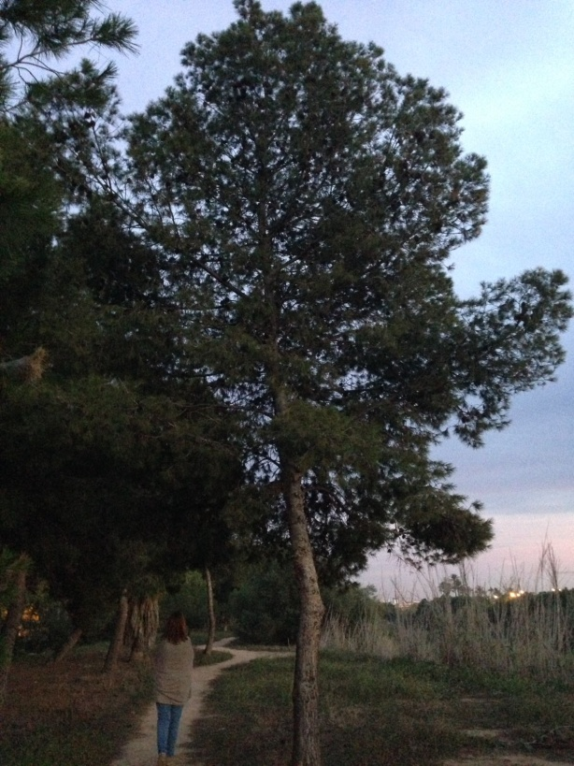
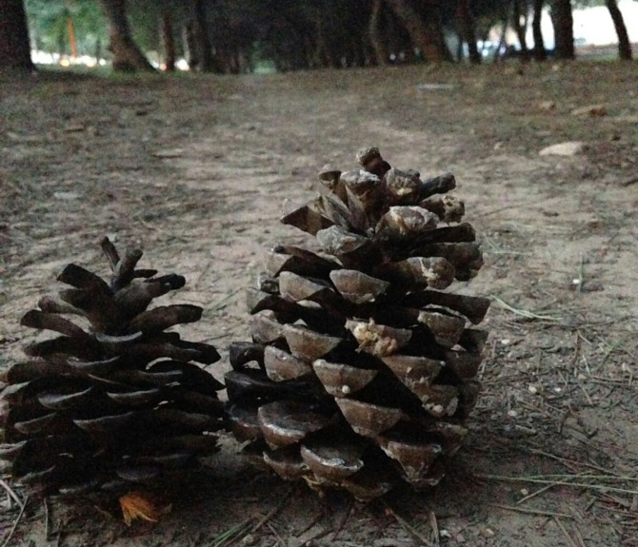
THE WHITE PINE
characteristics:
This kind of tree is one of the most abundant species that we can find in Picanya.
Some pines can get to
measure 20 m.
Their fruits are the pinecones.

Slide 4
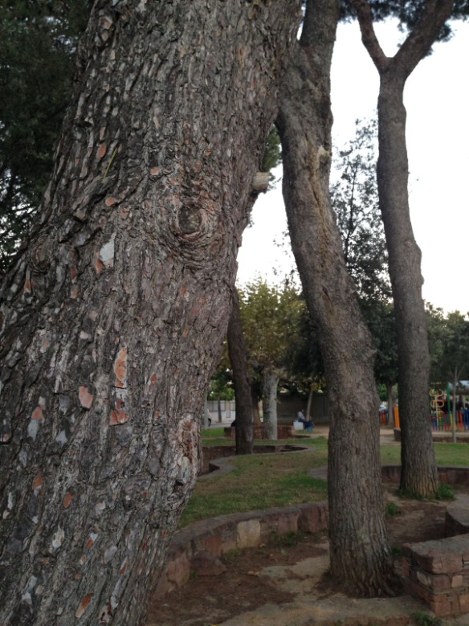
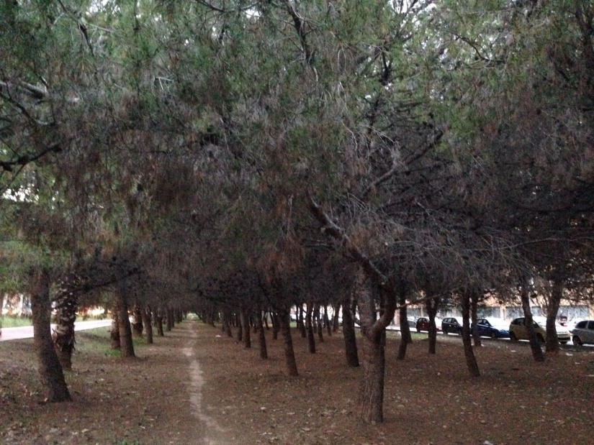
location
There are especially located in the village´s green areas like the Passeig de la primavera (the Spring park), Parque de Panazol (the Panazol´s Park) or the areas that there are near the ravine.

Slide 5
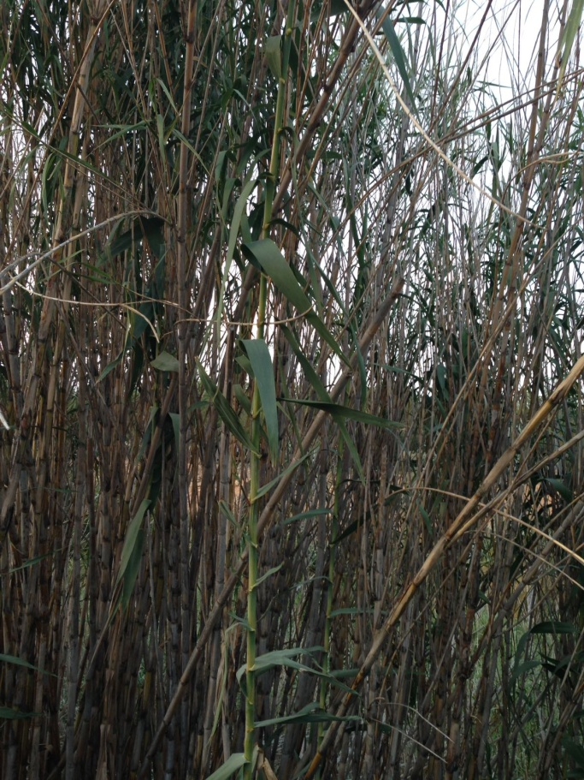
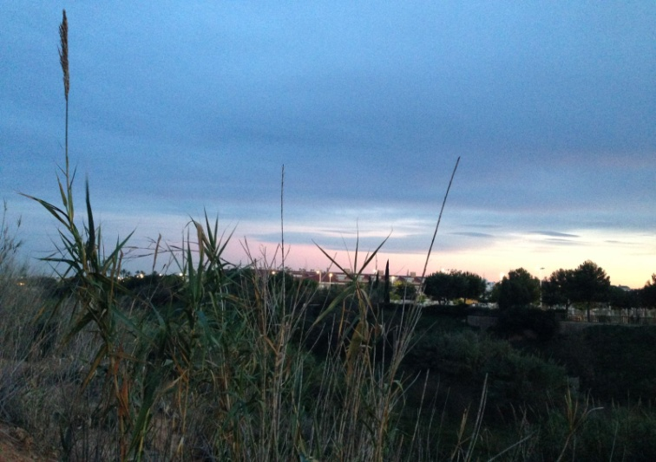
THE REEDS
characteristics:
This is a kind of vegetation
that needs a humid environment to grow.
They have long leaves and they finish
with a spike at the tip.
The reeds usually measure between
3 and 6 meters.

Slide 6
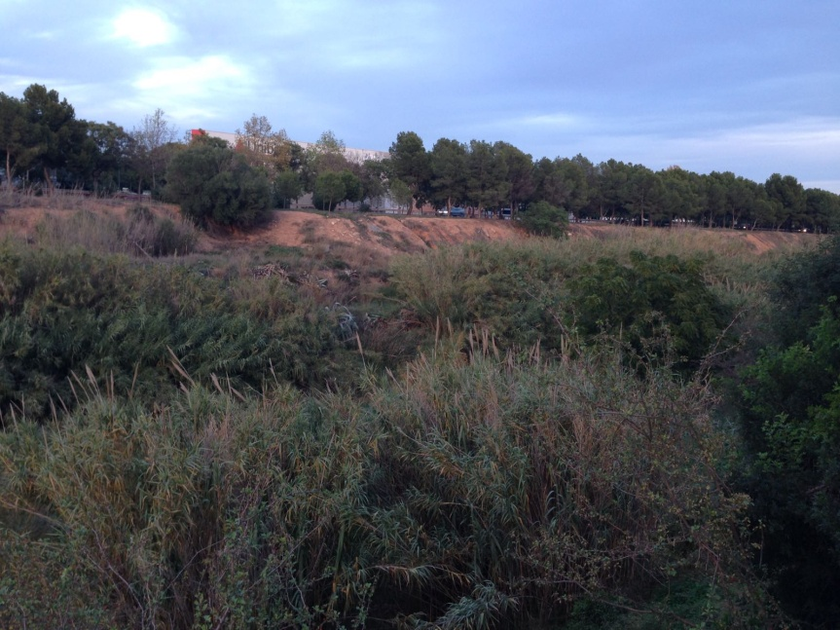
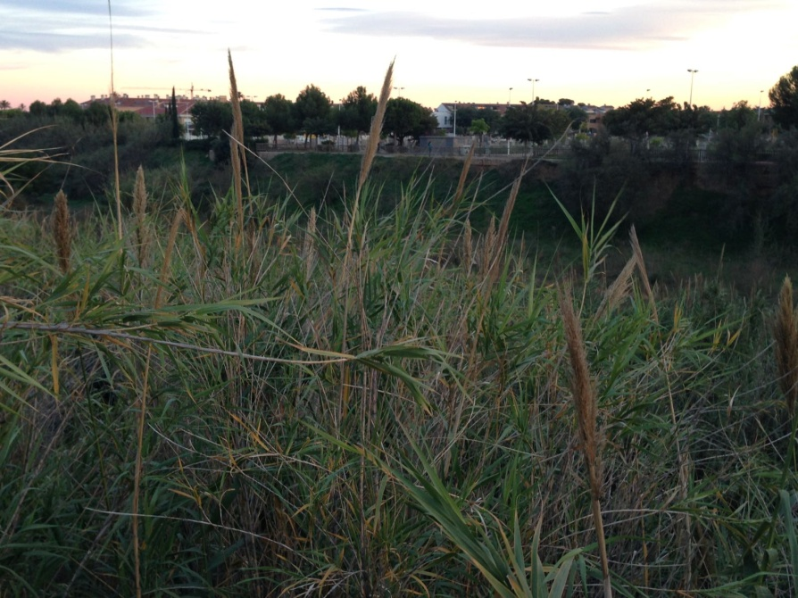
location
They are located in humid areas, especially in the ravine. Here there are a lot of them.

Slide 7
THE END
By: Violeta Quesada Villarroya
*All images have been taken by me

