Slide 1
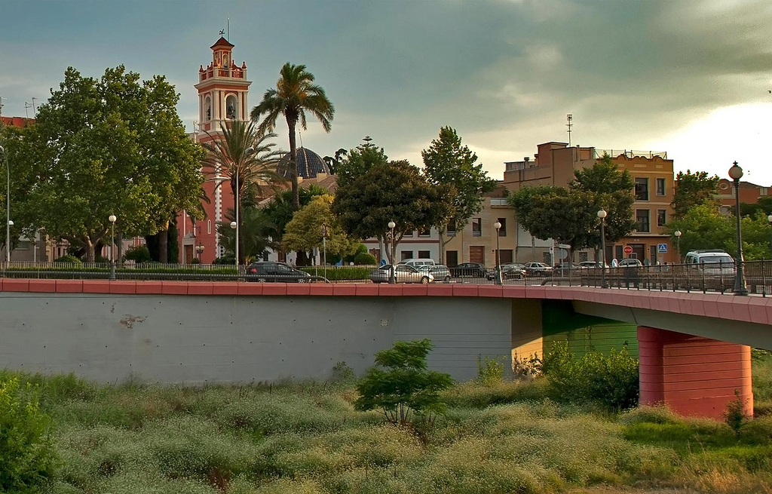
Picanya

Slide 2
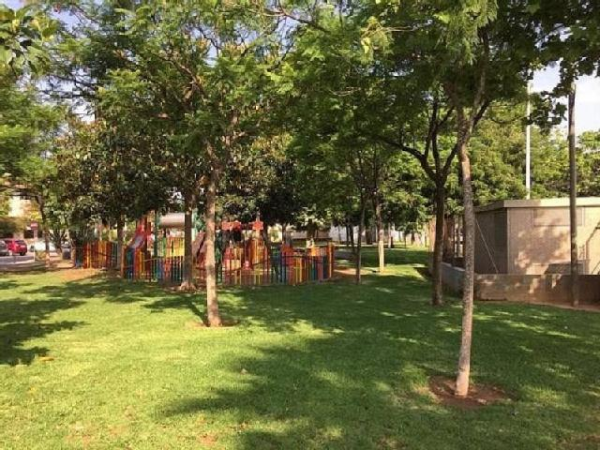
Picanya is a town with a lot of trees…

Slide 3
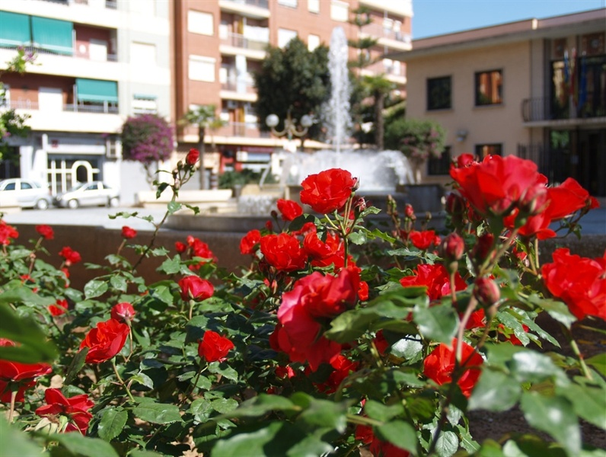
And a lot of beautiful flowers

Slide 4
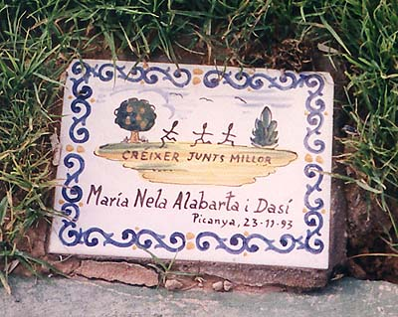
Thanks to the town hall of Picanya every time a child is born,a tree is planted or a plaque
is placed with the name and date of birth. We call this: a child, a tree

Slide 5
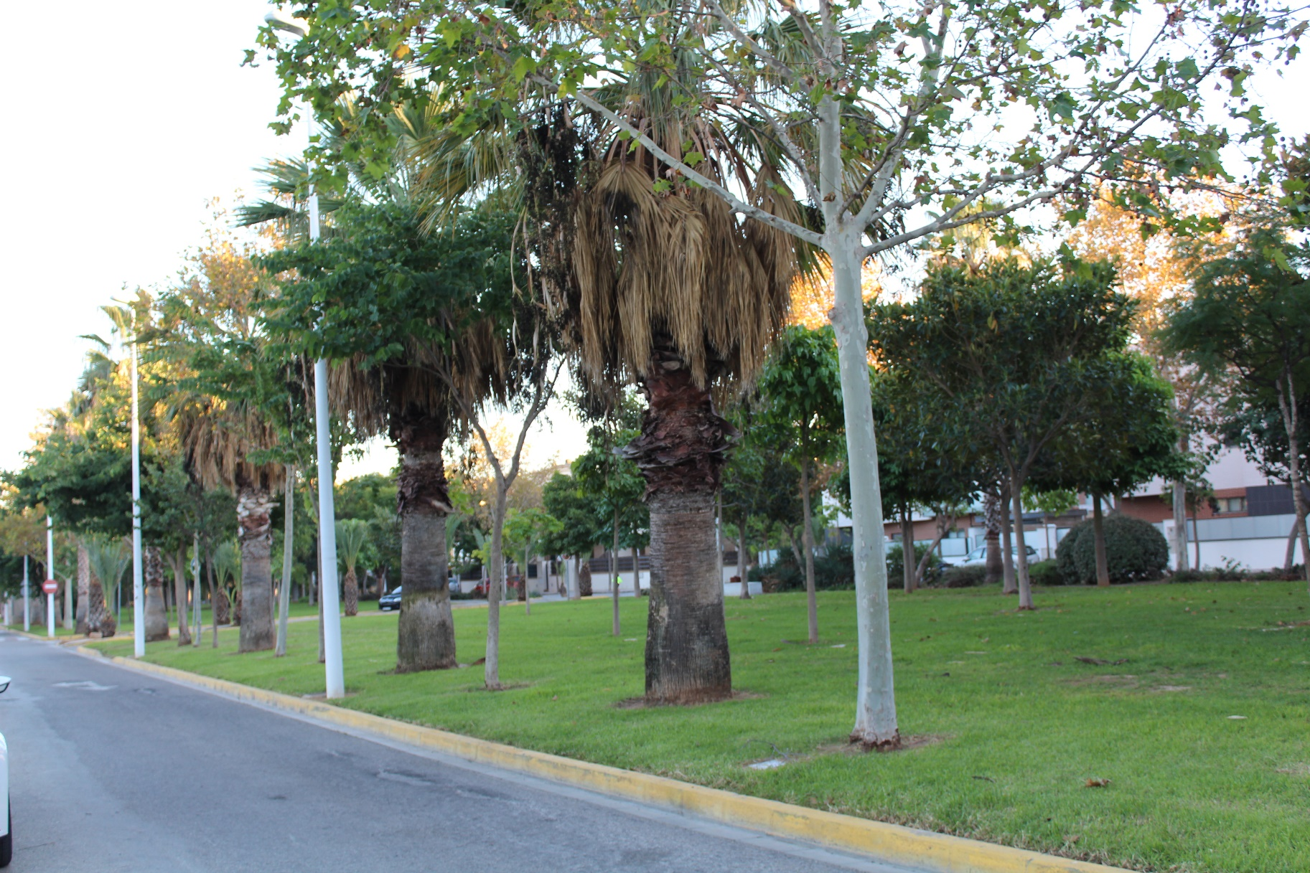
There is no street without any trees or plants.

Slide 6
Copyright: ajuntament de picanya

Slide 7
The End

