Slide 1
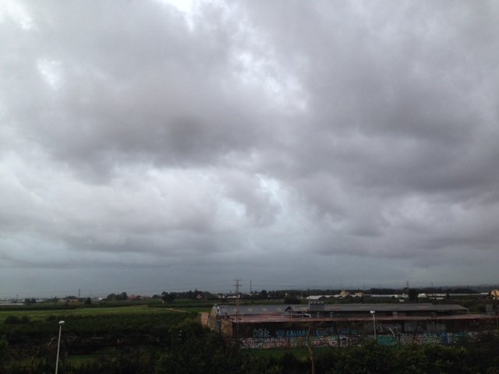
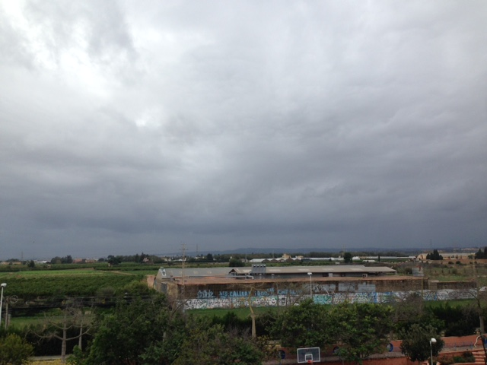
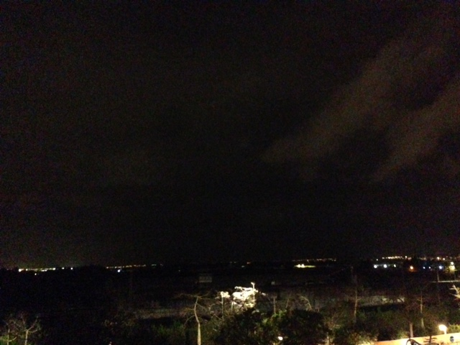
Wednesday 30
8:00 am//11ºC//Wind East//Cloudy
15:00 //16ºC//Wind East//Cloudy
17:40//15ºC//Wind Northeast//Cloudy

Slide 2
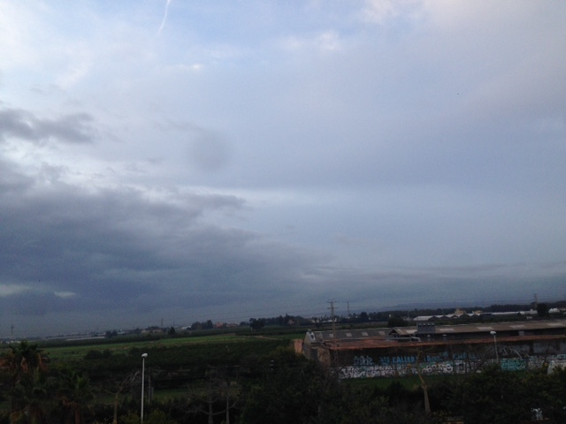
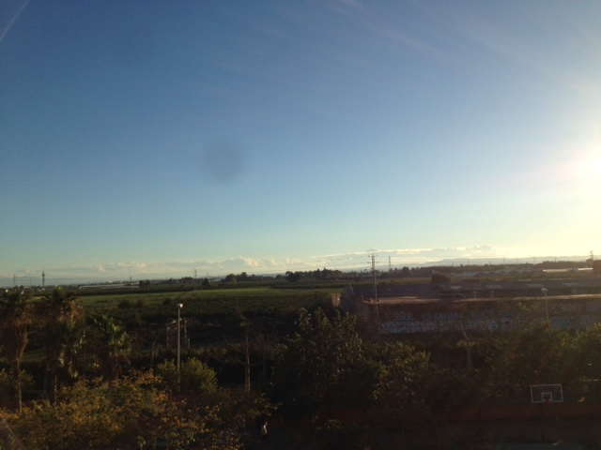
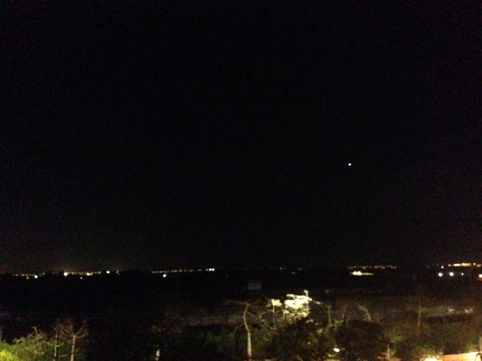
Thursday 1
7:30 am//11ºC//Wind North//Cloudy
17:00//14ºC//Wind North//Cloudy
15:30//15ºC//Wind East//Cloudy

Slide 3
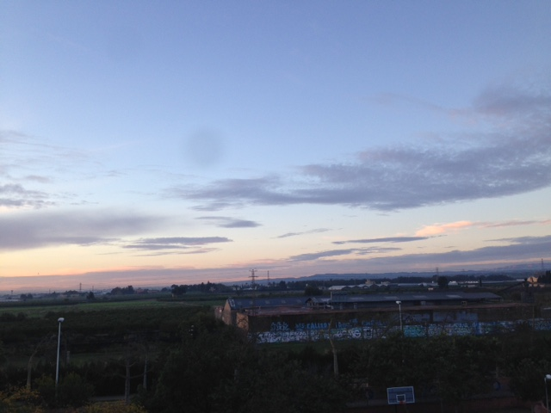
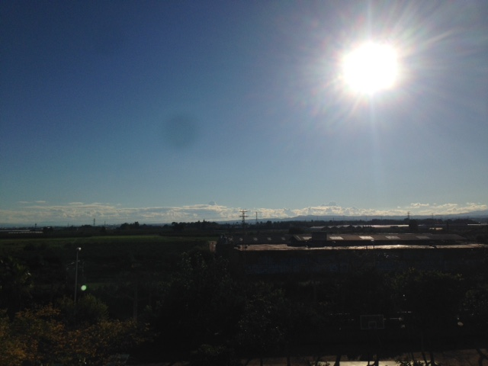
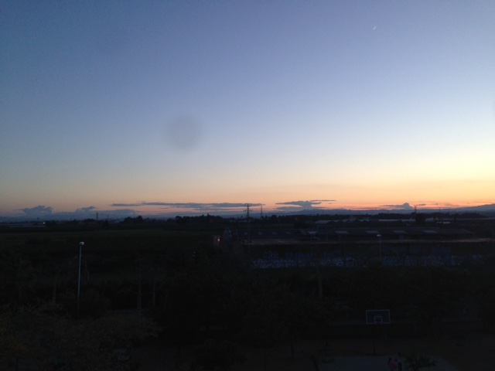
Friday 2
8:00 am//9ºC//Wind West//High Clouds
15:00//16ºC//Wind West//High Clouds
17:30pm//20ºC//Wind Southwest//Sunny

Slide 4
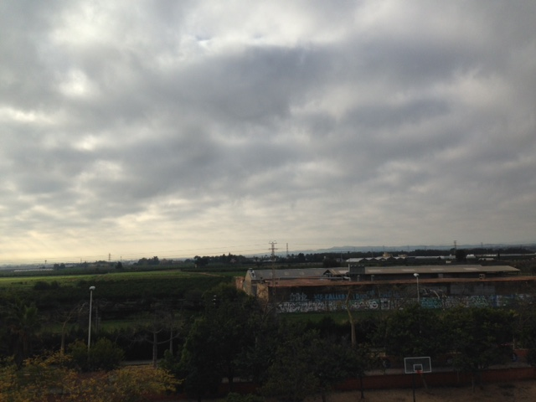
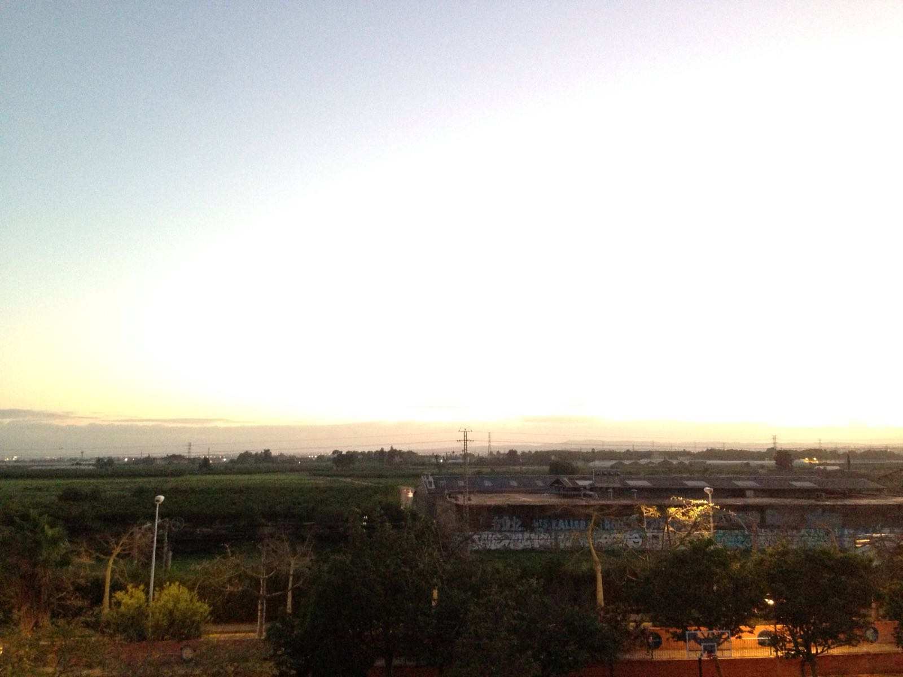
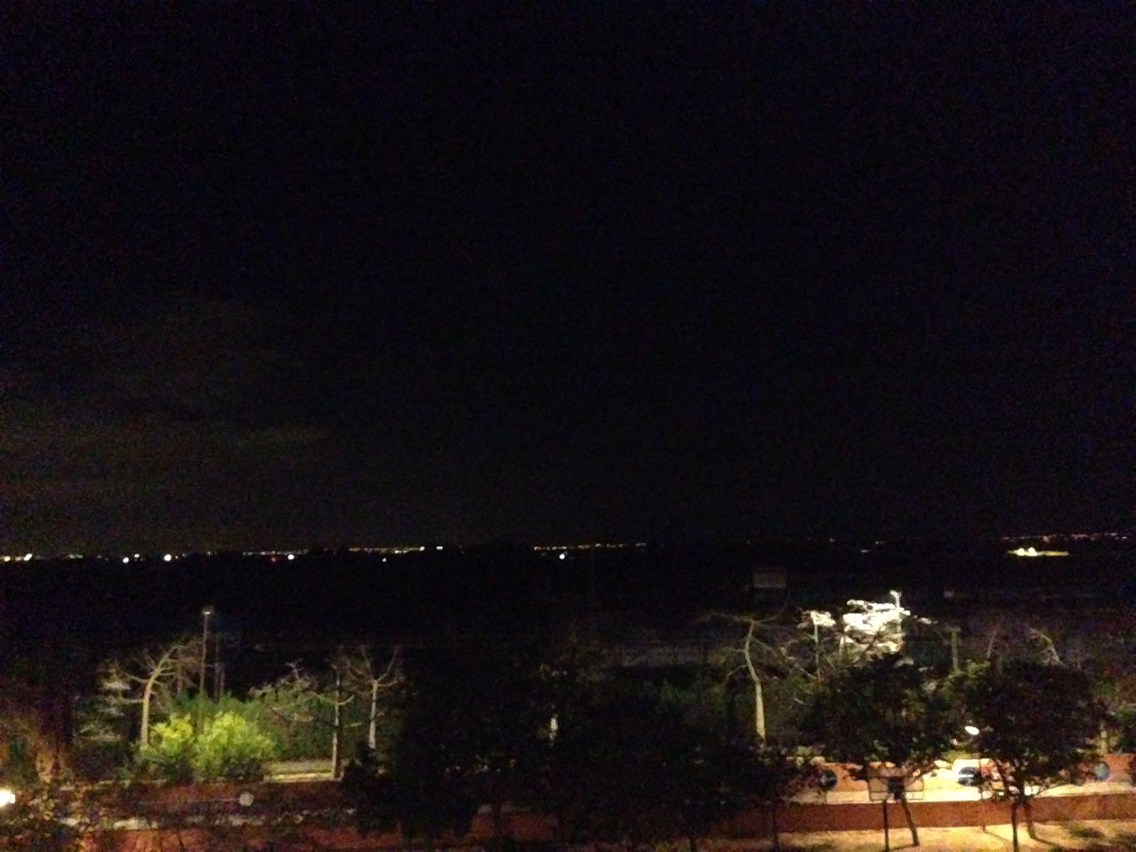
Saturday 10
8:00 pm//9ºC//Wind West//Cloudy
15:00pm//16ºC//Wind East//Cloudy
17:30//16ºC//Wind East//Sun and Clouds

Slide 5
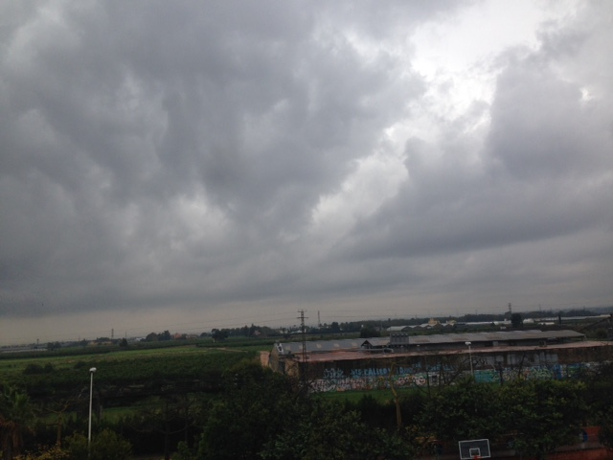
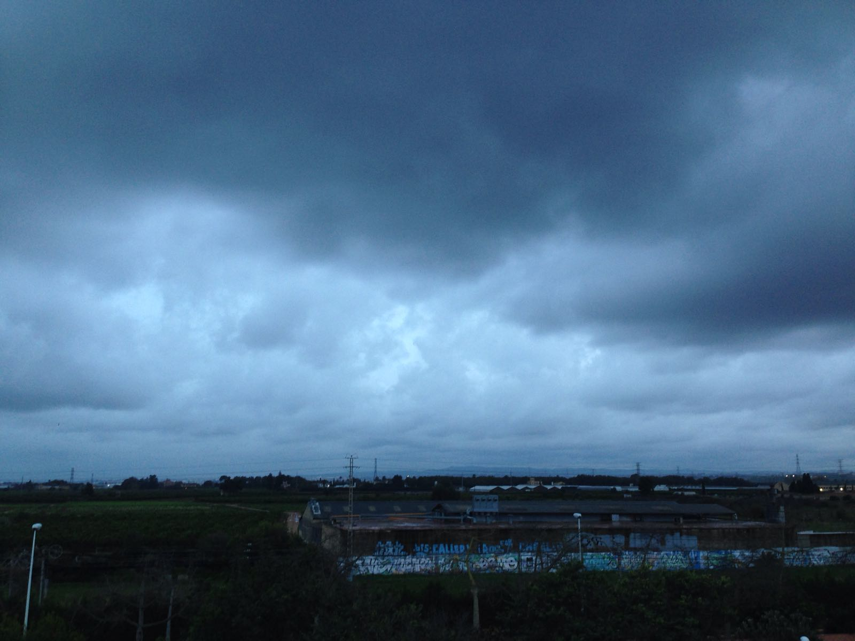
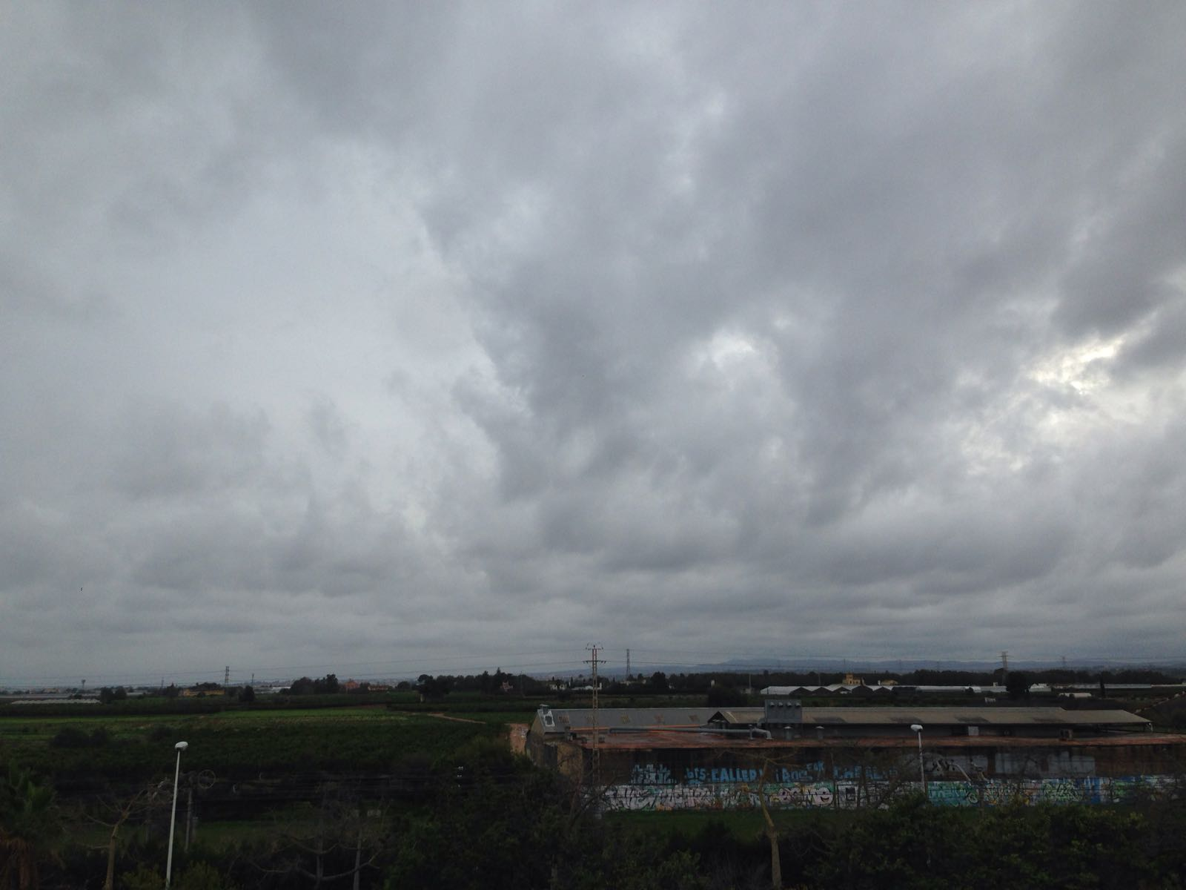
Sunday 4
8:30 am//12ºC//Wind North//Raining
17:30//16ºC//Wind East//Raining
15:30//14ºC //Wind East//Raining

Slide 6
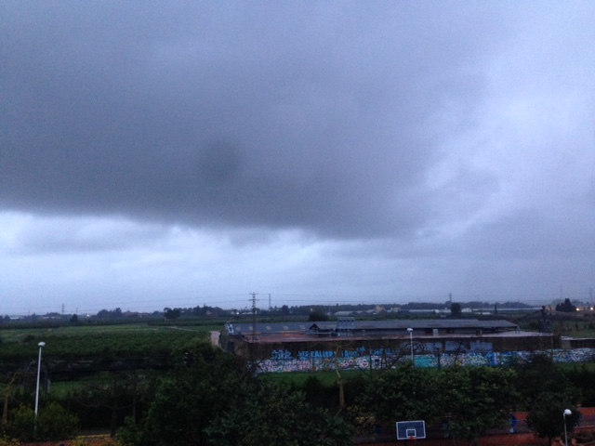
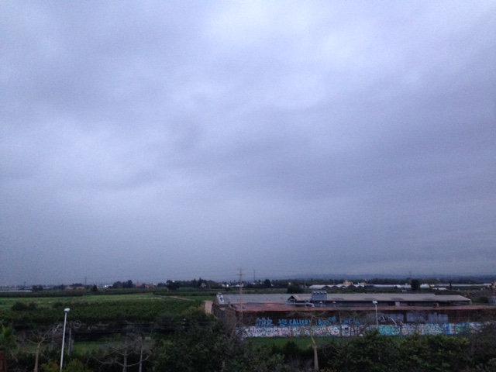
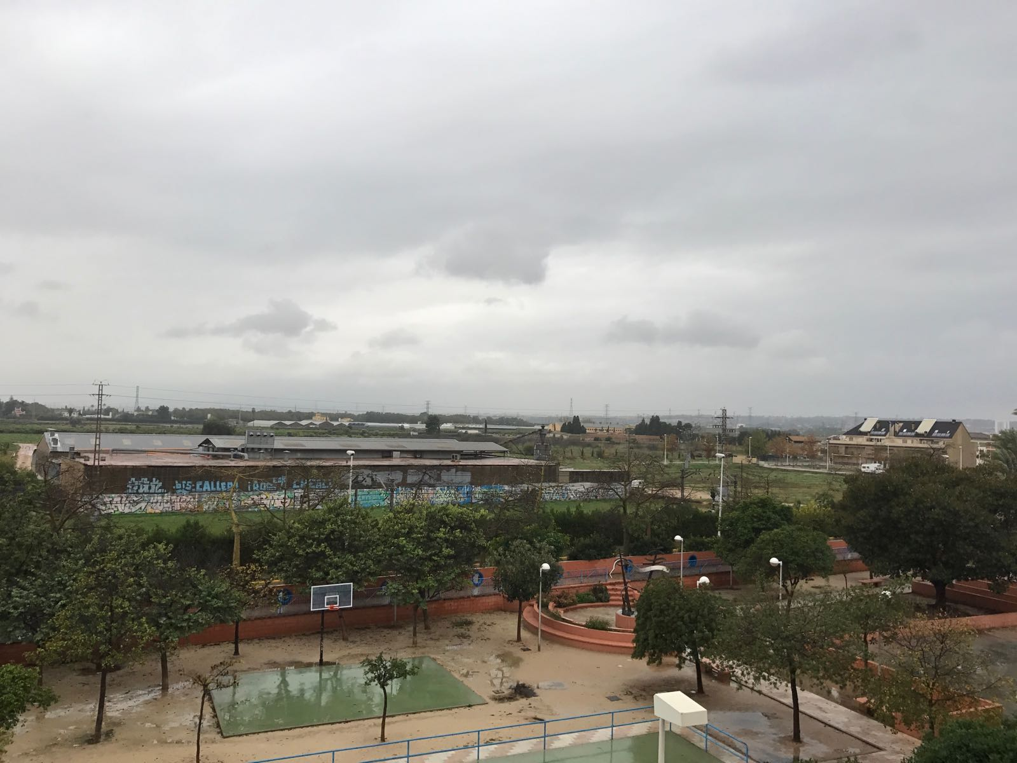
Monday 5
8:00 pm//13ºC//Wind North//Rainy
17:30 P.m//13ºC//Wind North//Rain
15:00 pm//10ºC//Wind North//Rain

Slide 7
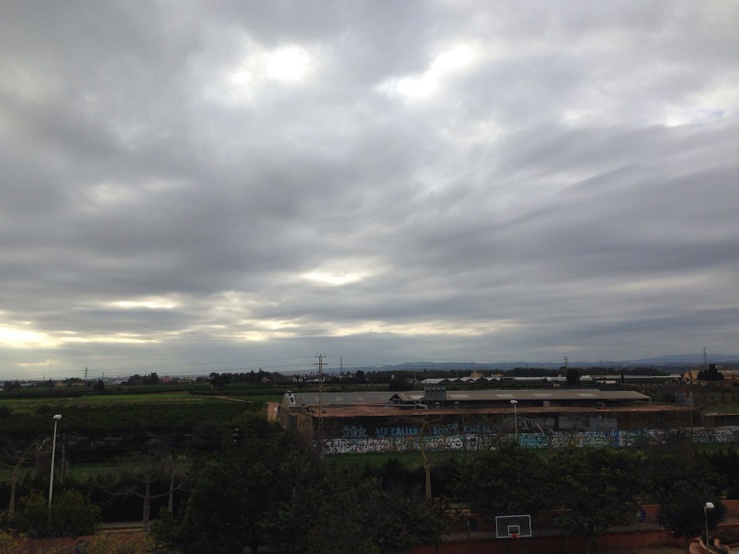
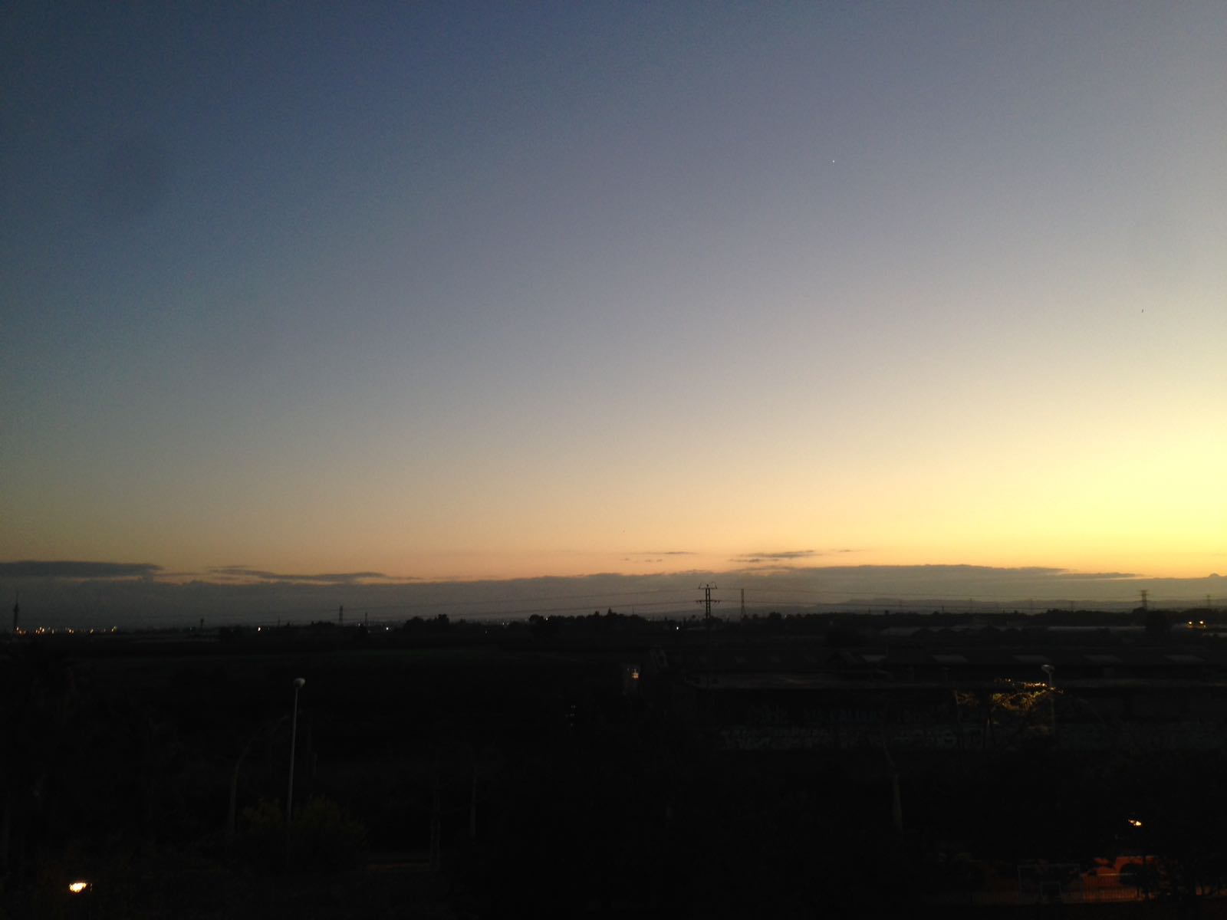
Tuesday 6
10:00 A.m//13ºC//Wind North//Cloudy
17:30 pm//14ºC//Sunny//Wind North
15:00 pm//16ºC//Wind Northeast
//Cloudy

Slide 8
Copyright Claudia Vidal.
-The End-

