Slide 1
ERASMUS + PROJECT
MARIA PILAR CASABÁN ESTEBAN

Slide 2
BOUGAINVILLEA
This flower is typical in South America, but it is in Spain, too. This bush is from 1 to 12 m tall and its flowers are of different colours like purple, pink, red, orange and white. This plant has got a lot of different names over the world like Bunganvilla in Spain or Napoleón in Honduras. This flower is very beautiful, but it has got a waxy substance inside.

Slide 3
HISTORY
This flower was described by Philippe Commerçon, a botanist accompanying French navy admiral Louis Antoine Boungainville during his voyage of circumnavigation around the earth. Twenty years later the Boungainvillea was known worldwide and appeared in Generea Plantarum in 1789 but it was corrected in 1930.

Slide 4
CULTiVATION AND USES
Bungainvilleas are a popular ornamental plant in most areas with warm climates like Mediterranian climate. There are over 300 varieties of bungainvilleas around the world. The bungainvillea is also a very atractive bonsai in many places.

Slide 5
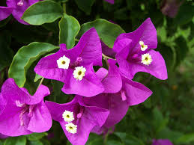
PHOTO
This photo is from the internet page call :
enciclovida.mx

Slide 6
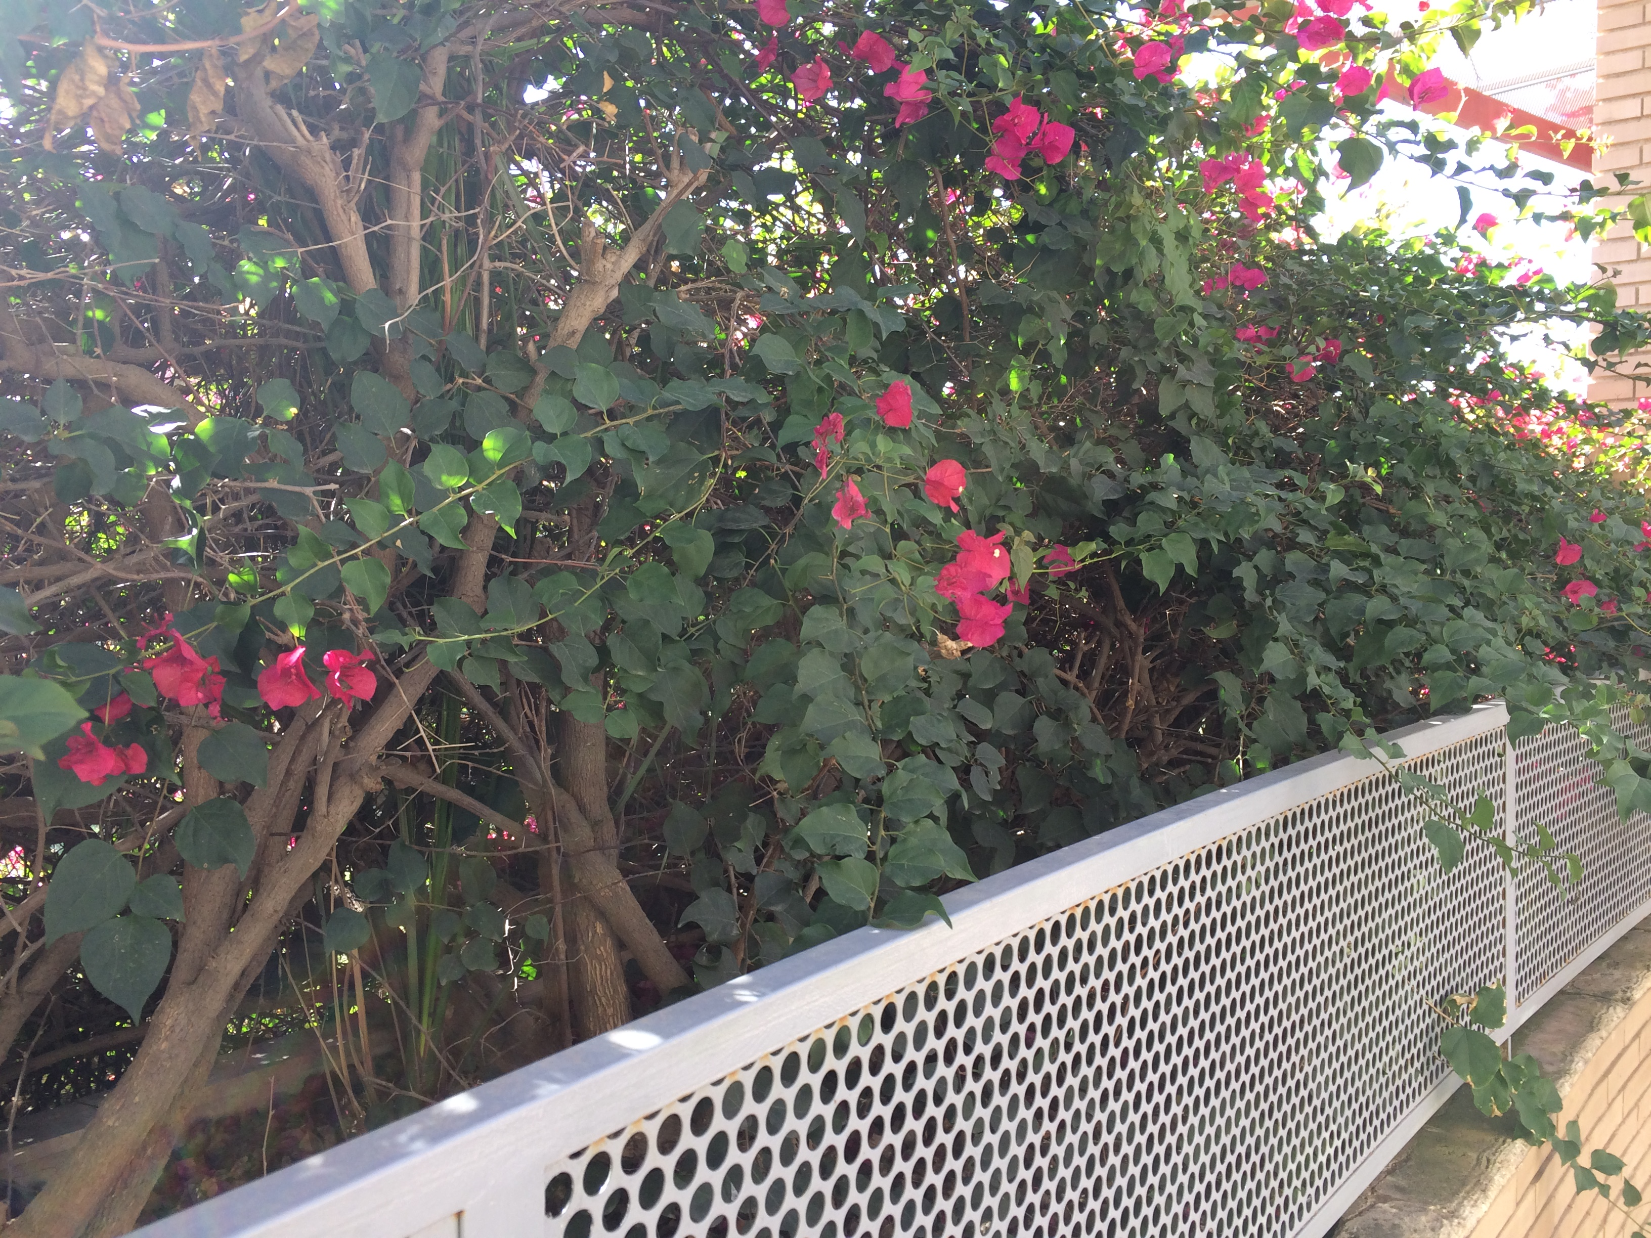
PHOTO 2
This photo was taken by me.

