Slide 1
El passeig de la primavera
THE VEGETATION OF PICANYA
A presentation by Mariola Monfort
Notes:
<número>

Slide 2
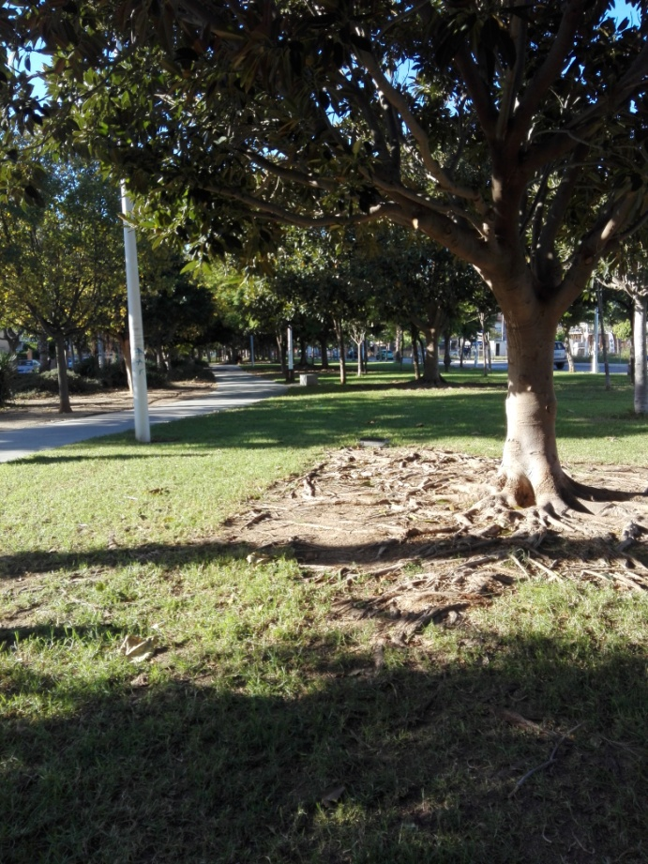
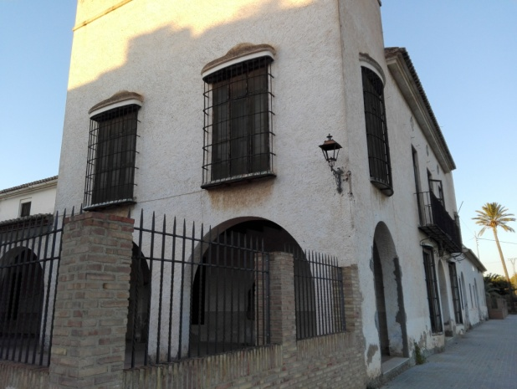
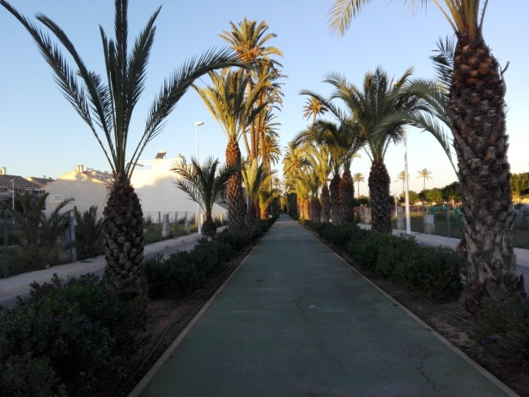
Location and history
El paseig de la primavera (in English ''the spring park'') is one of the many green areas in Picanya, located in the suburbs of the village.
Initially, this part of Picanya belonged to a farmhouse, '' l'Alqueria de les Palmes '', but when the village started to unify, the owners of the farm sold it to the town hall. Now, the building itself stays there in memorial of Valencian culture.
There we can find many species of plants.
Notes:
<número>

Slide 3
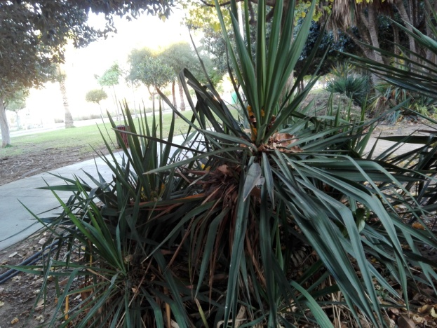
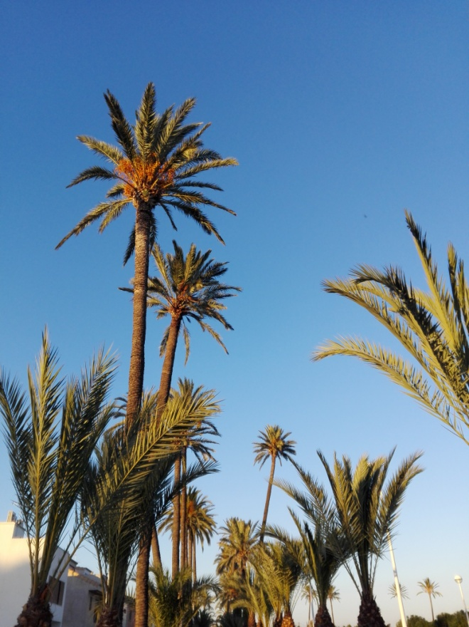
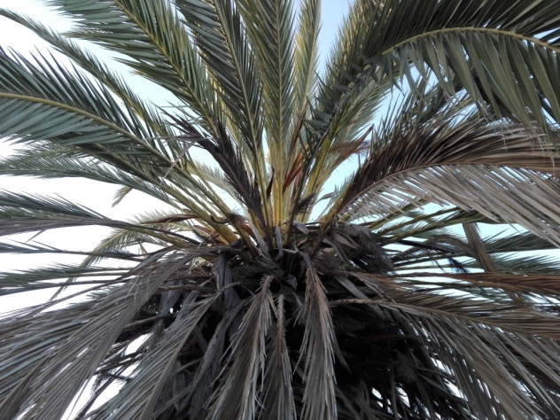
The palm tree
The palm tree is very common in this area, in spite of its African origin.
This is because when Spain was part of Al-Andalus, the peole who lived here cultivated the palm tree, so they brought it with them.
There are two basic species, even though we can find a few more:
- The date palm tree, wich produces dates and is really tall.
-The ''Palmito'', wich is tipical of the Mediterranian zone. It's smaller, with thinner leaves.
Notes:
<número>

Slide 4
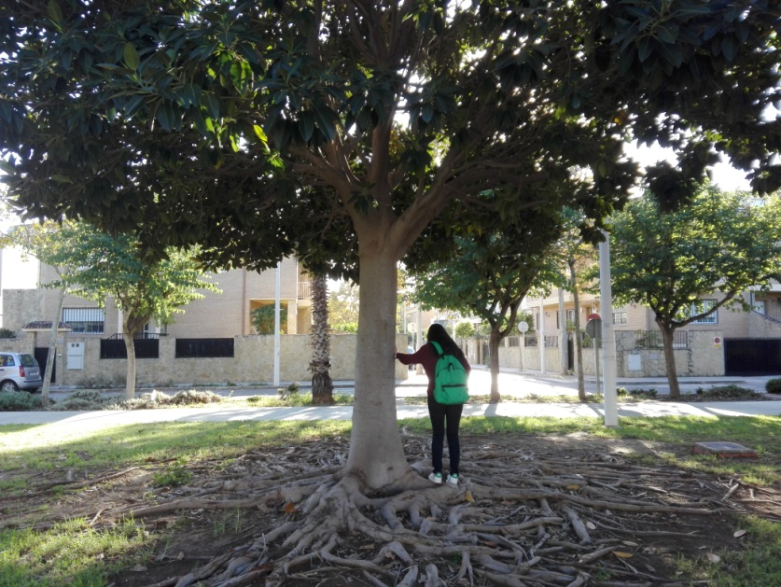
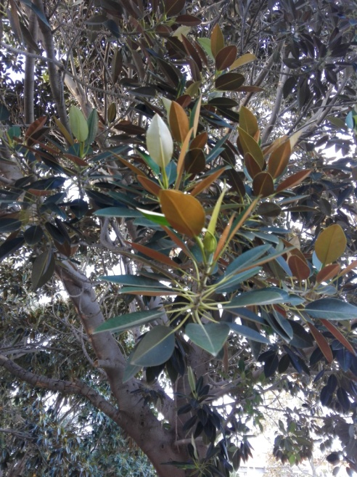
The ficus
Another tree is the ficus, specifically the ficus elastica (or rubber figue), wich has perennial leaves and aerial and buttressing roots.
It is used as an ornameltal plant in the park, because it tolerates drought and sunlight.
Notes:
<número>

Slide 5
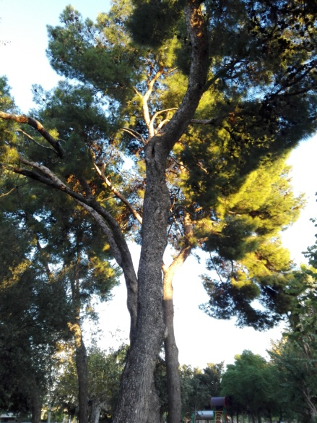
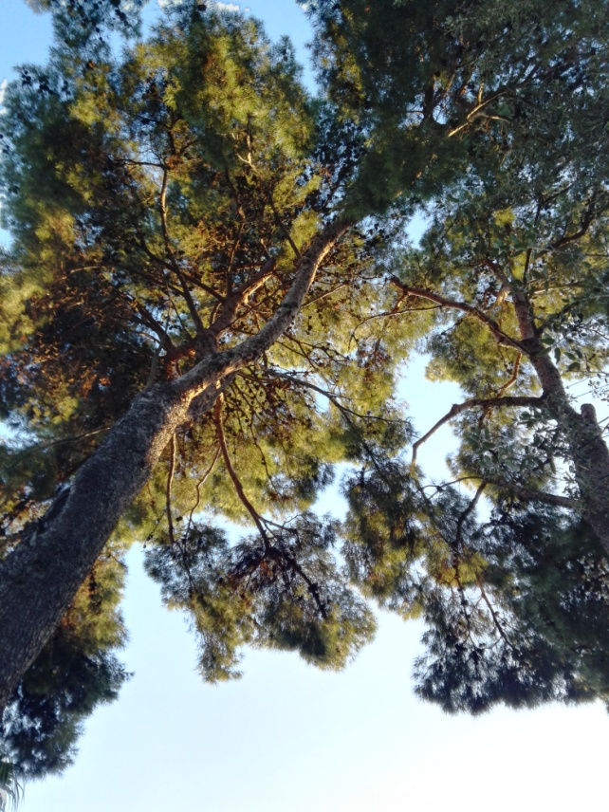
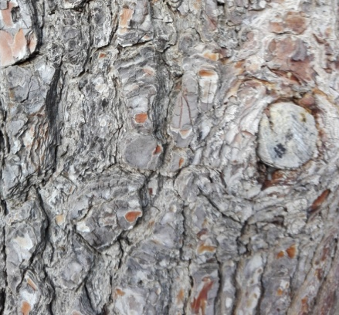
The pine tree
This tree is very typical of the Mediterranean forests, and it also gives Picanya its name (PI-Pine CANYA-cane).
It has a strong trunk and needle shaped leaves.
Its flowers are the pinecones. They are the result of the female flowers when they are ripening.
Notes:
<número>

Slide 6
THE END
I HOPE YOU'VE LIKED IT
Notes:
<número>

