Slide 1
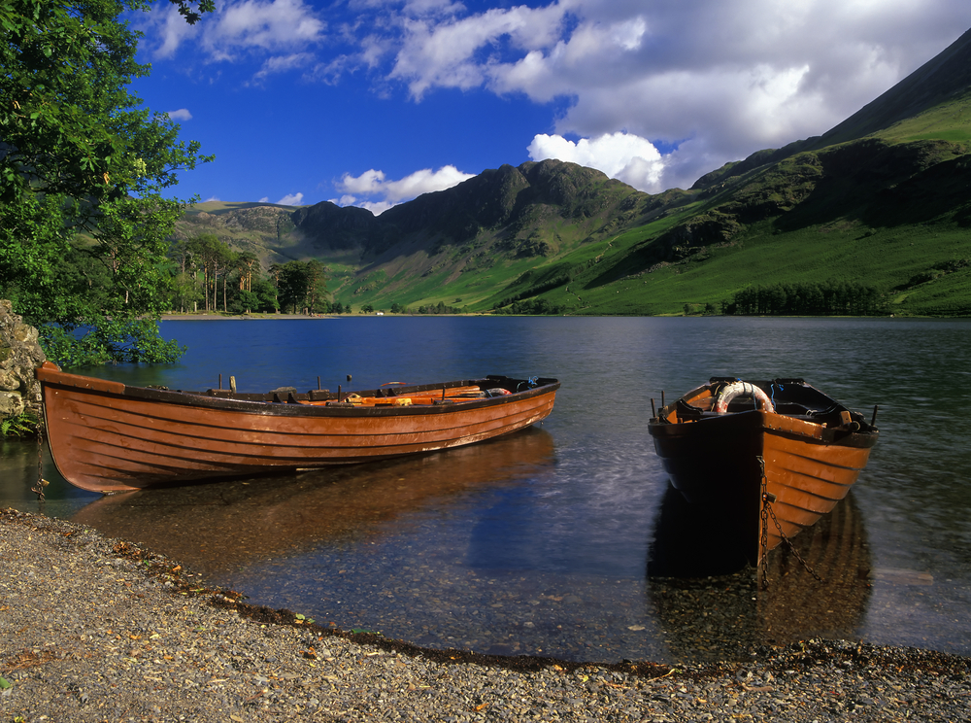
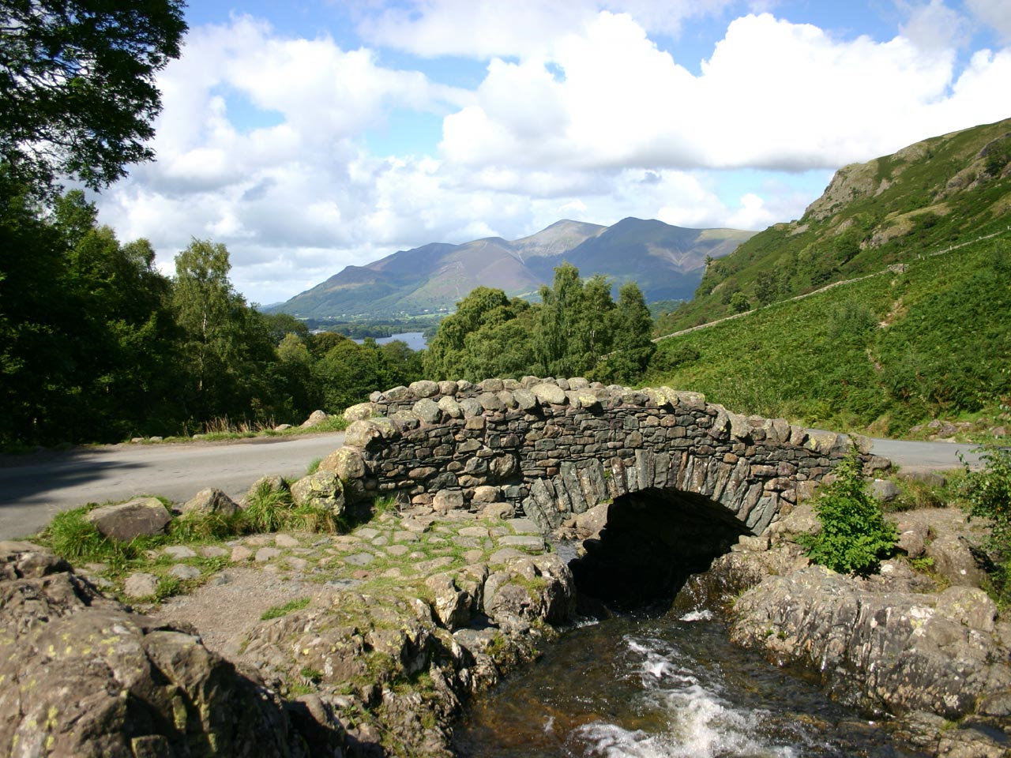
The Lake District
By Linea

Slide 2
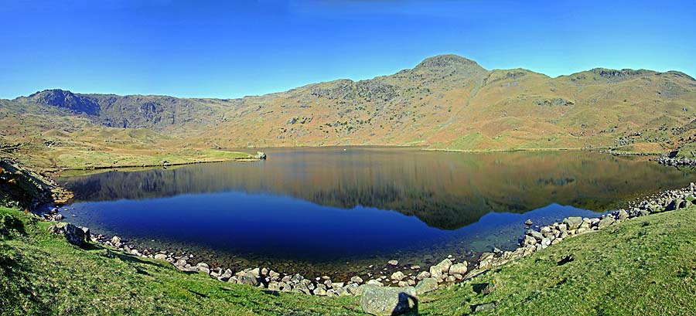
What is a Tarn?
A tarn is not a normal lake it is a lake that you have to climb to (on mountainous ground)to see, so it is not at ground level it is above.

Slide 3
Description of the Lake District
The Lake District, the UKs largest National Park. Located in Cumbria in the North West of England.
Sheep farming in particular has been a main stay of the economy over the years. To this day sheep farming remains an important factor both to the economy of The Lake District, as well as in preserving the stunning landscape which attracts visitors and hence income to the region.
Certain lakes provide a source of drinking water.
The Lake District National Park is the destination for millions of tourists who every year come to take on the challenges the mountains and fells have to offer, or the pleasures of hiking, sailing, and horse riding, and also to visit the numerous and varied attractions.

Slide 4
Animals
A lot of animals live in the lake district including the ones in the wildlife park. These are just a few of them: Owls, swans, red squirrels, cows, otters, pigs, sheep, hawks and foxes.

Slide 5
Five largest lakes
Windermere - 14.8 square kilometers
Ullswater - 8.9 square kilometers
Derwentwater - 5.5 square kilometers
Bassenthwaite Lake - 5.3 square kilometers
Coniston Water - 4.0 square kilometers

