Slide 1
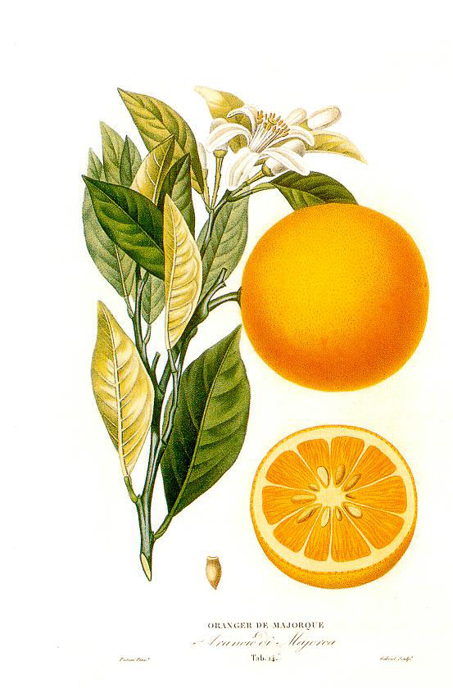
THE ORANGE TREE

Slide 2
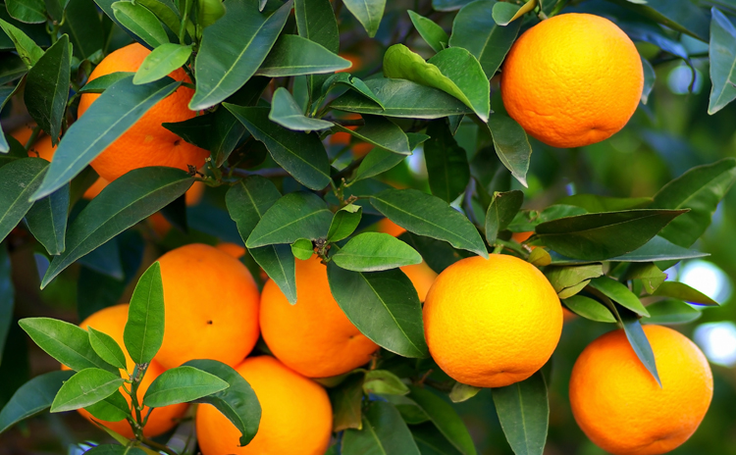
DESCRIPTION OF THE TREE
The orange tree is a fruit tree. It is a tree that reaches up to 13 m high, is perennial, with a large cup, round leaves with 7 to 10 cm and branches sometimes with large spines (more than 10 cm).

Slide 3
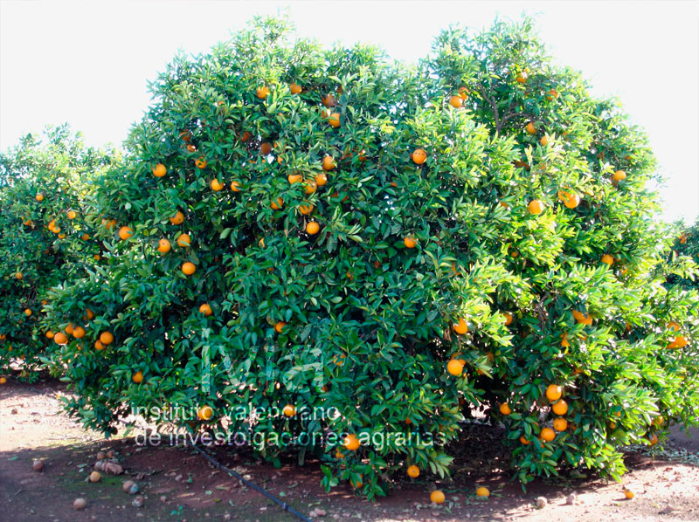
The orange tree is a medium-sized tree, 3 to 5 meters high, with rounded crown and regular branches. A trunk, green first and gray later. The branches appear one meter, more or less, from the ground. The leaves are evergreen, medium and elongated, rounded at the base and pointed.

Slide 4
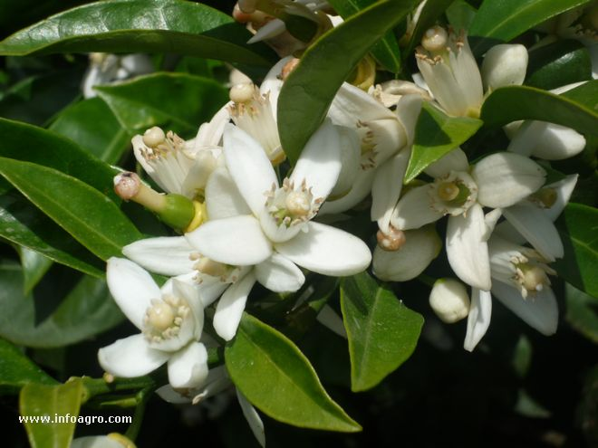
FLOWERS OF THE ORANGE TREE
Its white flowers, are born singly or in clusters and are very fragrant.

Slide 5
THE END
By Paula García Domínguez
Credits of the photos:
-1st photo: https://upload.wikimedia.org/wikipedia/commons/thumb/6/60/Histoire_et_culture_des_orangers_A._Risso_et_A._Poiteau._--_Paris_Henri_Plon,_Editeur,_1872.jpg/225px-Histoire_et_culture_des_orangers_A._Risso_et_A._Poiteau._--_Paris_Henri_Plon,_Editeur,_1872.jpg
-2 photo: http://jardin.aki.es/wp-content/uploads/2015/11/naranjo.jpg
-3 photo: http://www.naranja-valenciana.com/wp-content/uploads/2010/09/naranjo.jpg
-4 photo: http://www.infoagro.com/galeria/fotos/b/427-flor_naranjo6.jpg
Music: Jonas Blues-Perfect Strangers

