Slide 1
Picanya’s flora
In Picanya there are many types of flowers and plants but now I am going to talk about the lantana, brugmansia and leonotis leonurus.

Slide 2
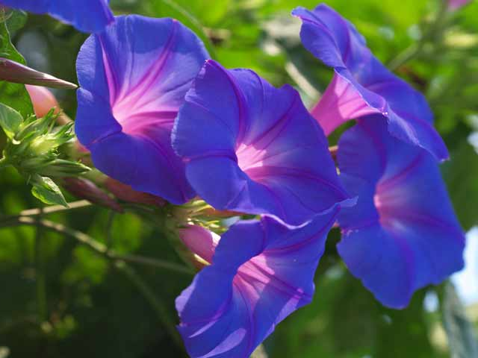
Brugmansia
Brugmansia
Species: podranea
This is a green, vigorous plant that blooms in the autumm. It’s largely cultivated, especially in the provinces of mild climate of the east and south of the peninsula and the Balearic Islands.

Slide 3
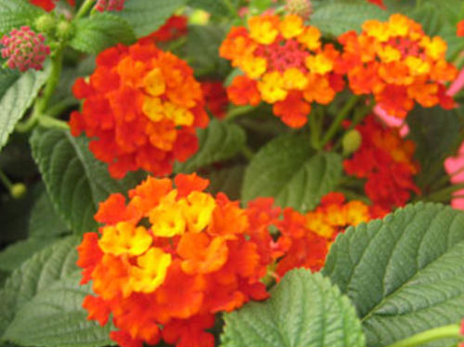
Lantana
The lantana.
Its flowers can change colour in less than a day, for example, from yellow to orange. It’s a poisonous plant, its fruits can produce poisoning.

Slide 4
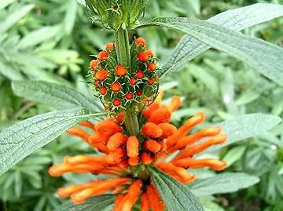
Leonotis leonurus
The leonotis leonurus of the species leonotis.
Its leaves are used to make medicinal tea of hypnotic character. Leaves and roots are also used as a cure for the snake bite.

