Slide 1
THE
PINE
BY MARIA GUARCH

Slide 2
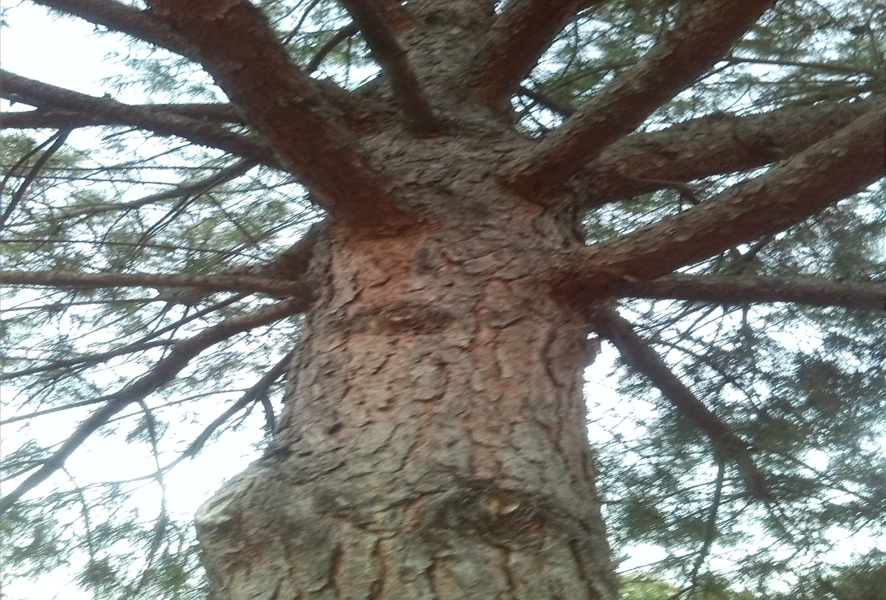
DESCRIPTION
They have long, thin, pointed and green leaves.
Its trunk has got a brown and hard bark.

Slide 3
PINECONES
Its fruit is called pinecone and in some of them you can find pine seeds.
You can eat them, they’re delicious.

Slide 4
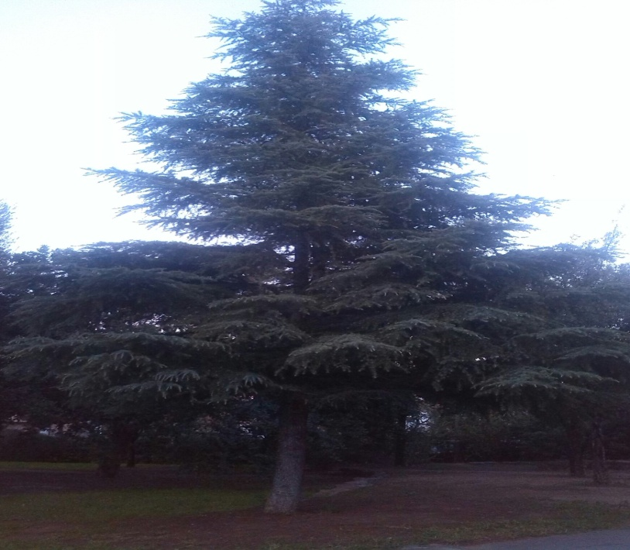
WHERE CAN THEY LIVE?
These trees can grow in sandy soils from sea level until high mountain.
Its roots can grab to rocks, if they need to survive.

Slide 5
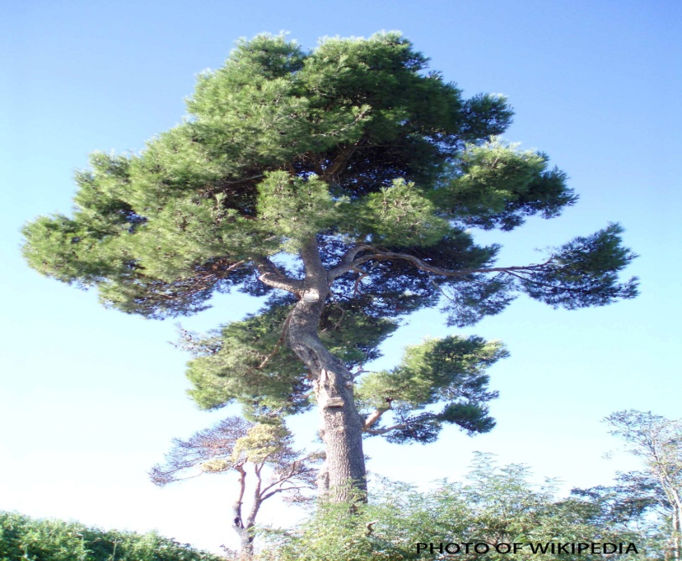
HOW MANY ARE THERE?
There are around one hundred and ten different kinds of pines.
There are twelve pine species in Europe.
In this photo you can see a “ Pino carrasco”.

