Slide 1
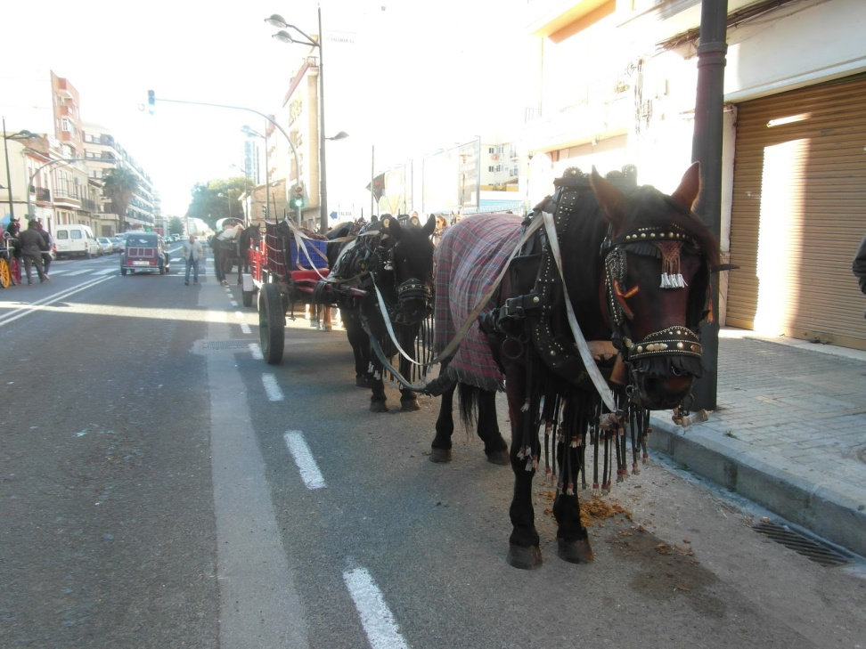
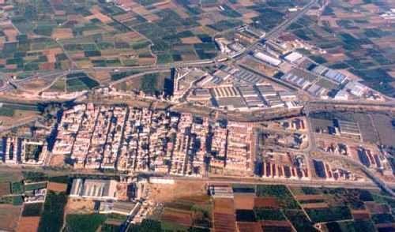
FLORA AND FAUNA IN PICANYA
San Antoni Abad’s day
Aerial view of Picanya

Slide 2
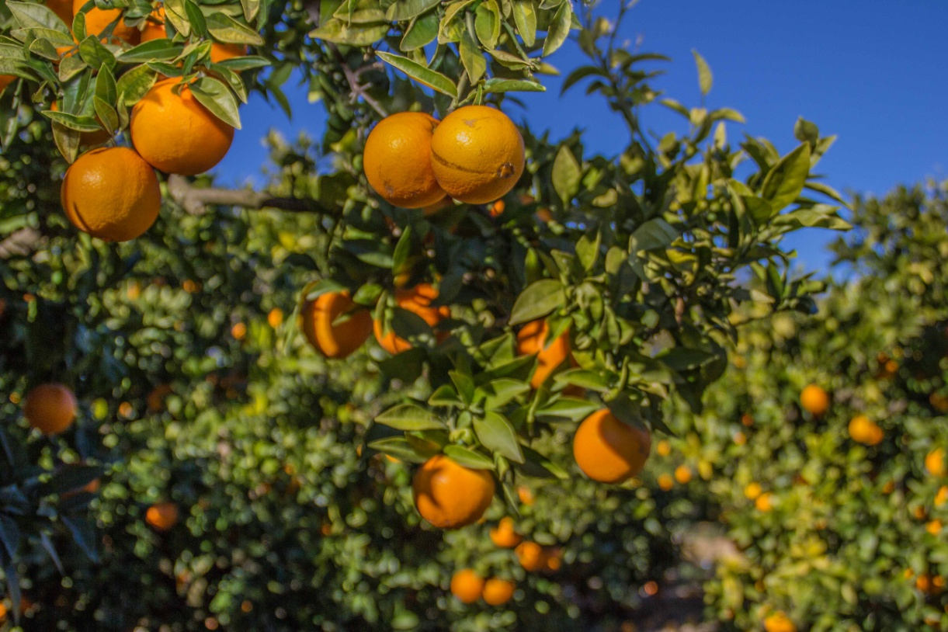
FLORA
The fields surrounding Picanya have got a great variety of vegetables : orange trees, lettuce, cauliflower and a great variety of fruit .

Slide 3
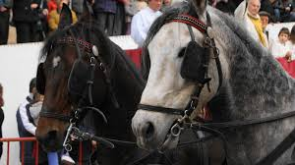
FAUNA
There are horses for people who practice horseriding, and farms where children can visit animals : rabbits , pigs , hens, geese, etc...

