Slide 1
THE NATIVE FLORA OF PICANYA:
MULBERRIES

Slide 2
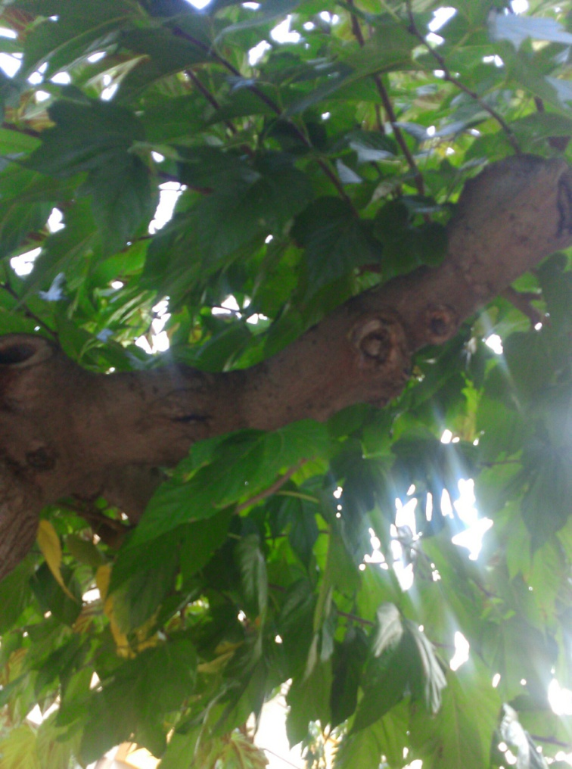
USES:
This species is grown for its leaves and they are the only food
of silkworms and are
also used as an
onrnament in
gardens, walkways and
streets.

Slide 3
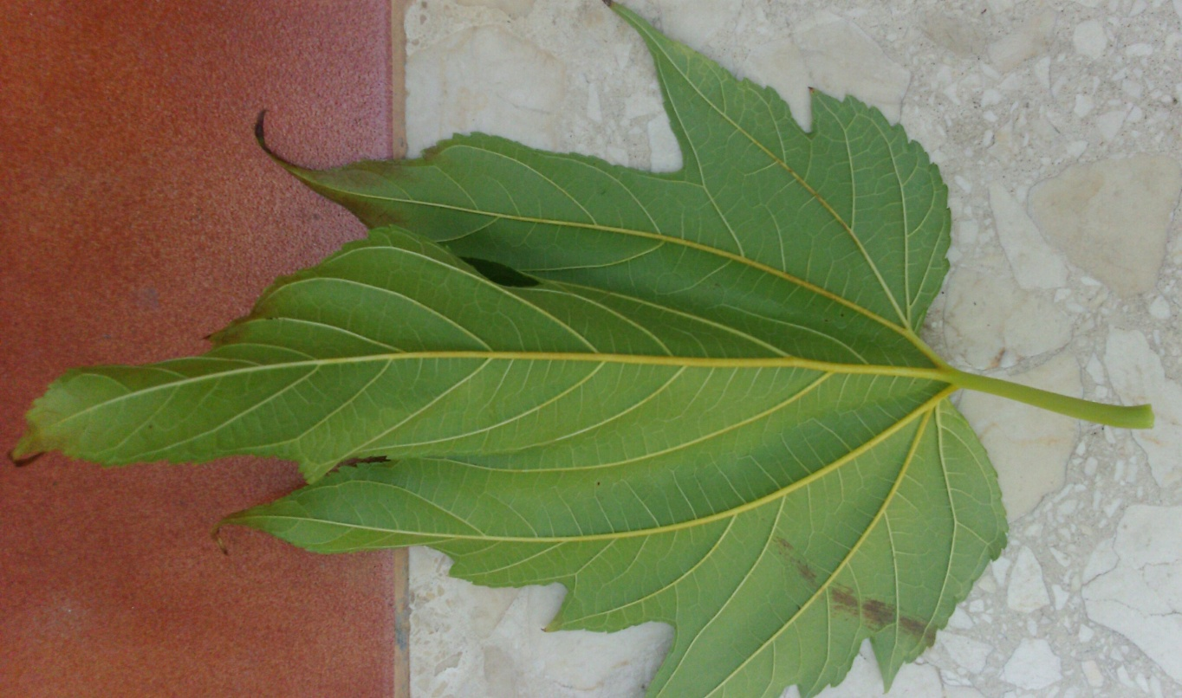
CULTIVATION:
They are native trees of the tempetate
areas of Asia and East of Asia, Europe and America.

Slide 4
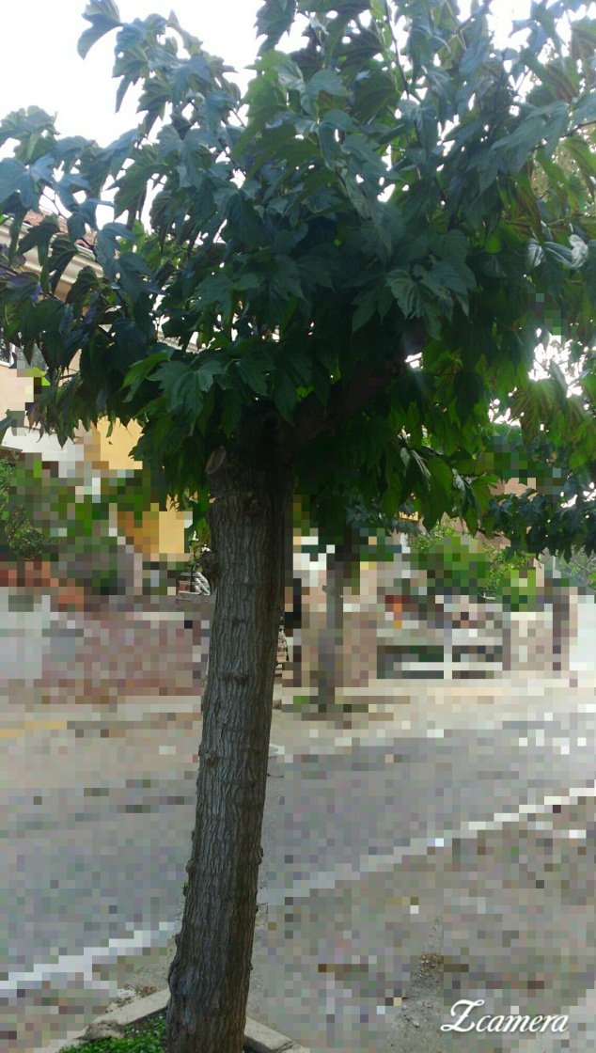
DESCRIPTION:
Trees can measure up to 15 meters and its leaves are simple with serrated edges. The
fruit (blackberry) can be white
or black. If they are white, they start as
light green and when ripe they
change color. The black ones
start out red but when mature
will be pulling a black to purple
and become sweet.

Slide 5
THE END

