Slide 1
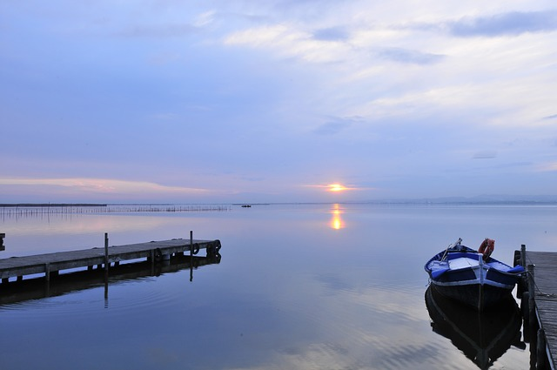
THE ALBUFERA LAKE
Notes:
<número>

Slide 2
What’s it?
It’s a freshwater lake on the coast of the Valencian Community. It has got an area of
21.120 hectares and a great variety of fauna and flora.

Slide 3
Fauna
There is a big variety of fish, so let’s highlight a few, the Spanish toothcarp and the European eel:
-the Spanish toothcarp, or in Valencian “fartet”, is a fish that is in danger of extinction. Its risk of extinction is one of the most serious of any Iberian vertebrate.
-the European Eel is a kind of eel that can reach a length of 1,5m in exceptional cases, but they are normally around 60–80 cm.

Slide 4
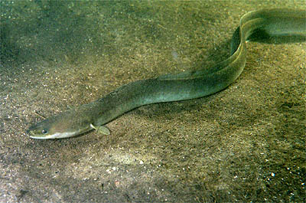
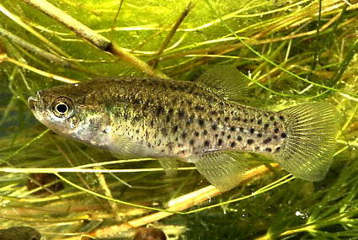
The Spanish Toothcarp:
The European Eel:
http://www.mediterranea.org/cae/divulgac/peces/fartet.htm
https://es.wikipedia.org/wiki/Anguilla_anguilla

Slide 5
Flora
The flora of the Albufera can be separated in three groups:
-Coastal dunes→ here we can highlight typical species like European beachgrass and Morning Glory.
-Salt marshes→here we can find plants adapted to the salt, for exemple, the small cordgrass.
-Schrubland and Mediterranian forest→ this is formed by trees and bushes like the Pine tree and Rosemary.

Slide 6
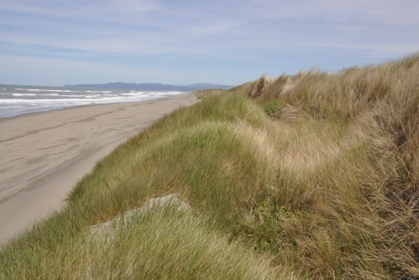
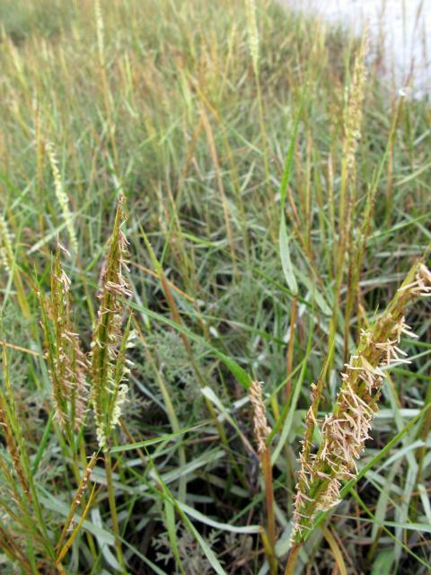
European beachgrass
Small cordgrass
https://www.fws.gov/refuge/Humboldt_Bay/wildlife_and_habitat/InvasiveSpeciesManagement.html
http://gallery.nen.gov.uk/asset668650_1445-.html

Slide 7
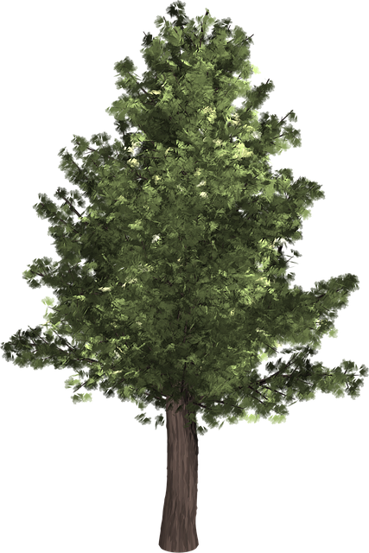
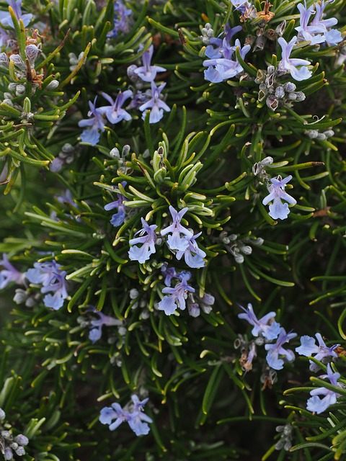
Pine tree
Rosemary

