Slide 1
FLORA OF PICANYA
SAMARA WHITEHEAD OLIVER 2ºD

Slide 2
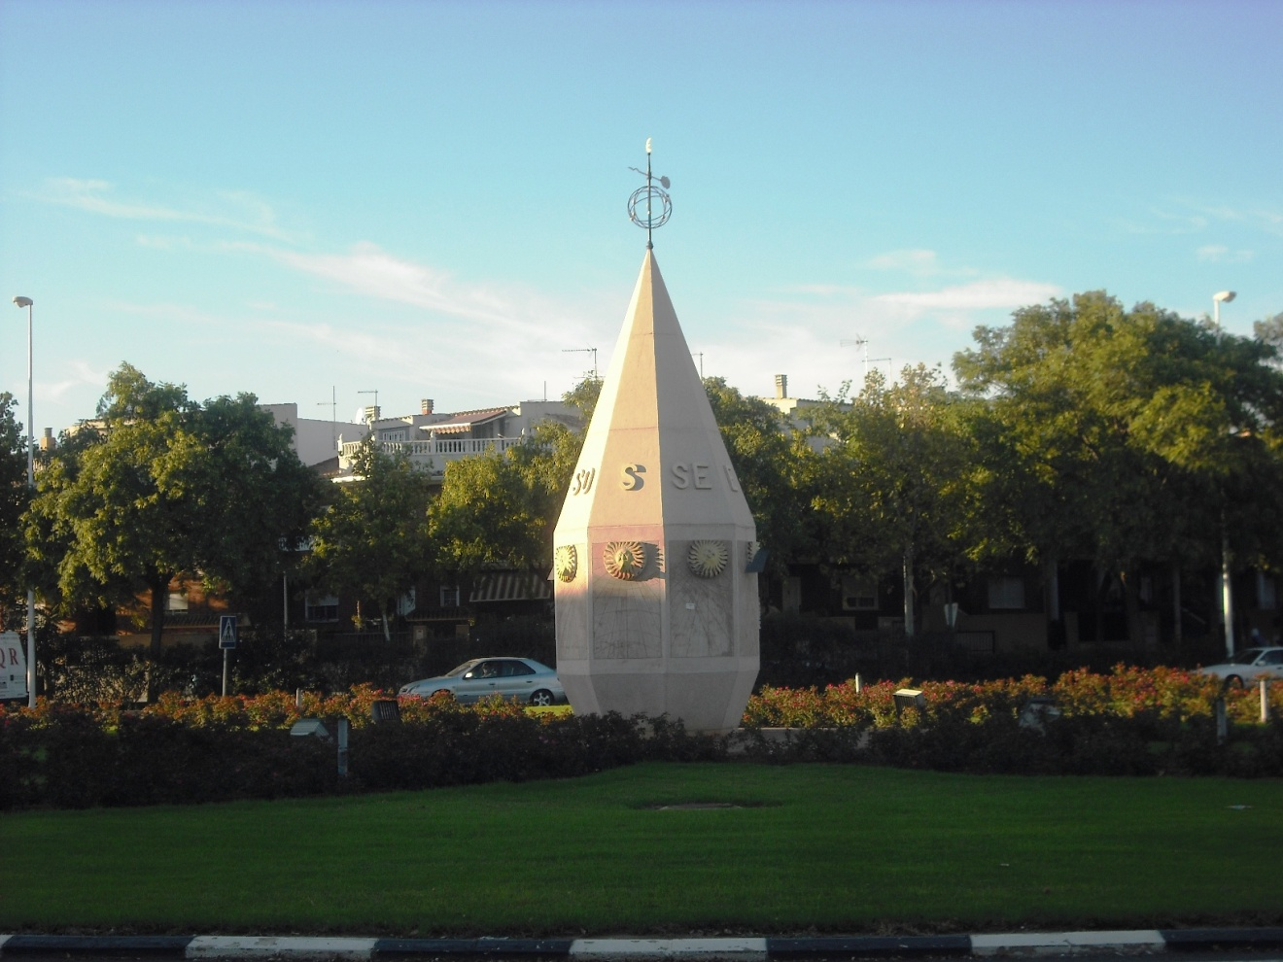
Picanya is a city full of trees.
There are a lot of types of trees, like palm trees.

Slide 3
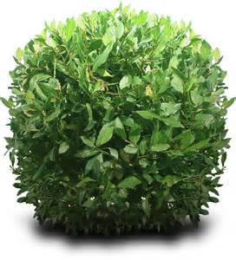
Palm trees are a botanical family of perennial lianas, shrubs and trees.
Notes:
<número>

Slide 4
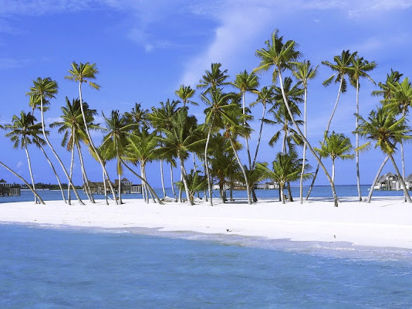
There are about 2600 species of palm trees, most of them living in tropical, subtropical and warm climates.

Slide 5
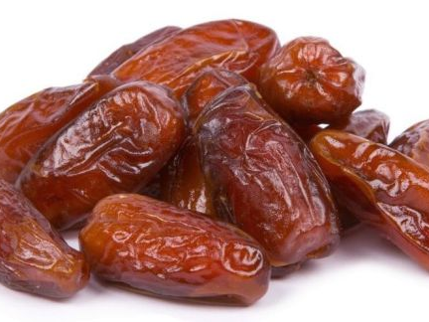
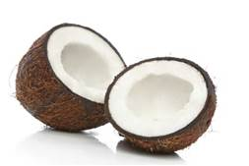
Many common products and foods come from palm trees like the coconut and the date fruit.

Slide 6
In the past palm trees were symbols of victory, peace and fertility .

Slide 7
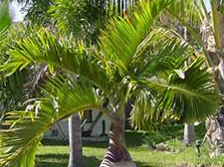
Today palm trees are a popular symbol for the tropics and for holiday.

