Slide 1
Westerwald - forest in our region

Slide 2
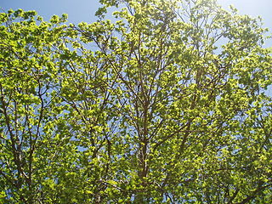
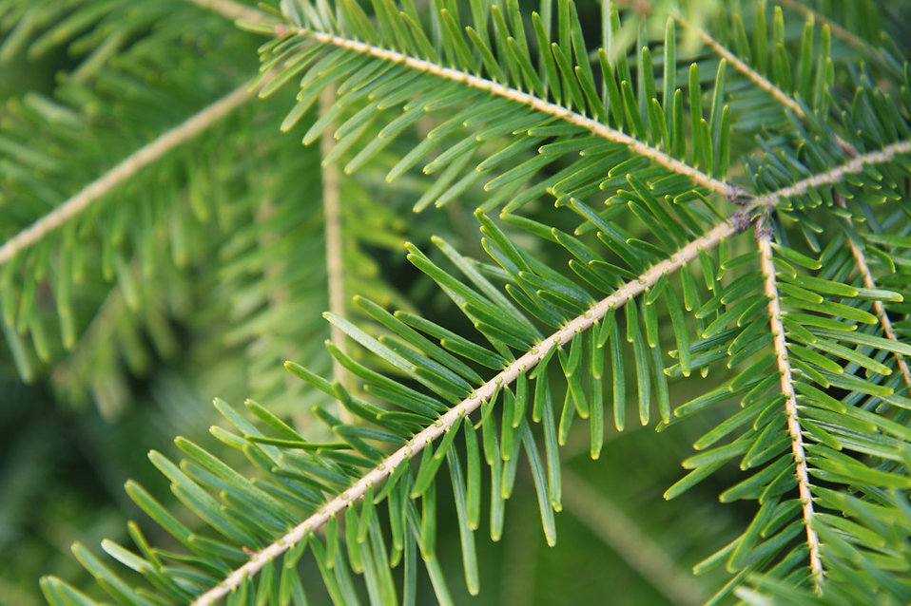
Forests in our region
Our forest is called the Westerwald. It is in Rhineland Palatinate.
It is a mixed forest.
This means there are trees with leaves and trees with needles.

Slide 3
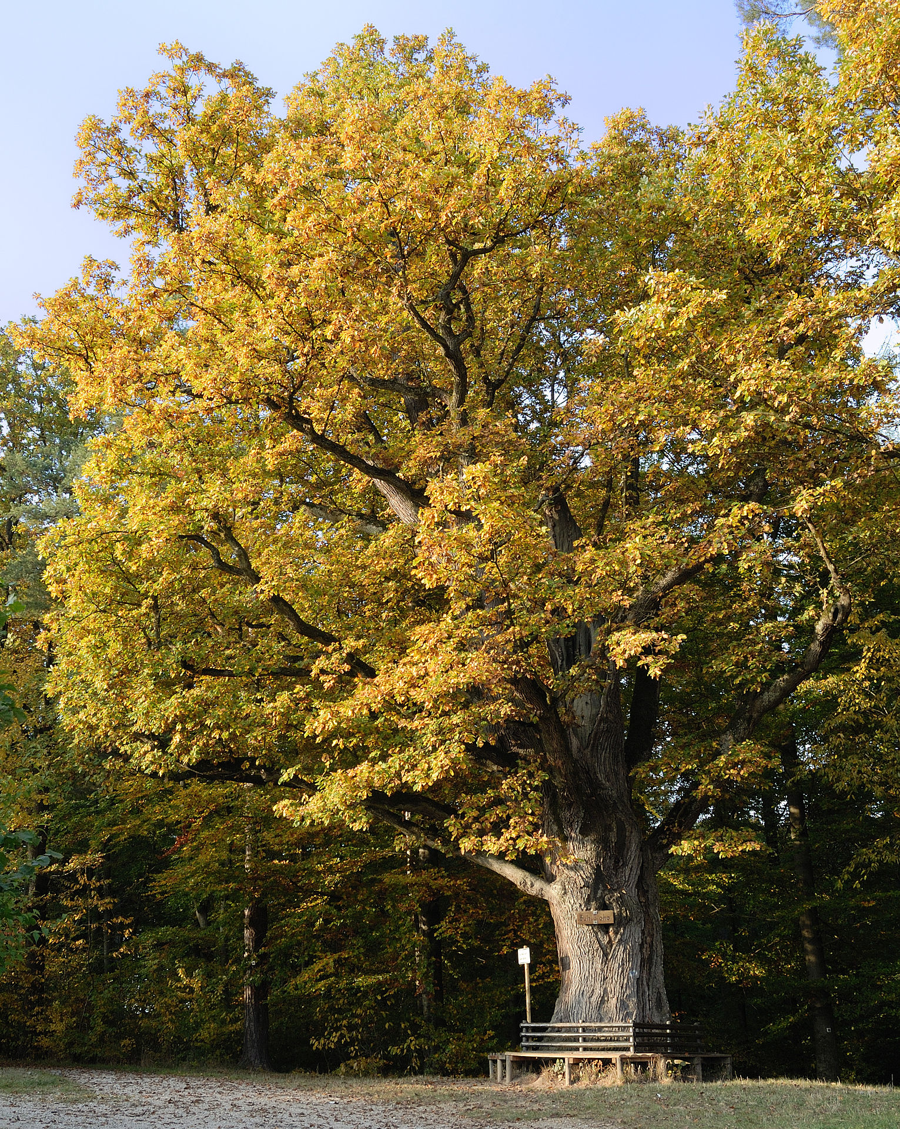
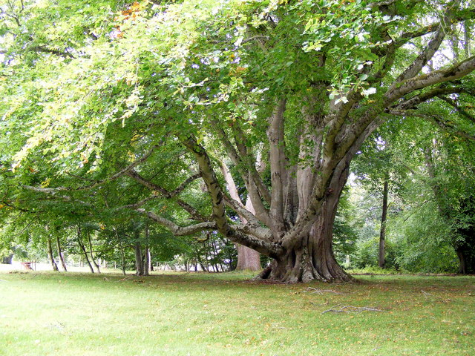
Trees in Germany
The most common trees with leaves are oak and beech.

Slide 4
Oak

Slide 5
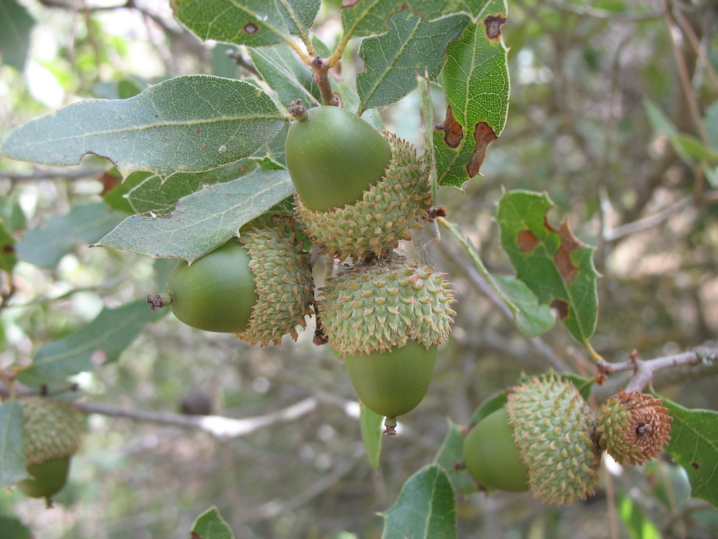
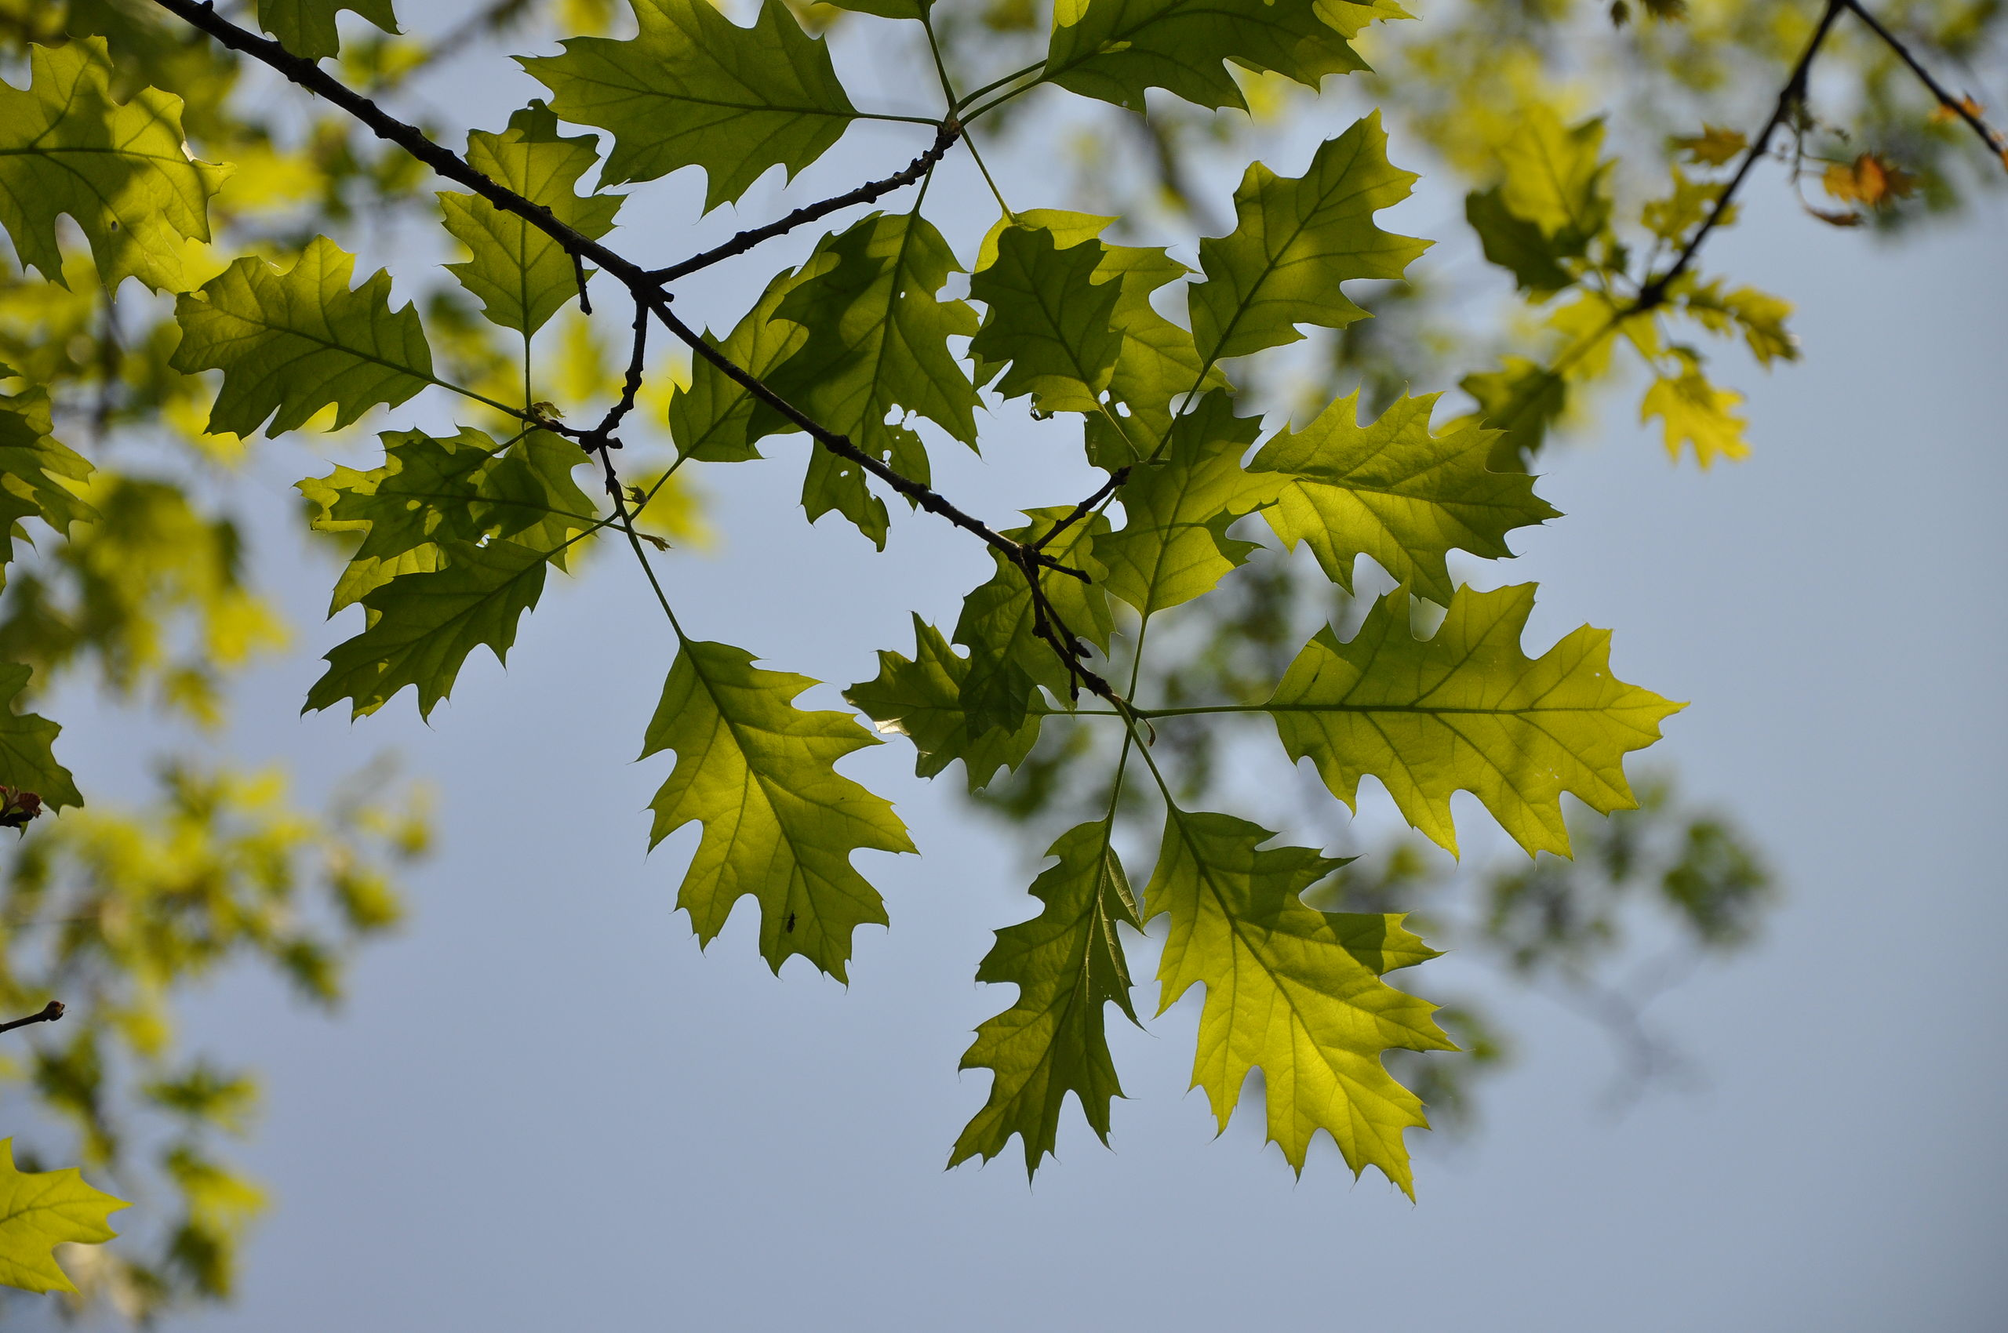
Oak
Acorns grow on oak trees.
They are often found in the forest in our region.
Oak trees lose their leaves in Autumn.

Slide 6
Beech

Slide 7
Beech
Beech trees grow very high branches.
Lots of people use beech wood to burn on the fire.
The beech tree is the most common tree with leaves in Germany.
15% of trees in German forests are beech trees.

Slide 8
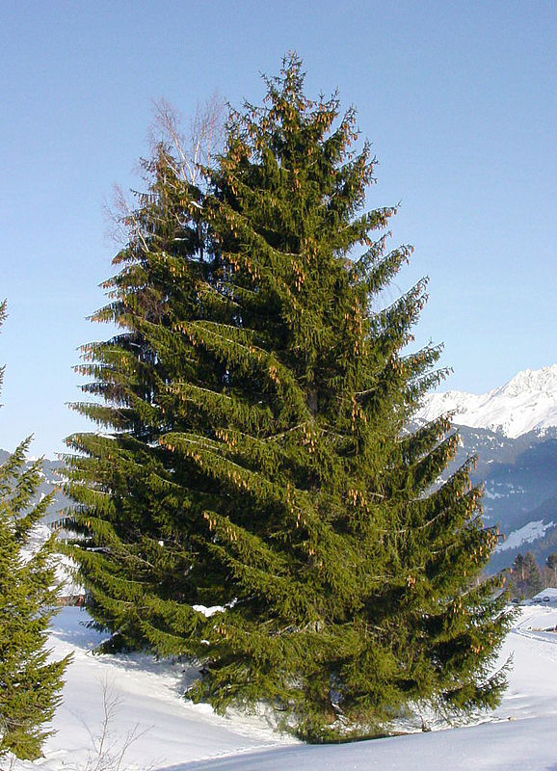
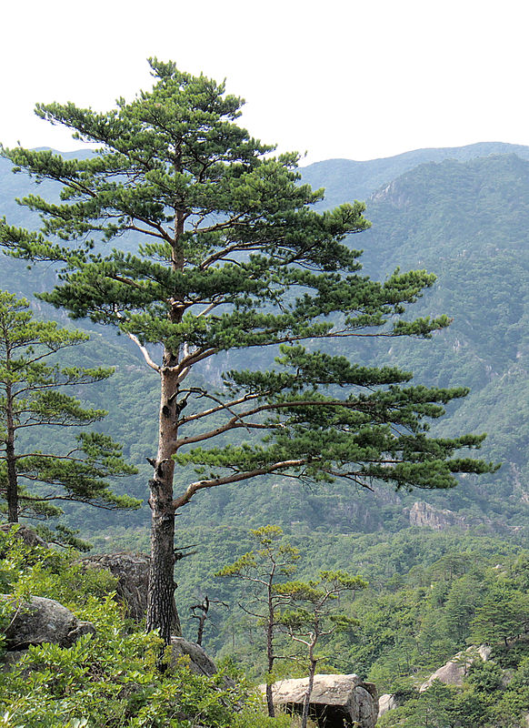
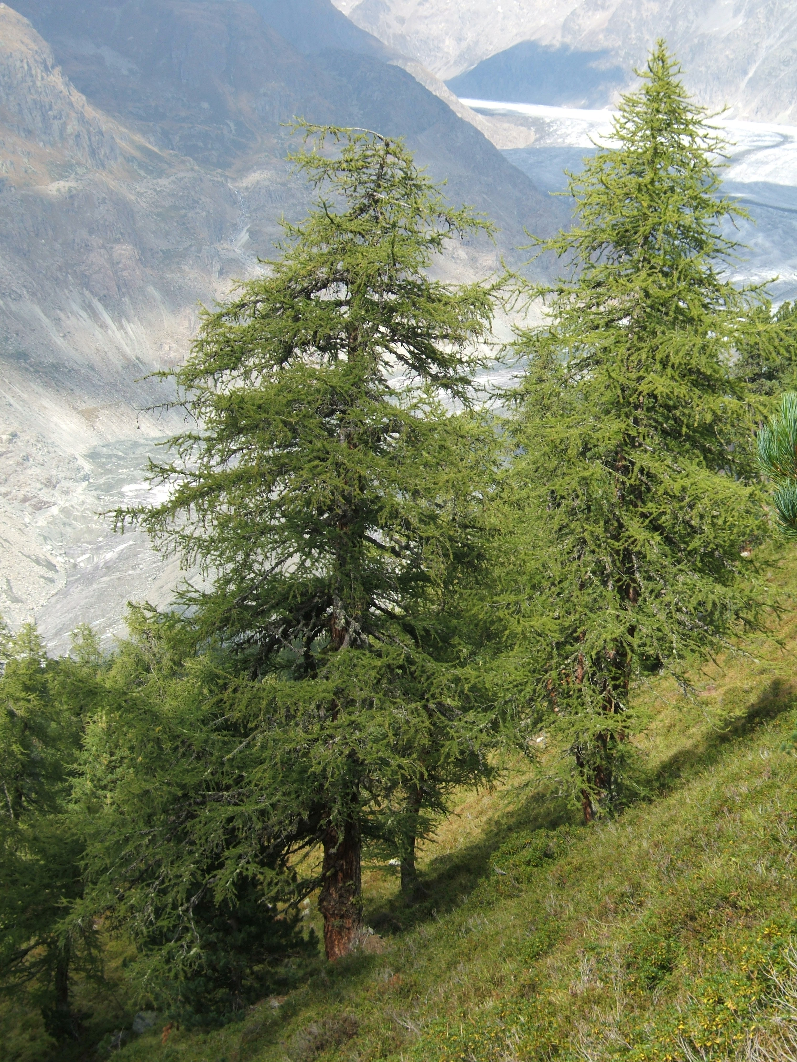
Trees in Germany
The most common trees with needles are Spruce, Pine and Larch.

Slide 9
Spruce

Slide 10
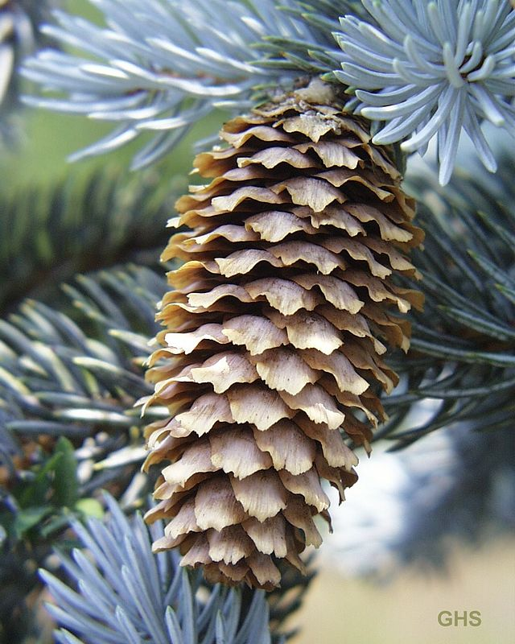
Spruce
Spruce trees have needles instead of leaves.
They produce cones.
Lots of people use spruce trees as Christmas trees.
Squirrels can often be found in spruce trees.

Slide 11
Pine

Slide 12
Pine
Pine trees live for a very long time.
Cones also grow on pine trees.
They have needles instead of leaves, like spruce trees.

Slide 13
Larch

Slide 14
Larch
Larch trees also have needles and no leaves.
In Autumn, the needles turn orange and in Winter they fall off.

