Slide 1
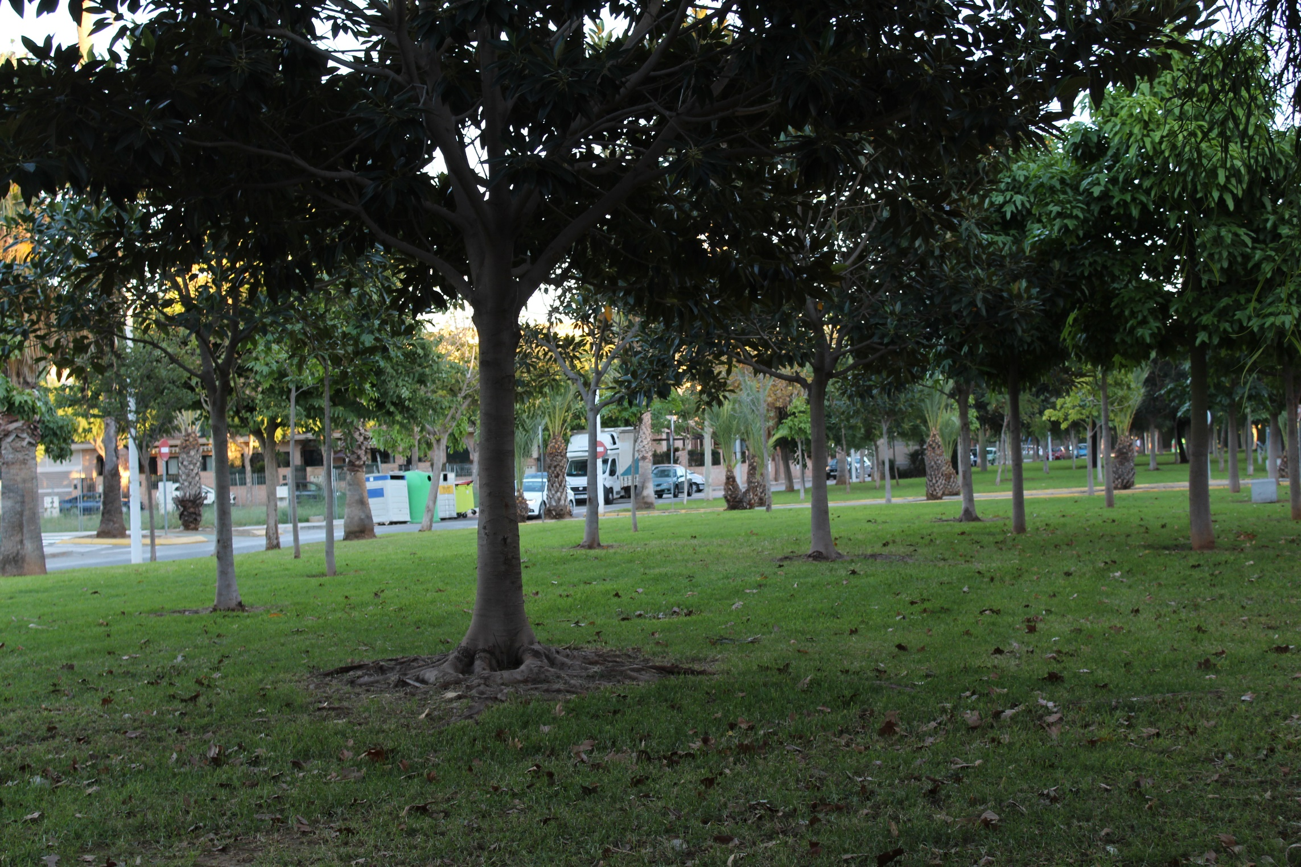
Primavera Park
Primavera Park
Vegetation
Vegetation

Slide 2
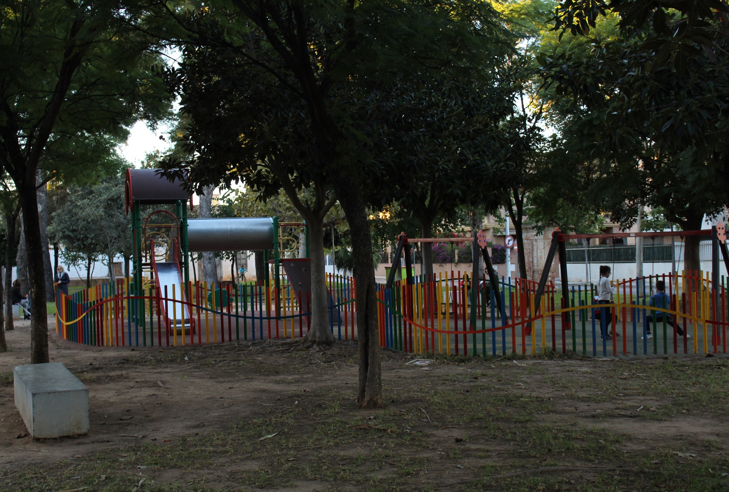
There are a lot of vegetation in this park. We can find bike ways,green areas,playgrounds for children…

Slide 3
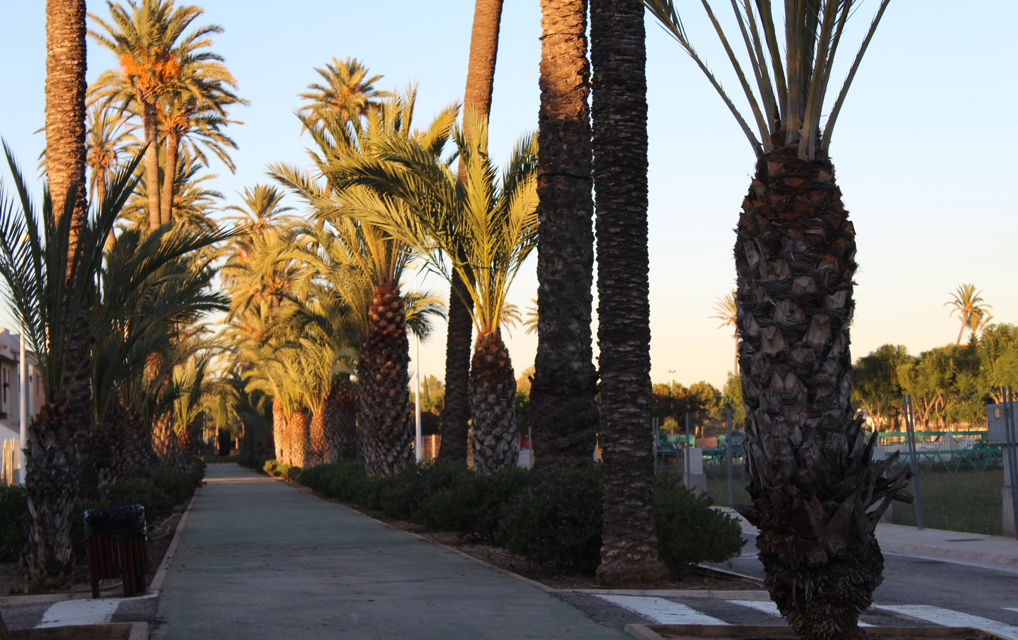
This is typical in the Primavera Park and in the environments of the park , the palm tree.
It`s a beautiful tree and walking by the bike way is awesome.

Slide 4
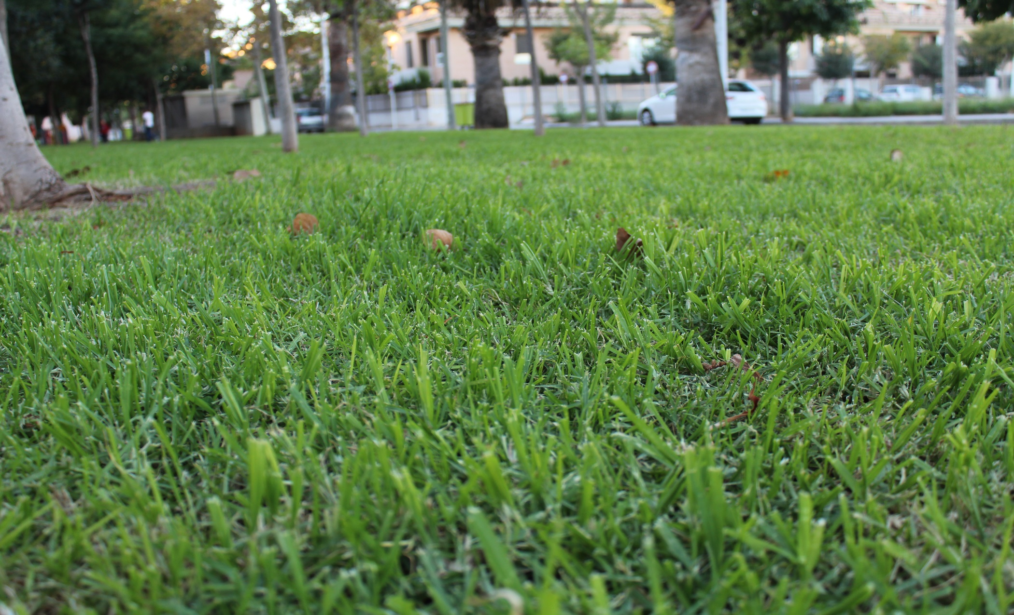
There is also a lot of grass,that makes Primavera Park pleasant.Dogs like playing in this grass because it`s very soft.
Children also play football in this grass using the trees as goals.

Slide 5
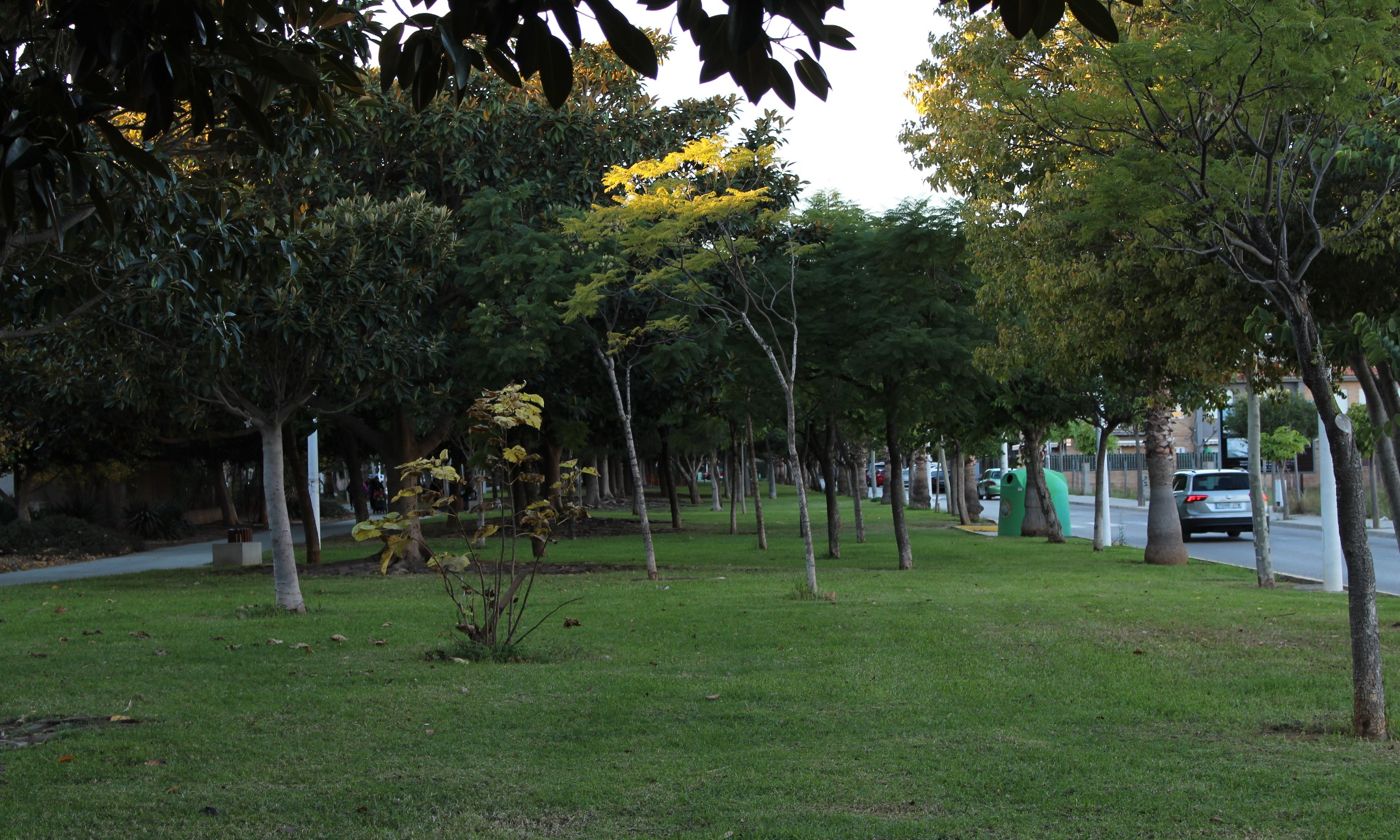
As you can see,there are lots of types of trees and flowers like the chestnut flower,the common tree,magnolia and
lots of insects like butterflies and lizards.

Slide 6
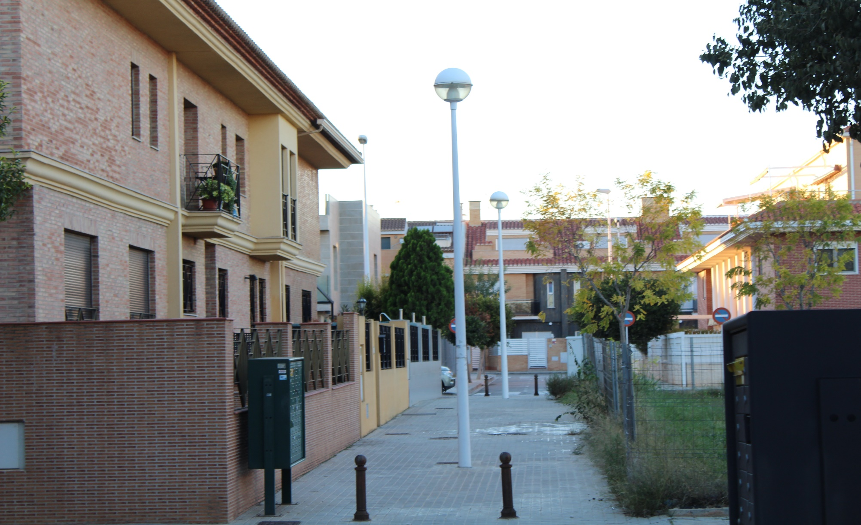
Environments of this park are spectacular and the quality of life is very high.

Slide 7
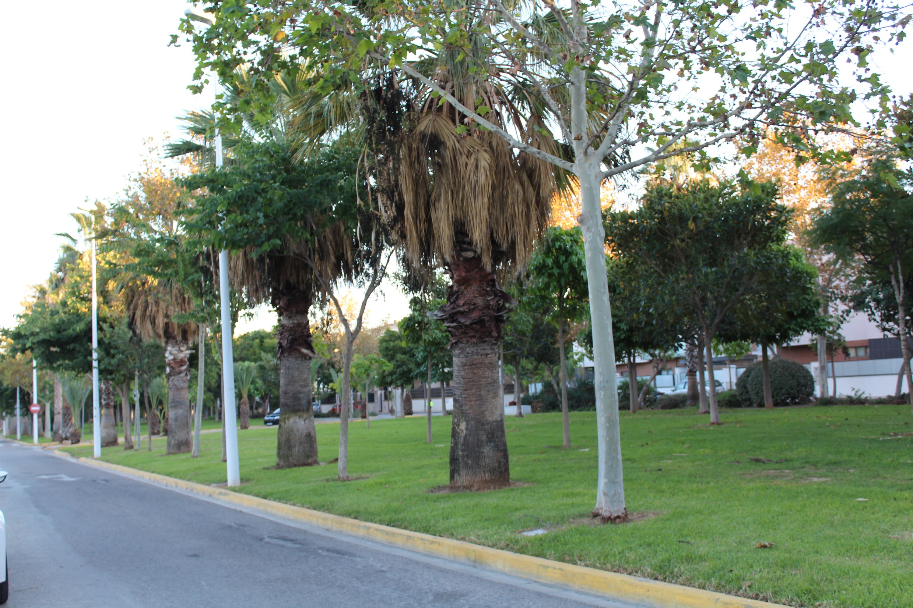
The End

