Slide 1
UK Coasts
By Laura And Alice

Slide 2
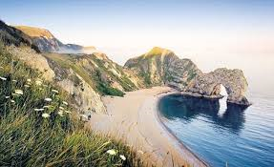
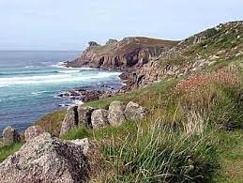
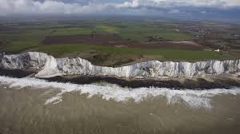
The UK is an island which means we are surrounded by sea. This principal means that we have a lot of coastline. Our coastline is around 12,429 km (including the larger islands).

Slide 3
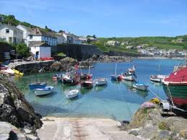
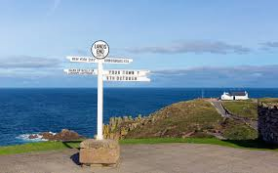
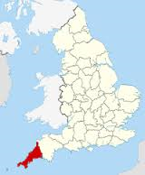
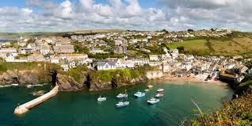
Cornwall
Cornwall is a county on England’s rugged southwestern tip, it is home to Land’s End which is UK’s most southern point.
Land’s end

Slide 4
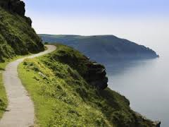
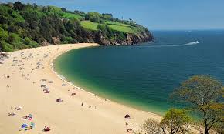
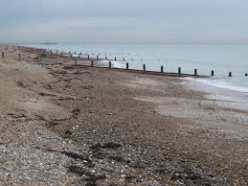
The Coastal path
The coastal path is the walk around the coast. The coast in Cornwall and the Gower in wales is sandy whereas the beaches in Brighton are pebbly.

