Slide 1
Animals and plants in the forest

Slide 2
Animals

Slide 3
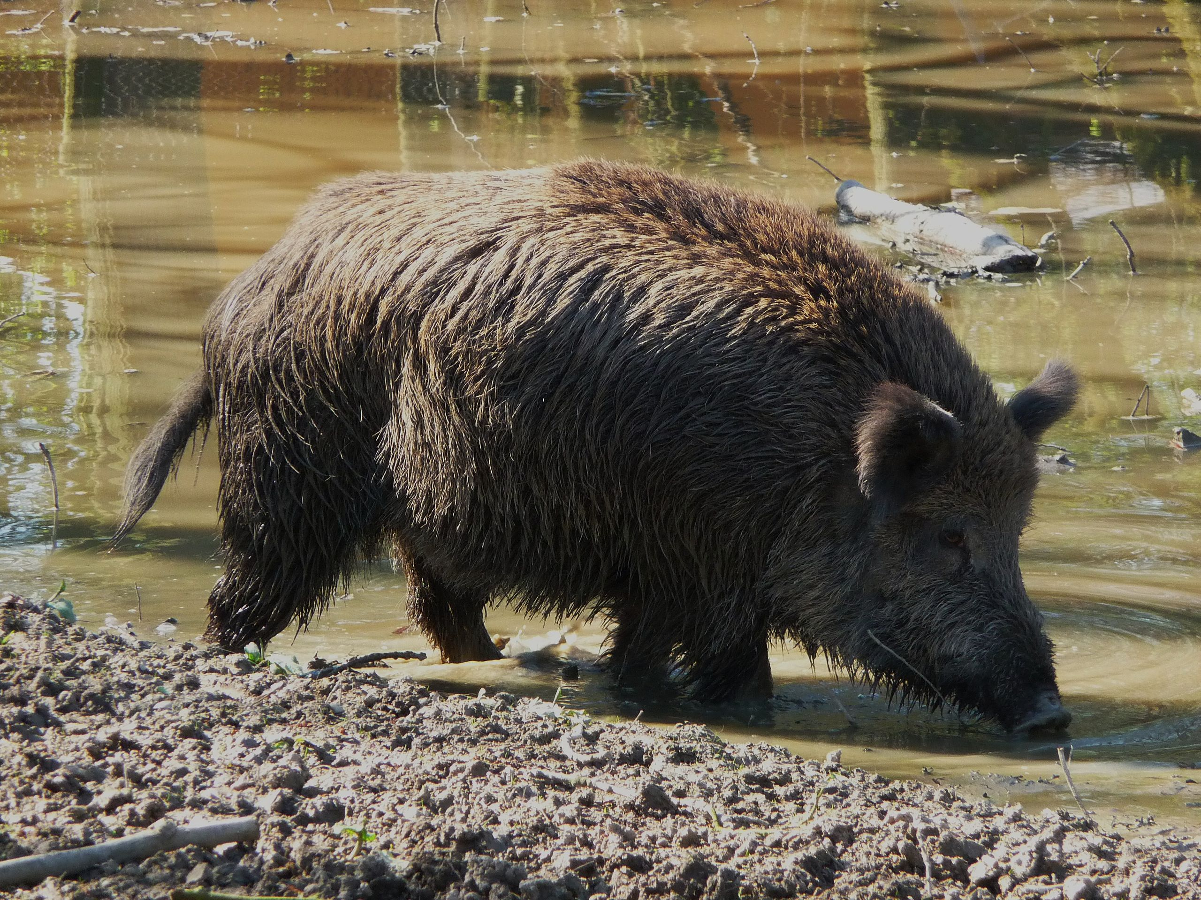
Wild boar

Slide 4
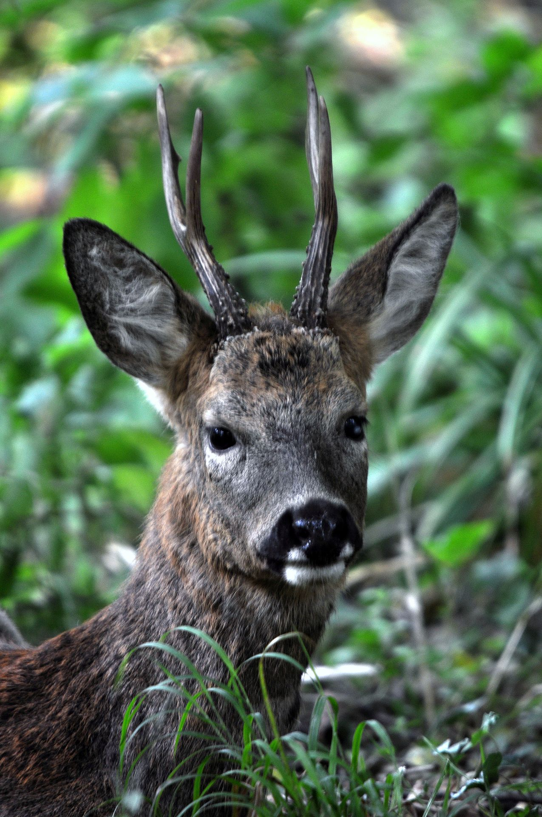
Reh => roe deer

Slide 5
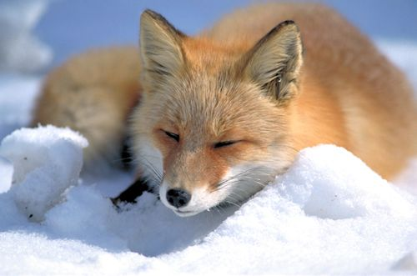
Fuchs => Fox

Slide 6
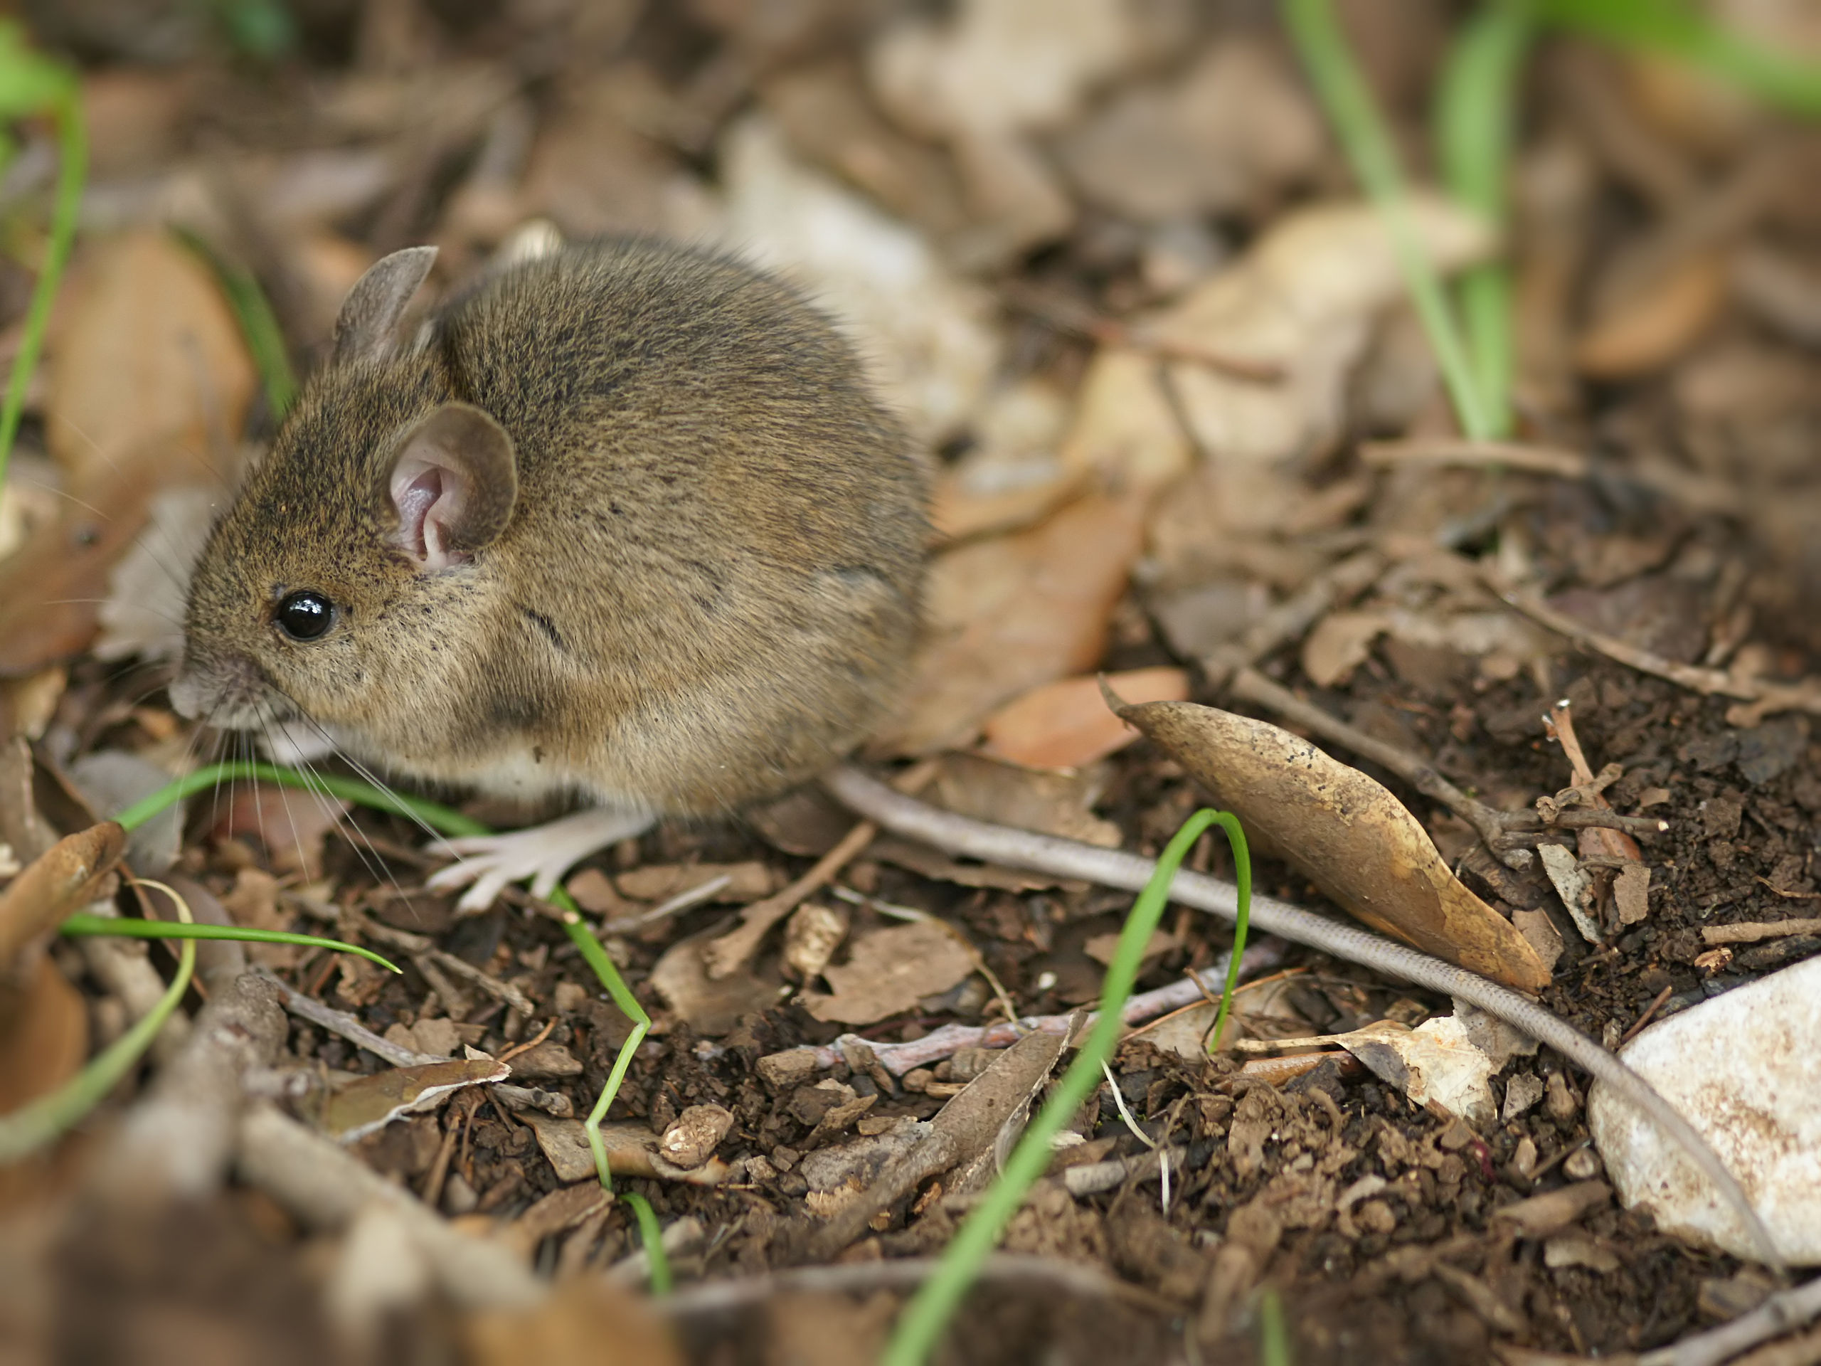
Maus => mouse

Slide 7
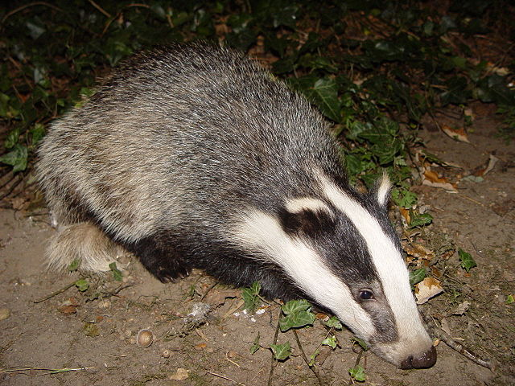
Dachs => badger

Slide 8
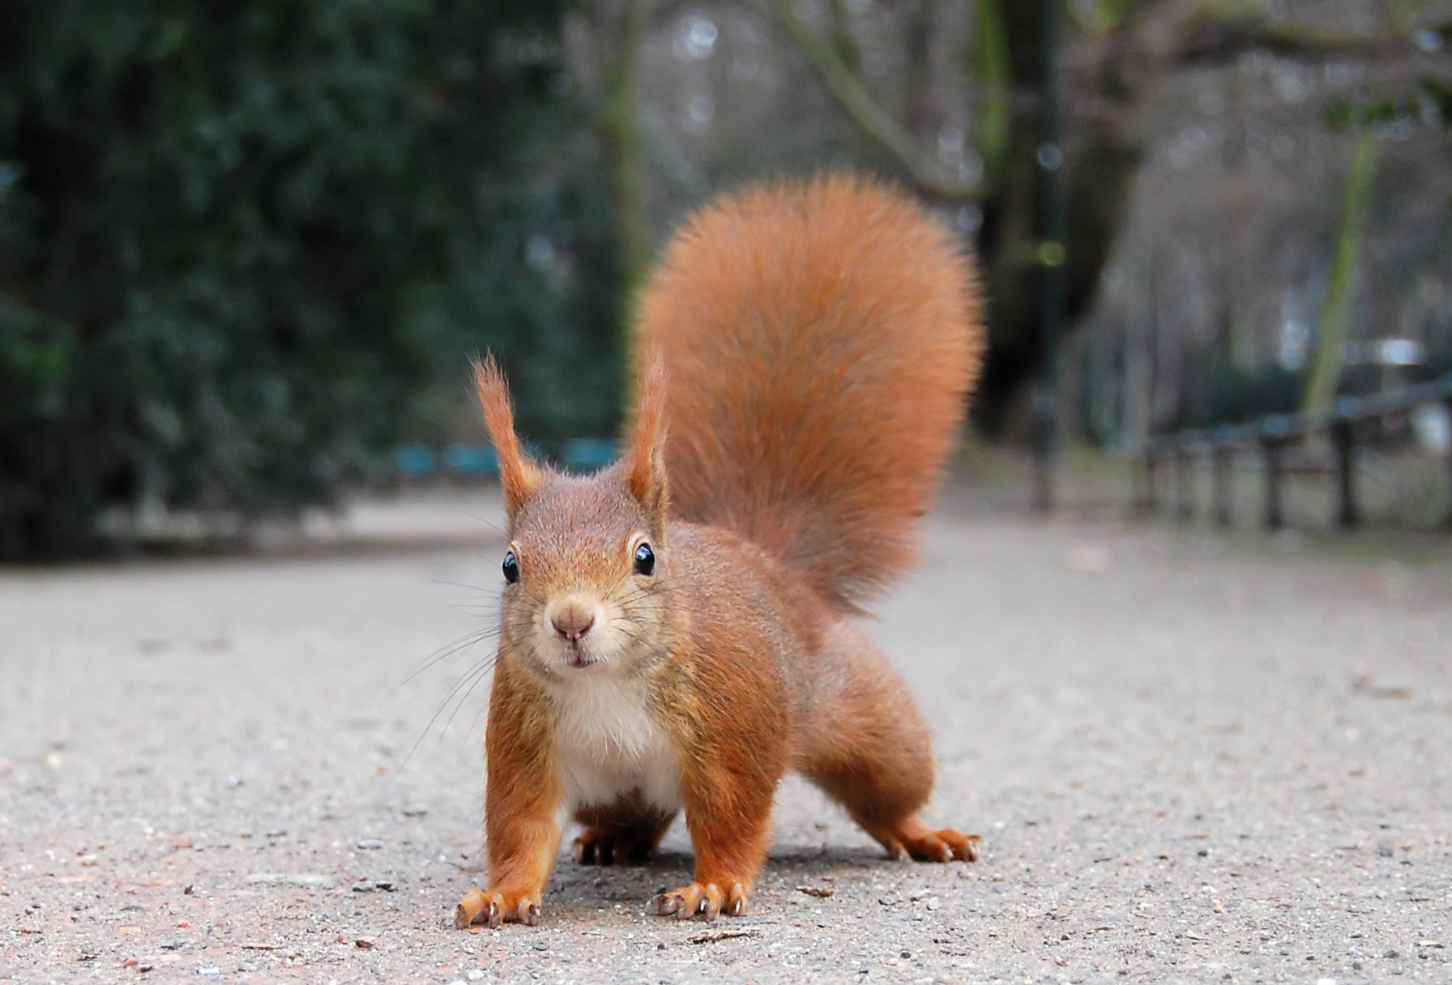
Eichörnchen => squirrel

Slide 9
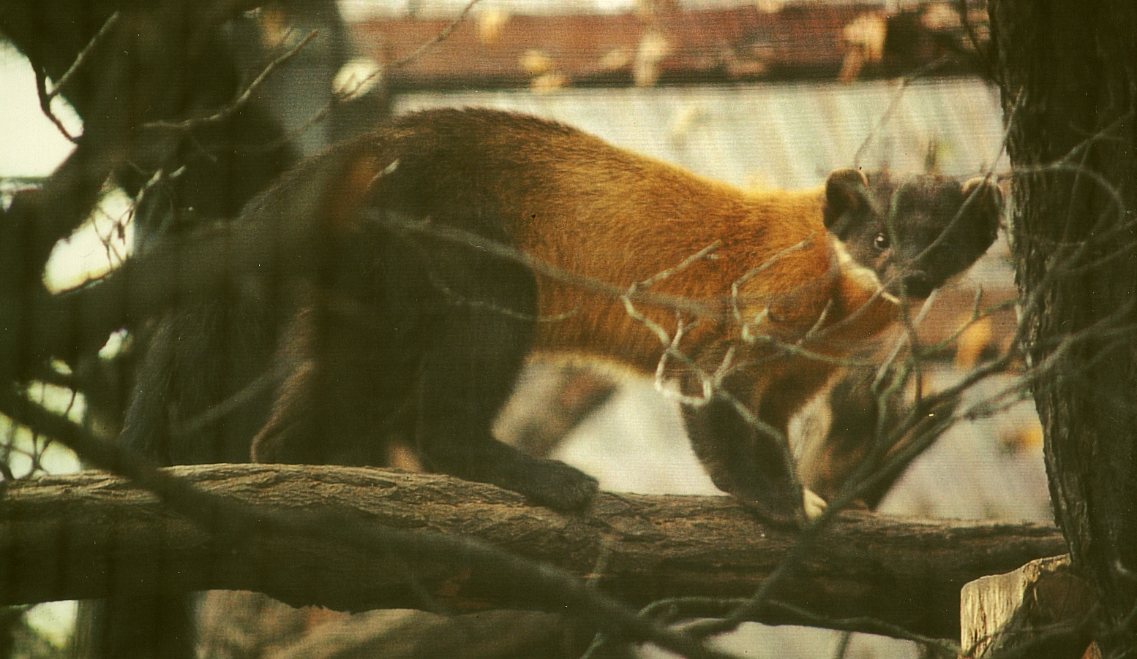
Mader => marten

