Slide 1
The weather of Picanya
By: Violeta Quesada

Slide 2
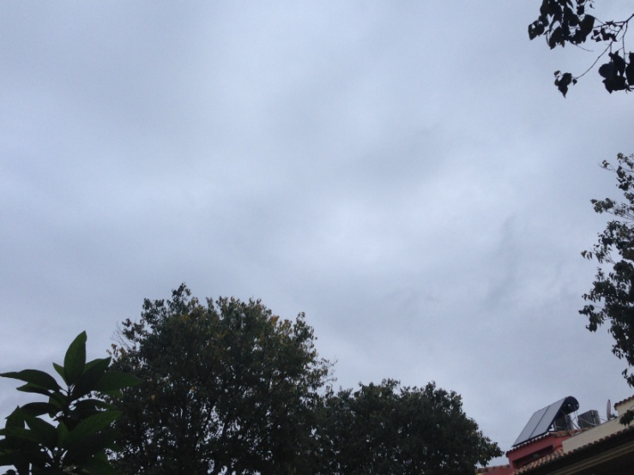
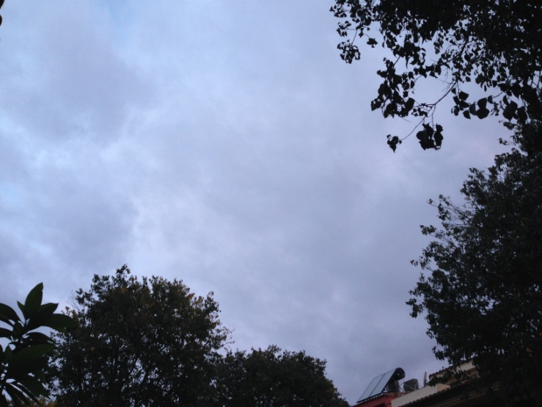
1st DAY
Cloudy.
Highest temperature: 16ºC
Lowest temperature: 9ºC
Sunrise: 8:02
Sunset: 17:38
Chance of rain: 10%
Humidity: 85%

Slide 3
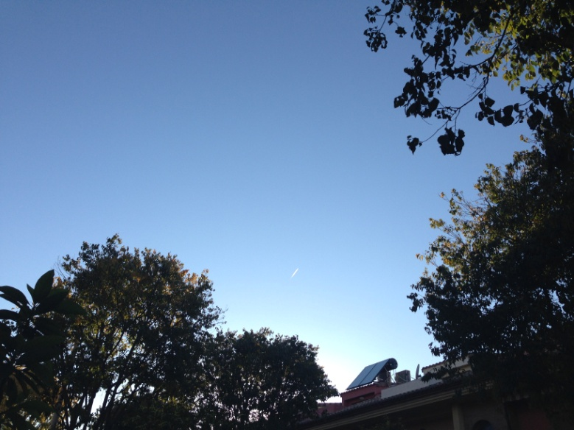
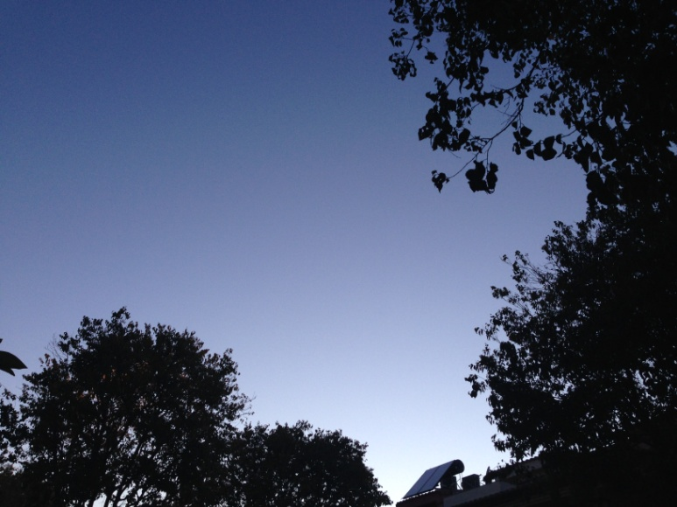
2nd DAY
Mainly sunny
Highest temperature: 17ºC
Lowest temperature: 7ºC
Sunrise: 8:04
Sunset: 17:38
Chance of rain: 0%
Humidity: 72%

Slide 4
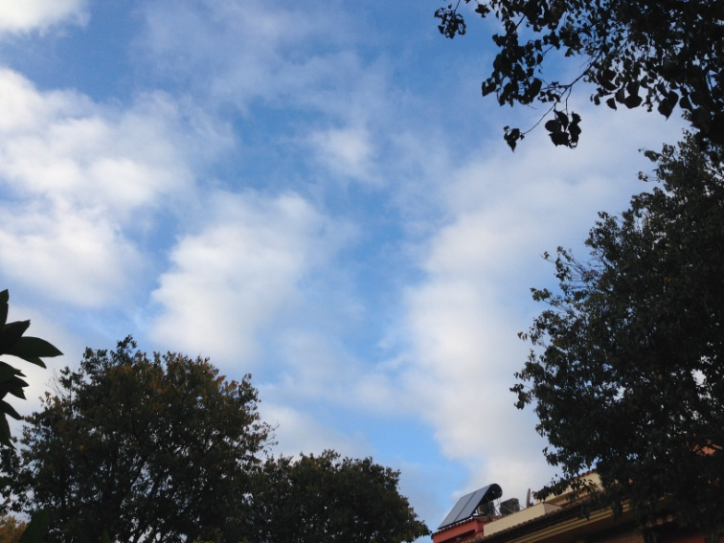
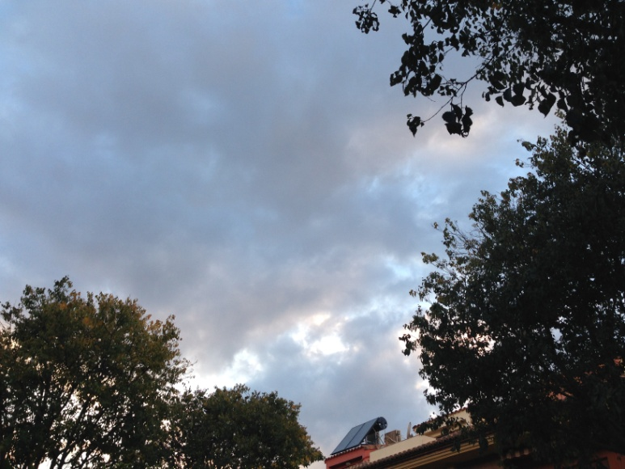
3st DAY
Squally day
Highest temperature: 16ºC
Lowest temperature: 6ºC
Sunrise: 8:05
Sunset: 17:37
Chance of rain: 40%
Humidity: 86%

Slide 5
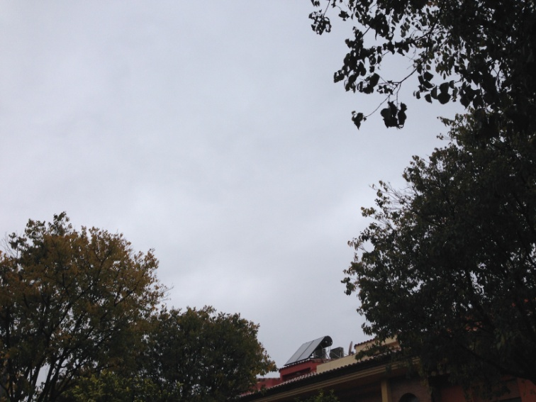
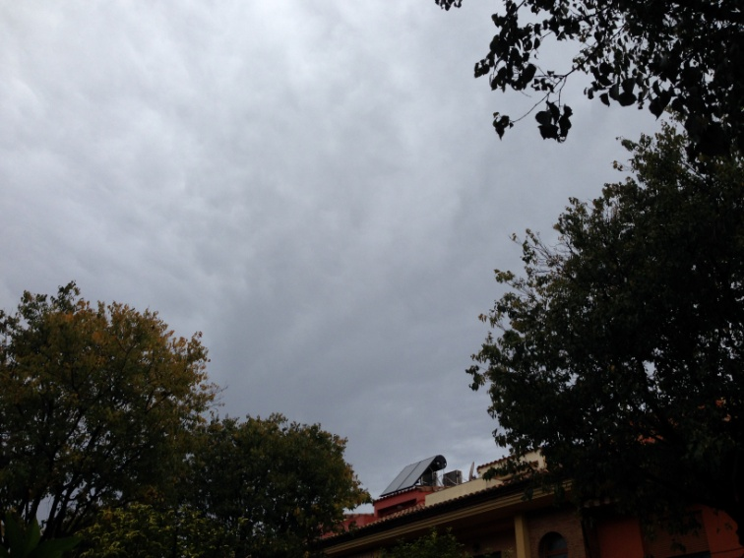
4th DAY
Rainy
Highest temperature: 16ºC
Lowest temperature: 14ºC
Sunrise: 8:06
Sunset: 17:38
Chance of rain: 80%
Humidity: 98%

Slide 6
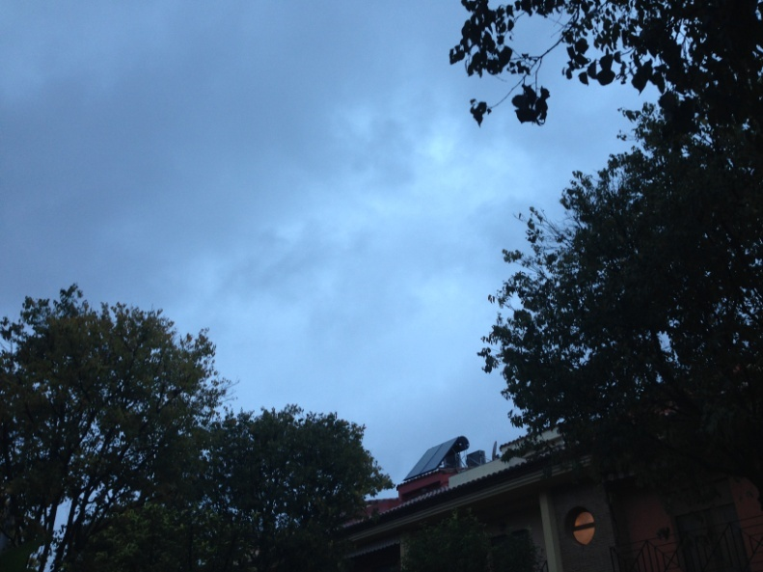
5th DAY
Partly cloudy
Highest temperature: 16ºC
Lowest temperature: 13ºC
Sunrise: 8:05
Sunset: 17:36
Chance of rain: 45%
Humidity: 60%

Slide 7
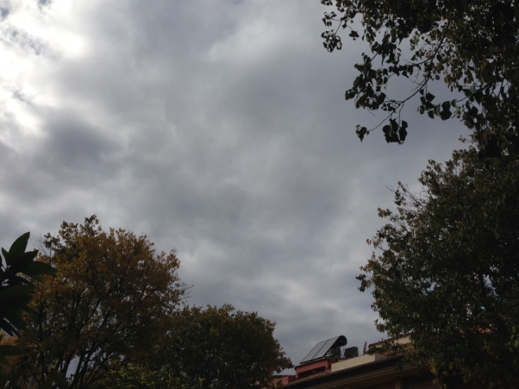
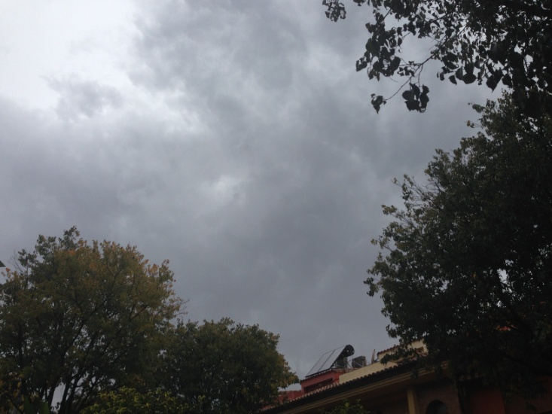
6th DAY
Cloudy
Highest temperature: 8ºC
Lowest temperature: 17ºC
Sunrise: 8:08
Sunset: 17:37
Chance of rain: 10%
Humidity: 71%

Slide 8
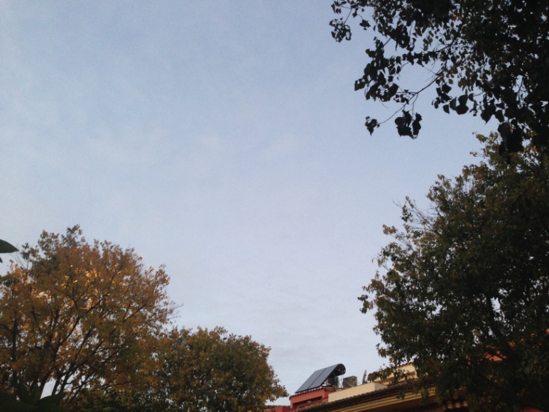
7th DAY
Sunny
Highest temperature: 9ºC
Lowest temperature: 17ºC
Sunrise: 8:09
Sunset: 17:37
Chance of rain: 10%
Humidity: 72%

Slide 9
THE END

