Slide 1
Pflanzen im Westerwald
Plants in the Westerwald
Yannick,Cassandra

Slide 2
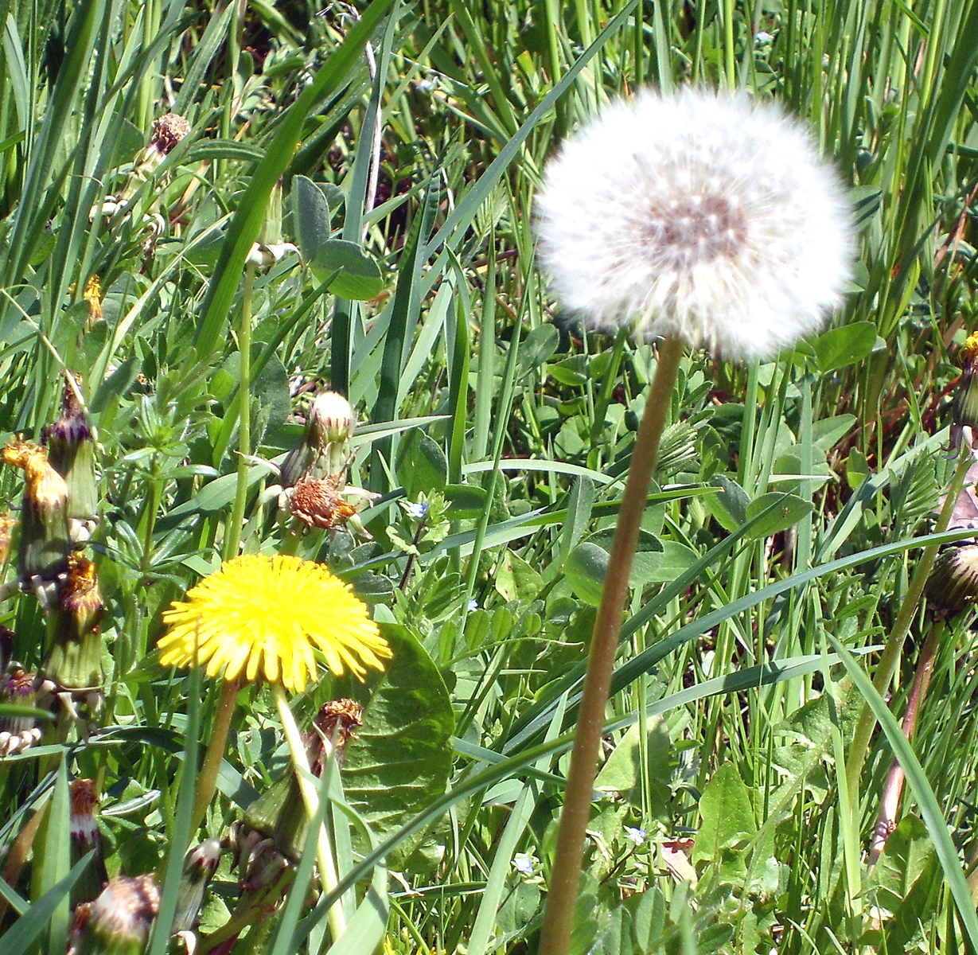
Dandelion
Name: Dandelion/Löwenzahn
Size:10-30cm
habitat: meadow

Slide 3
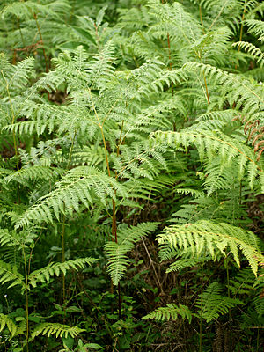
Bracken
Name: Bracken
Size: 50cm - 2meters
Habitat: edges of the forest
Blooming period: all year round

Slide 4
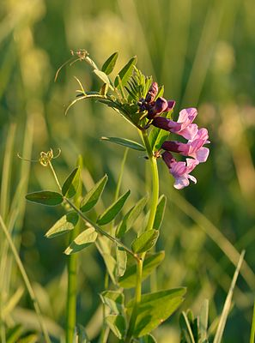
Bush Vetch
Name: Zaun Wicke/Bush vetch
Size : 5 - 10 cm
Habitat: forests and meadows

Slide 5
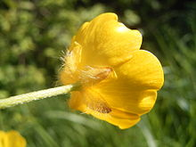
Crowfoot
Size: 1,8- 5,2

