Slide 1
The immigration

Slide 2
WHAT’S IMMIGRATION?
Immigration is the transfer of one person or groups from their country to another countries.

Slide 3
Who are they ?
Immigrants are a group of people that escape from their country because of wars, diseases and famine … and they hope that coming here they are luckier. But I think that italians don’t want them because they think that their life change.

Slide 4
causes of immigration
The causes of immigration are:
Economic ( to escape the pover to seek better living conditions);
Working ( to find a work or improve their job and earn more money);
Political condition (dictatorships, persecution, oppression, wars, genocides, ethnic cleansing);
Religion (inability to practice their religious worship);
Natural disaster (tsunamis, floods, earthquakes, droughts, landslides, avalanches);
Personal (ideological choice, engagement with a partner resident in another country);
Sentimental (family reunification);
School education (to go to school and earn a degree, ensure their children an education).

Slide 5
How many are ?
Countries | Absolute value of immigrants
Austria | 1.249.424
Ireland | 586.826
Belgium | 1.327.421
Germany | 8.651.958
Spain | 4.418.158
United Kingdom | 5.640.674
Italy | 5.026.153
Denmark | 463.088
Sweden | 773.232
Grece | 798.357

Slide 6
Here there are some pictures about immigrants

Slide 7
the Memorial of the immigrant
The Memorial of the immigrant is a Museum in the city of San Paolo in Brasil . The museum preserves the history and the cultural heritage of Brazilians.

Slide 8
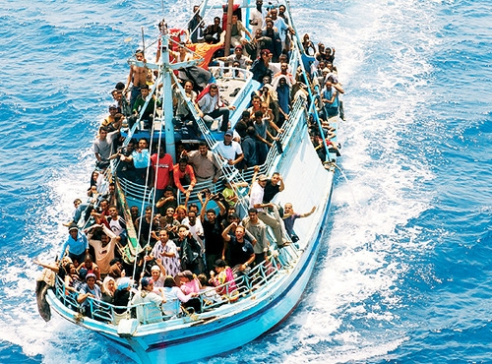
People escape from their country.

Slide 9
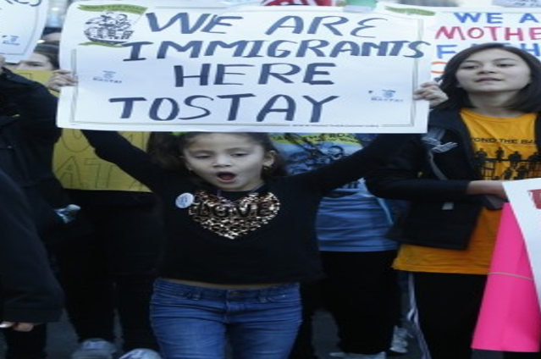
This girl wants make people understand that:
“We are immigrants here to stay!!!”

Slide 10
This is a graffiti that says:
« IMMIGRATION IS NOT A CRIME »

Slide 11
Two children holding hands :
“No matter if we are of a different nationality, religion, culture, we can be friends!”

Slide 12
WE'RE ALL THE SAME!!!
THE HUMAN RACE IS ONLY ONE!!!

Slide 13
THE END
Work carried out by : Bruno Giorgia 1^B

