Slide 1
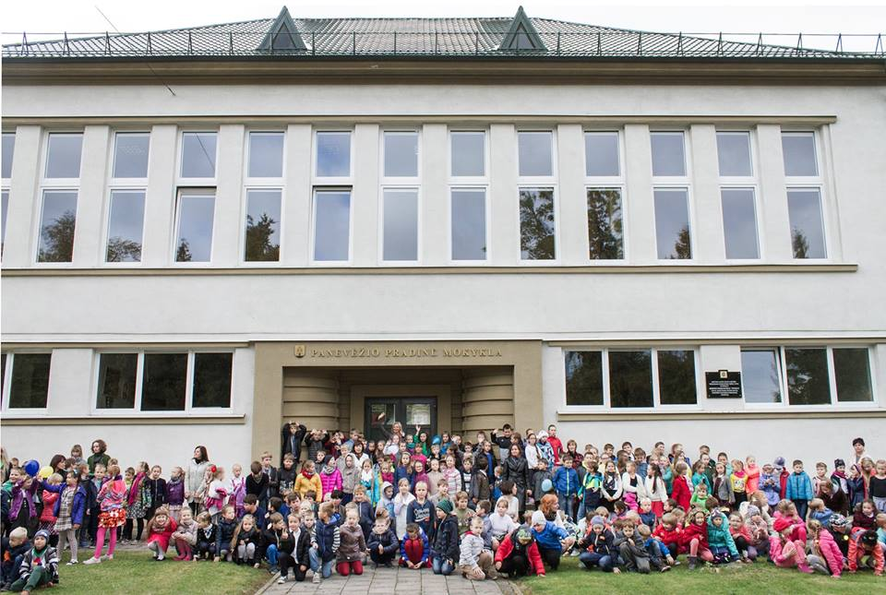
Panevezys Primary School by Šarūnas and Adonė Motekaičiai

Slide 2
This is our school

Slide 3
Our school teachers

Slide 4
The headmaster of our school Rita Charisova

Slide 5
Students in the cloakroom

Slide 6
Photo gallery in the entrance hall

Slide 7
Studens in the library (Book readers activity after lessons)

Slide 8
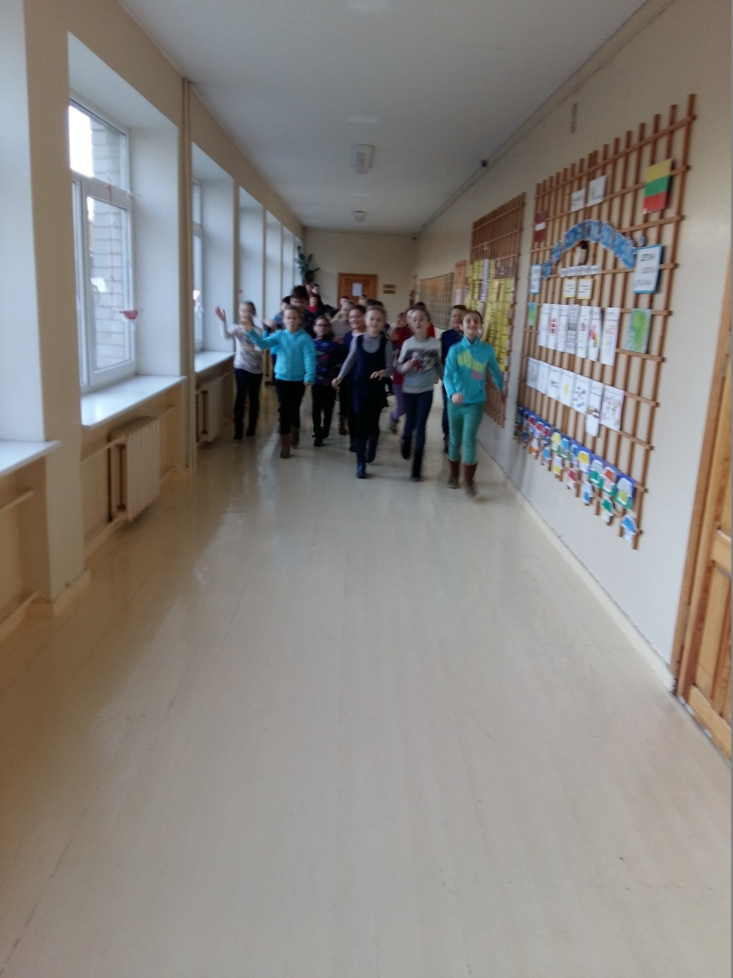
Students are having fun!

Slide 9
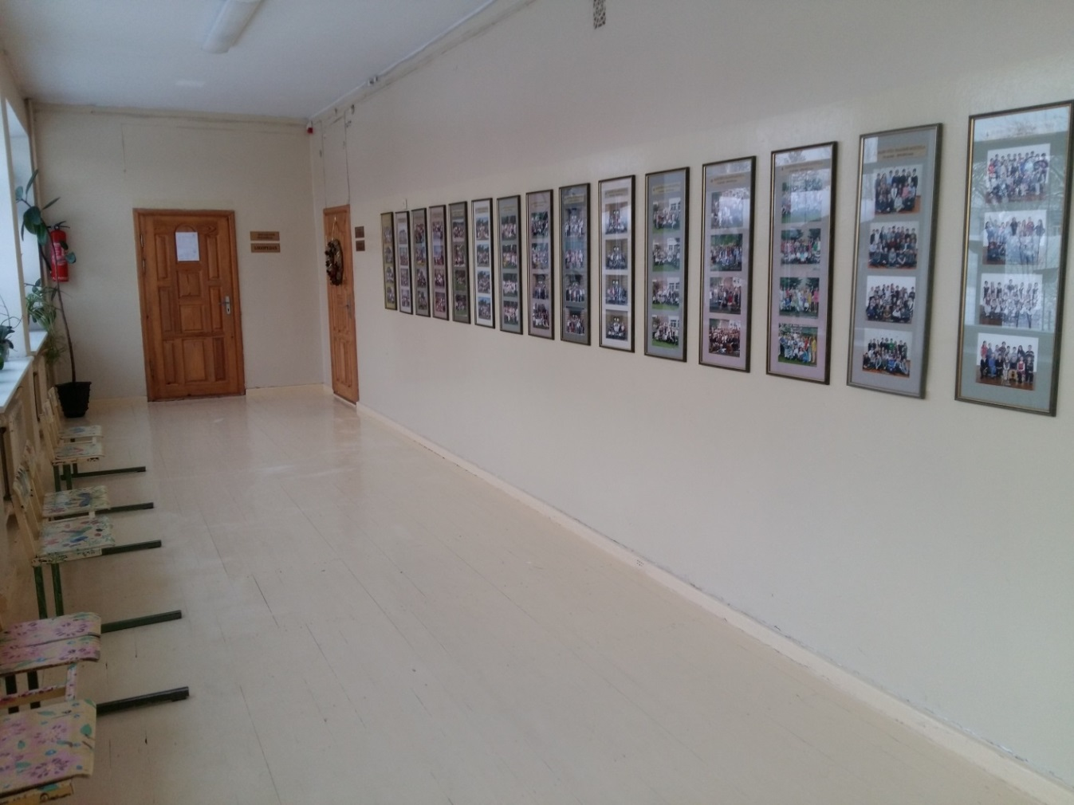

Slide 10
Project “What is common and What is different?”

Slide 13
The music class

Slide 14
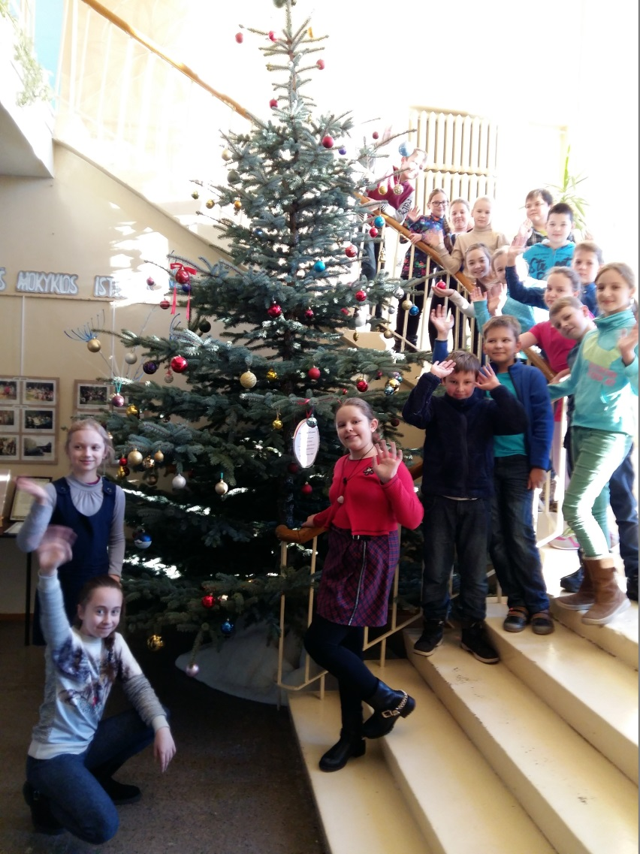
Our students love Christmas

Slide 15
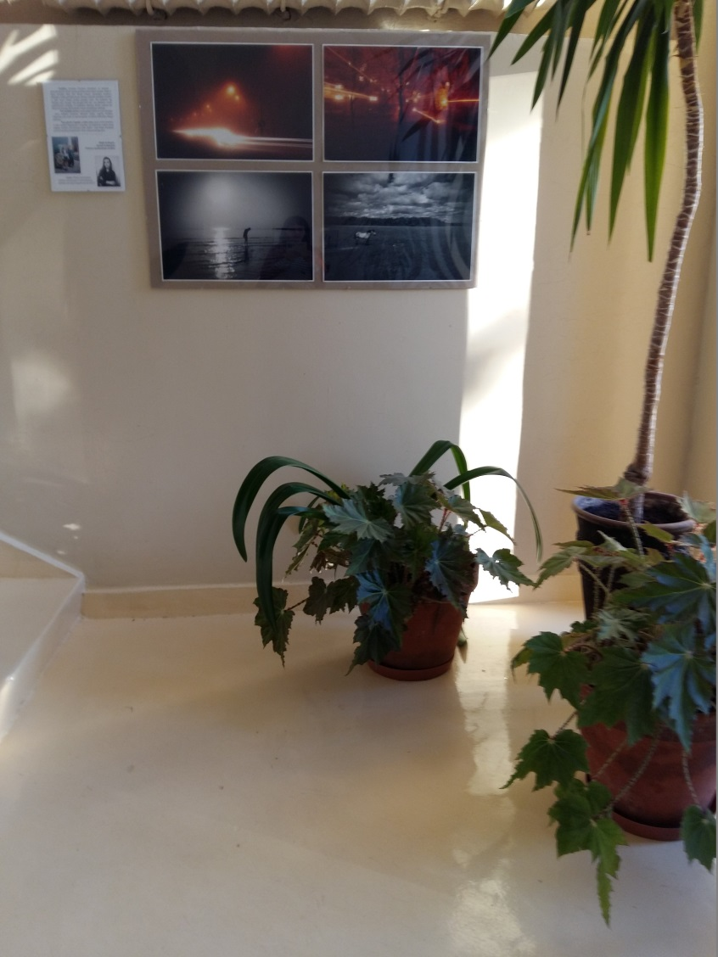
Our school is full of plants, photo galleries and colourful paintings

Slide 16
The board of our best students

Slide 17
We loves sports!

Slide 18
Happy students from 4a class

Slide 19
Happy students from 4b class

Slide 20
Happy students from 4c class

Slide 21
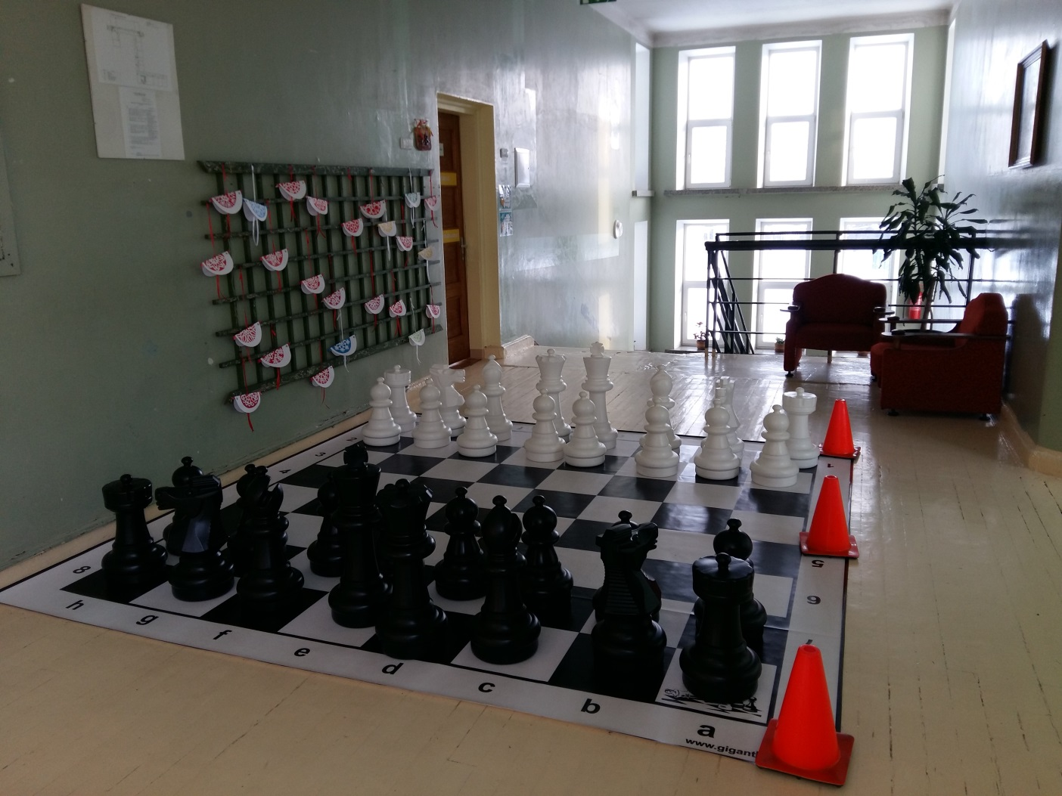
A gift from the parents – a huge chess board

Slide 22
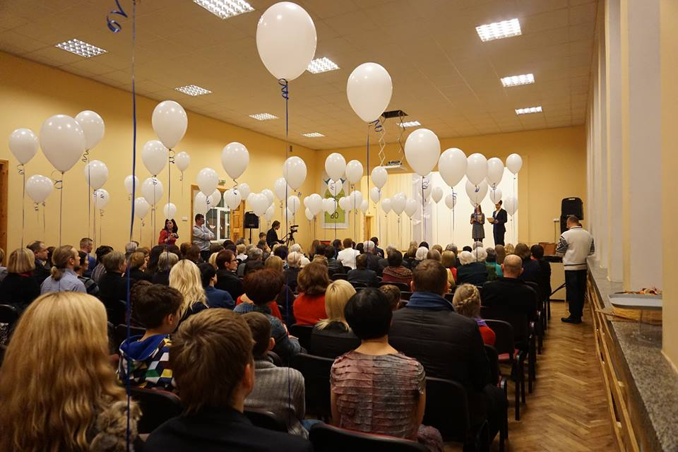
Our beautiful hall

Slide 23
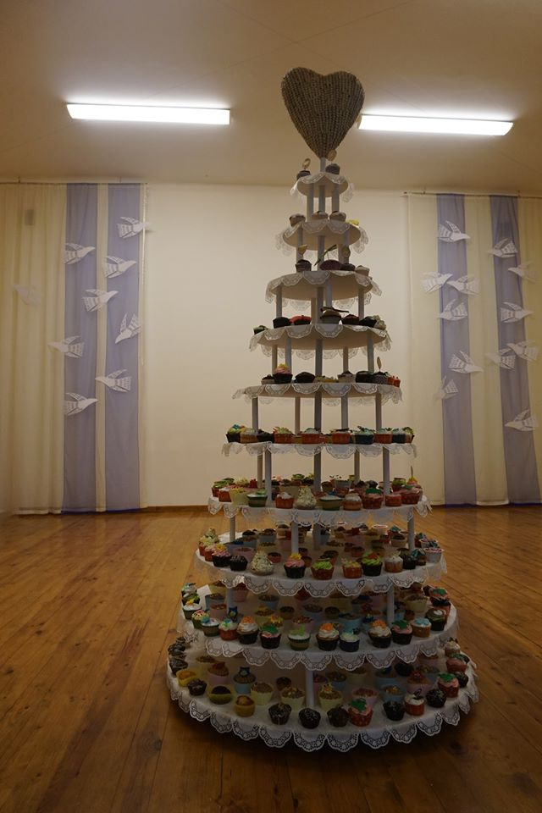
Dancers performance in school festival

Slide 24
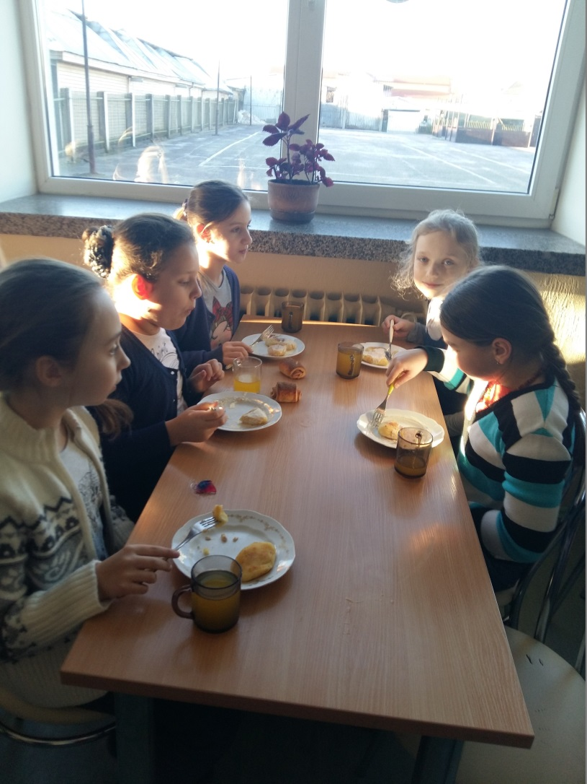
Lunch in the canteen

Slide 26
Students in the games corner

Slide 27
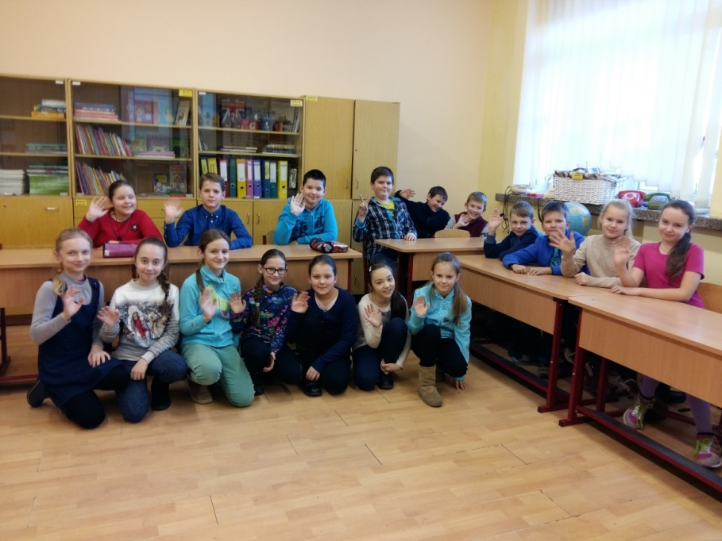
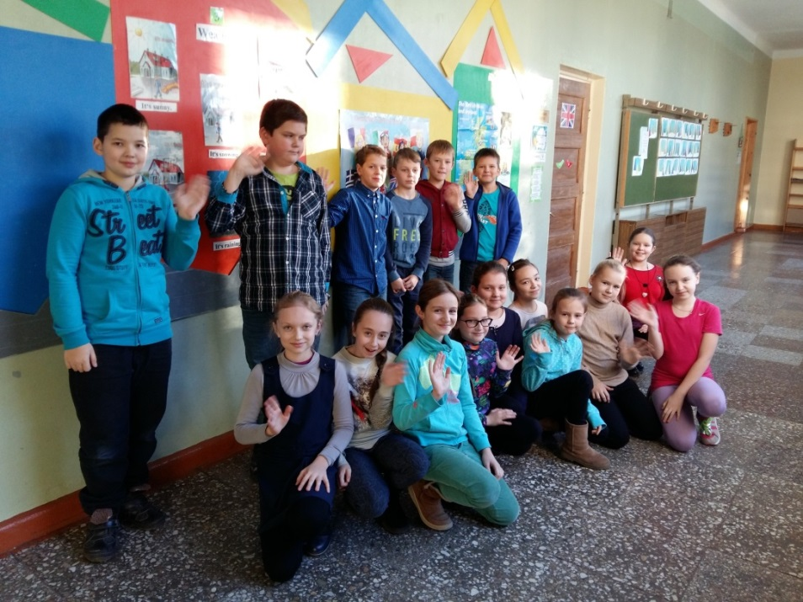
Students send you greetings from Panevezys Primary School and can’t wait to see you here!

