Slide 1
SCREENPLAY THEORY

Slide 2
IDEA

Slide 3
MAIN CHARACTER

Slide 4
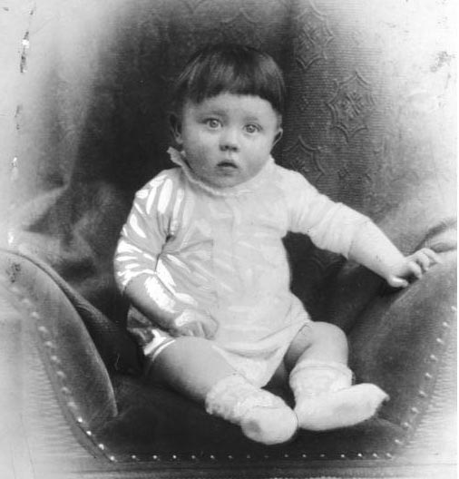
Notes:
Who could be that child?

Slide 5
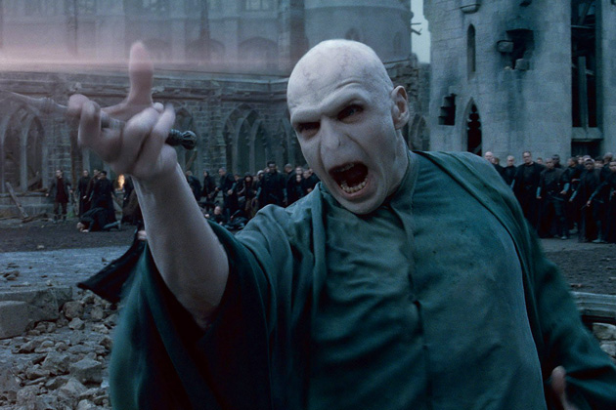
ANTAGONIST

Slide 6
CONFLICT

Slide 7
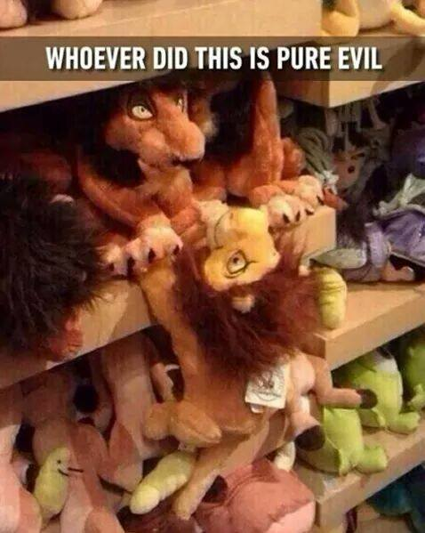
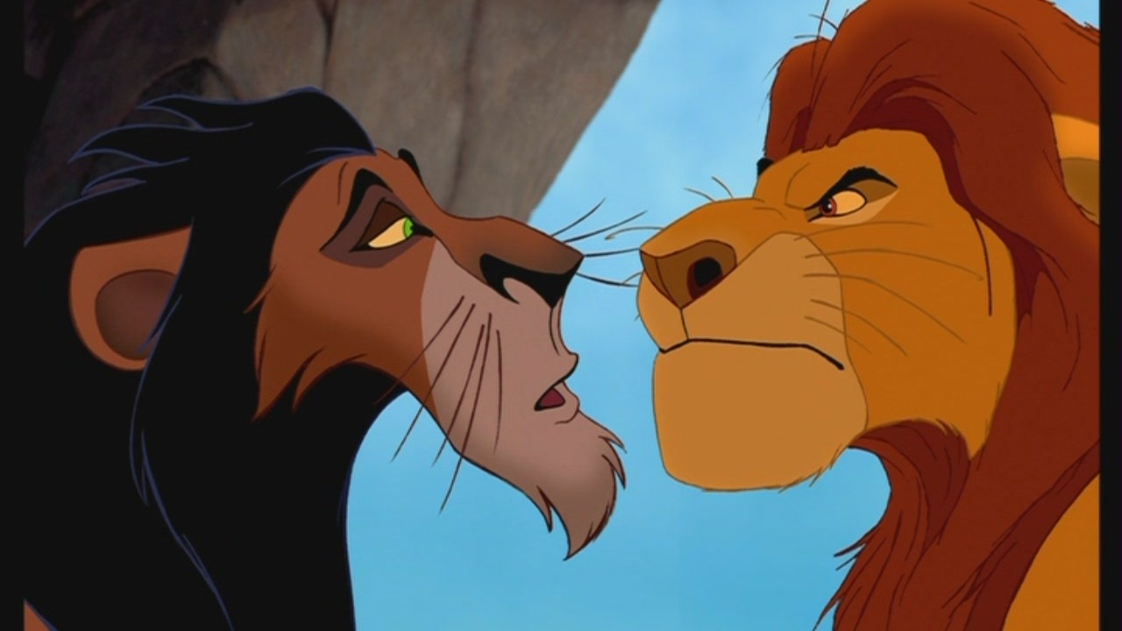
CONFRONTATION

Slide 8
Exercise 1. Create the best main character.
Write five sentences about your main character.
Notes:
Remember to find someone who is not simple. Look for some anomaly. Write five sentences about your main character.

Slide 9
Exercise 2. Create an idea for the film with some information.
Work in groups
Notes:
Work in groups. Words (for example): an apple, bowl, policeman, curtain, block of flats, tank, ant, diva.

Slide 10
Syd Field’s Paradygm
and Aristotle idea

Slide 11
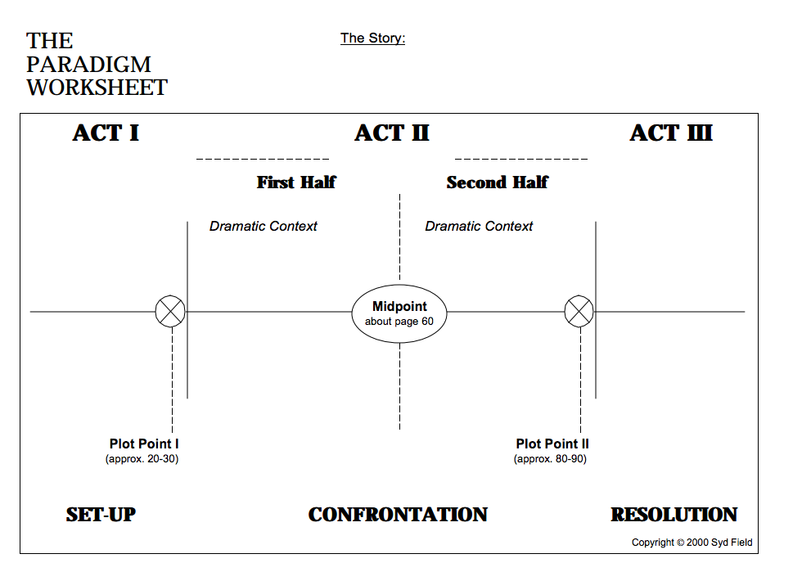

Slide 12
Exercise 3. Try to find Syd Field’s Paradygm in the film which you have seen lately.
Notes:
The second part might be about writing paradygm in short scenes.

Slide 13
ACTION & EMOTION THEORY

Slide 14
Tom wakes up. He looks out of the window. → ACTION
Tom feels horrible. Yesterday Marry told him it’s the end of their love. → EMOTION
Tom tries to drink yesterday’s tea. He grimaces and throws a mug away.
→ ACTION

Slide 15
Exercise 4. Create a short story based on emotion and action idea.
Notes:
Second part might be about writing paradygm in short scenes.

Slide 16
Mystery of writing dialogues: 1) Strike out! 2) Improvise! 3) Listen to people on train, tram, bus, in the daily life.

Slide 17
Exercise 5. Create a dialogue between two people.
Notes:
Use the best words you have ever heard on a bus, a tram or somewhere else. They should be based on reality.

Slide 18
DOCUMENTARY AND FEATURE FILM
What is a difference?

Slide 19
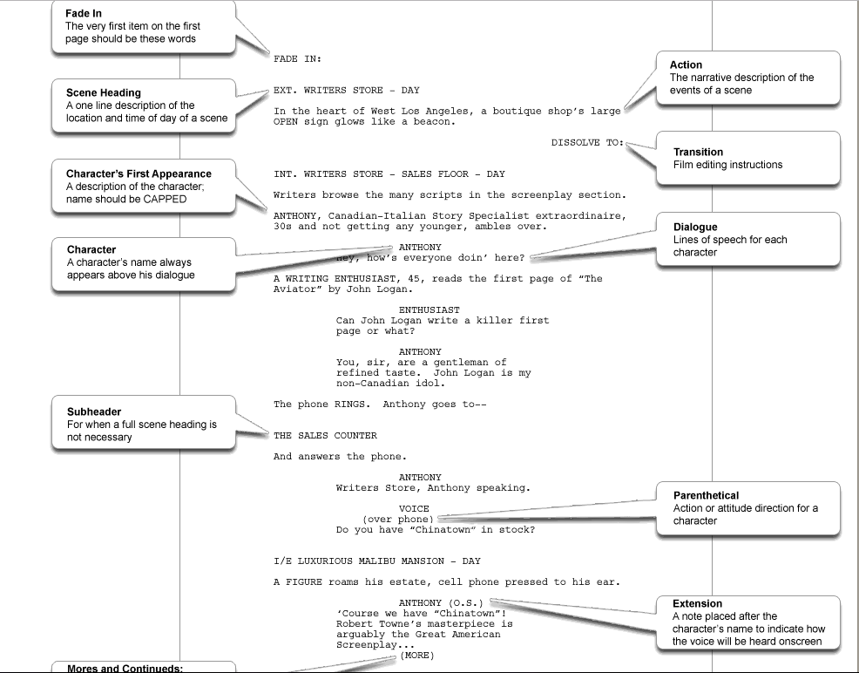
SCRIPT FORMAT

Slide 20
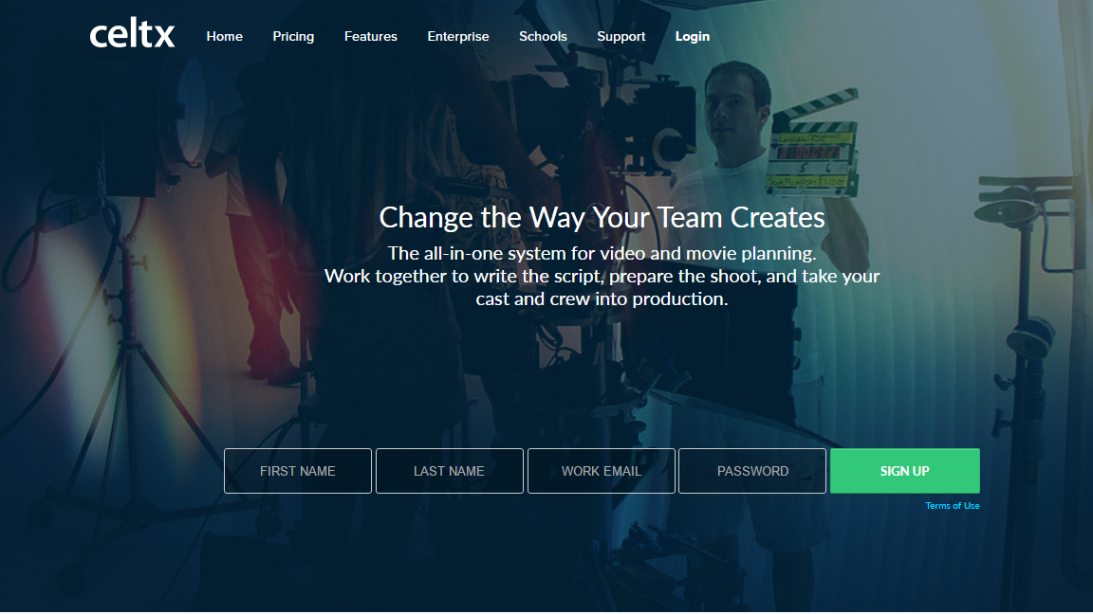
WWW.CELTX.COM

Slide 22
INTERESTING WEBSITES
Notes:
https://www.writersstore.com/how-to-write-a-screenplay-a-guide-to-scriptwriting/
https://en.wikipedia.org/wiki/Enneagram_of_Personality
https://www.nyfa.edu/student-resources/10-great-websites-download-movie-scripts/
http://www.camerimage.pl/pl/Marek-Zydowicz-Nominowany-Do-Tytulu-Osobowosci-Roku-2016.html
http://scriptfiesta.pl/

Slide 23
e-mail: zofiazurawska@onet.pl

