Slide 1
SCRIPT WRITING TIPS AND STAGES

Slide 2
1. Observe the world around you!
Notes:
Get inspired by the reality. Look for emotions and thoughts in you.

Slide 3
2. Have a true story
Notes:
It is easier to base your storyline on a true story, true characters.

Slide 4
3. Create your character.
Notes:
Create a whole story of his (or her) life. Get to know everything about him (or her). Visualise your character in details.

Slide 5
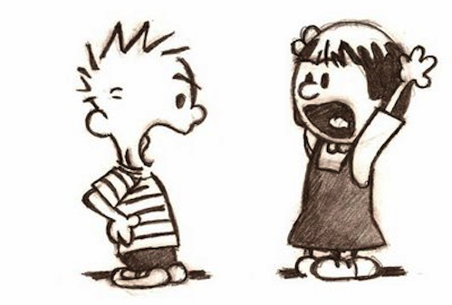
4. Find a conflict
Notes:
The best way to do this is to create an antagonist. Get to know everything about him (or her).

Slide 6
5. Write down your idea in one sentence.
It is a story about the big green ogre who saved beautiful princess.
Notes:
Ladder – drabina
Then do it again in three sentences and finally in ten. After that you will come up with the way you should deal with the script.

Slide 7
6. Find the beginning, middle, confrontation scene (climax) and the end.
7. Write down in points all
your scenes. Number them.

Slide 8
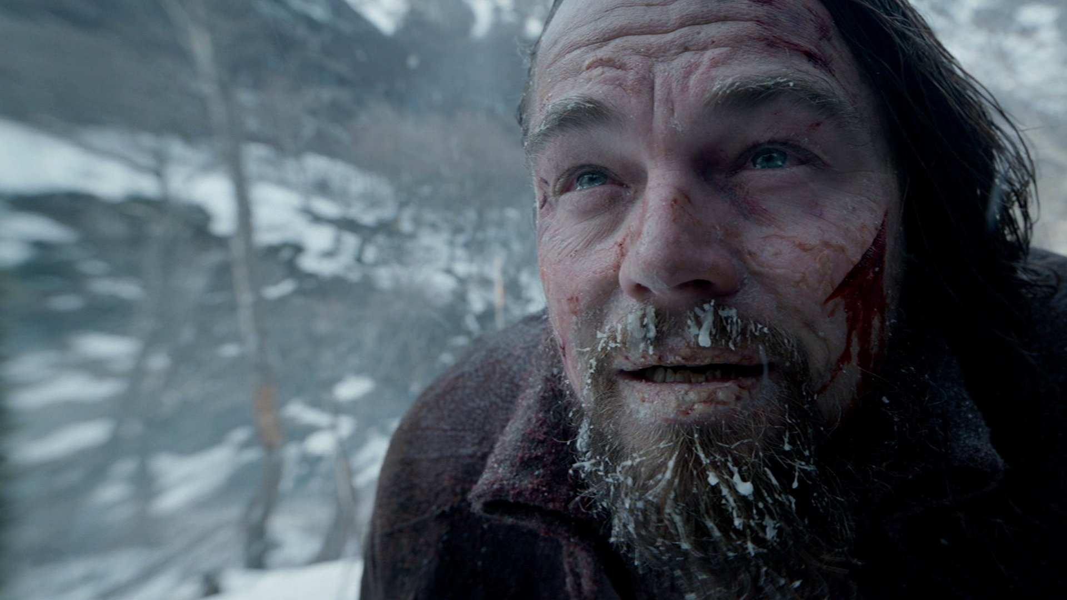
8. Close your eyes, visualise the whole story as a main character, experience it.

Slide 9
9. You are prepared to write your script. Just do it!

Slide 10
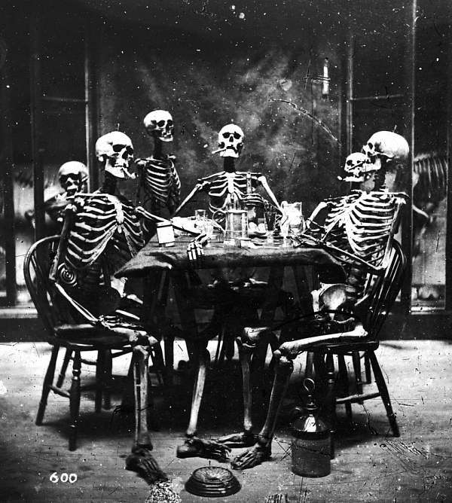
10. Avoid long dialogues.
Notes:
The best way is to don’t write any dialogues for beginning. First dialogues are usual boring, not real and not smart enough. Try be best but be patient and take your time.

Slide 11
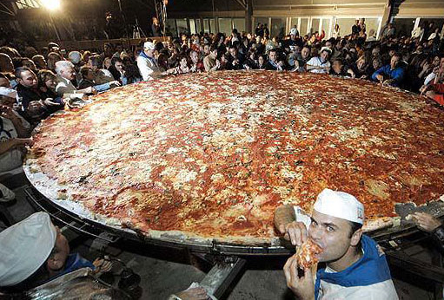
11. Invite your friends for a pizza.
Notes:
Read a script. Ask them to read it too. Listen to them, their ideas. Write down all the observations.

Slide 12
12. Try to update your story.
Notes:
Again, and again.

Slide 13
See? It is so simple!

